Slide 1
Common Information Sharing Environment Technical Standardization
Bernhard Wehner
ISG CDM KoM
29.05.2019

Slide 2
Agenda
What is CISE
CISE Principles
CISE Architecture
Objectives for CISE Technical Standardization
Why ETSI
ISG CDM

Slide 3
What is CISE
The aim of integrated maritime surveillance is to generate a situational awareness of activities at sea both cross-borders and cross-sectors, impacting on seven User Communities
About 400 authorities across Europe deploy
radars, satellites aircraft, ships, and information
systems to survey the maritime domain
& protect EU interests in
7 Maritime Sectors
− Maritime safety and security
− Border control
− Fisheries control
− General Law enforcement
− Defence
− Trade and economy
− Maritime pollution and maritime environment
so much information – but not always shared

Slide 4
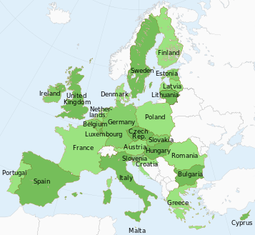
What is CISE
39 Partners
15 EU/EEA
maritime Countries
Open to new partners
and to collaborations
with EU Agencies
Maritime Authorities
Experts
Research Institutions

Slide 5
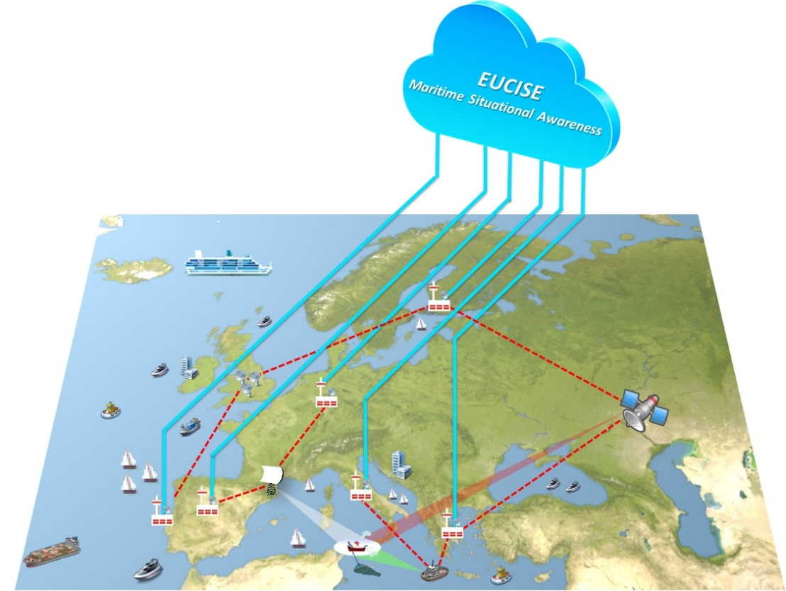
What is CISE
Operational Concept
Primary mission of EUCISE2020 is to support the EU Maritime Situational Awareness capability by means of an Information Sharing Environment capable to implement adequate security measures and protocols ensuring the confidentiality, integrity and availability of the data required and transmitted in the CISE community.
EUCISE2020 will not affect the functionalities of the operational information systems belonging to the participating Public Authorities or of the European existing sectorial information systems.
Blue lines depict flows of information within the CISE community, while the red dashed lines depict flows of information within the legacy systems belonging to single Public Authorities.

Slide 6
CISE Principles
CISE Principles
Military/civilian cooperation;
Management of EU RESTRICTED information through a special channel
Complete decentralization according to CISE Hybrid Architecture: no central system, no central database
Independence from any system and sensor
Independence from any national or European architecture
Firm adherence to standards and open source software
Adherence to the CISE data and service models
EUCISE2020 will promote standardizations groups inside the EU bodies (ETSI)
Open to new partners and to European Agencies
IPR management and sharing
Common technical architecture

Slide 7
CISE Architecture
Logical Architecture of EUCISE2020 Configurations A, B and C:
Inside the red line components developed through the European tender
Outside the red line interfaces developed through the national procurements

Slide 8
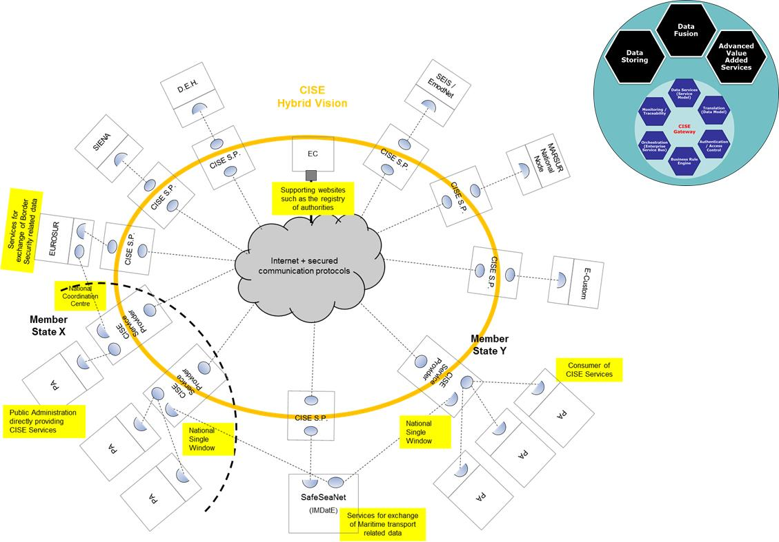
Objectives of CISE Technical Standardization
«Define new technical standards for the components of CISE, including the protocol stack, the semantic and data model specifications, the core and common services.»

Slide 9
Why ETSI
Procedural options for technical standardization
Elaborate documents for EU Commission use, or
Transfer standardization process to an expert community
Expert community: European Standards Organisation
Expert involvement in discussion and evolution of standards
Public authorities and industry expertise cooperation
Non EUCISE2020 participation possible
Self- sustaining after end of EUCISE2020 project

Slide 10
Why ETSI
European Telecommunications Standards Institute
Considered most appropriate with regard to technical scope
CISE data model
CISE service model
Offers an evolutionary option (ISG – TC)
Process open to non- ETSI members
Process supported by EU Commission

Slide 11
ISG CDM
Approaches to ETSI standardization
Allocate work under an existing Technical Committee (TC) and related Working Group (WG): not applicable
Create a new TC: not applicable
Create a new Industry Specifications Group (ISG)
ISG CDM most appropriate for CISE technical standardization

Slide 12
Questions ?

