Slide 1
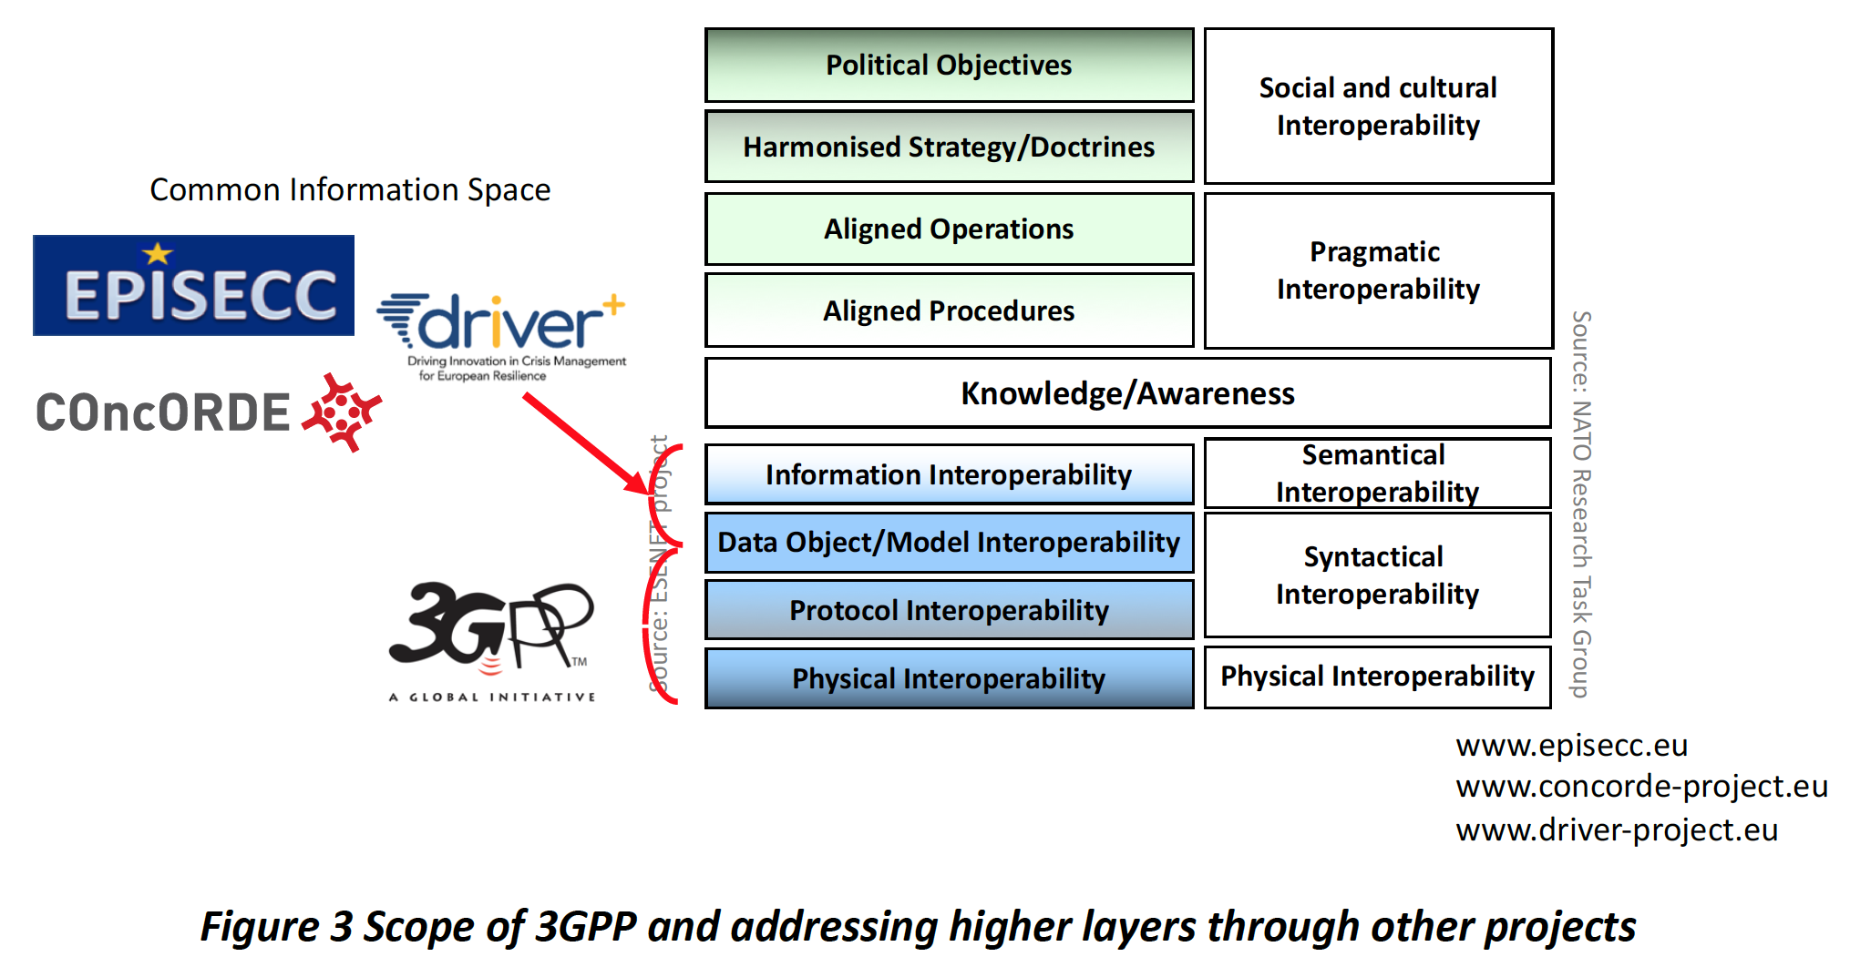

www.psc-europe.eu
Dr David Lund
Vice-President, Public Safety Communication Europe (PSCE) Forum
Coordinator of BroadWay
  ETSI CDM KO Meeting
  Sophia Antipolis, 20 May 2019

Slide 2
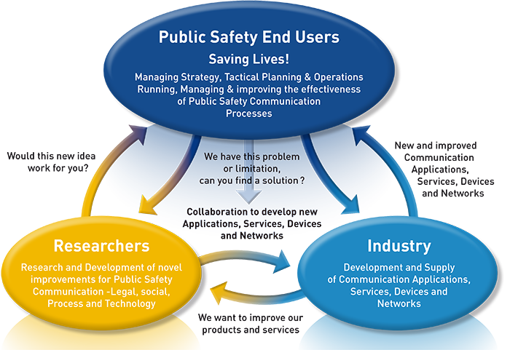
PROFILE – NEEDS – EXPECTATIONS
www.psc-europe.eu
2
PSCE was formed ~10 years ago due to the FP6 NARTUS project recognizing that this dialogue is essential

Slide 3
Why are PSCE interested in Standards?
Pre-commercial Procurement of:
Pan-European Interoperable mobile broadband for Public Safety
To Improve Collaboration between responders from different agencies and different countries
To Enable mobility of responders between different countries

Slide 4
Why are PSCE interested in Standards?
This is why
Pre-commercial Procurement of:
Pan-European Interoperable mobile broadband for Public Safety
To Improve Collaboration between responders from different agencies and different countries
To Enable mobility of responders between different countries

Slide 5
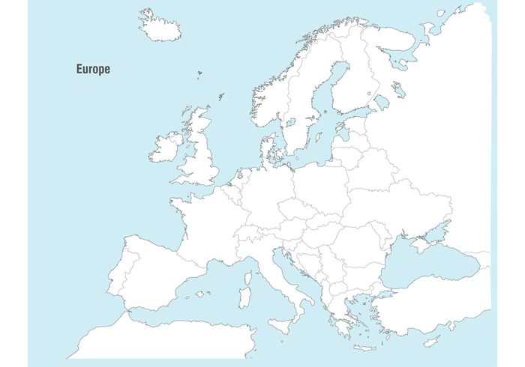














The Common Challenge
– we have today
Minimal interoperability – a limiting factor for pan-European response collaboration
Old technology – voice and short data only (2G equivalent)
Vendor locked
Notes:
Today – every country has its own network
Some are from the same manifacturer some are not.
But even some networks are from the same manifacturer – interoperability is not possible.

Slide 6

The Common Challenge
– we need today
Secure, Mission Critical broadband communication – operable everywhere !!
Applications & the Internet of Public Safety things (IoPST) Ecosystem
Future evolution as technology advances – standardised with no vendor lock
Notes:
The idea is that all those networks – act like one
It will probably not be one network but all those networks has to act like one.

Slide 7
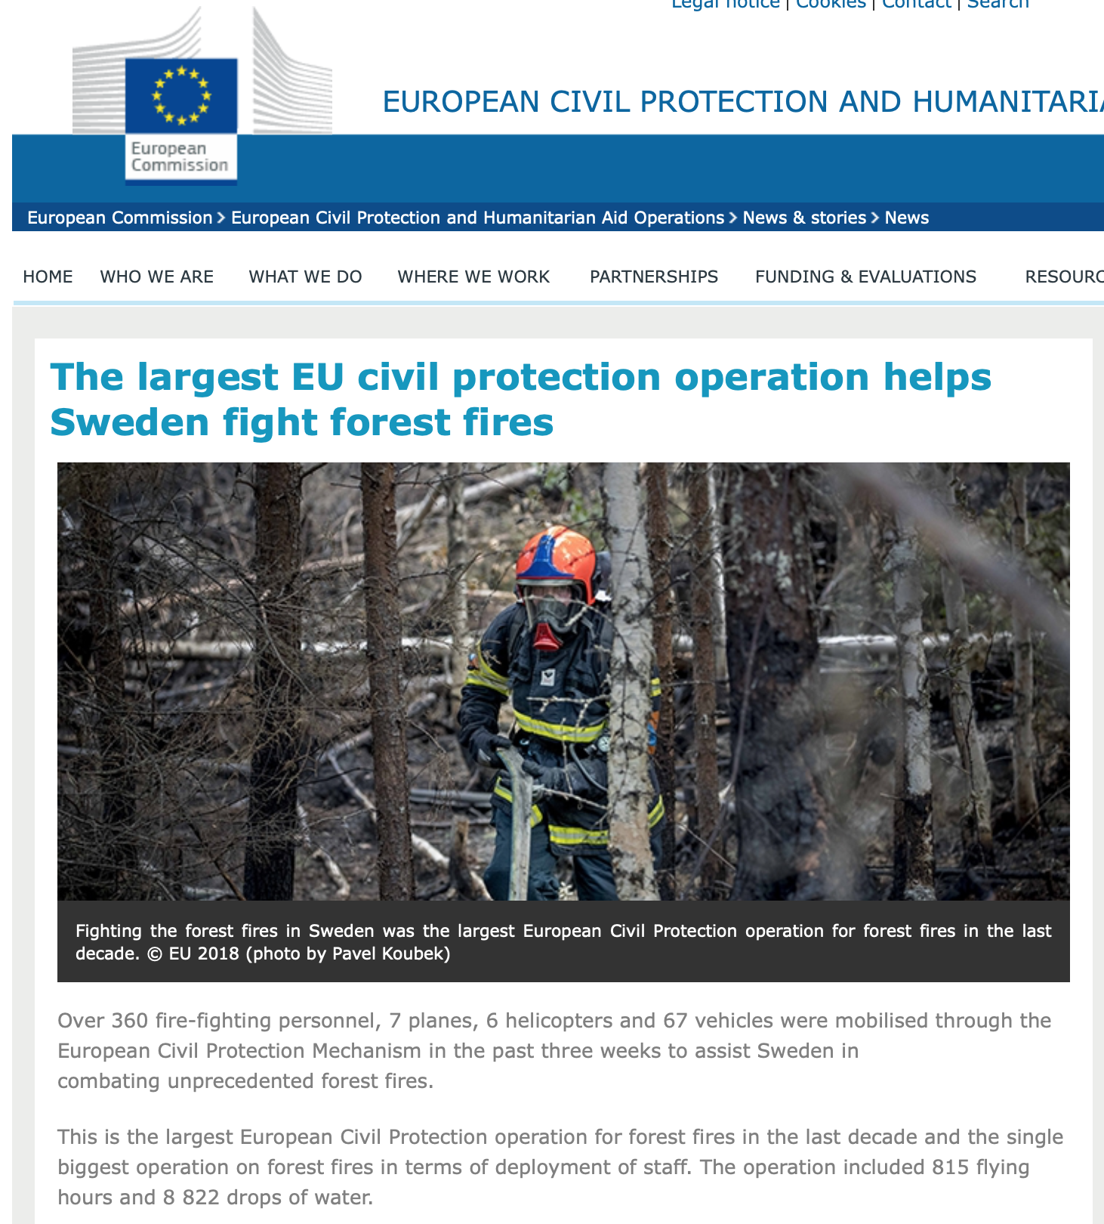
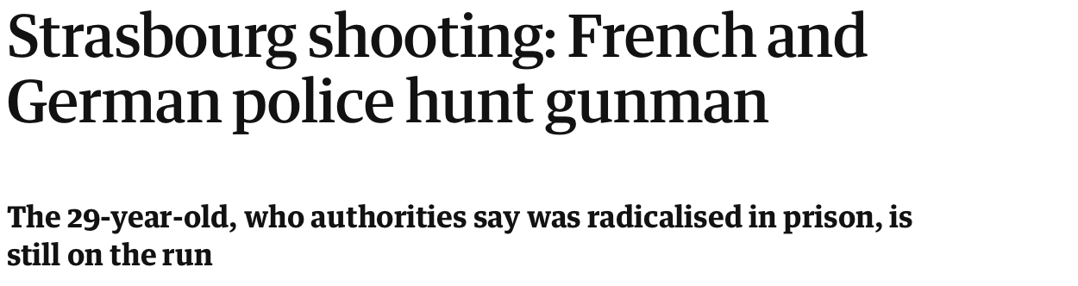
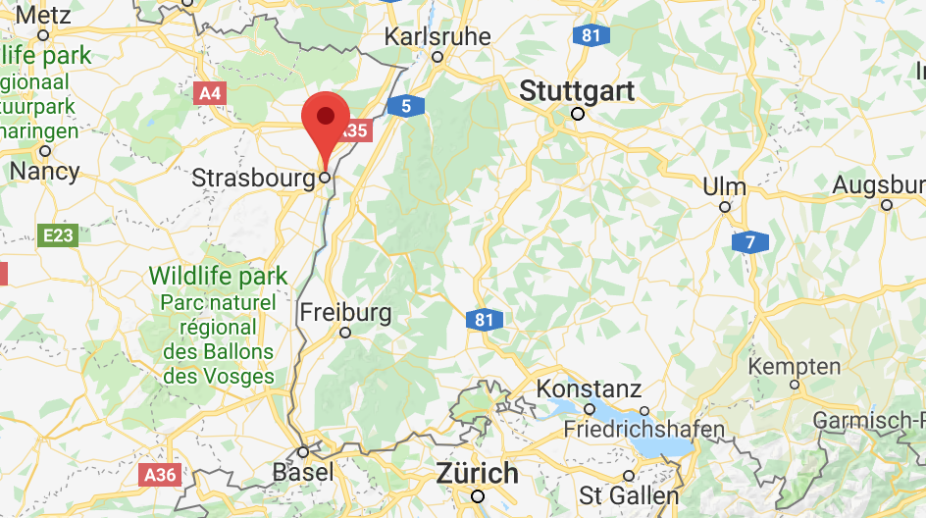
https://ec.europa.eu/echo/news/largest-eu-civil-protection-operation-helps-sweden-fight-forest-fires_en

Slide 8
We have a collective responsibility to make sure that the Public are kept safe

Slide 9
We have a collective responsibility to make sure that the Public are kept safe
Everyone in this room has that responsibility !!!

Slide 10
We have a collective responsibility to make sure that the Public are kept safe
Technology and information exchange for the good guys,
MUST
be more capable and secure than the bad guys !!

Slide 11
We have a collective responsibility to make sure that the Public are kept safe
Technology and information exchange for the good guys,
MUST
be more capable and secure than the bad guys !!
And MUST continue work in harsh and compromised situations

Slide 12
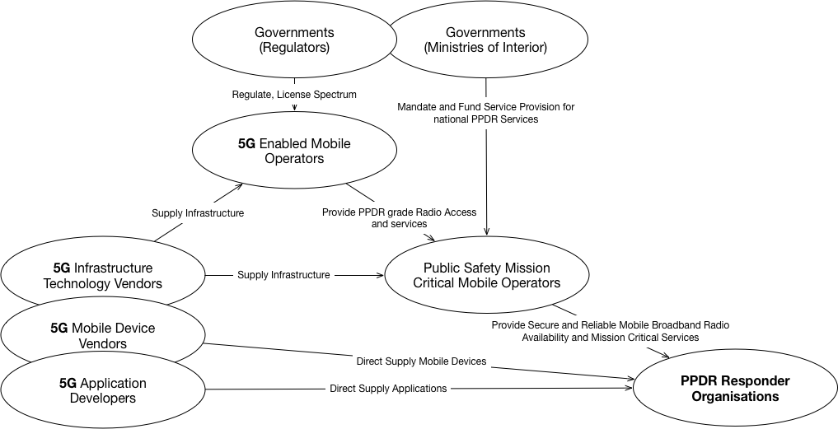
Public Safety Comms Value Chain
Copyright © 2018 PSCE. All rights reserved.

Slide 13
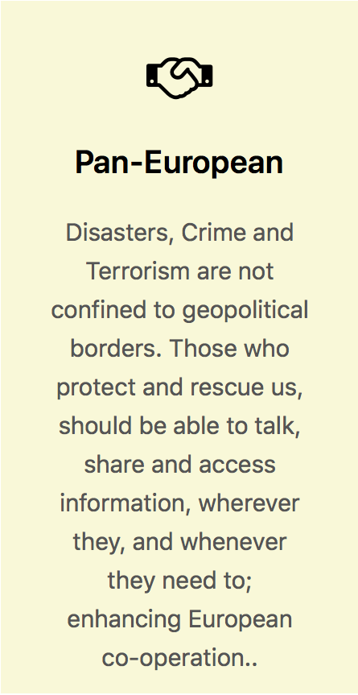
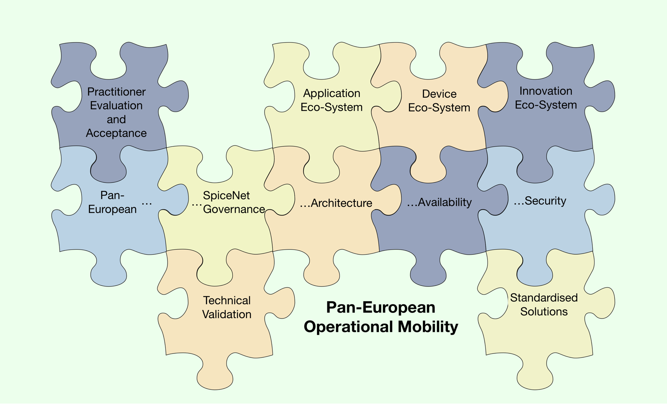
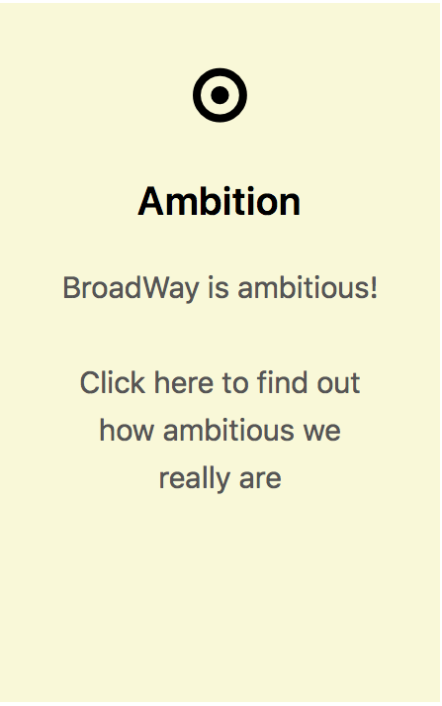

Slide 14
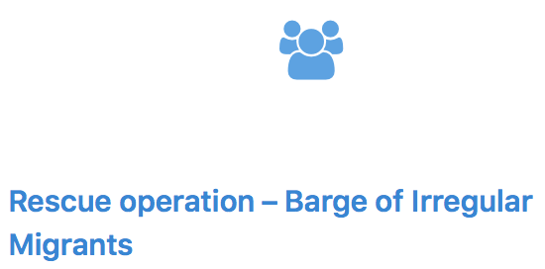
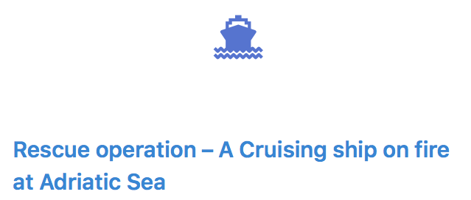
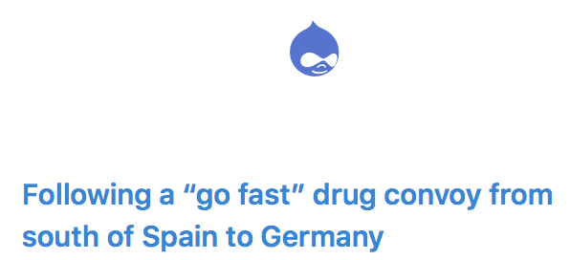

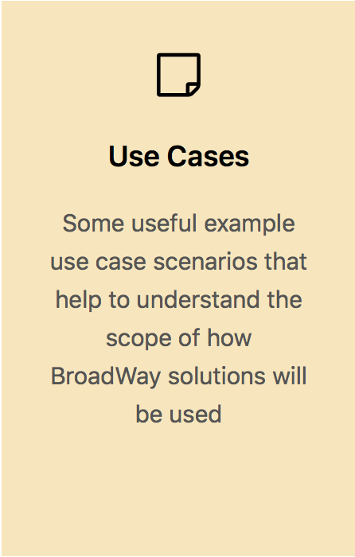
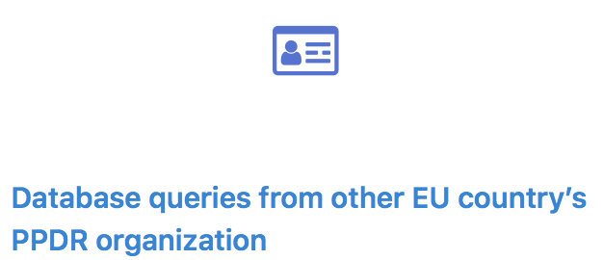



Slide 16

Driver+
www.driver-project.eu

Slide 17
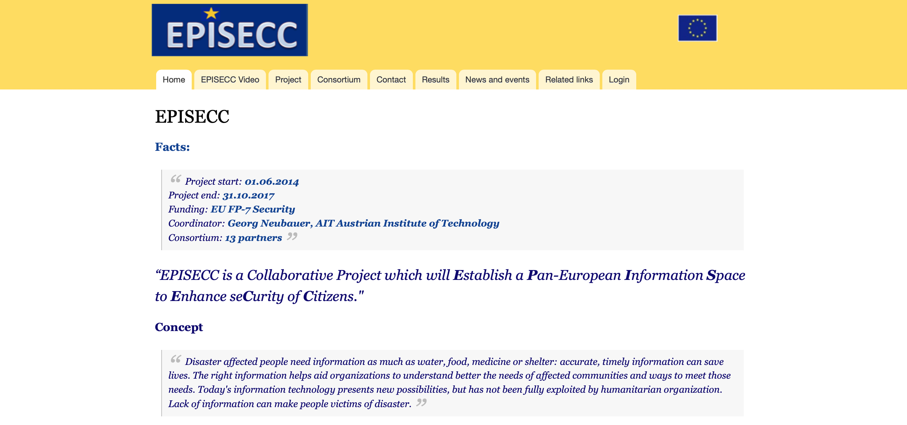
www.episecc.eu

Slide 18

www.concorde-project.eu

Slide 19
Cen workshop agreement
Requirements on Information Exchange across Organisations and Borders – Semantic and Syntactical Interoperability for Crisis and Disaster Management
Kick Off Meeting, DIN, Berlin 29th of April 2019
Georg Neubauer

Slide 20
Draft Scope and purpose
  This CEN Workshop Agreement (CWA) defines requirements to achieve interoperability on syntactical and semantic level in organization and border crossing crisis and disaster management.
  To achieve this target, a conceptual frame (topology) and basic requirements for the development of software interfaces that allow different organisations, using different IT systems for the execution of their crisis and disaster management procedures, to connect to a common platform in order to receive and send data while maintaining the same data formats on their systems, will be provided.
  In addition basic security requirements of such a data exchange process are set up encompassing authentication, grouping functionalities and encryption as well as resilience aspects (e.g. concepts to avoid single points of failure, capabilities to federate).
  Moreover, a conceptual frame for a distribution mechanism including service registration, addressing, communication, synchronization and message repository aspect is set up. Other conceptual aspects to be covered are requirements for semantic services and finally management of registration procedures as well as participants registration data.

Slide 21
Draft CWA consortium
  AIT Austrian Institute of Technology
  PSCE
  TNO
  Frequentis
  HITEC
  IES
  CSNR Technologies Ltd.
  …….
  ……..

Slide 22
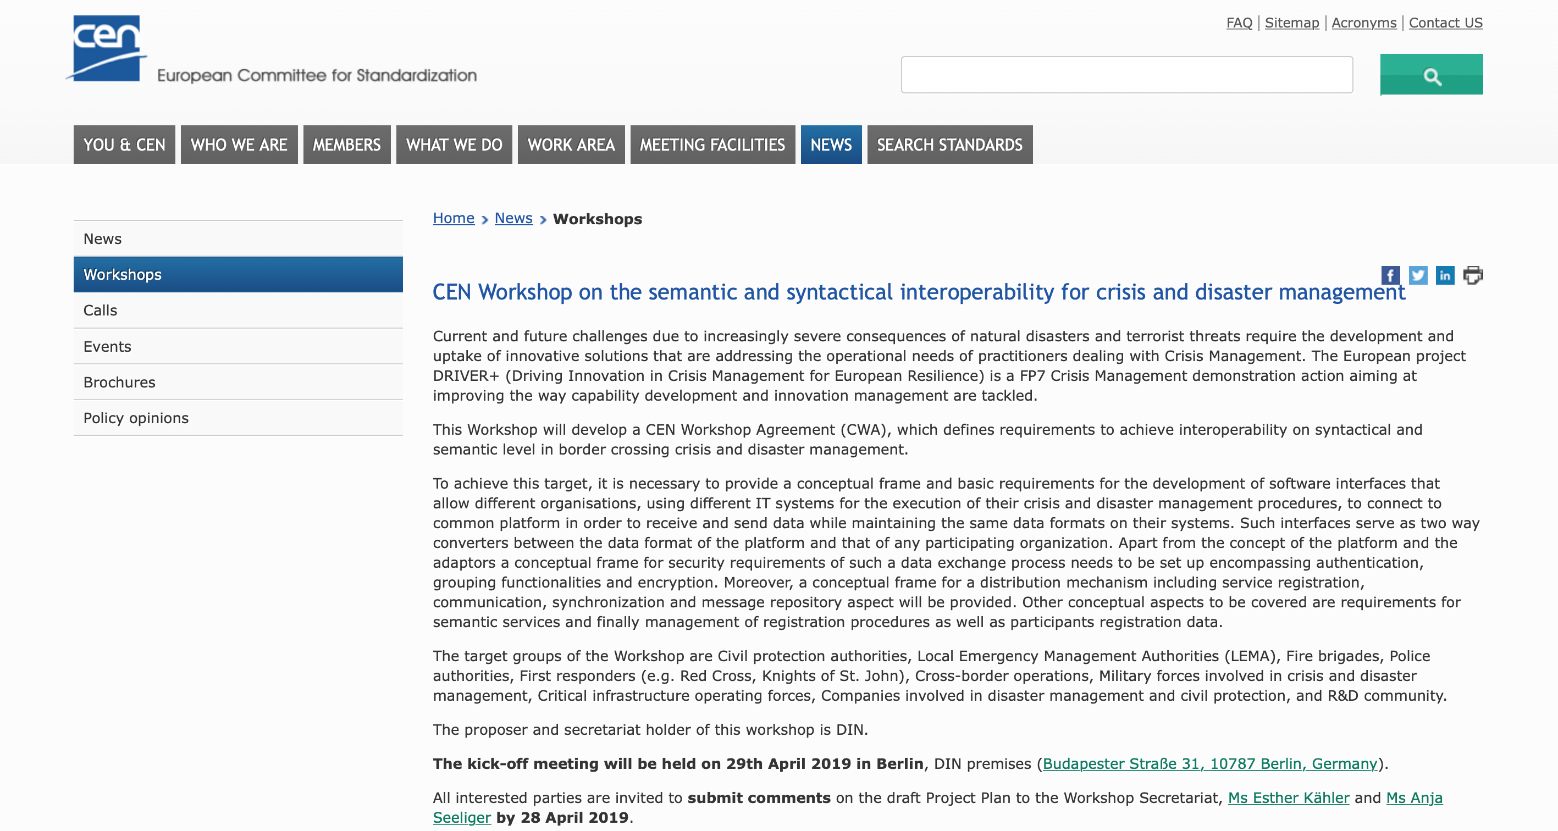
https://www.cen.eu/News/Workshops/Pages/WS-2019_006.aspx

Slide 23


May ‘18
2022
Request for Tender
– February 2019
Preparation
Pre-Commercial Procurement
Procurement
An understanding of the need
TRL8

Slide 24
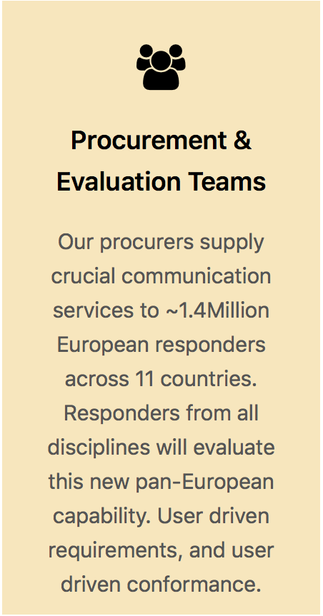
We are a team of
11 Government Orgs in
11 European Members states
Representing 1.4Million responders

Slide 25
Public Safety Comms Value Chain
Copyright © 2018 PSCE. All rights reserved.

Slide 27
How do we get involved in 3GPP ?
MRP Application and acceptance in London PCG/OP – October 2016
Attend PCG !
  Remote participation was not ideal but better than not being able to travel
Attending SA1 and SA6
  Understanding of the processes, status and direction of travel of the work
SA1 Gap analysis in BroadMap
  2 gaps found - considering 700+ responder level requirements
  We tried to address. Whilst not explicitly standardised, it borders on being an implementation issue. Then BroadMap ended…
We support proposals of others when requested, and applicable

Slide 28
Our current participation
Preparatory phase - Watch and pounce…
  take time to learn until now, we may need to intervene later to support our goal
Watching - WG outputs
  confidence in capability of the mobile standards, now and in the future..
Watching - ETSI MCX PlugTests…
  gives us confidence in supply

Slide 30
Thanks for listening !!
www.psc-europe.eu
Copyright © 2018 PSCE. All rights reserved.

