Slide 1
An introduction to ETSI ISG CDM: Rules of procedure and ETSI Secretariat support
Marlene Forina, ISG CDM Support
CDM#01, 29 May 2019
27.05.2019

Slide 2
Main characteristics of an Industry Specification Group (ISG) (1)
A technical group addressing a specific technology area as defined in its Terms of Reference
Including ETSI Members and non-Members (Participants)
→ restrictions(*) + fee
With a fixed duration defined at the outset (usually 2 years with extension if required)
ISGs follow the ETSI Technical Working Procedures (TWP) (ETSI Directives)
Deviations are indicated in annexes of the ISG agreements
Notes:
Restrictions:
ETSI Members can participate to the work of ALL Technical Committees and all ISGs(*) if they want, they can contribute, vote, and hold official positions. No meeting fee.
Non-Members can just take part to the work of the ISGs for which they have signed the PA, they cannot participate to Technical Committees, they cannot vote, and cannot be Chair, VC, or WG Chair. They cannot initiate new work and be supporting company for a new WI proposal (yet they can be rapporteur). shall pay a meeting fee.

Slide 3
Main characteristics of an Industry Specification Group (ISG) (2)
ISG CDM was authorized the following deviations to ETSI TWPs:
Officials mandate duration: 2 years.
Vote result interpretation for elections = Simple majority (50%)
Voting eligibility (present at 2 of the past 3 plenary)
Kick-off period (2 plenaries)

Slide 4
ISG Basic rules
Only ETSI Member representatives can
Apply for ISG Chairmanship, Vice-Chairmanship, or WG Chairmanship*
Be listed as Supporting company for Work Items
Vote
ISG Participants
Are required to pay participation fees to attend face-to-face meetings
All ISG representatives may
Apply for a Rapporteur role
Contribute to draft deliverables
Submit contributions to meetings (kindly register your planned attendance)

Slide 5
ISG Basic rules
All ISG representatives shall
Comply with the ETSI IPR Policy

Slide 6
Responsibilities of the ISG CDM Chairman
The Chairman has an overall responsibility to ensure that the activities of her/his ISG follow the ETSI rules and procedures.
The Chairman is responsible for reporting to the General Assembly, the Board and the OCG on the activities of the ISG.
The ISG Chairman is responsible for the overall management of the Work Programme and the efficient working of the ISG.
The Chairman is responsible for external communication
Any communication outside the ISG itself by the Chairman and/or by its members shall be made in coordination with the ETSI Secretariat
In performing these tasks the Chairman shall maintain strict impartiality and act in the interest of ETSI and its members.
The Chairman may delegate part of these tasks to one or more Vice Chairs.

Slide 7
CDM Support: what we can do for you
Prime contacts for the ISG, within and outside of ETSI.
Provide guidance and assistance on the processes and procedures - ETSI Directives, ETSI Drafting Rules (EDRs), ISG rules
Ensure processing and publication of deliverables in coordination with editHelp
Ensuring quality of deliverables ETSI publish is a principal task.
Reference point for networking, press release, conferences, promotion.
Handling of administrative tasks e.g. ISG mailing lists management, update of the ISG Work Programme.
Support and help with ETSI tools – Portal, ETSI Website, conference-call scheduling (GoToMeeting).
Handling of incoming and approved outgoing Liaison Statements

Slide 8
ETSI ISG CDM deliverables: Group Report (GR) & Group Specification (GS)
1 Work Item/1 deliverable
First step: approval by ISG CDM of a corresponding Work Item, supported by at least 4 supporting ETSI Members
WI proposal includes title, scope, Rapporteur, WI time schedule
The Rapporteur can be a Member or a Participant
The Rapporteur:
uses either the Group Report skeleton (GR-informative documents) or the Group Specification skeleton (GS-nominative documents)
applies the ETSI Drafting Rules (EDRs)
is responsible for all draft development
Each draft GR or GS has to be approved by the ISG before publication.

Slide 9
ETSI ISG CDM deliverables: Group Report (GR) & Group Specification (GS)
EditHelp reviews the draft GR/GS before publication.
2 references: Guide to Writing World Class Standard & ETSI Rapporteur’s guide .

Slide 10
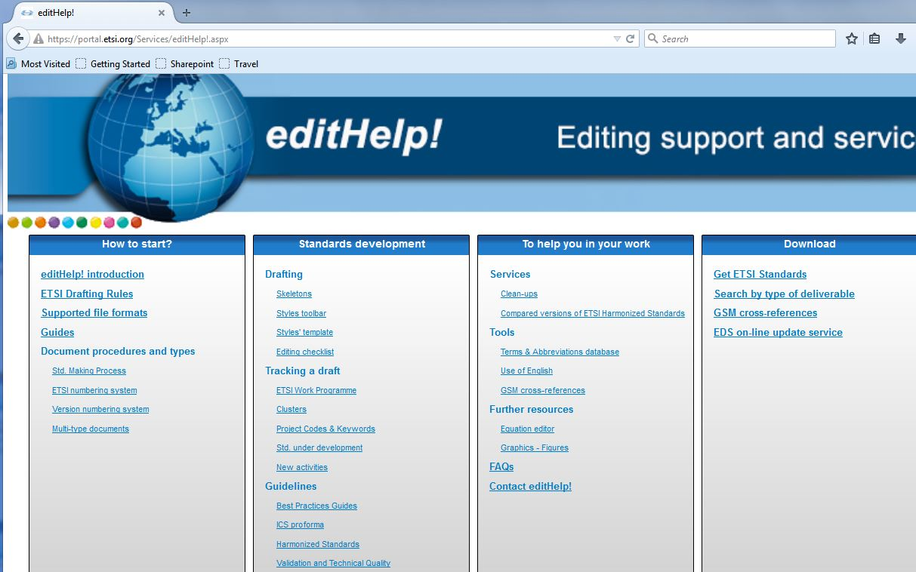
editHelp!
editHelp! role is to advise Rapporteurs and ISG members on ETSI drafting rules, best practices and publication issues. Do not hesitate to contact them!

Slide 11
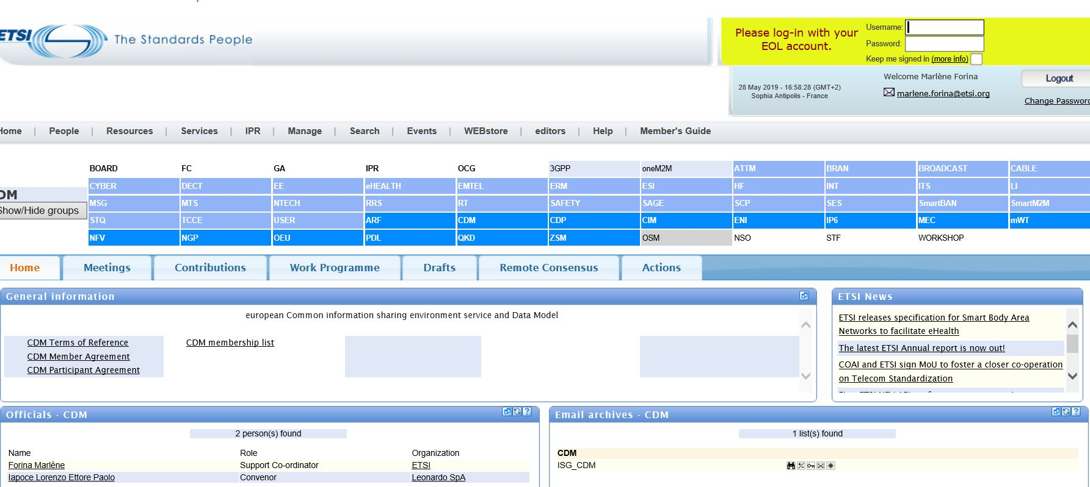
ISG CDM Portal: the interface for accessing information on the technical activities of ISG CDM
First thing, log in!
Notes:
The portal is the principal platform for those who wish to follow and participate in the work of the ISG. Login is required!
General information section- Agreements, ToR, List of Members and templates
Please join the ISG_CDM mailing list and play an active role in the discussions.
Each delegate participating in a conference call or plenary meeting is requested to register online on the ETSI Portal.
Via the different tabs you may access the meeting calendar, contributions, work programme, Drafts, Remote Consensus and Action list.

Slide 12
Useful links
ETSI ISG CDM portal: https://portal.etsi.org/tb.aspx?tbid=876&SubTB=876#
EditHelp!: https://portal.etsi.org/Services/editHelp!.aspx
ETSI Directives (with EDR): https://portal.etsi.org/directives/40_directives_apr_2019.pdf
Portal help: http://help.etsi.org/index.php?title=Contributions_Portlet
Guides:
Writing World Class Standards: https://portal.etsi.org/Portals/0/TBpages/edithelp/Docs/AGuideToWritingWorldClassStandards.pdf
Delegate’s Guide: https://portal.etsi.org/guides/delegates/
Rapporteur's Guide: https://portal.etsi.org/Portals/0/TBpages/edithelp/Docs/ETSI_Rapporteurs_Guide.pdf
Chairman’s Guide: https://portal.etsi.org/Portals/0/TBpages/edithelp/Docs/Chairmans_guide.pdf

