Slide 1
“European Common Information Sharing Environment Service Model” Standardization
Lorenzo Iapoce
ISG CDM Kick off Meeting
29.05.2019

Slide 2
Agenda
Standardaziation goals;
Creating ISG CDM.
Approach for standardization:
Work phase;
Deliverables and Time schedule proposal;
Standardization goal.
Standardizing Cise Data Model and Services:
Area of activity: ECISE2020 components;
2019 steps forward;
AOB.

Slide 3
Acronyms
CDM CISE Data Model;
CISE Common Information Sharing Environment;
EUCISE European Common Information Sharing Environment;
ISG Industry Specification Group.
Referenced Docs
ISG_CDM_MEMBER_Agreement;
Board_Consultation_on_ISG_CDM;
ISG_CDM_ToR_D-G_Approved_20190408.

Slide 4
Standardization goals

Slide 5
EU policy framework of CISE
Integrated Maritime Policy (IMP) &
Blue Growth
EU Maritime Security Strategy (EUMSS) &
European Agenda for Security
EU Digital Agenda &
Standardisation Policy
CISE
The CISE supports the development of Blue Economy of the European Union and is a key innovation of the European maritime governance. It is also an element of the European Digital Agenda and, finally, is a pillar of the European Action Plan for the European Maritime Security Strategy.

Slide 6
ISG CDM Scope
to develop a consistent set of technical specifications to allow data exchange among different legacy systems in a cooperative network, European Common Information Sharing Environment (CISE);
to enable User Communities, Member States, Public Authorities or EU Agencies to facilitate information exchange between all parties, and also to promote the European Maritime Security Strategy1 (through Common and Core Services developed in EUCISE2020);
to provide a universal data and service model that may serve as reference for all cross- sectoral and cross- border information exchange between European public authorities.
ISG Founding Members are: Leonardo SpA, Consorzio Nazionale Interuniversitario per le Telecomunicazioni (CNIT), Finnish Transport and Communications Agency (TRAFICOM), Ministerio Dello Sviluppo Economico (MISE), Federal Ministry of Economic Affairs and Energy (BMWI).

Slide 7
Approach for Standardization

Slide 8
ToR for ETSI ISG “European Common Information Sharing Environment Service Model” (CDM)
Phase 1 (informative):
Organizing a kick off meeting with the team and discuss about the standardization model;
Identify a reference architecture which might be used for the development of Core and Common Services;
Phase 2 (normative):
Group Specifications developed within the ISG CISE SM will be public and subject to ETSI IPR policy, especially concerning timely declaration.
Do note:
To maintain a tight focus, the ISG CISE SM will at the end of the first and of the second year make a review of its work and a proposal to ETSI on how to evolve the ISG CISE SM’s future activities:
terminate the ISG, or transfer the work and continue the activity in a (existing or new) ETSI
Technical Body or other standards body, or continue the ISG CISE SM for an additional period with
(potentially revised) Terms of Reference.

Slide 9
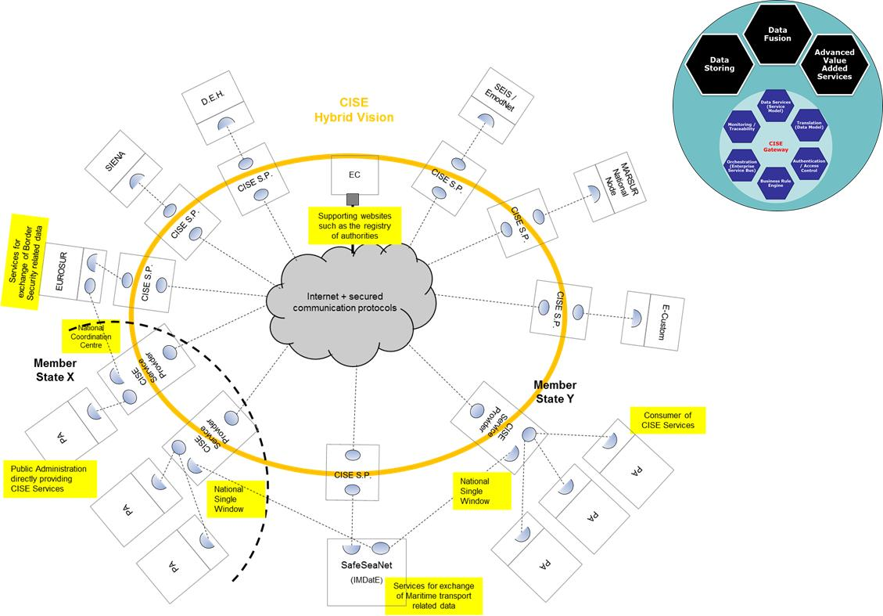
ISG Standardization work phase 1 - Informative
The CISE SM components (based on the EUCISE2020 concept) are able to:
Translate the request of information coming from PAs in a common vocabulary;
Ensure the exchange of messages within the CISE Community based on a Service Oriented Architecture paradigm;
Manage access rights on information Exchange based on a roles/rules based approach;
Handle classified information up to EU restricted level;
Implement a collaborative environment;
Optionally, implement advances functions to enhance the information available at PAs level.

Slide 10
ISG Standardization work phase 2 - Informative (2/2)
The network topology of EUCISE 2020 is based on the CISE hybrid vision concept. Each Member State and Community can adopt one of the following paradigms:
Single-way approach: All Public Authorities of a Member State are connected to the EUCISE2020 Network through a single access point.
Multiple-way approach: Public Authorities of a Member State are connected to the EUCISE2020 Network through different access points (at least two).
With the implementation of a Common Information Sharing Environment (CISE) the interoperability of the platforms, is granted through:
Harmonised front-end interfaces;
Implementation of Infrastructural Core Services for the enforcement of a multi-level data access and distribution policy;
Suitable information protection measures for the exchange of sensitive information under the directives of the respective Member States;
Open, selective and tailored web-based access to Sectorial and National Users, delivering standardized cross-sector Information Services made available by the interested information hubs powered by existing national information infrastructures;
Information sharing with the existing sectorial networks and with the relevant EU Agencies and Stakeholders.

Slide 11
ISG Standardization work phase 2 - Normative (1/2)
1. ISG CISE SM Founding Members and ISG CISE SM Participants are reminded that acting
contrary to ETSI IPR policy and/or delaying timely declaration of IPR can only delay the successful
completion of the specification(s), undermining a critical success factor for the ISG.
2. Planned deliverables and delivery dates:
ISG CISE SM intends to meet quarterly (physical and/or electronic meetings) as needed to draft,
discuss, review and approve the deliverables to be developed;
ISG CISE SM plans to develop an ISG CISE SM Group Report (informative) and several
ISG CISE SM Group Specifications (normative);
According to the ISG CISE CDM time plan, the intent is to finalize an ISG CISE CDM
Group Report (GR) and a set of ISG CISE SM Group Specifications (GS) within one (2) year
after the first meeting.

Slide 12
ISG Standardization work phase 2 - Normative (2/2)
Schedule and Deliverables:
(T0+03) Group Report describing the overall architecture;
(T0+05) Group Specification for Common and Core Services (preliminary);
(T0+06) Group Specification of languages, processes and domains for service modelling;
(T0+07) Group Specification: First set of Service models;
(T0+09) Group Specification: Second set of Service models;
(T0+12) Group Specification: Third set of Service models;
(T0+12) ISG ISE SM Review of Work and proposal to ETSI for next period;
(T0+18) Review of suitability of the Group Specifications and data models based on evidence gathered from EUCISE2020 software implementations;
(T0+22) If needed: Create and publish Version 2 of the Group Specifications based on the previous Review;
(T0+24) ISG CISE SM Review of Work and (if needed) proposal to ETSI for next period.

Slide 13
Standardizing
European Common Information
Sharing Environment
Service and Data Model (ISG CDM)

Slide 14
Areas of activity of ISG CDM: EUCISE2020 Components (1/2)
Network and Secure Communication (communication between Adaptors, Gateway and Nodes – Core Services);
Application Security (identification, authentication and authorization of the users across the network, managing access to secured resources maintained at a service provider – Core Services);
Auditing (to perform analysis on events through logging, monitoring and accounting services – Core Services);
Collaborative tools (multimedia and auxiliary tools provided to facilitate the communications and work among the users – Core Services);
Provider component (The service provider component implement the web service and publishes its interface and access information to the service registry. Each provider must decide which services to expose, how to price the services, or (if no charges apply) how/whether to exploit them for other value – Common Services);
Consumer component (The service consumer or web service client locates entries in the broker registry using various find operations and then binds to the service provider in order to invoke one of its web services. Whichever service the service-consumers need, they have to take it into the brokers, bind it with respective service and then use it. They can access multiple services if the service provides multiple services– Common Services).

Slide 15
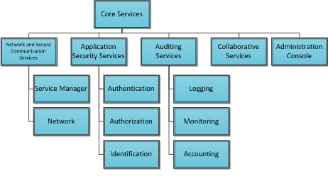
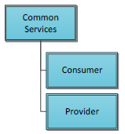
Areas of activity of ISG CDM: EUCISE2020 Components (2/2)
The main goal of Core and Common Services standardization is to create a standard to allow data exchange among different Legacy Systems in a cooperative Network.

Slide 16
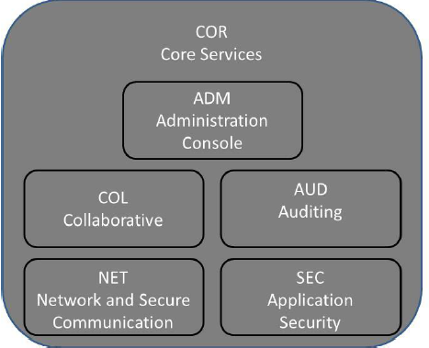
Core Services (1/3)
Auditing Services
The Auditing Services play a crucial role in the CISE application flow;
The Auditing Services periodically test the availability of the services, resources on a specific configuration. The most significant data is to be persisted in the Auditing dedicated database, which is then provided for analytical and statistical purposes on the Auditing Presentation layer.

Slide 17
Core Services (2/3)
Collaborative Services
The Collaborative Services are in charge to support users by providing them multimedia and auxiliary tools in order to facilitate the communications and work among them. The users that can use the collaborative tools exposed by the Community are intended as one of the operational user of each legacy systems.
The tools provided by the Collaborative Services are the followings:
Instant messaging: Participants are able to send each other text messages in an easy and efficient way, in a one-to-one chat or using group chats between more Participants;
E-Mail: using a SMTP server the Collaborative services is possible to send mail to other Participants and receive notifications on predefined events;
Video and Voice Conference: by exploiting the Collaborative services, Participants can perform Video and Voice conferences between two or more Participants;
White Board: Collaborative services provide shared white boards in which several Participants can draw, write, create images and cliparts in a joint session;
File Transfer: using FTP servers on the Gateway/Node is possible to send and receive files among the Participants;
Shared Documents Repository: each Gateway/Node has a document repository shared with the others Participants by using the WebDAV protocol;
SharedCalendar: a user can create calendar events to be shared with others Participants and send/receive e-mail with details of the scheduled meetings.

Slide 18
Core Services (3/3)
Administration Console
The Administration Console is intended to be used by the Configuration Manager or a Member State Administrator and
will provide a human interface to perform the following functions:
Monitoring of services and network connectivity;
Manage Participants access and credential;
Manage Access Right Rules (create, update, delete);
Manage Services;
View and Export Reports (log report, statistic report).
The Administration Console, using the related Core Services, will permit to the logged user to:
show graphically network connectivity and the status of all provided services;
manage Participant credential (add, delete, modify);
manage authorization rules (add, delete, modify) and apply them to the services;
manage services (add, delete, update);
show statistics about usage frequency of services.
show log messages filtered by classification level;
create reports on all the provided statistics.

Slide 19
Common Services (1/3)
The Common Services while using the defined message exchange patterns, allow the following business activities:
Query – Query data about an entity/service.
Query Response – Return data previously requested in a Query.
Subscribe and unsubscribe – Subscribe and unsubscribe information about an entity/service.
Notification – Notify about information either resulting from a previous subscription or to unknown destinations.
Feedback – Provide feedback on information already received or sent.
Acknowledgement – Provide success or error messages upon delivery of a message during the transfer process.
Discovery – Discover other services in the Common Information Sharing network that match the requested profile
Independently of the message exchange pattern used or the business operation, in the end the provided services will allow the exchange of information. The supported information model and their relationships is detailed in the Data Model. The data model does not have an implicit relational paradigm: the relational paradigm and representation is achieved through relational entities which are encapsulated by the core entities. Typically, these relational entities aggregate the target entity and some relationship characterization info.

Slide 20
Common Services (2/3)
A Legacy System wanting to be integrated in Common Information Sharing Environment has to be interfaced though an Adaptor properly developed to the Common Services. The Adaptor is the bridge between the Legacy System and the Common Services (available in the Gateway).
The Common Services Interface defines the technical interface used by Adaptors to communicate with thecommon network and vice versa. This interface is materialized in a SOAP/REST Service called “CISE Message Service”. This service offers one operation called “send” that receives a Message type. This Message type is the parent entity of several others that represent the message exchange patterns.
The Adaptor has two main functions, act as Consumer and as a Provider, during the process of information transfer between the Legacy System and the common network.
The Adaptor has the responsibility to expose the known Common Services interface necessary to allow the Common Services to connect and transfer the information sent by another Participant. While the Common Services in the Gateway (or Node in the case of Configuration C) also make available a known interface that allows an Adaptor to send information to the common network.
The Adaptor must implement the same service signature as defined in the Common Service IDD, which consists in a generic service with an operation that supports the usage of PULL and PUSH message exchange patterns

Slide 21
Common Services (3/3)
The Common Services are available through a single generic Web Service interface that has a single operation supporting every message exchange pattern as well as every operational service type.
The Web Service is available in two protocols, SOAP and REST, and while in the Gateway both interfaces are available as entry points, in the Adaptor one can be choose. This must be configured in the Service Manager to allow the correct deliver of incoming messages to the Adaptor.
Some considerations:
The Adaptor must implement the CISEMessageService interface with which the Gateway Common Services will communicate. The choice to use the SOAP or REST interface is a decision of the Adaptor but must be set during the service registration in the Gateway. The organization developing their Adaptor is responsible for implementing the business logic inside the local available interface (CISEMessageService).
This unique interface contract implemented by the Adaptors, allow less software package dependencies and easier life cycle management regarding the Common/Core Services and Adaptors. The Common Services allow several business operations that use the message exchange patterns defined for the Common Information Sharing Environment. Is through these operations that Legacy Systems/Adaptor send and receive information, always using the previous defined Web Service (and single operation).
All available operations are supported by a specific data structures for input and output. The main entities are Push, Pull Request, Pull Response, Feedback and Acknowledgement. All these entities inherit from a super entity called Message.

Slide 22
2019 Steps forward
Objective:
(T0+07) Group Specification: First set of Service models - 2nd meeting?
Roadmap:
(T0+03) Group Report describing the overall architecture;
(T0+05) Group Specification for Common and Core Services (preliminary); - 1st meeting?
(T0+05) Group Specification of languages, processes and domains for service modelling.
How to:
Technical team work in progress definitions.

Slide 23
Questions?

Slide 24
Thanks for your attention
Lorenzo Ettore Paolo Iapoce Interagency Programmes
Project Manager
Leonardo – Società per azioni Via Tiburtina km 12,400 - Roma - 00131 - Italy
Tel: +39 0641505586 Tel: +39 3346078215 Fax:+39 06 4150 5740
lorenzo.iapoce@leonardocompany.com leonardocompany.com
HELICOPTERS / AERONAUTICS / ELECTRONICS, DEFENCE AND SECURITY SYSTEMS / SPACE

