Slide 1
Supporting Global Research for IMS 2020 Vision
dimitris.kiritsis@epfl.ch

Slide 2
Roadmapping for ims 2020+ on:
Sustainable manufacturing interested in technology solutions for manufacturing processes and manufactured products which are efficient with respect to resource use and lead to minimal waste. Ergonomics, industrial disaster prevention and mitigation and safety of nanomaterials and related manufacturing processes are part of such topic.
Energy efficient manufacturing interested in solutions to improve efficiency and reduce the carbon footprint in energy utilisation for manufacturing and operational processes.
Key technologies interested in technologies that will yield a high impact on the next generation of manufacturing, including model-based enterprise, nanotechnology, and smart materials.
Standards interested in manufacturing research issues that can benefit from standardization to create open manufacturing and product standards that are accessible to everyone and enhance innovation.
Education interested in new education paradigms for supporting IMS education, such as eLearning and Technology Enhanced Learning.

Slide 3
Roadmap Relationship
KAT 1 Sustainable Manufacturing
KAT 2
Energy
Efficient Manufacturing
KAT 3
Key
Technologies
KAT 4
Standards
KAT 5
Education

Slide 4
IMS2020 in short
Participants:
15 partners from research and industry
Roadmapping Support Group (RSG) is represented by 78 organisations from industry and research (number growing), out of which 54 are industries
Participating regions: EU, Switzerland, USA, Korea, Japan
Funding: 2‘000‘000 € (only European partners)
Duration: 24 months, 01/2009– 12/2010

Slide 5
IMS2020 partners
IMS Partners
Roadmapping Support Group (RSG)
selection of members
30.6.2008
5

Slide 6
IMS 2020 Roadmap Research Topic example
Standardization of product field data (1 of 2)
Problem description
Various products are used & maintained globally for long time period (e.g. locomotives for 30+ years) by various operators and service providers
During these years a lot of interesting field data is gathered by using different data models, different applications, etc.
Therefore these field data can not be easily exchanged and compiled between operators, service providers and manufacturer, e.g.
To allow operators to know full product lifecycle
To support service providers to enhance their services (e.g. maintenance, refurbishment)
To enable manufacturers for improved development of future products
Research features
Standardization of data model, structure, formats and attributes for
Static product data (e.g. product metadata, like ID number, name, dimensions)
Dynamic field data (e.g. product operation time/mileage, error messages, configurations as maintained)
Data exchange format between Computerized Maintenance Management System (CMMS) applications (similar to STEP)
Operator
Manu- facturer
Service Provider

Slide 7
IMS 2020 Roadmap Research Topics
Standardization of product field data (2 of 2)
Expected results and impact:
Product operation / usage, maintenance / refurbishment and development will be done more accurately & efficiently due to larger & more profound data basis on product performance over all its lifecycle
New business models could be realized, e.g. by alignment / cross-linking of operator, maintainer and manufacturer business objectives & value chains
SW suppliers of CMMS applications need to incorporate the standardized data models & interfaces into their SW to allow data exchange
Timeline: up to 5 years
Key area: Standards
Industrial sectors: Transportation, Investment / industrial equipments, etc.

Slide 8
Observe, Compare, Understand, Predict, Communicate & Close the Information Loops
PEID
Knowledge agent
DFX agent
Sensors
Tags
Memory
Data
Product
Data
Manufacturer’s
Product data DB
© EPFL
PLM Server
Info
Advice
Data
Info
Info
Info request
PLM agent
(reader)
Diagnosis
Decision making

Slide 9
Closing the product information loops
Product lifecycle data/information/knowledge
(1) Horizontally closed
BOL
MOL
EOL
(2) Vertically closed
Business applications
- Information, Knowledge
- Feedback
Analyzing and knowledge transformation (Middleware)
Gathering data
Feedback
Data gathering (PEID)

Slide 10
PROMISE Architecture

Slide 11
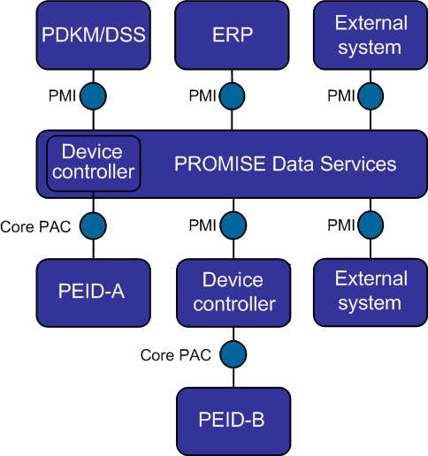
PROMISE Architecture

Slide 12
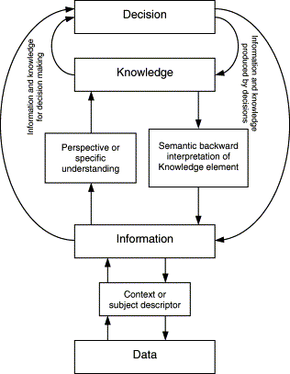
Data transformations to information to knowledge
Hicks et al. 2002

Slide 13
The next step: Time Based PLM
PRODUCT TYPE
PLM
PRODUCT ITEM
PLM
TIME
Processes
(ie. Production, Design, Maintenance, Recycling etc.)

Slide 14
Ontology based CL2M

Slide 15
Characteristics of intelligent (smart) products
Sensing (sensors)
Memory (memory chips)
Logic (micro-processors + software)
Seamless communication (wireless)
Identity (barcodes, RFID, …)

Slide 16
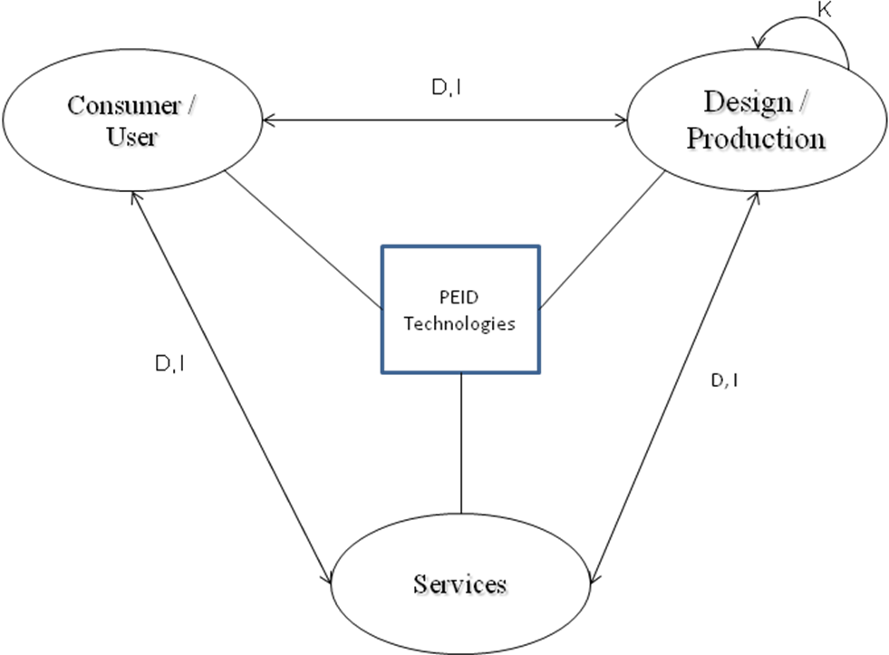
The intelligent consumer/user in the intelligent product lifecycle loops
Notes:
16

Slide 17
If your product could tell what to do with itself next, what could you do with that?
Thank YOU
www.ims2020.net
www.promise-innovation.com
www.cl2m.com

