Slide 1
ETSI – Standards FOR Information And Communication technologies
Dirk Weiler, Chairman of the Board and IPR Special Committee, ETSI Head of Standards Policy, Nokia
Vortrag in der Reihe „Datenschutz und IT-Sicherheit“ , Hochschule München, 21. Dezember 2016

Slide 2
ETSI – Standards FOR Information And Communication technologies
Standardization
Overview of ETSI
Security in ETSI

Slide 3
Business considerations
For-profit organizations prefer monopoly over standard
Proprietary solution – no need for consensus building
Economies of scale
More brain power
Customer pressure for competition
Government pressure against lock-in

Slide 4
Some reasons to participate
Ensure interoperability
Drive your technology of choice into the standard
Access to leading-edge ICT knowledge
Opportunities to meet and influence your customers & competitors
Direct insight into critical issues, including regulatory & spectrum matters, and the ability to influence them
Contribute the views of your constituency (e.g. environment, users, social interests, SMEs)

Slide 5
Interests of standard contributors and standard users
Standard contributors
Standard users
Develop the most suitable standard
Fair and reasonable access to the standard for all interested users
Reward for the investments into developing the standard
Optimum reward
Have the most suitable standard available
Fair and reasonable access to the standard for all interested users
Minimum constraints for using the standard
Minimum costs

Slide 6
Contribution of Standardization to GDP
Country | Publisher | Time frame | Growth rate of GDP | Contribution of standards
Germany | DIN (2000) | 1960–1996 | 3,30% | 0,90%
France | AFNOR (2009) | 1950–2007 | 3,40% | 0,80%
United Kingdom | DTI (2005) | 1948–2002 | 2,50% | 0,30%
Canada | Standards Council of Canada (2007) | 1981–2004 | 2,70% | 0,20%
Australia | Standards Australia (2006) | 1962–2003 | 3,60% | 0,80%
Source: The Economic Benefits of Standardization, DIN, 2011
http://alt.din.de/sixcms_upload/media/2896/GNN_2011_engl_FINAL.pdf
Further information (ISO/IEC)
http://www.standardsinfo.net/info/benefits/benefits_s1.html

Slide 7
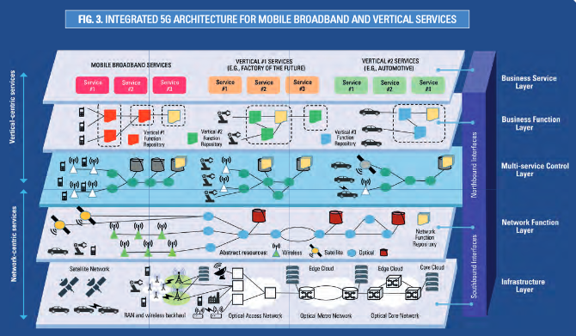
Mobile Communication
https://www.gsmaintelligence.com/
https://5g-ppp.eu/wp-content/uploads/2016/02/BROCHURE_5PPP_BAT2_PL.pdf

Slide 8
ETSI – Standards FOR Information And Communication technologies
Standardization
Overview of ETSI
Security in ETSI

Slide 9
The family tree
Mid 80’s
Emergence of mobile communications (the GSM success story)
Industrial/ political will to work on a common set of standards for EU
Industry in the driving seat
European
Commission
CEPT
(EU Conference of Posts
& Telecommunications)
MoU (1988)
Notes:
9

Slide 10
European Standardization Organisations (ESO) (EU Regulation 1025/2012)
DIN
Deutsches Institut
für Normung e.V.
DKE
Deutsche Kommission Elektrotechnik Elektronik Informationstechnik in DIN und VDE.
CEN
Comité Européen
de Normalisation
- All other domains - National delegation
CENELEC
Comité Européen
de Normalisation Électrotechnique
- Electro-technical - National delegation
ETSI
European Telecommunications Standards Institute - ICT - Direct participation
Vienna agreement
1991
Dresden/Frankfurt
agreement
1996/2016
Working
relationships
ISO
IEC
ITU
(T, R & D)

Slide 11
The three dimensions of ETSI business
Standards in support of EU regulation
Standards for global ICT markets
Service provision

Slide 12
ETSI’s Basic Principles
ETSI's fundamental values with regard to the work it undertakes are timeliness, quality and responsiveness to market needs
ETSI is inclusive with a global membership representing a wide range of stakeholders, a global network of partnerships and a consensus approach in its working methods
ETSI is fully compliant with WTO/TBT provisions and EU Regulation (EU) 1025/2012
ETSI works across all sectors of industry and society that make, use or rely on ICT technology
ETSI works at the forefront of developing and emerging technologies
ETSI produces technical standards aimed at being adopted by the most competitive markets
ETSI promotes the adoption of its technical standards worldwide for the benefit of its members' competitiveness
ETSI, in its role as an ESO, provides technical standards supporting EU regulatory requirements and policy
ETSI produces technical standards that use spectrum effectively, minimise interference and avoid undesirable effects, in accord with appropriate regulatory frameworks

Slide 13
ETSI’s Vison, Mission and Strategic Objectives
VISION
ETSI is a leading standardization organization for
Information and Communication Technology (ICT)
standards fulfilling European and global market needs
MISSION
To provide the platforms where interested parties come
together and collaborate on the production of standards
for Information and Communication Technology (ICT)
systems and services that are used globally
Strategic Objectives
Being at the Heart of Digital
Being an Enabler of Standards
Being Global
Being Versatile
Being Inclusive
ETSI LTS 2016-2021

Slide 14
ETSI’s Product, services and collaboration
Technical specifications and standards with global application
Support to industry and European regulation
Specification & testing methodologies
Interoperability testing
112 Partnership agreements

Slide 15
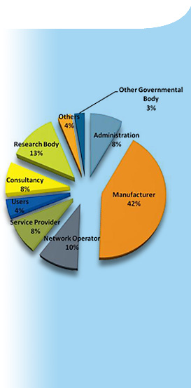
ETSI Membership
800+ members, big and small, from 68 countries on 5 continents
Manufacturers, network operators, service and content providers, national administrations, ministries, universities, research bodies, consultancies, user and societal organizations
A powerful and dynamic mix of skills, resources and ambitions

Slide 16
ETSI membership - research, university, security
82 Research organizations, 40 Universities
Universities Bremen, Dresden, Erlangen, Göttingen, Kaiserslautern
Hochschulen für Technik und Wirtschaft Dresden, Saarland
Fraunhofer Gesellschaft, Fraunhofer AISEC, ESK, FOKUS, HHI, IMW, IIS, SIT
BfV, LKA Bayern, LKA NRW, E-Codex, Zollkriminalamt
CESG (UK), ANSSI (FR), SSIS (HU)
Teletrust, BSIA (UK), JNSA (JP)

Slide 17
The ETSI structure
General Assembly
ETSI Board
Special Committees
Technical Committees
ETSI Projects
ETSI Partnership Projects
Industry Specification Groups
“Technical Organization”
Working Groups
The ETSI Secretariat gives support to all the different entities in the Organization

Slide 18
ETSI is the home of many diverse technologies
2G, 3G, 4G, 5G Mobile Communications
Air Traffic Management
Automotive Radar
Autonomic Systems
Body Area Networks
Broadband Wireless Access
Broadcasting
Cable Networks
Cloud Technology
Cognitive Radio
Content Delivery
Cyber Security
DECT™
Digital Mobile Radio
Digital Rights Management
eHealth
Electromagnetic Compatibility
Electronic Signatures
Emergency Communications
Energy Saving
Environmental Aspects
Fixed-line Access
Fixed Radio Links
Human Factors
IMS Network Testing
Intelligent Transport
Internet of Things
Interoperability
Lawful Interception
Low Power Radio
Machine-to-Machine Communications
Maritime Communications
Media Content Distribution
Millimeter Wave Transmission
Mobile-Edge Computing
Network Functions Virtualisation
Next Generation Networks
Open Source Software
Powerline Communications
Protocols
Public Safety Systems
Quality of Service
Quantum Key Distributi on
Quantum-Safe Cryptography
Radio Regulations
Radio Systems
Railway Communications
Safety
Satellite Communications
Security Algorithms
Short-range Radio
Smart Appliances
Smart Cards
Soft ware Defined Radio
Telemedicine
Testing
Terrestrial Trunked Radio (TETRA)
Wireless Medical Devices
DECT
Annual report (http://www.etsi.org/images/files/AnnualReports/etsi-annual-report-april-2016.pdf)
Work program (http://www.etsi.org/images/files/WorkProgramme/etsi-work-programme-2016-2017.pdf)

Slide 19
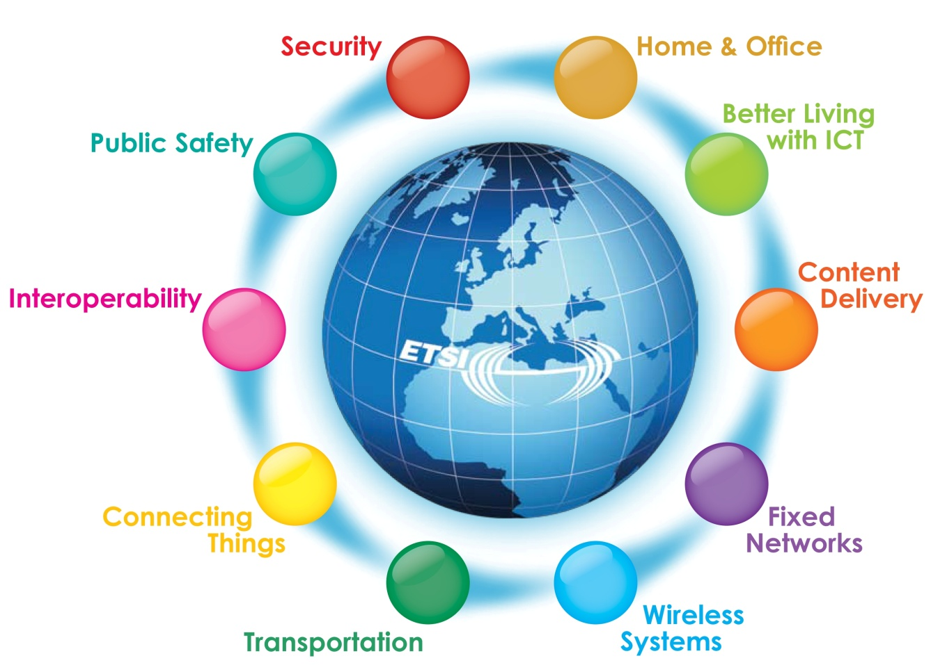
ETSI Clusters
http://www.etsi.org/technologies-clusters/clusters

Slide 20
The 3rd Generation Partnership Project
Europe
Cellular telecommunications network technologies covering Radio access, Core transport network and Service capabilities - including codecs, security, QOS
Provides complete system specifications, also providing hooks for non-radio access to the core network and interworking with Wi-Fi networks
3GPP (launched 1998) is a partnership project of regional standards organizations, currently 7 Organizational Partners (OP), it is not an official standards body.
3gpp.org
Japan
North America
Japan
China
Korea
India

Slide 21
The 3rd Generation Partnership Project
3GPP produces Technical Specifications (TS)
TS are transposed by the OPs into official standards
Companies participate as Individual Members (IM) via an OP (535 IM today)
3GPP has 16 Market Representation Partners (MRP)
Offer market advice, bring a consensus view of market requirements

Slide 22
oneM2M
oneM2M was launched in 2012 as a global initiative to ensure the most efficient deployment of Machine-to-Machine (M2M) communications systems and the Internet of Things (IoT).
Its aim is to develop technical specifications for a common M2M Service Layer that can be embedded within various hardware and software to connect the wide range of devices worldwide with M2M application servers.
onem2m.org

Slide 23
oneM2M
Partner Type 1
Europe
North America
A partnership project of currently:
8 partner type 1 (regional standards organizations)
6 partner type 2 (4 globally active industry consortia, 2 regional standards organizations)
223 Members
Any legal entity with interest in the development and/or implementation of oneM2M Technical Specifications and Technical Reports. Members must be members of a Partner Type 1 and must agree to that partner's IPR policy.
6 Associate Members
Any government or regulatory agency that has an interest in oneM2M, with the right to attend and provide input to meetings of the Technical Plenary and its subgroups, limited to clarifications regarding regulatory matters and informational contributions.
Japan
China
Korea
India
Partner Type 2

Slide 24
Workshops and events since last GA (i)
ETSI branded events organized by the Secretariat:
ETSI Summit on 5G: From Myth to Reality, 21 April in ETSI
ETSI Workshop “From Research to Standardization”, 10-11 May in ETSI
ETSI Security Week, 13-17 June in ETSI
ETSI Workshop on Open Source and Standardization: Legal Interactions, 16 September in ETSI
4th ETSI/IQC Workshop on Quantum-Safe Cryptography, 19 – 21 September in Toronto, Canada
ETSI Workshop on “Public Protection and Disaster Relief: Regulatory changes and new opportunities for Broadband PPDR”, 29 September in ETSI
UCAAT 2016 - ETSI User Conference on Advanced Automated Testing, 26-28 October in Budapest, Hungary
ETSI Workshop on “Managing Rail Mobile Communications Evolution. On Track for Future Challenges", 2-3 November in ETSI

Slide 25
Workshops and events since last GA (ii)
Non ETSI branded events where ETSI has been represented through speaker, stand or just endorsed by ETSI:
MEC DAY @ SCWS – 9 May, London, UK
Network Virtualization & SDN MENA, 10-11 May, Dubai, UAE
DECT World Conference 2016 – 31(st) May – 1(st) June, Barcelona, ES
Critical Communications World, 31 May - 2 June, Amsterdam, NL (jointly with 3GPP)
Network Virtualization & SDN World, 31 May - 2 June, Madrid, ES
Network Edge Europe 2016 – 6-7 June, London, UK
5G World, 28-30 June, London, UK (jointly with 3GPP)
Connected Cars, 28-30 June, London, UK
MEC Congress + 1st ETSI MEC PoC ZONE, 20-22 September, Munich, DE
Network Virtualization & SDN Asia, 27-28 September, Singapore, SG
SDN & OpenFlow World Congress – 11-14 October, The Hague, NL
Broadband World Forum – 18-20 October, London, UK (jointly with 3GPP)
IEEE Conference on NFV – SDN – 9 November, Palo Alto, US

Slide 26
ETSI – Standards FOR Information And Communication technologies
Standardization
Overview of ETSI
Security in ETSI

Slide 27
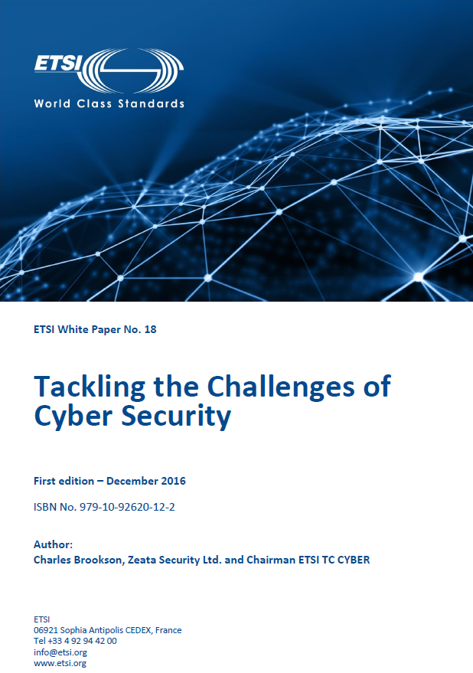
2016 security standardization white paper
Security standardization, sometimes in support of legislative actions, has a key role to play in protecting the Internet, the communications and business it carries and both the private and corporate users who rely on it.
The timing of the standardization of new technologies, products and services is particularly important; we need to make our ICT secure from the start, as well as throughout their lifetime.
There are many organizations worldwide working on Cyber Security, and co-ordination and liaison is important to ensure that we all pull together and do not duplicate our efforts.
Security White Paper 2016

Slide 28
Areas of security standardization (I)
Privacy by Design
Privacy by Design - protecting privacy by building protection in up front rather than trying to ‘bolt it on’ as an afterthought.
ETSI (together with CEN and CENELEC) is responding to the European Commission (EC) Mandate on Privacy by Design (M/530). Up to 11 standards are expected , e.g. TC CYBER works on a practical introductory guide to privacy and a Technical Report (TR) outlining a high-level structured ecosystem of security design requirements for communication and IT networks and attached devices.
TC CYBER is working on
Protection and retention of Personally Identifiable Information (PII)
Defining the technical means to enable the assurance of privacy and the verification of that assurance
Addressing identity management and naming schema protection mechanisms to prevent identity theft and resultant crime.

Slide 29
Areas of security standardization (II)
The Sharing of Cyber Threat Intelligence
The sharing of information is a crucial weapon in our armoury against cyber-attack.
TC CYBER is preparing a TR on the means for describing and exchanging cyber threat information in a standardized and structured manner.
TC CYBER also provides and regularly maintains a global overview of Cyber Security activities in technical fora.
Securing Technologies and Systems
One of ETSI’s key strengths is in the securing of overall systems and technologies such as mobile communications, NFV, Future Networks, Intelligent Transport Systems, Digital Enhanced Cordless Telecommunications (DECT™), M2M communications and emergency telecommunications (including Terrestrial Trunked Radio (TETRA)). The security standards required by these technologies are dealt with primarily within dedicated technology-focused technical committees.

Slide 30
Areas of security standardization (III)
TC DECT is implementing security architecture enhancements in the core technology to better protect end-user privacy and the confidentiality of communications.
Reconfigurable Radio Systems (TC RRS) is protecting the integrity of reconfigurable radio communications. It is important to guarantee the integrity of radio applications and prevent their use as attack vectors against either individual devices or the network itself
TC CYBER embarks on new work to support the Network and Information Security Directive, intended to increase consumer confidence and maintain the smooth functioning of the European internal market.
TC CYBER started new work on network gateway cyber defence, aimed at improving Cyber Security by identifying and then advancing changes to technology standards.

Slide 31
Areas of security standardization (IV)
The Internet of Things
The IoT is at the edge of cyber-space. As such, Cyber Security must be embedded and ready-to-use by the consumer without any previous specialist technical knowledge. In order to achieve this, we need greater co-operation between producers and operators of technical systems, as well as society and service providers.
Work in oneM2M is focused on three aspects of security: protecting the oneM2M service layer; providing security as a service to IoT applications, and leveraging communication network security services, where available.
eHealth
Our eHealth Project (EP eHEALTH ) is looking at eHealth in general and in particular its relation to the IoT and M2M, including concerns surrounding security and privacy. From a Cyber Security viewpoint, requirements for the protection of privacy make eHealth a particularly difficult M2M/IoT use case.

Slide 32
Areas of security standardization (V)
Trust Service Providers
We support EU Regulation N°910/2014 on electronic identification and trust services for electronic transactions in the internal market (the ‘eIDAS Regulation’), and are developing standards to meet the needs of the international community for trust and confidence in electronic transactions. Our Electronic Signatures and Infrastructures committee (TC ESI) is building on its standards for trust services providers (TSPs), electronic signatures, electronic seals and electronic time-stamps, including the definition of security and policy requirements for TSPs providing public key certificates and electronic time-stamps. We are now defining the security and policy requirements for TSPs providing registered eDelivery services, remote signature creation and remote signature validation.

Slide 33
Areas of security standardization (VI)
Secure Cards and Elements
Work is underway to address the embedded UICC (eUICC) and the definition of test cases related to the support of multiple secure elements for mobile contactless communication over the Near Field Communication interface.
As the convergence of different market segments such as banking, identity services and fixed line communication with the mobile market is leading to new requirements, we are also considering the future of the secure element. We are looking at improving the existing physical/electrical interface and/or logical interface or defining new ones for removable and non-removable secure elements.
Cryptography
Strong (and efficient) cryptography is a central building block for security in a huge range of products and systems.

Slide 34
Areas of security standardization (VII)
Security Algorithms
ETSI’s Security Algorithms Group of Experts (SAGE) provides both ETSI and 3GPP with cryptographic algorithms and protocols specific to fraud prevention, unauthorized access to public and private telecommunications networks and user data privacy.
Principle in 3GPP security is nowadays that systems should support two different algorithms from day one, providing ‘belt and braces’ security against the possibility that either algorithm may be broken in the future.
Currently working on new algorithms for GPRS, 128-bit encryption algorithm (GEA5) and new 128-bit integrity algorithms (GIA4 and GIA5). These are being developed primarily for EC-GSM-IoT, a radio interface solution for use in the IoT.

Slide 35
Areas of security standardization (VIII)
The Impact of the Quantum Computer
TC CYBER has published an ETSI Guide (EG 203 310) on the impact of quantum computing on ICT security that reinforces the notion of having cryptographic agility as a root capability of products and services, and also advises that business management, including business continuity, takes due account of the role of cryptography in the business process.
Quantum-Safe Cryptographic Algorithms
TC CYBER started identifying cryptographic primitives that are resistant to both conventional and quantum-computing attacks.
Six specifications including a quantum-safe algorithmic framework and a threat and risk assessment for real-world use cases soon to be completed. Further work concern the characterization of cryptographic primitives, benchmarking their performance and their suitability to a variety of applications.

Slide 36
Areas of security standardization (VIII)
Quantum Cryptography
Quantum cryptography provides primitives that are intrinsically quantum-safe, as they are based on the laws of nature rather than computation complexity. It allows keys and digital signatures to be shared over optical fibre or free space links and can be used in a general Cyber Security framework, and to complement algorithmic methods for specific applications. Apart from resilience from every possible attack on a quantum computer, quantum cryptography also provides forward secrecy in that recorded communications cannot be decrypted in future when more powerful supercomputers will be available.
Our ISG on Quantum Key Distribution (QKD) is developing specifications that will allow this radically new technology to be adopted in communication networks. We are addressing best-practice security guidance for implementation security. We are also specifying measurement protocols for characterising optical components and complete QKD transmitter modules.

Slide 37
Areas of security standardization (IX)
Network Functions Virtualisation
Detailed specifications are being developed in support of trusted platforms, remote attestation, public key infrastructure in the NFV environment and others.
Lawful Interception and Data Retention
TC LI develops Lawful Interception and Retained Data (RD) capability, these standards are being adopted around the world. LI implementation is required by the EU which allows for LI to prevent crime, including fraud and terrorism.
Current work: Dynamic triggering of interception, security for LI and RD systems as those are increasingly IP service-centric, globally distributed and, frequently, software-based. Guidance on LI and RD standards and concepts, and on LI for LTE™.
Further aspects: Assurance of the integrity and originator of approvals/authorisations, the security aspects of internal interfaces for LI, and security issues around global, trusted-third-party components of law enforcement equipment

Slide 38
3GPP / GSMA work on security assurance for network equipment
Joint 3GPP and GSMA activity to create a security assurance scheme for network equipment
Processes and requirements defined for security accreditation of:
Product development lifecycles of equipment vendors
Product lifecycles of equipment vendors
Test activities for network equipment of test labs
Conflict resolution
Technical security requirements for particular classes of network equipment (MME, HSS, PCRF, eNodeB, …)
Benefits
Raised security quality of network equipment (standard products)
Standardised set of minimum security requirements for network equipment
Simplified quotation/contract negotiation process
Liaison with regulators of local governments to unify legislation

Slide 39
Joint 3GPP and GSMA Security Activity
3GPP SA3
Launched SECAM activity in 2012
3GPP specifications cover interfaces and protocol security
SECAM adds test cases for 3GPP network equipment security assurance
GSMA SECAG (formerly NESAG until end of 2014)
Established in Feb 2014
Defines and governs security accreditation scheme for network equipment evaluation and conflict resolution
Operates accreditation supported by third parties

Slide 40
Contact
Dirk.weiler@nokia.com
ETSI: info@etsi.org
Discussion

Slide 41
Contact
Dirk.weiler@nokia.com
ETSI: info@etsi.org
Thank you!

