Slide 1
C-ITS technical specifications for Interoperability status and roadmap
Compass4D Webinar 5.10.2016
Sebastian Müller, ETSI CTI

Slide 2
Outline
ETSI’s Role
Interoperability Events (so called Plugtests)
Plugtest Schedule
Use Cases

Slide 3

ETSI : European Telecommunications Standards Institute - Sophia Antipolis
ETSI produces globally-applicable standards for Information and Communications Technologies including fixed, mobile, radio, converged, broadcast and internet technologies
The most famous ETSI standards are DECT, Smart Cards, electronic signatures..and GSM (3GPP)
Today ETSI is famous for NFV.. and IoT/M2M developed in oneM2M and TC SmartM2M, part of ETSI « Connecting Things » cluster
800 member organizations, 64 countries and five continents
Notes:
ETSI www.etsi.org
Based in Sophia Antipolis (France), the European Telecommunications Standards Institute (ETSI) is one of the three recognised European Standardisation Organisations, responsible for standardization of Information and Communication Technologies (ICT) within Europe. ETSI is an independent not-for-profit organization which unites over 700 members from 64 countries inside and outside Europe, including industrial companies, SMEs, administrations, academic and research bodies and user associations - in fact, all the key players in the ICT arena. ETSI plays a major role in developing a wide range of standards and other technical documentation as Europe's contribution to world-wide ICT standardization. Standards development activities are supplemented by interoperability testing services. ETSI's Members determine the Institute’s work programme, allocate resources and approve its deliverables. As a result, ETSI's activities are closely aligned with market needs and there is wide acceptance of its products.

Slide 4
ETSI’s Role
Standards-making
  Development of base communications standards
  Development of conformance and interoperability test specifications
  European Standards (ENs) are developed following a standardization request (mandate) from the European Commission (EC)/European Free Trade Association (ETFA)
Supporting services
  Specification of methodologies for standards writing and test development
  Arrangement and management of interoperability testing events, called Plugtests™

Slide 5
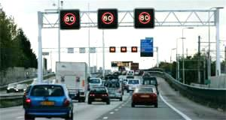
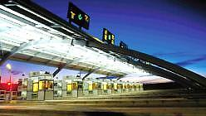
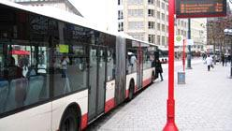
Why do we need standards ?
Enable interoperability of systems/services
Encourage innovation, foster enterprise and open up new markets for suppliers
Create trust and confidence in products and services
Expand the market, brings down costs and increases competition
Help to prevent duplication of effort
Support greater confidence in procurement
Interchangeability of system component suppliers
Marco Annoni, Telecom Itali S.p.A./TILAB – Service Platform Innovation – ITS & Logistics
Notes:
5
5

Slide 6

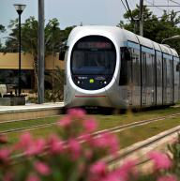

EU Policies
Transport White Paper 2011
EC Roadmap to a Single European Transport Area
Towards a competitive and resource efficient transport system
To meet the challenges, transport has to:
  Use less energy
  Use cleaner energy
  Exploit efficiently a multimodal, integrated and ‘intelligent’ network
By 2050 reduce emissions by 60%, and 20% by 2020 (2008 level)
By 2050 move close to zero fatalities in road transport, halving road casualties by 2020

Slide 7
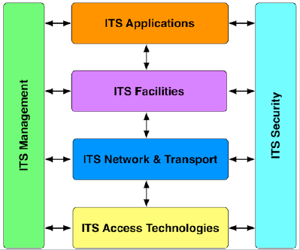
ETSI TC ITS – Minimum set of standards for interoperability
Release 2
Adaptive Cruise Control, Platooning, Vulnerable Road User Safety
6 Test Specification series published for Release 1
More than 50 base standards for Release 1 published
Notes:
Reference Architecture for ITS

Slide 8
ETSI TC ITS – Major Achievements
Release 1
ETSI TR 101 607
Facility
ETSI EN 302 637-2 Cooperative Awareness
ETSI EN 302 637-3 Decentralized Environ
Notification
Transport/Network
EN 302 634-4-1 Geo Networking
Access
IEEE 802.11p profile
Congestion Control
Security
ETSI TS 103 097 Security Header and
Certificate Formats
ETSI TS 103 301 Infrastructure Services
Notes:
Technical : For information

Slide 9
Centre for Testing and Interoperability (ETSI CTI)
Time
Industry
Implementations mature from prototypes to INTEROPERABLE commercial products
Market Awareness
Simulations
Prototypes
Demos
Proofs of Concepts
Base Standard Validation
Test Standard Development
Interoperability Testing Events
(Plugtests)
Frameworks for standards writing
and test development
ETSI CTI
Mutual Feedback
Mutual Feedback
Technical
Committees
INTEROPERABLE standards evolve in tandem with product development

Slide 10
What is a PlugtestsTM event?
A test event
  Organized and run by ETSI (as neutral body) in collaboration with industry partners
  Scope, test infrastructure and test plan based on standards
  Feedback to the ETSI technical group
  A tool for the ETSI technical group to validate and enhance the quality of their standards
An opportunity for implementers
  To validate their understanding of the standard
  To test with (many) other real implementations
  To debug their implementation: early bug fixing, saving time
An opportunity for the community
  To promote the technology and the eco system
  To demonstrate end-to-end interoperability

Slide 11





























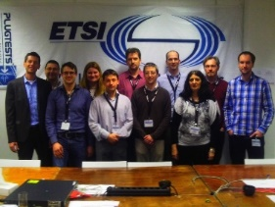



Previous Plugtests editions
Event Date & Location | Companies | Test Scopes
1st Plugtests Nov. 11-18, 2011 Helmond, Netherlands (Hosted by TNO)
2nd Plugtests Jun. 11-15, 2012 Versailles, France (Hosted by IFSTTAR)
3rd Plugtests Nov. 25-29, 2013 Essen, Germany (Hosted by Cetecom)
4th Plugtests Mar. 17-27, 2015 Helmond, Netherlands (Hosted by Tass International)

Slide 12
Plugtest Schedule
Phase 1: Test Track Design
  Livorno-Florence highway
  IoT testbed
  Test track through the port of Livorno
Phase 2: Pre-qualification of Device Under Test (DUT)
    Conformance Testing
Phase 3: Connecting all participants
  Remote labs
  Traffic Control Centre of Autostrade (Datex Node)
  RSUs in harbour and highway test track
Phase 4: Testing !
  1 week lab test in Cruise Terminal
  1 week of field tests on test track

Slide 13
Phase 1: Test Track Design
Definition of the principal route
  2,5 km in harbor
  10 km on Fi-Pi-Li highway
Identification of possible RSU installation points
  11 potential RSU locations
Identification of Urban Canyons and Radio Coverage Measurements
  4 RSU locations selected
Recording
  GPS recording of the vehicle path
Design of Use Cases
  Zones, Traces, Stop lines, Reference Points, Relevance Areas

Slide 14
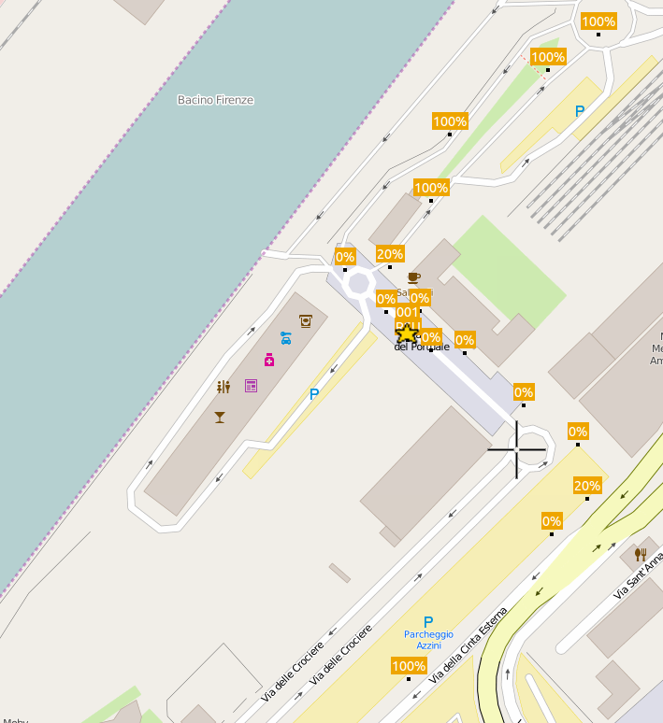
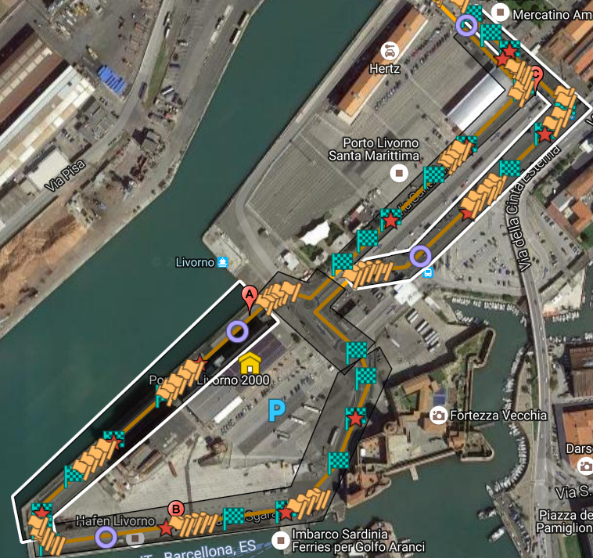
Phase 1: Test Track Design

Slide 15
Phase 2: Pre-qualification of DUTs
Test case DB
Upper Tester Commands via Ethernet
Test Controller
Proxy (Convert CAN messages, optional)
RF GPS signals
CAN
Diag
Ethernet
CAN
GNSS replayer
Upper Tester
App
App 1
App 2
Logging + Analysis
FAC
11p
11p signals
NET
PHY
DUT (ITS Station)

Slide 16
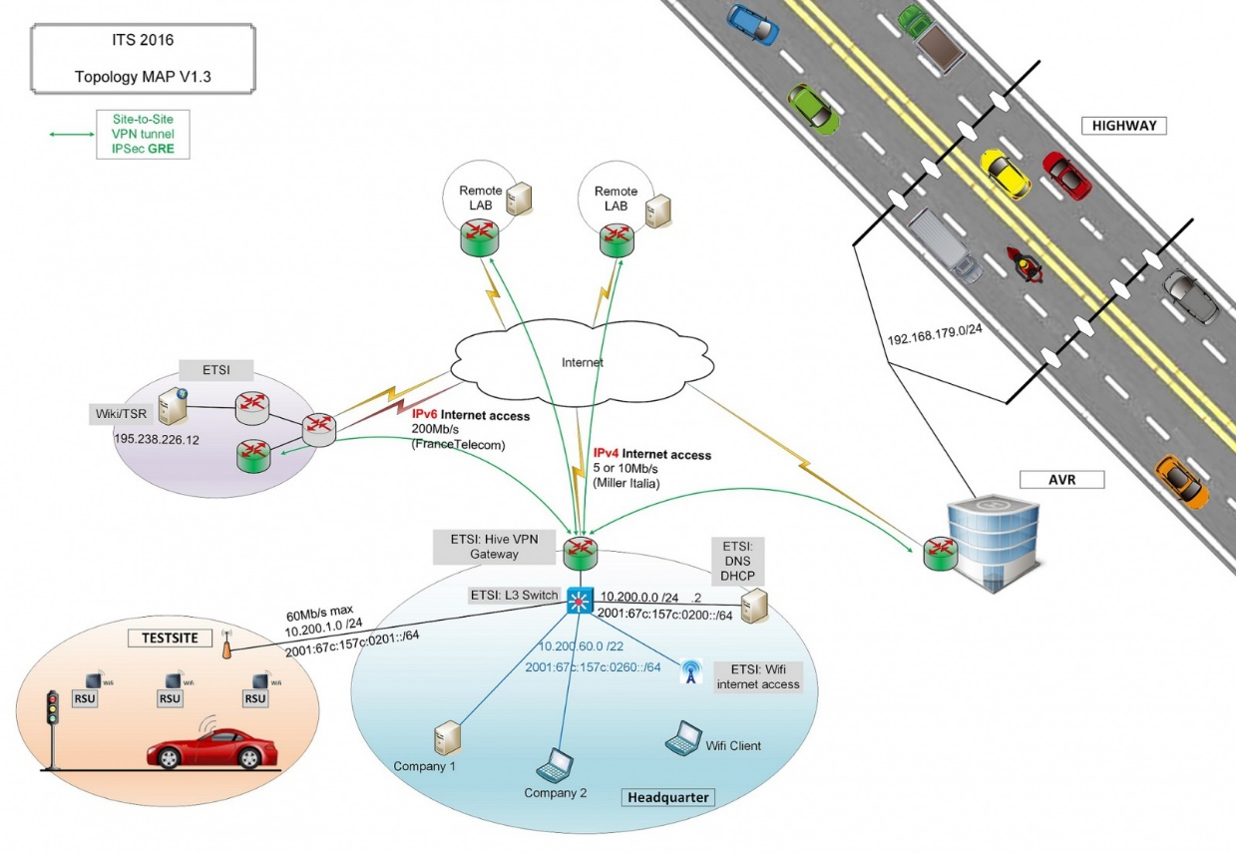
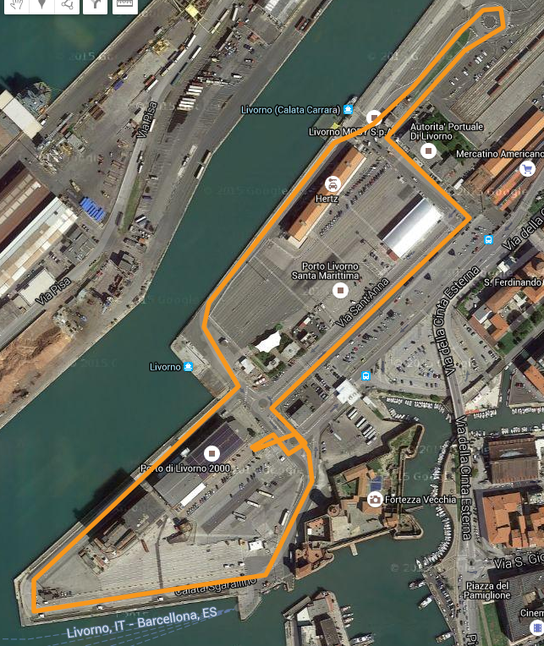
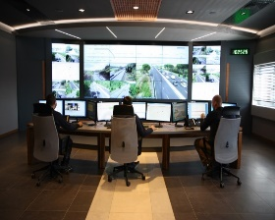
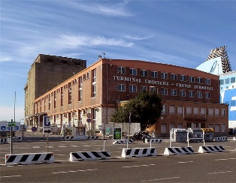
Phase 3: Connecting all participants

Slide 17
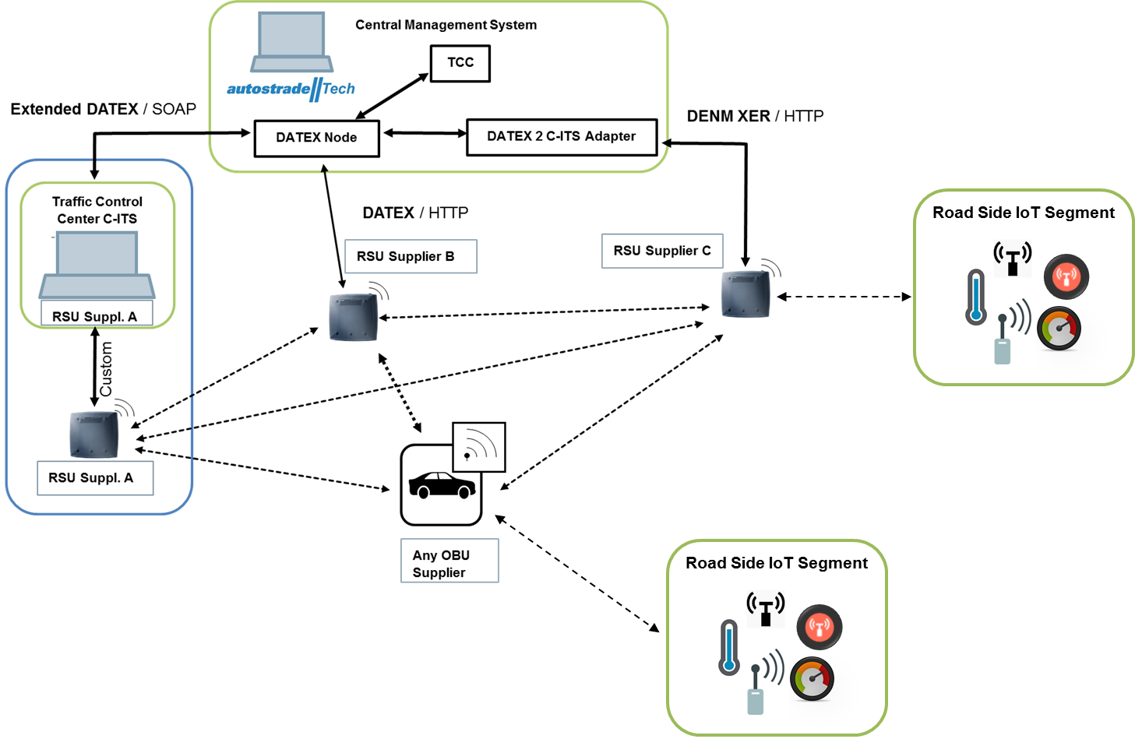
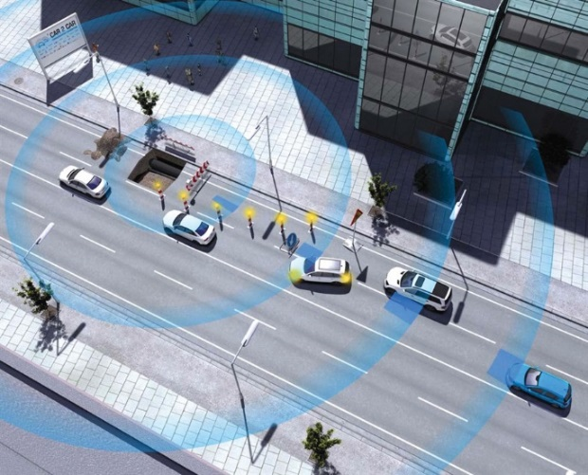
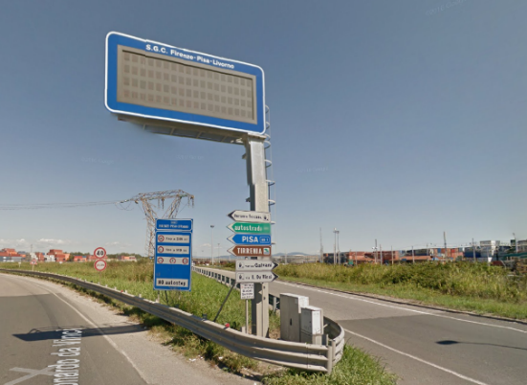
Phase 3: Connecting all participants

Slide 18

Phase 4 : Testing !
(Participants – Status 15.Sep 2016)

Slide 19
Field Interoperability trials
UC-01 Road Hazard Signalling
UC-02 Distribution of Road Hazard Signals
UC-03 Time To Green / Traffic Sign Violation
UC-04 Vehicle Data Aggregation
UC-05 In-Vehicle Signage
UC-06 Intersection Collision Risk Warning
UC-07 Longitudinal Collision Risk Warning
UC-08 Loading Zone Management
UC-09 Tolling
UC-10 Authorization Tickets Reloading
Motorways network
integration
Internet of Things integration
Testing tolling interoperability

Slide 20



Use Case #1 Road Hazard Signalling
AVR Control Center provides input for message generation (DENM)
RSUs which cannot connect to C-ITS send pre-defined messages
Project related Data elements can be send, e.g. Wrong Way Driving, Weather Condition, Hazardous Location, Traffic Condition, Emergency Vehicle Approaching
1 | [O] Input for message generation from AVR
TCC [optional]
Central ITS-S [optional]
2 | [O] C-ITS sends hazard warning to RSU
4 | At the same time information is sent from the safety trailer to the Traffic Control Center . Additional information can also be sent from the Traffic Control Center to the trailer e.g. speed limit
b | [O] RSU queries the sensor network and detects the road conditions. Sends DENMs to the relevant zones
C2I Road Side Unit
On-Board display
Driver Information
4 | The driver receives the information on the Display of his on-board unit or an additional smart device.
Standard IoT Protocols
5.9 GHz Air Link
3 | RSU sends
DENM to OBUs
C2X
On-Board Unit
a | [O] Sensors on the road side perceive a danger on the road surface (water, ice, oil, pollutants / pedestrian).

Slide 21
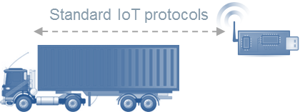
Use Case #2
Distribution of locally detected Hazard Warning
A vehicle sends a Traffic Hazard/Stationary Vehicle Warning
A RSU receives the warning and sends the information to the C-ITS station
C-ITS station distributes information
Central ITS-S
3 | C-ITS distributes IVS (e.g. speed limitations) and DENMs to the relevant zones
2 | RSU receives hazard warning and informs C-ITS station
5.9 GHz Air Link
On-Board display
Driver Information
5.9 GHz Air Link
1 | Vehicle sends hazard warning.
On-Board display
Driver Information
4 | The driver receives the information instantly on the Display of his on-board unit or an additional smart device.
C2X
On-Board Unit
a | On board wireless sensors send information about dangerous goods.
c | The trucks stops on the road and disseminates information using DENMs
b | OBU receives / queries the data about the cargo and disseminates information using CAMs

Slide 22
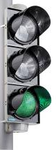
Use Case #3
Time To Green / Traffic Sign Violation
The traffic light sends a pre-defined sequence of SPAT+MAP messages
Based on GPS positioning and the Intersection Information, the in-vehicle application can provide different intersection assistance functionalities such as Fast preemption of traffic due to traffic light signal change (red to green)
RSUs which cannot generate SPAT/MAP messages send pre-defined messages
Central ITS-S [optional]
Traffic Light
2 | The driver receives the information instantly on the Display of his on -board unit
or an additional smart device.
1 | Information about the actual state of the next traffic light in driving direction is sent from the Road Side Unit.
C2I Road Side Unit
On-Board display
Driver Information
5.9 GHz Air Link
C2X
On-Board Unit
4 | ICRW application triggers a warning notification to a driver if a traffic sign violation is detected.
3 | The driver waiting on the red traffic light is informed that the signal will change soon to green so that he can prepare for a swift start.

Slide 23
Use Case #4
Virtual Traffic Loop (Data Aggregation)
Virtual Traffic Loop functionality implemented by RSU
RSU aggregates CAM data from multiple vehicles and provides information to C-ITS
Central ITS-S
3 | [O] C-ITS Station receives the virtual sensor information and decides to relay information to CMS or to generate warnings (e.g. Distribution of locally detected Hazard Warning)
2 | RSU receives, aggregates and anonymizes CAMs and sends ‘virtual traffic loop’ data to C-ITS
On-Board display
Driver Information
5.9 GHz Air Link
1 | Vehicles send CAMs.
C2X
On-Board Unit

Slide 24
Use Case #5 In-Vehicle Signage
Message generation of IVI
RSUs which cannot connect to C-ITS send pre-defined messages
Central ITS-S [optional]
2 | [O] C-ITS sends information to RSU
4 | At the same time information is sent from the safety trailer to the Traffic Control Center . Additional information can also be sent from the Traffic Control Center to the trailer e.g. speed limit
C2I Road Side Unit
On-Board display
Driver Information
4 | The driver receives the information on the Display of his on-board unit or an additional smart device.
5.9 GHz Air Link
3 | RSU sends
IVI to OBUs
C2X
On-Board Unit

Slide 25
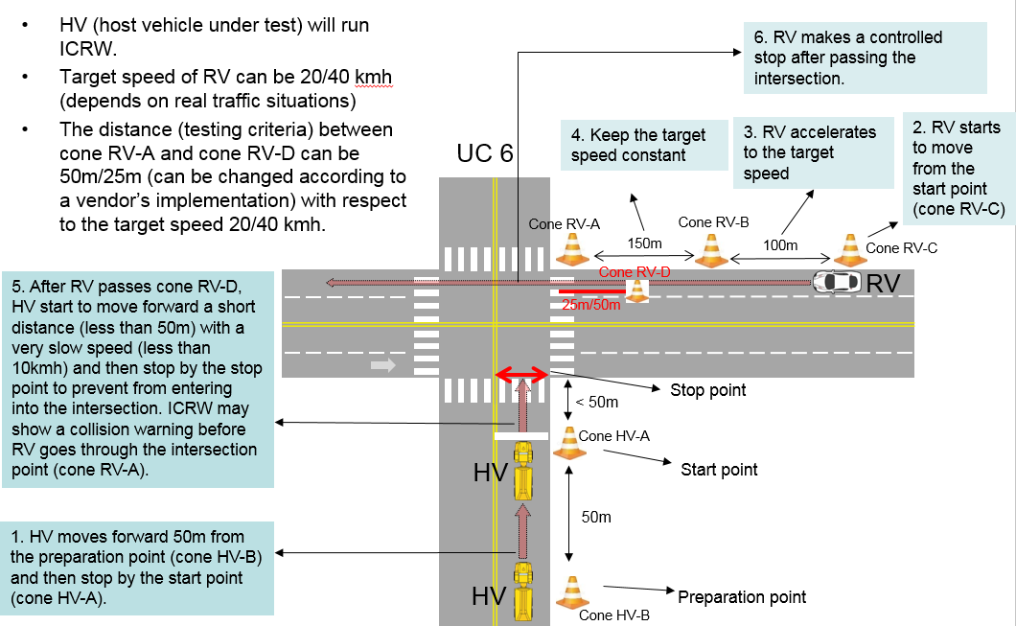
Use Case #6 Intersection Collision Risk Warning
– (Stop and Go Scenario)

Slide 26
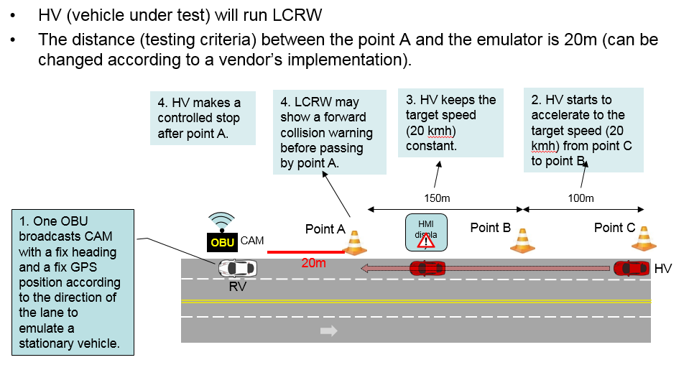
Use Case #7 Longitudinal Collision Risk Warning
– Stationary Vehicle

Slide 27

Use Case #8
Monitored loading/unloading zone
A network of smart camera or presence sensors monitors the occupancy of a loading zone
A RSU is able to receive the information and to propagate Point of Interest notification for each free parking slot
4 | [O] RSU forwards the information to the C-ITS Station which monitors the occupancy of parking lots.
Central ITS-S [optional]
1 | The smart camera signals an empty slot in the loading unloading zone.
2 | RSU receives the occupancy status of a set of parking slots and propagates a Point of Interest notification with all empty slots.
Standard IoT protocols
On-Board display
Driver Information
5.9 GHz Air Link
3 | The vehicle shows the information to the driver.
C2X
On-Board Unit

Slide 28
Use Case #9
Mitigation of interferences with tolling equipment
A tolling equipment for testing purposes is deployed, ETSI ES 200 674-1 compliant
A RSU is able to send CAM with an appropriate ProtectedCommunicationZone content, to protect the tolling zone
Approaching OBUs are able to receive and consume the CAMs following the procedures defined in ETSI TS 102 792
The vehicle, having also on board ETSI 200 674-1 OBU, enters the tolling protected zone and applies mitigation techniques
The ETSI 200 674-1 DSRC transaction is executed with no interferences and no packet loss perceived by the ETSI 200 674-1 RSU
TCC
Central ITS-S
4 | TCC listens to ETSI 200 674-1 communication to check the correct transaction and to detect packet losses
1 | RSU in proximity to the ETSI 200 674-1 tolling equipment disseminates CAMs with appropriate protectedCommunicationZone
5.9 GHz Air Link
ETSI 200 674-1
Road-Side Unit
3 | When the vehicle enters the protected zone, CITS communications enter coexistence mode and ETSI 200 674-1OBU executes its transaction.
ETSI 200 674-1
On-Board Unit
C2X
On-Board Unit
ETSI 200 674-1
On-Board Unit
2 | An approaching OBU receives and consumes the CAM
5.8 GHz Air Link
Protected Communication Zone

Slide 29

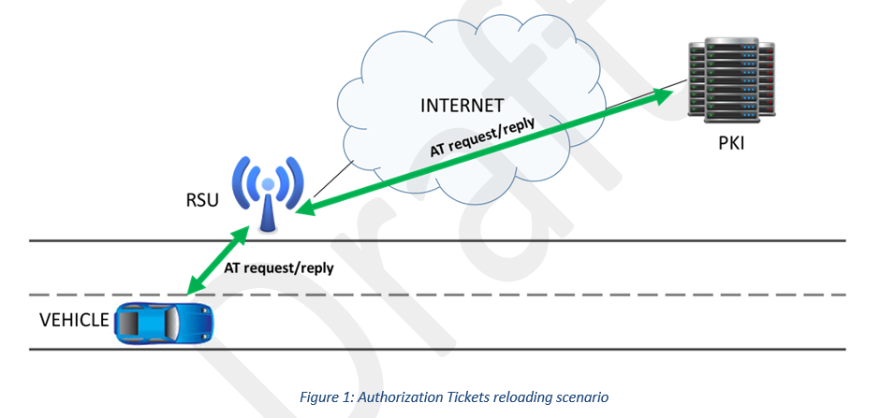
Use Case #10
Authorization Tickets Reloading
RSU Operator Backend
C2C-CC protocol via TLS
AT request / reply
ISE protocol
AT request / reply

Slide 30

Contact Details:
Sebastian MULLER
Project Manager
sebastian.mueller@etsi.org
http://www.etsi.org/news-events/events/1054-plugtests-2016-itscms5
Thank you!

