Slide 1
Eine vernetzte Welt – nur mit Standards realisierbar!
Dirk Weiler, Chairman of the Board and IPR Special Committee, ETSI Head of Standards Policy, Nokia
Zukunftsdialog: FutureStandardsNow – Industrie 4.0
15. März 2017, Austrian Standards

Slide 2
European Strategy for Digital Transformation?
Digital Transformation affects everybody
Government
Industry
Society
Consumer
Today’s digital industry is global
Digital transformation can only be global
Need to work together by setting regional, national and European priorities
No Europe only/ first /second
Cooperation between all relevant stakeholders needed

Slide 3
European Single market and Standardization
Standardisation Policy
Standardisation Regulation 1025/2012
Single Market Strategy
Joint Initiative on Standardisation
Digital Single Market Strategy
ICT standardization
European Multi Stakeholder Platform on ICT Standardisation
Standardisation Priorities for the DSM

Slide 4
Standardization – Business considerations
For-profit organizations prefer monopoly over standard
Proprietary solution – no need for consensus building
Economies of scale
More brain power
Customer pressure for competition
Government pressure against lock-in

Slide 5
Some reasons to participate
Ensure interoperability
Drive your technology of choice into the standard
Access to leading-edge ICT knowledge
Opportunities to meet and influence your customers & competitors
Direct insight into critical issues, including regulatory & spectrum matters, and the ability to influence them
Contribute the views of your constituency (e.g. environment, users, social interests, governmental interests, SMEs)

Slide 6
Contribution of Standardization to GDP
Country | Publisher | Time frame | Growth rate of GDP | Contribution of standards
Germany | DIN (2000) | 1960–1996 | 3,30% | 0,90%
France | AFNOR (2009) | 1950–2007 | 3,40% | 0,80%
United Kingdom | DTI (2005) | 1948–2002 | 2,50% | 0,30%
Canada | Standards Council of Canada (2007) | 1981–2004 | 2,70% | 0,20%
Australia | Standards Australia (2006) | 1962–2003 | 3,60% | 0,80%
Source: The Economic Benefits of Standardization, DIN, 2011
http://alt.din.de/sixcms_upload/media/2896/GNN_2011_engl_FINAL.pdf
Further information (ISO/IEC)
http://www.standardsinfo.net/info/benefits/benefits_s1.html

Slide 7
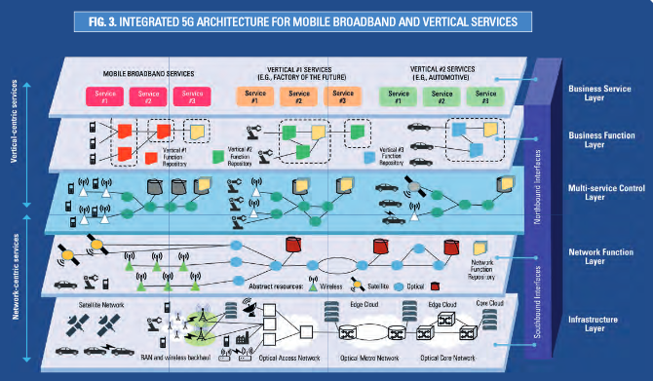
Mobile Communication
https://www.gsmaintelligence.com/
https://5g-ppp.eu/wp-content/uploads/2016/02/BROCHURE_5PPP_BAT2_PL.pdf

Slide 8
ETSI’s creation
Mid 80’s
Emergence of mobile communications (the GSM success story)
Political and industrial will to work on a common set of standards for Europe
Industry in the driving seat
European
Commission
CEPT
(EU Conference of Posts
& Telecommunications)
MoU (1988)
Notes:
8

Slide 9
European Standardization Organisations (ESO) (EU Regulation 1025/2012)
ASI
Austrian Standards Institute
ÖVE
Österreichischer Verband für Elektrotechnik
CEN
European Committee for Standardization - All other domains - National delegation
CENELEC
European Committee for Electrotechnical Standardization
- Electro-technical - National delegation
ETSI
European Telecommunications Standards Institute - ICT - Direct participation
Vienna agreement
1991
Dresden/Frankfurt
agreement
1996/2016
Working
relationships
ISO
IEC
ITU
(T, R & D)

Slide 10
The three dimensions of ETSI business
Standards in support of EU regulation
Standards for global ICT markets
Service provision

Slide 11
ETSI’s Basic Principles
ETSI's fundamental values with regard to the work it undertakes are timeliness, quality and responsiveness to market needs
ETSI is inclusive with a global membership representing a wide range of stakeholders, a global network of partnerships and a consensus approach in its working methods
ETSI is fully compliant with WTO/TBT provisions and EU Regulation (EU) 1025/2012
ETSI works across all sectors of industry and society that make, use or rely on ICT technology
ETSI works at the forefront of developing and emerging technologies
ETSI produces technical standards aimed at being adopted by the most competitive markets
ETSI promotes the adoption of its technical standards worldwide for the benefit of its members' competitiveness
ETSI, in its role as an ESO, provides technical standards supporting EU regulatory requirements and policy
ETSI produces technical standards that use spectrum effectively, minimise interference and avoid undesirable effects, in accord with appropriate regulatory frameworks

Slide 12
ETSI’s Product, services and collaboration
Technical specifications and standards with global application
Support to industry and European regulation
Specification & testing methodologies
Interoperability testing
113 Partnership agreements

Slide 13
ETSI’s Vison, Mission and Strategic Objectives
VISION
ETSI is a leading standardization organization for
Information and Communication Technology (ICT)
standards fulfilling European and global market needs
MISSION
To provide the platforms where interested parties come
together and collaborate on the production of standards
for Information and Communication Technology (ICT)
systems and services that are used globally
Strategic Objectives
Being at the Heart of Digital
Being an Enabler of Standards
Being Global
Being Versatile
Being Inclusive
ETSI LTS 2016-2021

Slide 14
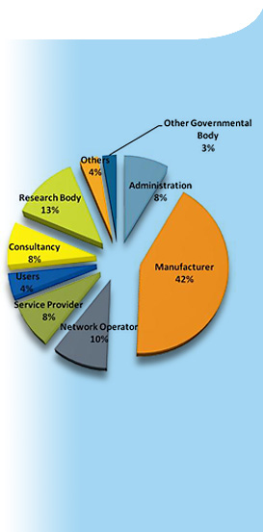
ETSI Membership
800+ members, big and small, from 67 countries on 5 continents
Austria: 17 members
Manufacturers, network operators, service and content providers, national administrations, ministries, universities, research bodies, consultancies, user and societal organizations
A powerful and dynamic mix of skills, resources and ambitions

Slide 15
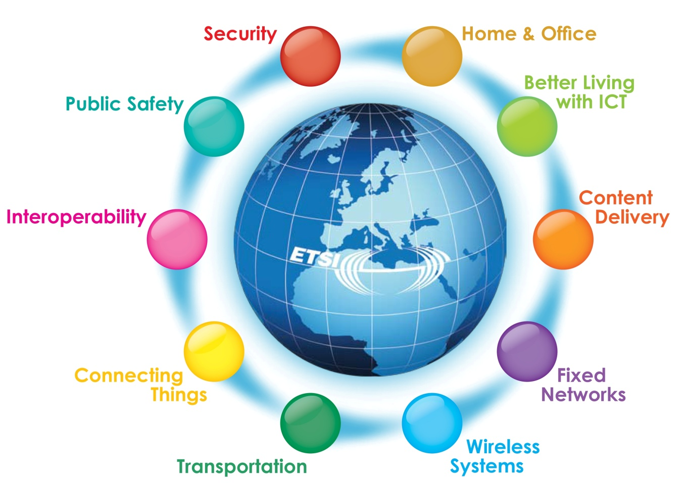
ETSI Clusters
http://www.etsi.org/technologies-clusters/clusters

Slide 16
ETSI is the home of many diverse technologies
2G, 3G, 4G, 5G Mobile Communications
Air Traffic Management
Automotive Radar
Autonomic Systems
Body Area Networks
Broadband Wireless Access
Broadcasting
Cable Networks
Cloud Technology
Cognitive Radio
Content Delivery
Cross-cutting Context Information Management
Cyber Security
DECT™
Digital Mobile Radio
Digital Rights Management
eHealth
Electromagnetic Compatibility
Electronic Signatures
Emergency Communications
Energy Saving
Environmental Aspects
Experiential Network Intelligence
Fixed-line Access
Fixed Radio Links
Human Factors
IMS Network Testing
Intelligent Transport
Internet of Things
Interoperability
Lawful Interception
Low Power Radio
Machine-to-Machine Communications
Maritime Communications
Media Content Distribution
Millimeter Wave Transmission
Multi-access Edge Computing
Network Functions Virtualisation
Next Generation Networks
Open Source Software
Powerline Communications
Protocols
Public Safety Systems
Quality of Service
Quantum Key Distributi on
Quantum-Safe Cryptography
Radio Regulations
Radio Systems
Railway Communications
Safety
Satellite Communications
Security Algorithms
Short-range Radio
Smart Appliances
Smart Cards
Soft ware Defined Radio
Telemedicine
Testing
Terrestrial Trunked Radio (TETRA)
Wireless Medical Devices
DECT
Annual report (http://www.etsi.org/images/files/AnnualReports/etsi-annual-report-april-2016.pdf)
Work program (http://www.etsi.org/images/files/WorkProgramme/etsi-work-programme-2016-2017.pdf)

Slide 17
Main Characteristics of ETSI IPR Policy
Focus on the most suitable technology for the standards.
Early identification and disclosure of essential IPRs, especially in cases where the holder of essential IPR is not prepared to grant licences under FRAND terms and conditions.
Ensuring the future applicability of the standards by requesting irrevocable FRAND licensing undertaking.
IPR holders should be adequately and fairly rewarded for the use of their IPRs in the implementation of STANDARDS and TECHNICAL SPECIFICATIONS.
No involvement of ETSI in any commercial discussion on IPR matters (i.e., terms and conditions of the licenses to be determined by the parties of the agreement).
These characteristics are well aligned with the policy objectives of CEN and CENELEC as published in their policy paper

Slide 18
The 3rd Generation Partnership Project
Europe
Cellular telecommunications network technologies covering Radio access, Core transport network and Service capabilities - including codecs, security, QOS
Provides complete system specifications, also providing hooks for non-radio access to the core network and interworking with Wi-Fi networks
3GPP (launched 1998) is a partnership project of regional standards organizations, currently 7 Organizational Partners (OP), it is not an official standards body.
3gpp.org
Japan
North America
Japan
China
Korea
India

Slide 19
The 3rd Generation Partnership Project
3GPP produces Technical Specifications (TS)
TS are transposed by the OPs into official standards
Companies participate as Individual Members (IM) via an OP (535 IM today)
3GPP has 16 Market Representation Partners (MRP)
Offer market advice, bring a consensus view of market requirements

Slide 20
oneM2M
oneM2M was launched in 2012 as a global initiative to ensure the most efficient deployment of Machine-to-Machine (M2M) communications systems and the Internet of Things (IoT).
Its aim is to develop technical specifications for a common M2M Service Layer that can be embedded within various hardware and software to connect the wide range of devices worldwide with M2M application servers.
onem2m.org

Slide 21
oneM2M
Partner Type 1
Europe
North America
A partnership project of currently:
8 partner type 1 (regional standards organizations)
6 partner type 2 (4 globally active industry consortia, 2 regional standards organizations)
209 Members
Any legal entity with interest in the development and/or implementation of oneM2M Technical Specifications and Technical Reports. Members must be members of a Partner Type 1 and must agree to that partner's IPR policy.
7 Associate Members
Any government or regulatory agency that has an interest in oneM2M, with the right to attend and provide input to meetings of the Technical Plenary and its subgroups, limited to clarifications regarding regulatory matters and informational contributions.
Japan
China
Korea
India
Partner Type 2

Slide 22
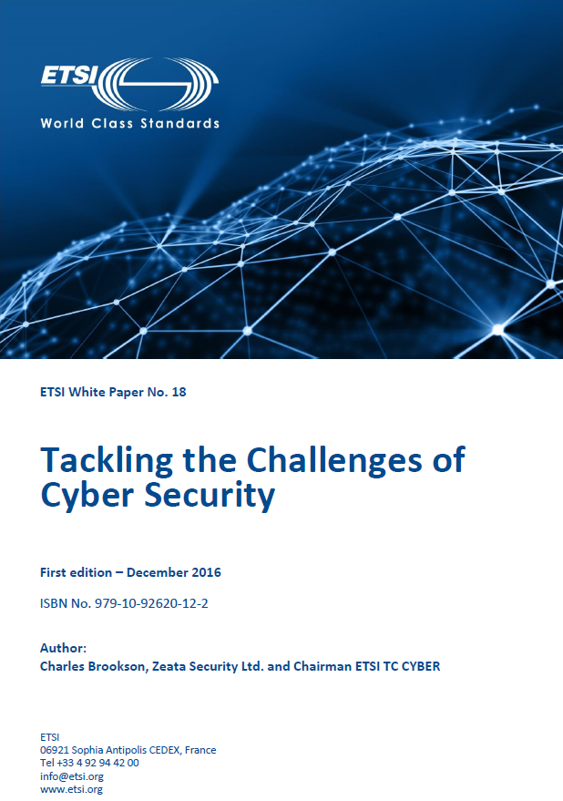
2016 security standardization white paper
Security standardization, sometimes in support of legislative actions, has a key role to play in protecting the Internet, the communications and business it carries and both the private and corporate users who rely on it.
The timing of the standardization of new technologies, products and services is particularly important; we need to make our ICT secure from the start, as well as throughout their lifetime.
There are many organizations worldwide working on Cyber Security, and co-ordination and liaison is important to ensure that we all pull together and do not duplicate our efforts.
Security White Paper 2016

Slide 23
Summary
Digital Transformation affects everybody
No single body can produce the necessary standards
SDO’s have different memberships, ways of working
Cooperation between all relevant stakeholders needed
ETSI has a track record of cooperation with all relevant stakeholders

Slide 24
Contact
Dirk.weiler@nokia.com
ETSI: info@etsi.org
Thank you!

