Slide 1
ITUWebinars
Second Joint ETSI ISG F5G, BBF, CCSA TC6 and ITU-T SG15
Workshop on“FTTR”
Fibre-to-The-Room (FTTR)
22 June 2022
14:00 – 18:00 CEST
https://itu.int/go/FTTR-2
Co-organized by

Slide 2
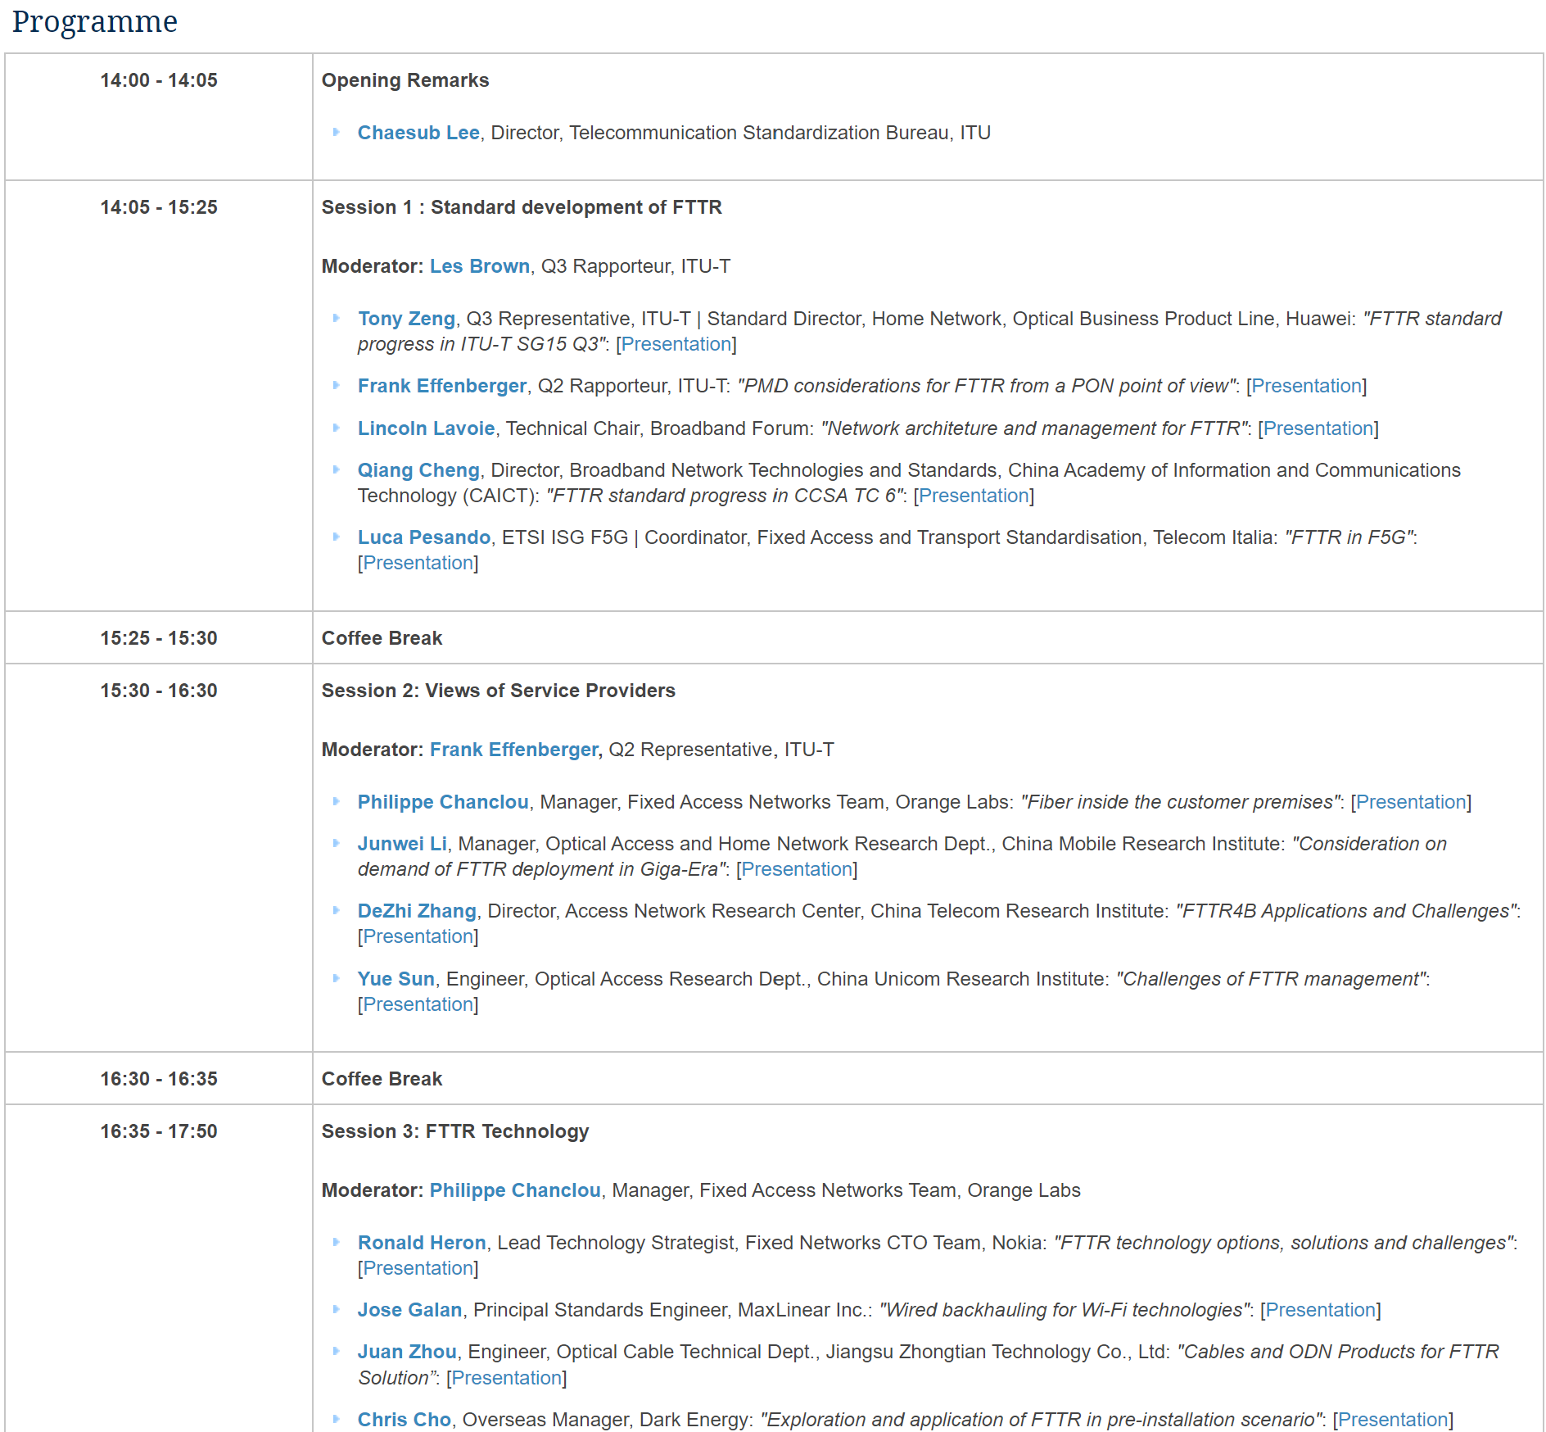
Detail Agenda for the “4-party Joint FTTR Workshop”
Part 1: SDOs perspective
Part 2: Operators perspective
Part 3: Technologies perspective
You can watch the recorded video and download all the material via:
https://www.itu.int/en/ITU-T/Workshops-and-Seminars/2022/0628/Pages/default.aspx

Slide 3
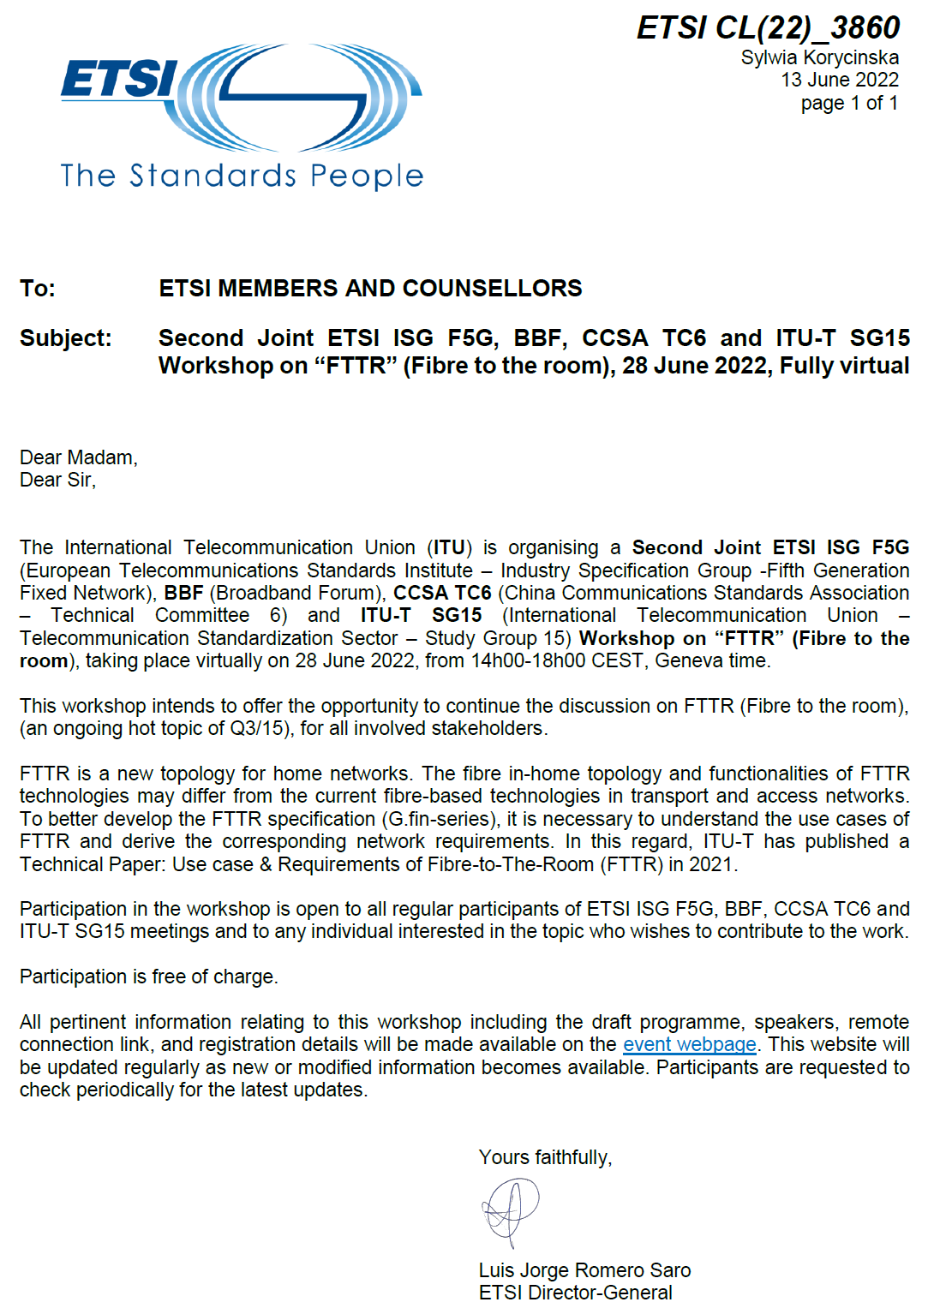
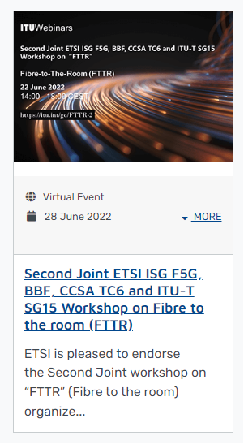
Collective letter by ETSI DG and news release in ETSI portal
News release in ETSI portal:
ETSI - Second Joint ETSI ISG F5G, BBF, CCSA TC6 and ITU-T SG15 Workshop on Fibre to the room (FTTR)
https://www.etsi.org/events/2084-2022-06-2nd-ws-fttr

