Slide 1
Open Source Projects Collaborations with ONAP
ShiTao Li, Huawei
Rapporteur of ETSI GS NFV-SOL 001
2018-09-21

Slide 2
Topics
ETSI NFV descriptor model is used in ONAP
Collaboration between ETSI NFV and ONAP members

Slide 3
ETSI NFV descriptor model is used in ONAP

Slide 4
ONAP: onboard ETSI NFV VNF: ETSI GS NFV-SOL 001 & ETSI GS NFV-SOL 004
Onboarding
Composition
Orchestration
Operation
ETSI GS NFV-SOL 001
ETSI GS NFV-SOL 004
ONAP internal DM
ONAP internal DM
ONAP internal DM
HEAT
ONAP DM
DM: Data model
On boarding time: support multiple options,
ETSI GS NFV-SOL001 & ETSI GS NFV-SOL004 based model is one of the options
Run time: 2 internal DM options,
ONAP R2+ Design-Time Resource DM clean version (based on ETSI GS NFV-SOL001 ) enhancement for VoLTE, vCPE (stretch goal)
ONAP SDC TOSCA AID enhancement for vCPE

Slide 5
Two internal DMs used in ONAP R2 and R3
Based on ECOMP
~40 node types, ~60 data types
Implemented by using HEAT + TOSCA
Supported by vCPE use case
Using heat model as on-boarding model
https://wiki.onap.org/display/DW/SDC+Data+model
SDC AID model
Introduced by many ETSI NFV members
Reference ETSI NFV specs (ETSI GS NFV-IFA011, ETSI GS NFV-SOL001)
~10 node types, ~40 data types
Implemented by using TOSCA
Supported by VoLTE use case
Same with on-boarding model
ONAP R2+ Design-Time Resource DM clean version
R2/R3 Model

Slide 6
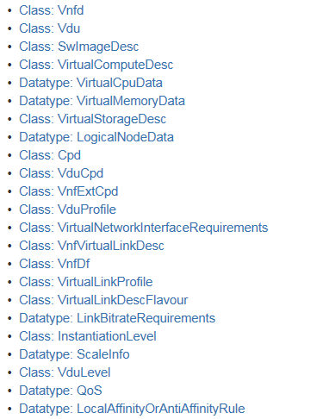
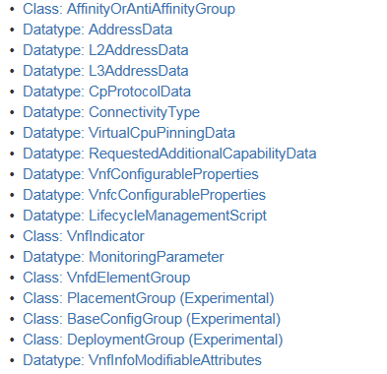
ONAP R3(Casablanca release) Model
This model is based on ETSI GS NFV-IFA011 v 2.4.1 and ETSI GS NFV-SOL001 v 0.6.0.
Support only one VNF deployment flavour
Support VnfExtCpd exposed by VduCpd
Does not support scalingAspect
Does not support instantiation level
Does not support VNF lifecycle interface
https://wiki.onap.org/display/DW/ONAP+R3+Resource+Design+Time+Model+Clean+Version

Slide 7
ONAP R3 extends
Those are the examples that ONAP R3 Model adds new properties on top of the ETSI NFV model.
https://wiki.onap.org/display/DW/ONAP+R3+Resource+Design+Time+Model+Clean+Version

Slide 8
Collaboration between ETSI NFV and ONAP members

Slide 9
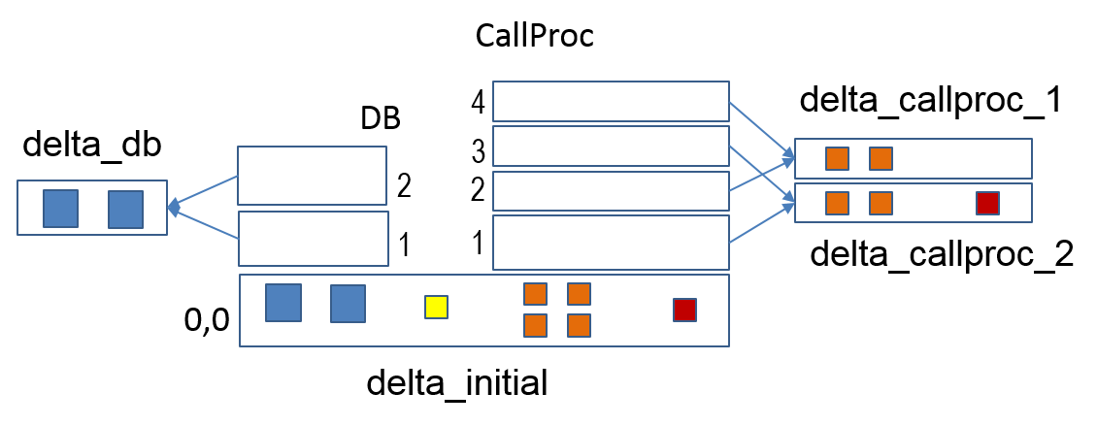
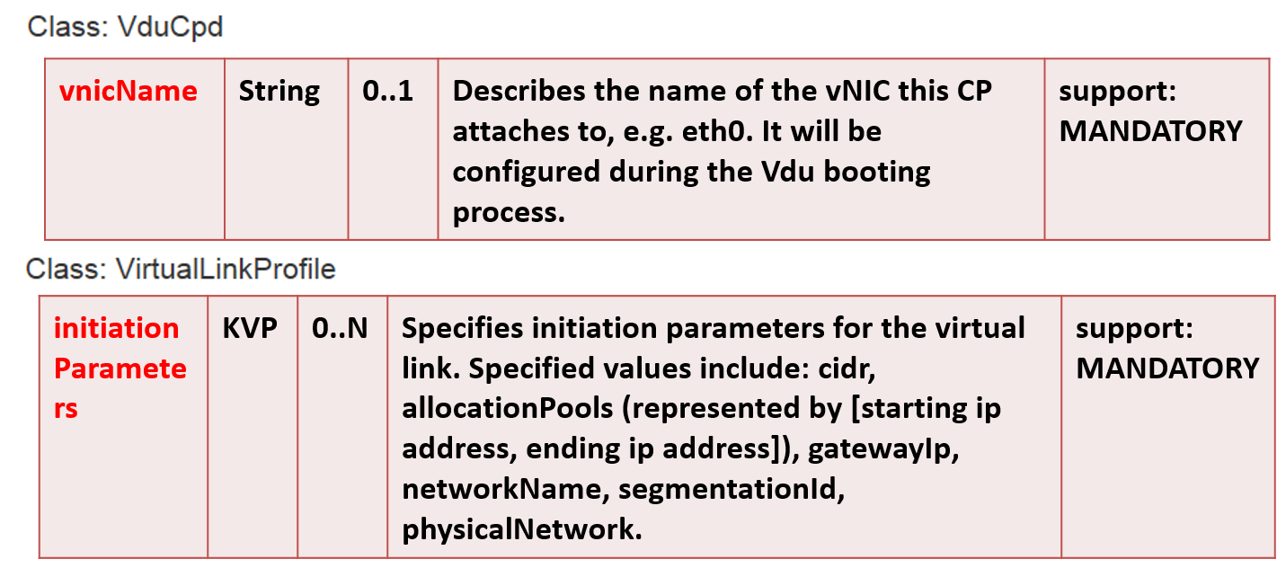
Collaboration Between ETSI NFV and ONAP members
ETSI NFV updates the scaling model, so it can be easily mapped to the SDC AID model.
VF module
Add-on module
Base module
Some of the ONAP requirements are accepted by ETSI NFV spec also.

Slide 10
ONAP: onboarding ETSI NFV VNFD
Service Designer enriches the “VNF 1” model to describe the input level data that must be supplied with the instantiation request to configure the application data, optimization information for specific network cloud environments, and the data transformation and mapping to VNF configuration API(s).
Service Designer defines the “Service A’” model which includes VNF 1’. Included is the definition of the input level data that must be supplied with the Service A instantiation request, and the associated data transformation and mapping to the VNF 1’ “deployment data” and “application data”.
ONAP Design-time
VNF 1
SOL004 (VNF Package) SOL001 (VNFD)
Translate
Enrich
ONAP Run-time
ONAP SD, VNFD
Translation involves creating an equivalent VNF model in ONAP based on the formal ETSI spec. I.e., translation results in an ONAP representation of VNF 1 (blue) that has only “deployment data” specified.
Service A’
VNF 1’

Slide 11
Thank you!

