Slide 1
TST Working Group Update
Silvia Almagia, ETSI CTI Pierre Lynch, Ixia/Keysight, TST WG Chair

Slide 2
Agenda
ETSI NFV Plugtests + OPNFV Plugfest
TST WG Activities

Slide 3









3rd NFV Plugtests & OPNFV PLUGFEST
&
#OPNFVplugfest

Slide 4

Preparation
15 -19 January 2018
2nd NFV Plugtests, ETSI
Sophia Antipolis (FR)
26 February
12 March
22 March
31 March
14 May
29 May – 8 June 2018
3rd NFV Plugtests, ETSI
Sophia Antipolis (FR)
17 September
Demos
Update to ZERO TOUCH & CARRIER AUTOMATION CONGRESS, Madrid
2nd Plugtests Report to NFV#21
Update to NFV#22
3rd Plugtests Report to NFV#23
Plugfest
On-site presence (PLU2)
Remote Testing
PLU2 Report Review
Registration
Pre-testing
On-site presence (PLU3)
PLU3 Report Review
R. intg
Regular conf-calls

Slide 5
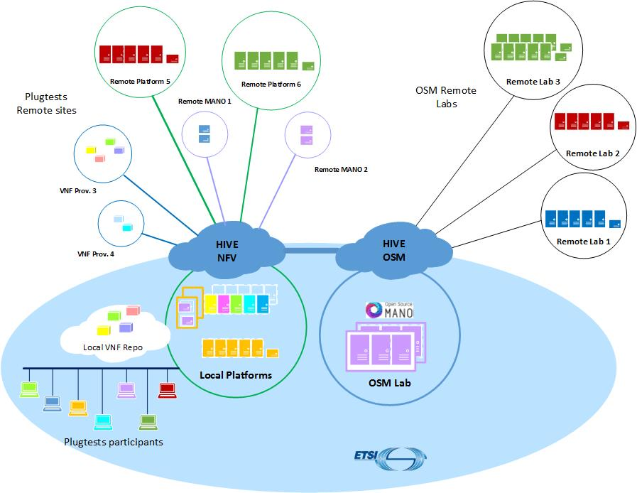
HIVE – Several Options
Connect as NFV Plugtests Programme participant
Connect as OSM remote lab
Bring HW to ETSI (from the remote integration phase March 2018)

Slide 6
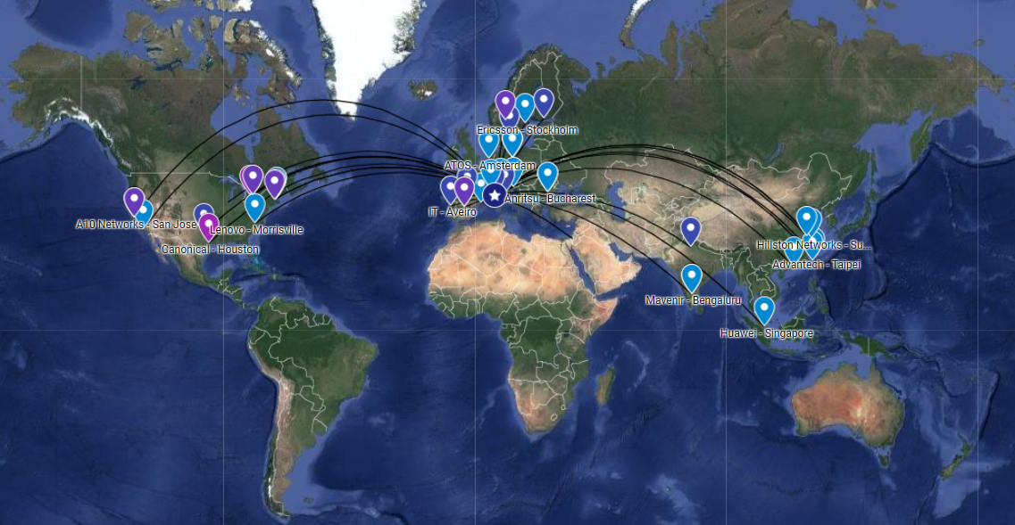
NFV Plugtests HIVE – 46 remote sites

Slide 7
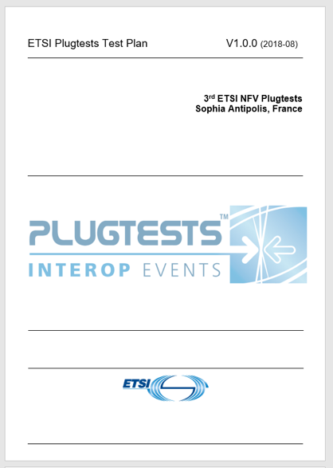
Interoperability Test Sessions
  3rd NFV Plugtests Test Plan
Pre-scheduled sessions targeted multi-vendor NS:
  Several parallel Test Sessions, 1 per MANO solution
  1 MANO, 1 VIM&NFVI, 2+ VNFs from different providers
Additional sessions:
  Single VNF NS (~pre-testing)
  EPA
  Multi-site (2+ VIM&NFVIs)
  Specific VNFM (Direct/In-direct mode)
  Scale to level
  VNF-FG, SFC
  Auto LC Validation

Slide 8
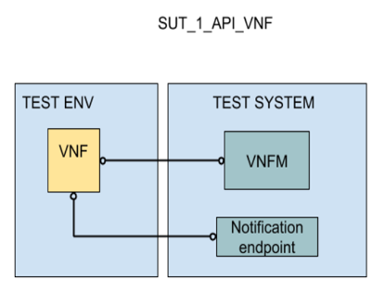
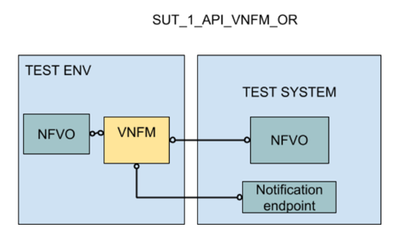
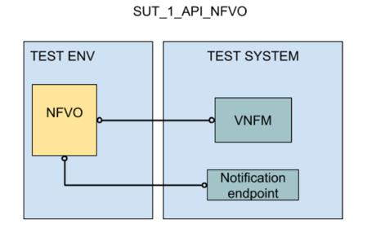
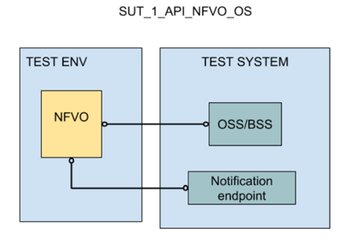
API Testing
Postman collections for SOL002, SOL003 and SOL005
Implementation Under test <-> Test System
Interface | Specification | Producer | Web editor
SOL003-VirtualisedResourcesQuotaAvailableNotification-API | SOL003 | NFVO | Link
SOL003-VNFFaultManagementNotification-API | SOL003 | NFVO | Link
SOL003-VNFIndicatorNotification-API | SOL003 | NFVO | Link
SOL003-VNFLifecycleOperationGranting-API | SOL003 | NFVO | Link
SOL003-VNFPackageManagement-API | SOL003 | NFVO | Link
SOL003-VNFPerformanceManagementNotification-API | SOL003 | NFVO | Link
SOL002-VNFConfiguration-API | SOL002 | VNF | Link
SOL002-VNFIndicator-API | SOL002 | VNF/EM | Link
SOL002-VNFIndicatorNotification-API | SOL002 | VNFM | Link
SOL003-VNFFaultManagement-API | SOL003 | VNFM | Link
SOL003-VNFIndicator-API | SOL003 | VNFM | Link
SOL003-VNFLifecycleManagement-API | SOL003 | VNFM | Link
SOL003-VNFPackageManagementNotification-API | SOL003 | VNFM | Link
SOL003-VNFPerformanceManagement-API | SOL003 | VNFM | Link
SOL005-NSDManagement-API | SOL005 | NFVO | Link

Slide 9
Participation: 9 Platforms (VIM & NFVI)
Organisations | Name | HW | Location | Short Description
Huawei | OPNFV Compass | OPNFV POD @Huawei | Singapore | OPNFV - OpenStack Ocata + Pike, ODL Nitrogen
Nokia | NCR18 | Nokia | Espoo, Finland
Red Hat | Red Hat OpenStack Platform | Lenovo OCP ‘OP@L’ POD | NC, USA | OpenStack Newton
Red Hat | Red Hat OpenStack Platform | QCT @ETSI | France | OpenStack Newton
SUSE | OPNFV XCI (Open SUSE) | POD @UNH IOL | NH, USA | OpenStack Queens + ODL Oxygen
Whitestack | WhiteCloud | Intel remote POD | USA | OpenStack Pike + ODL Carbon
Wind River | Titaniun Cloud R4 | Wind River @OSM Remote Lab | Hudson, MA, USA | OpenStack Newton + OF 1.3
Wind River | Titaniun Edge | Advantech remote POD | Taipei Taiwan | OpenStack Pike + OF 1.3
Wind River | Titaniun Cloud R4 | Lenovo OCP ‘OP@L’ POD | NC, USA | OpenStack Pike + OF 1.3

Slide 10
Participation: 10 MANOs (NFVO & VNFM)
Organisations | Name | Location | Short Description
Altice Labs Atos Demokritos iMEC | SONATA | Spain/ Netherlands | Open Source SONATA NFVO + Generic VNFM
Cisco | NFVO | Sweden | Cisco NFVO and Elastic Services Controller
EnterpriseWeb | EnterpriseWeb | USA/Canada | Microservice-based NFVO + Generic VNFM
Ericsson | Cloud Manager | New Jersey, USA | MANO Orchestrator, Generic VNFM,
Huawei | CloudOpera Orchestrator NFV | Xi'an/China | NFVO + Generic VNFM
Luxoft | SDL | Romania | NFVO + Generic VNFM
Netcracker | Hybrid Orchestrator | Waltham, MA | NFVO + Generic VNFM
RIFT.io | RIFT.ware | USA | Carrier Grade NFVO + Generic VNFM
Ubiqube | OpenMSA | Ireland | Network and Security Automation Framework
Whitestack | WhiteNFV | USA | OSM Rel FOUR distribution (NFVO + Generic VNFM)

Slide 11
Participation: 19 VNFs
Organisation | Solution | Team Location | Short Description
A10 Networks | vThunder | USA/Germany | Virtual traffic detection function: CGN, ADC, FW, Security
Anritsu | Master Claw vProbe | Romania/Czech Republic | Virtual Probe for Customer Service Assurance
Athonet | vEPC | Italy | Virtual EPC
Citrix | VPX + MAS | UK / India | Virtual ADC + Management, configuration, anaytics
EANTC | NFV Test Function | Germany | Traffic generator
Fortinet | FortiGate | France | FW, Security
Hillstone Networks | CloudEdge | China/USA | NGFW, Security
IT Aveiro | Heimdall Web | Portugal | SFC-MITM VNF to accelerate SSL/TLS processing (cloud-based)
IT Aveiro | Heimdall Hybrid Web | Portugal | SFC-MITM VNF to accelerate SSL/TLS processing (hybrid: part cloud, part edge)
Italtel | iRPS | Italy | Centralized Routing Engine
Keysight | IxLoad | USA/Romania | Application traffic simulator
Keysight | IxNetwork | USA/Romania | Traffic generator
Keysight | BPS | USA/Romania | Application traffic simulator
Mobileum | vNTR | India | Virtual NTR, Roaming
ng4T | NG40 vTester | Germany | Simulator, functional, capacity and load vTester
OpenAirInterface SA Eurecom | OAI-EPC | France | EPC Network Functionality
Spirent | Avalanche Virtual | California, USA | L4-7 Traffic generation and analysis
Spirent | TestCenter Virtual | California, USA | Traffic Generator, Traffic Analyzer, Capture, Control Plane emulator

Slide 12
27 Multi-vendor NS
NS Name | VNFs
NS1:A10 vThunder+FortiGate+STCv | vThunder (A10) FortiGate (Fortinet) TestCenter Virtual (Spirent)
NS2:A10 vThunder+STCv | vThunder (A10) TestCenter Virtual (Spirent)
NS3:A10 vThunder+IxLoad | vThunder (A10) IxLoad (Keysight)
NS4:A10 vThunder+EANTC | vThunder (A10) TestVNF (EANTC)
NS5:ng4T+OAI | vEPC (OAI) vTester (ng4T)
NS6:Athonet+IxLoad | vEPC (Athonet) IxLoad (Keysight)
NS7: Italtel+Anritsu | iRPS (Italtel) MasterClaw (Anritsu)
NS8: IT Aveiro+FortiGate | Heimdall Web (IT Aveiro) FortiGate (Fortinet)
NS9: Hillstone+Mobileum | CloudEdge (Hillstone) vNTR (Mobileum)
NS10:Citrix+STCv | vPX (Citrix) STCv (Spirent)
NS11:Athonet+ng4T | vEPC (Athonet) vTester (ng4T)
NS12:Anritsu+ng4T | MasterClaw (Anritsu) vTester (ng4T)
NS13:A10 vThunder+ng4T | vThunder (A10) vTester (ng4T)
NS14: Athonet+STCv | vEPC (Athonet) STCv (Spirent)
NS Name | VNFs
NS15: Citrix+EANTC | vPX (Citrix) TestVNF (EANTC)
NS16: FortiGate+STCv | FortiGate (Fortinet) STCv (Spirent)
NS17: FortiGate+Mobileum+STCv | Fortigate (Fortinet) vNTR (Mobileum) STCv (Spirent)
NS18: Italtel+IxLoad | iRPS (Italtel) IxLoad (Keysight)
NS19: Anritsu+Spirent | MasterClaw (Anritsu) STCv (Spirent)
NS20: Anritsu+IxLoad | MasterClaw (Anritsu) IxLoad (Keysight)
NS21: Mobileum+STCv | vNTR (Mobileum) STCv (Spirent)
NS22: Mobileum+IxLoad | vNTR (Mobileum) IxLoad (Keysight)
NS23: FortiGate+EANTC | Fortigate (Fortinet) TestVNF (EANTC)
NS24: Hillstone+IxLoad | CloudEdge (Hillstone) IxLoad (Keysight)
NS25: Italtel+EANTC | iRPS (Italtel) TestVNF (EANTC)
NS26: Mobileum+OAI+ng4T | vNTR (Mobileum) vEPC (OAI) vTester (ng4T)
NS27: vThunder+STCv+nginx | vThunder (A10) STCv (Spirent) nginx (SONATA)

Slide 13
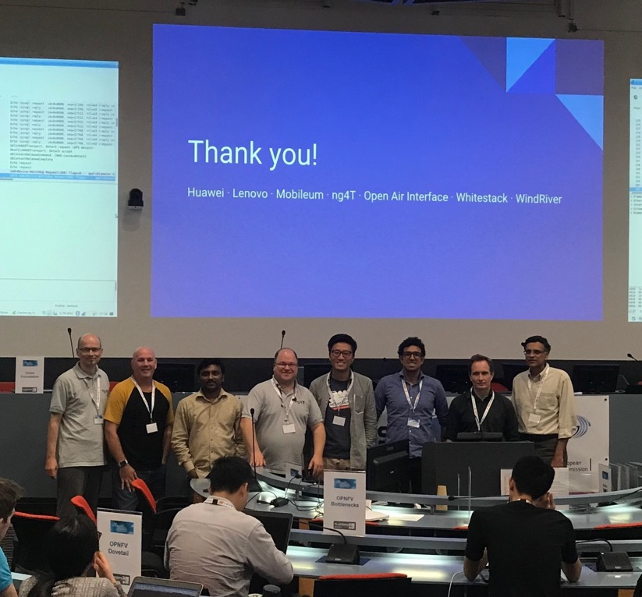
Multi-vendor Demonstrations
Demo 1: Multi-VNF NS Orchestration: LB FW
Participants: A10 Networks, Fortinet, Spirent, Cisco, Wind River, Red Hat, Lenovo
Demo 2: Orchestrated Service Assurance in NFV
Participants: Anritsu, ng4T, Cisco, Wind River, Lenovo
Demo 3: 4G Mobile Network Orchestration
Participants: ng4T, OperAirInterface SA, Mobileum, Whitestack (OSM), Wind River, Huawei (OPNFV), Lenovo
Demo 4: Automated Life Cycle Validation
Participants: Fortinet, Spirent, Cisco, RIFT.io, Wind River
Demo 5: NFV SOL001 and SOL006 Based VNFD Validation
Participants: Enterprise Web, Spirent
Demo 6: Multi-VNF NS Orchestration: LB Web Server
Participants: A10 Networks, Spirent, SONATA (5Gtango), Red Hat, Lenovo

Slide 14
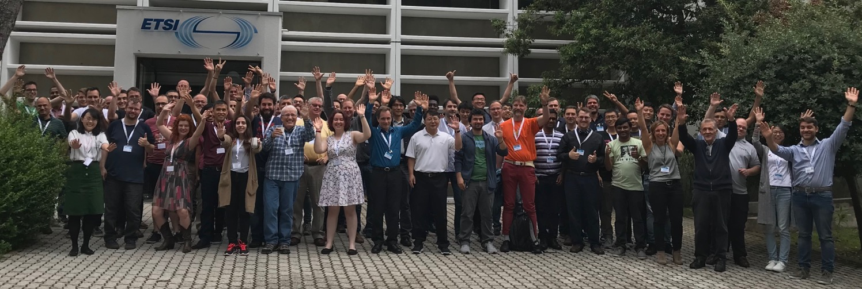
Cross-community synergy & joint activities
Several cross-community activities:
TST009 - Testing specification of networking benchmarks and measurement methods for NFVI
TST010 - API conformance testing specification
NFVI validation track (Dovetail)
OSM integration in OPNFV XCI
NSH based SFC Testing

Slide 15
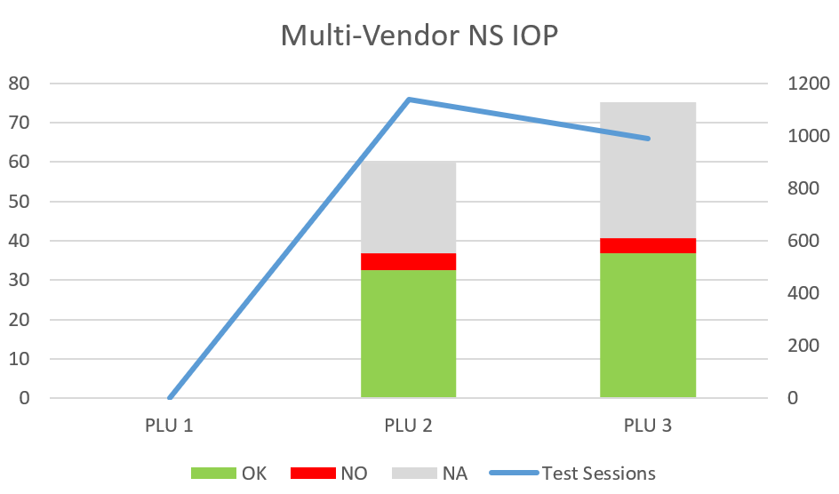
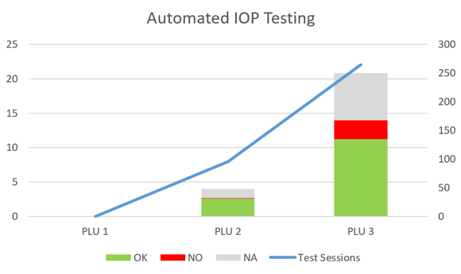
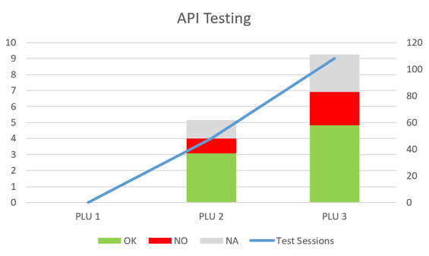
Results Highlights
Most of the interop testing focused on multi-vendor NS
  More Test Cases run in fewer (but longer) Test Sessions
  Interop rates similar to January (slightly higher)
+125% of API testing
  Learnings to guide TST010 NFV Conformance Testing
+175% of automated interop testing

Slide 16
Overall Results

Slide 17
Results per Multi-Vendor NS Sub-Group

Slide 18
API Track: results per Sub-Group

Slide 19
Feedback on NFV (SOL) Specifications
General
  API and Specs versioning
  JSON schema validation and extra fields
  Id vs location
  API readability
SOL002
  Inconsistencies in VNF Instance Ids
SOL003
  Assignment of floating Ips
  Order of connection points
  vnfdId vs vnfPkgId
  VIM Connection info
  extCps vs extLinkPorts
SOL005
  Typos
  PKg Mgmt return types
  NS state

Slide 20
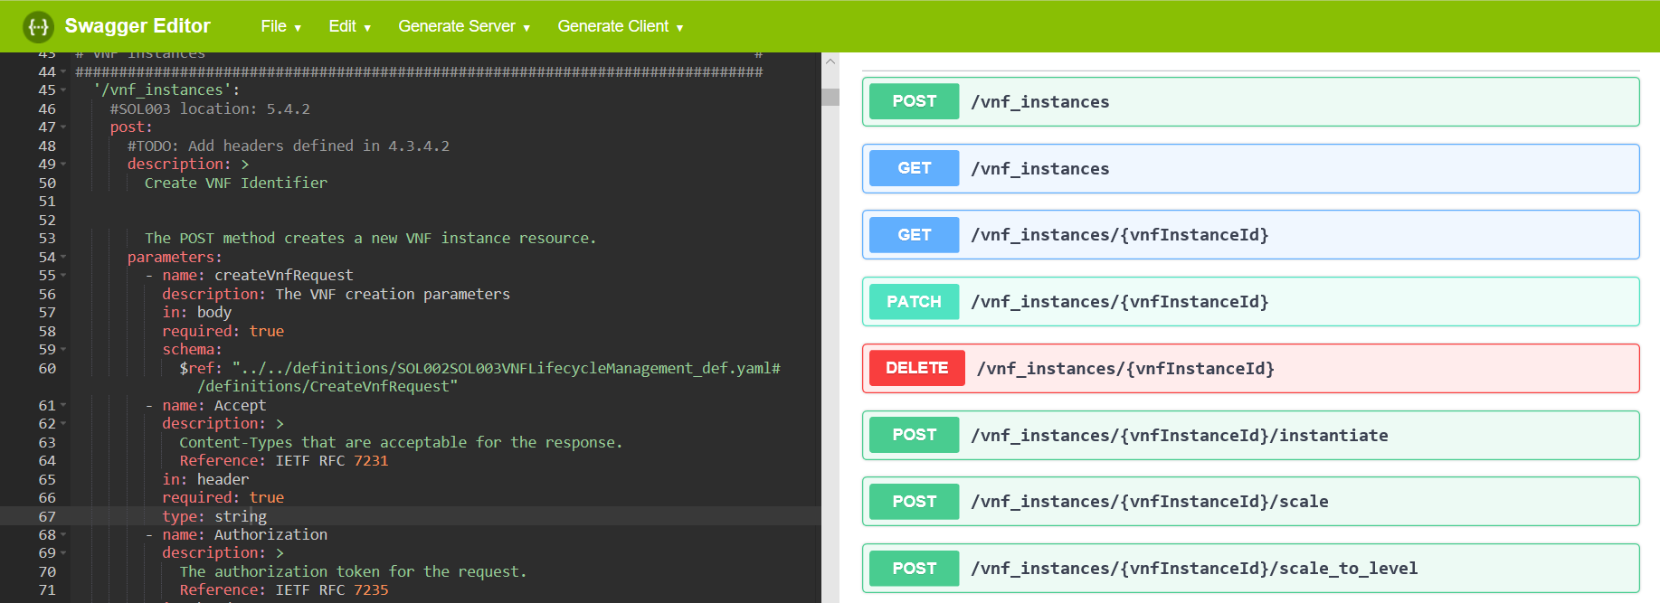
Feedback on OpenAPIs
15 bugs reported (… and fixed ☺)
Recommendation to accept “null” value in optional fields (as many REST libraries do)

Slide 21
Feedback on the Test Plans
Interoperability Test Plan contributed for TST007 maintenance
  30 new / updated Test Descriptions, covering:
    Performance Management
    Fault Management
    NSH based Service Function Chaining
    VNF and NS Scale to Level
Learnings from API Testing provided as input to TST010 and STF 557

Slide 22
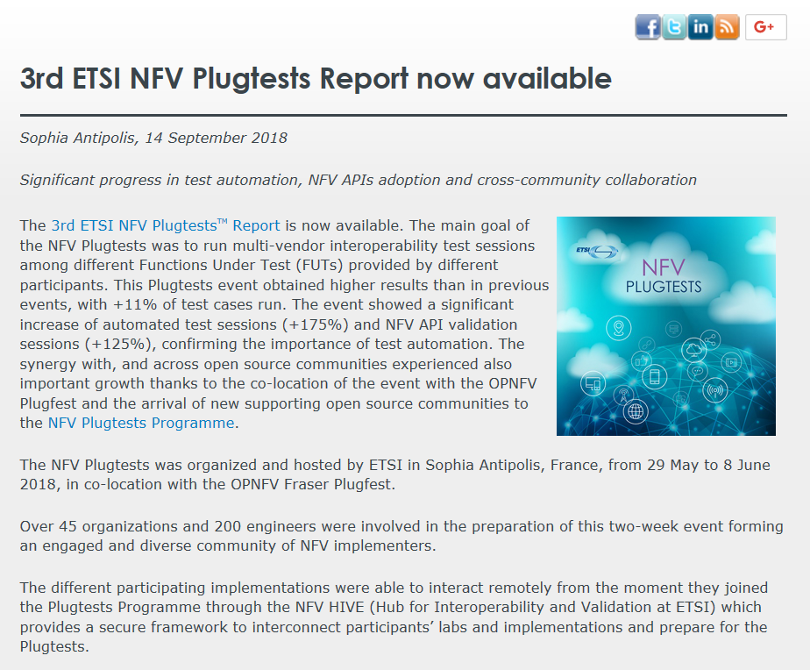
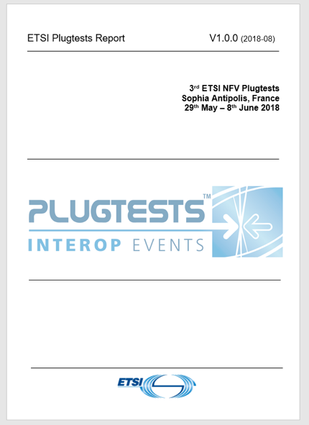

Plugtests & Joint Plugtest/Plugfest Reports
3rd NFV Plugtests Report
Joint ETSI Plugtests & OPNFV Plugfest Report

Slide 23

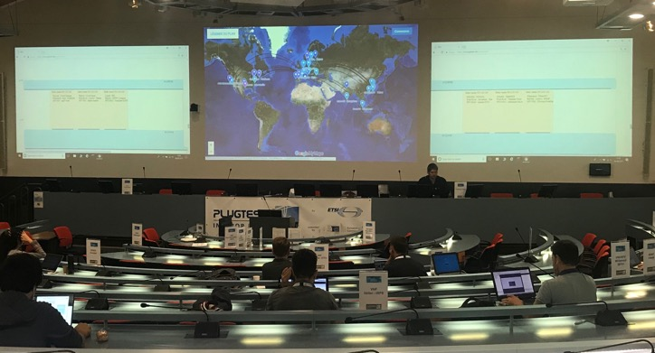
What’s next?
Remote NFV API Plugtests
  Fully remote event
  February – March 2019
  Individual API validation test sessions
    NFV SOL002, SOL003, SOL005
4th NFV Plugtests
  ETSI, Sophia Antipolis (France)
  3-7 June 2019
  Multi-party interoperability test sessions
Stay tuned! www.etsi.org/nfvPlugtestsProgramme

Slide 24
TST WG Activities

Slide 25
TST009 – NFVI Network Benchmarks and Measurement Methods
Expands the Requirements and Methods of RFC2544
  New reality of NFVI platforms are different than dedicated “boxes” of the past
Benchmark definition
Test setups
Test tool requirements
Methods of Measurement
Rapporteur: Al Morton (AT&T Labs)

Slide 26
Benchmarks
For each Benchmark:
}
Throughput
  Offered Load Frame Size
  Offered Load Step Size
  Min Trial Repetition Interval
  Trial Duration
  Max X% Loss Ratio
  Max # of Trials
Latency
Delay Variation
Loss
Background
Name
Parameters
Scope
Units of Measure
Definition
Units of Measure
Sources of Error
Discussion
Reporting Format

Slide 27
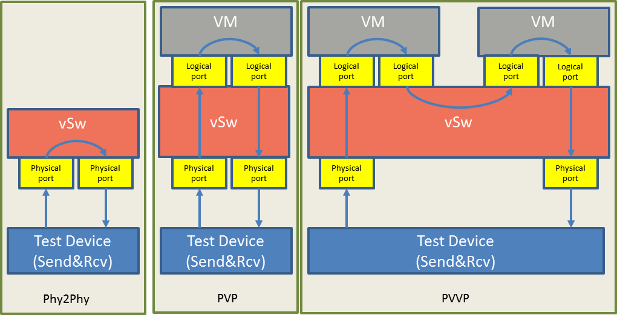
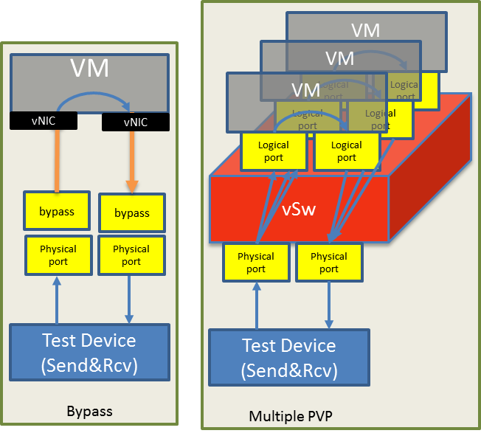
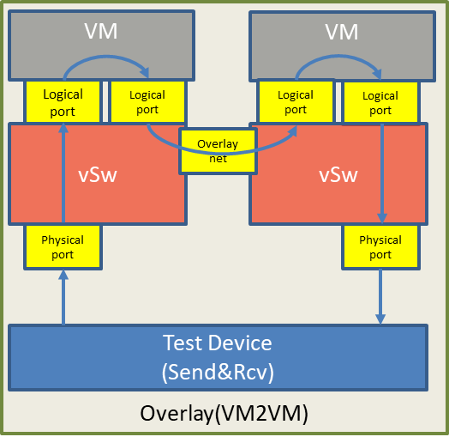
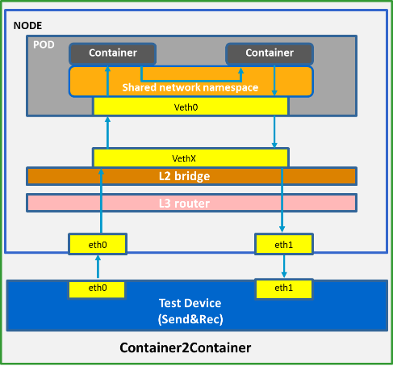
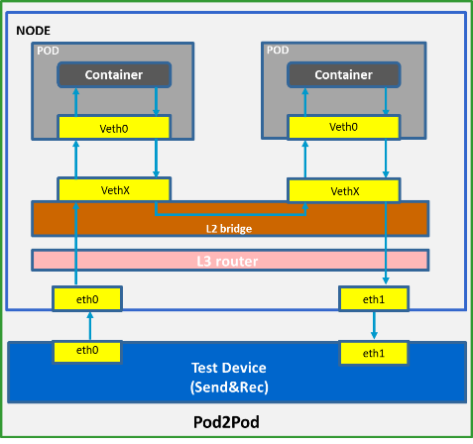
Test Setup Examples

Slide 28
Methods of Measurement: Core Procedures
Method (iterate over multiple frame sizes)
64 oct
128 oct
.256 oct
512 oct
1024oct
1280 oct
1518 oct
Method
Rep #1
Rep #2
Set (multiple repetitions of the same settings from Method)
Set
Meas Goal
Meas Goal
Test (multiple Trials searching for a Measurement Goal)
Test
30 Mfps
45 Mfps
37 Mfps
41 Mfps
43 Mfps
44 Mfps
Trials at different Offered Load levels
Trial

Slide 29


Mitigating Background Processes that Cause Errors (Loss)
0 Mfps
12 Mfps
1 Mfps
2 Mfps
....
11 Mfps
12 Mfps
Resource Exhaust, or Loss
False
False
....
True
True
Questioner
Responder / DUT
Traffic
Generator
~
Error-Free
Resource Limit Exceeded
Messages:
TRUE or FALSE
Traffic
Receiver
RCVR
Background Process Errors
Events per
Unit Time
Error converts FALSE -> TRUE
Error retains TRUE -> TRUE (half-lies)
Because of the nature of NFVI platform
Andrzej Pelc, "Searching games with errors— fifty years of coping with liars ", Theoretical Computer Science 270 (2002) 71–109. Available from https://www.gwern.net/docs/statistics/comparison/2002-pelc.pdf

Slide 30
Binary Search with Loss Verification
Goal
  Separate resource exhaustion and loss due to transient processes
  They are dealt with in separate ways
Solution
  If a trial fails because of loss (< z), run the trial again with the same stimulus (Max (r) = 2)
  Keep trials short to avoid transients
  Isolate loss due to transients
    Run long duration tests to characterize effects and frequency
Prototyped with OPNFV
Showed marked success in repeatability

Slide 31
TST010 – MANO API Conformance Test Suite
For 3 Reference Points:
  Os-Ma-Nfvo - ETSI GS NFV-SOL 005
  Or-Vnfm - ETSI GS NFV-SOL 003
  Ve-Vnfm - ETSI GS NFV-SOL 002
Document + Automatable Test Descriptions
  OpenAPIs developed by the SOL WG
  Using the open source Robot Framework
Collaboration with OPNFV:
Functest Integration
Potential Instrumented Platform
Rapporteur: Pierre Lynch (Keysight)

Slide 32
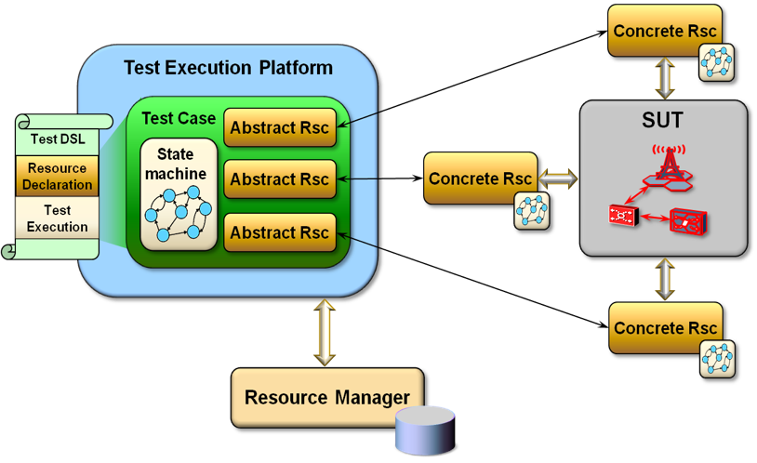
TST011 – Test Domain and Description Language Recommendations
NFV Test Domain with automation ecosystem
Recommendations for a DSL (Domain Specific Language)
Rapporteur: Frank Massoudian (Huawei)

Slide 33
TST012 - VIM & NFVI Control and Management Performance Evaluation
Focus on the control plane performance of VIM + NFVI
Based on functional requirements in ETSI GS NFV-IFA010
Potential Metrics:
  Virtualization container instantiation
  Scaling
  Migration
Delicate!
  VNFs can impact these metrics
  Care will be taken to define the metrics and methods to be independent of VNF (maybe use standard samples)
Rapporteur: Huang Cheng (Huawei)

Slide 34
Thank you!
https://www.etsi.org/NFVplugtestsProgramme
Silvia Almagia, Michele Carignani
plugtests@etsi.org
Pierre Lynch
pierre.lynch@Keysight.com

