Slide 1
OSM relation and ETSI NFV ISG Pål Grønsund, Telenor Research Vice Chair OSM

Slide 2
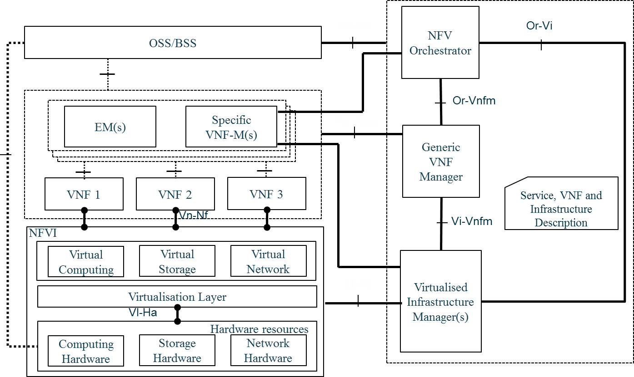
Open Source MANO (OSM) develop an Open Source MANO software stack aligned with ETSI NFV ISG

Slide 3
OSM is a large and diverse community, with 100+ members and participants
12 Global Service Providers
Leading IT/Cloud/OSS players
VNF providers
Academia

Slide 4
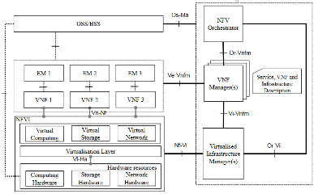
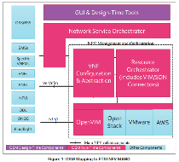
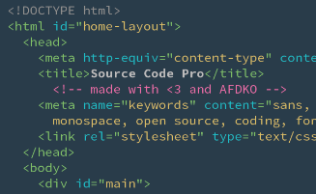
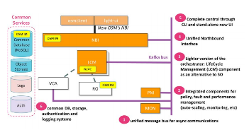
OSM activities create continuous feedback loops with ETSI NFV ISG
Architectural Framework
Information/Data Model (IM/DM)
API definitions
Test Specs
ETSI NFV
Testing
Release White Papers
IM improvements (100+ points raised), bugs in APIs
Lessons learnt EUAG White Paper

Slide 5
OSM is fully IM driven, with all operational procedures and requirements embedded, even for Day-2 operations
VNF Package
OSM’s NBI
NS Package
NS#1
NS Actions (Day 2)
VNF 2
2. NS Actions (Day 2 ops.)
Charms
VNF 1
VNF 3
1. Instantiate (Day 1 ops.)
VIM/SDN Connectors
NFVI
VIM
Hypervisor
Cloud Management System
1. Instantiate (Day 0 ops.)
Hardware
SDN Controller

Slide 6
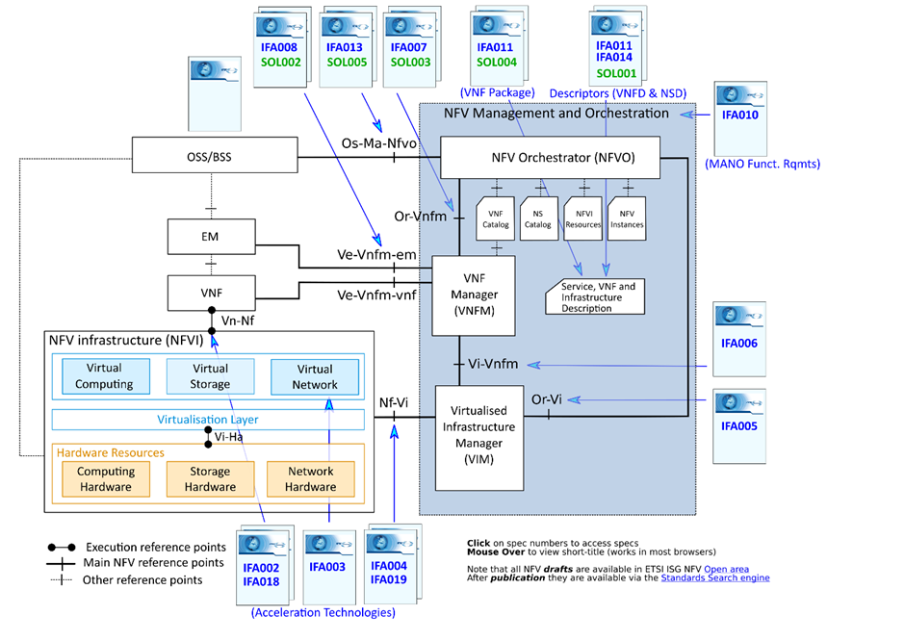
ETSI NFV ISG interface specifications of relevance to OSM
 | Semantic Specification | Syntactic Specification | Earlier Specification
Or-Vi | NFV IFA005 | - | NFV MAN001
Vi-Vnfm | NFV IFA006 | - | NFV MAN001
Or-Vnfm | NFV IFA007 | NFV SOL003 | NFV MAN001
Ve-Vnfm-em | NFV IFA008 | NFV SOL002 | NFV MAN001
Ve-Vnfm-vnf | NFV IFA008 | NFV SOL002 | NFV MAN001
Os-Ma-Nfvo | NFV IFA013 | NFV SOL005 | NFV MAN001
NSD | NFV IFA014 | NFV SOL001 | NFV MAN001
VNF Package | NFV IFA011 | NFV SOL004 | NFV MAN001
VNFD | NFV IFA011 | NFV SOL001 | NFV MAN001

Slide 7
ETSI NFV ISG interface specifications support by OSM
SOL005 (Os-Ma-Nfvo) supported
SOL004 (VNF package) supported.
SOL002 (Ve-Vnfm) supported – ongoing work to make it easier to use.
SOL003 (Or-Vnfm) support under consideration
SOL006 (YANG) support under consideration
Active participation in the three ETSI NFV Plugtests
NFV Plugtests Programme: Participated in the API validation track and provide feedback to the ETSI NFV OpenAPIs and conformance test methodology.

Slide 8
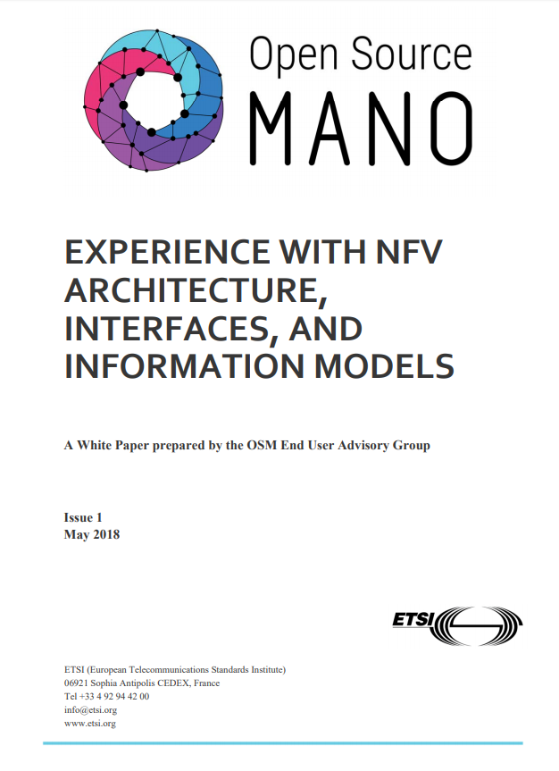
Other contributions to ETSI NFV ISG
Feedback to ETSI NFV ISG in the form of contributions to IFA WG with over 100 points raised on the ETSI NFV Information Models (NFV IFA011 and NFV IFA014).
White Paper from the End User Advisory Group sharing the experience and lessons learnt during the implementation of ETSI NFV specifications. https://osm.etsi.org/images/OSM_White_Paper_Experience_implementing_NFV_specs_final.pdf

Slide 9
THANK YOU! https://osm.etsi.org/

