Slide 1
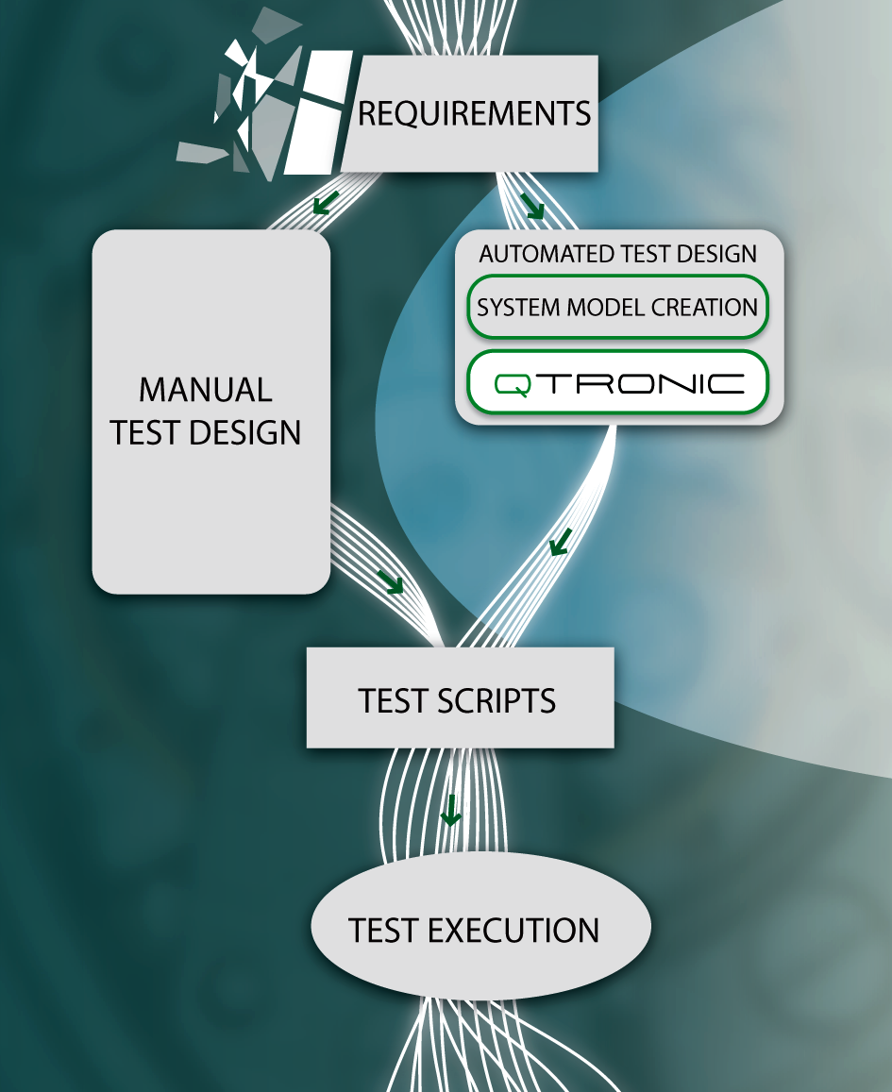
Proposal for 2012 MBT Standardization Activities Stephan Schulz (MTS Chair)
CONFORMIQ DESIGNER

Slide 2
Background
In MTS#53 agreement that further work on MBT is desirable
Discussion about STF to develop methodology vs. having as precondition for STF refinement of MBT ES (by MTS)
A bit of a “chicken & egg” problem
Pros and Cons for an STF
STF allows independent, more effective work with multiple view points
STF allows to really investigate practical application aspect
Modification requests by TC to STF documents can easily lead to administrative problems
Problems on lowering MBT ES abstraction level beforehand
No practical experience available
No real idea as to where level of abstraction should be

Slide 3
Basic STF Proposal
STF works on methodology EG and case study TR
Analysis multiple tools against current modeling ES
Creates models for a selected aspect of ITS (DENM) and
IMS (IOT) standard specifications with these tools
Collects weaknesses and improvement proposals for MBT ES and further needs for standardization
Develops in parallel to modeling ES updates [if needed] methodology EG
Documents case studies as example application of methodology in TR
Actual modeling ES refinement done outside of STF as MTS TC work
Physical coordination meetings with STF and TC MTS stakeholders
Meetings can also be used to identify need for further standards (e.g., output formats, coverage/test selection)
Tool providers support STF but participate via MTS work
Including provision of tool introduction and license provision for STF duration

Slide 4
Cornerstones for STF ToR
Timeframe: Jan-Dec 2012
May (MTS#56): 1st coordination meeting, analysis done, draft models
Oct (MTS#57): 2nd coordination meeting, modeling done, draft methodology, draft report
Dec: final methodology, final report
Resource estimate:
3-4 experts
Total: 3 mm paid + 1m voluntary (training)
Required skill set (across team):
Experience in methodology development
Proficient in programming (Java, .NET, TTCN-3, ???)
Strong experience in test development
Modeling experience in UML or SDL
Domain knowledge in ITS and IMS

Slide 5
Related Work Item Proposals
Methodology EG draft work item (attached to STF)
Title: “MTS; MBT; Methodology for standardized test specification development”
Scope: “Guidelines for creation models for testing from standard specifications and generation of tests from them in standardized test development.”
Case study TR draft work item (attached to STF)
Title: “MTS; MBT; Application of MBT to ITS and IMS case studies”
Scope: “Documentation of applying MBT in case studies for conformance and interoperability test specification development.”
Modeling ES revision work item
Title: “MTS; MBT; Requirements for Modelling Notations ”
Scope: “Refinement of concepts and requirements required from model notations to specify models in particular but not limited to the purpose of functional testing of communicating systems.”

