Slide 1
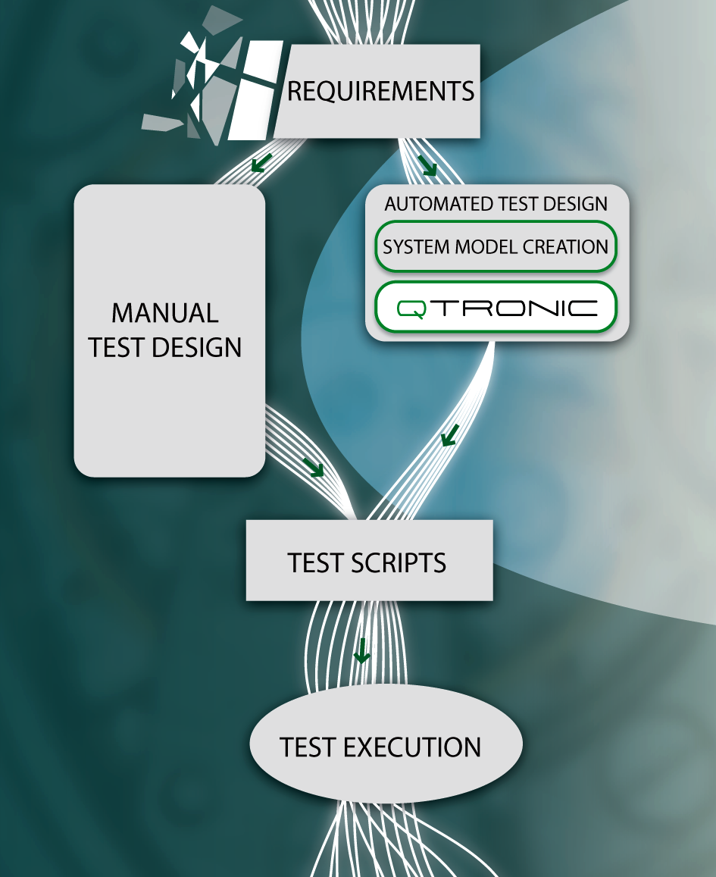
Thoughts on TDL Stephan Schulz Rapporteur Meeting, Munich, Dec 2010
CONFORMIQ DESIGNER

Slide 2
TDL - What’s New?
A number of efforts have been undertaken in the past to standardize ways how to describe tests at ETSI
Somehow they all fell through for one reason or another – why?
This is one view on them but there is likely to be more
The work on TDL should learn from them an avoid to repeat the “same mistakes”
Similar as with (other) model-based testing related work the general situation has changed and it is time to try again

Slide 3
Previous Attempts: TTCN
Earliest attempt we know of to standardize a way on how to describe tests at ETSI was (the birth of) TTCN
Initial goal when starting to design TTCN-2
We know how it ended … in a programming language
Why?
Because the fundament (clearly defined test execution) was missing?

Slide 4
Previous Attempts: TTCN-3 GFT
In 2000 ETSI releases the first edition of TTCN-3
At its core a textual test scripting language
But with also offering alternative “presentation formats” – one being the so called graphical format “GFT” (build on a MSC like notation)
In 2009 ETSI TC MTS declare the GFT part to be “historical” because this presentation format (as well as others) was not really adopted
Why?
Because it was driven only by a single tool vendor?
Because it tried to express too much graphically ? (GFT was “100%” compatible to core notation, i.e., 100s of pages of standard)
Because it had no (graphical) way for expressing data?

Slide 5
Previous Attempts: HLTD WI
In 2008 ETSI started a work item on “Requirements for High Level Test Descriptions”
Created after a Siemens presentation and answering a concrete to a concrete need at ETSI
Multiple rapporteurs meetings and standards drafts
In 2010 ETSI TC stopped the work item due to lack of progress & convergence
Lots of work and analysis … no standard
Why?
Disinterest by wider MTS community? No tool vendors?

Slide 6
Previous Attempts: TPLan
In 2008 ETSI started an attempt to test specification further by defining a notation for expressing so call “test purposes”
See presentation by Steve Randall
Intended for describing for “what” are we testing – not “how”
Purely textual: “a way of writing structured English” via dictionary
Precondition, stimulus, response
Reasonable success at ETSI
Used in a number of ETSI conformance test specification projects
3GPP has adapted “a simplified version”
No known use (beside in standardization) in industry
Only very rudimentary tool support (no commercial tools)

Slide 7
Why TDL? Why Now?
It has become significantly easier to produce tools for domain specific languages
The need in standardization is still there
TTCN-3 code can not be reviewed by committees
3GPP and others (e.g., OMA) have been and are using heavily test descriptions with no agreed format to date
Industrial test specification seems to be moving up in abstraction
TTCN-3 is “generally” used in industry (and ETSI) in conjunction with frameworks created by expert users .. on top of which tests are specified
New industry trend seems to replace TTCN-3 by keyword driven test tools
Deployment of MBT is picking up
In 2011 testers come increasingly with little programming background and desire to pick it up (in part because there is alternatives)

Slide 8
Conformiq Requirements on TDL
Should be suitable for test generation and should be able serve as basis for manual and automated test execution
Should be suitable for standardization and industrial/internal use
It should not require knowledge of programming syntax
Graphical/MSC like vs. tabular vs. prose vs. transfer format
Leave actual representation open?
Representation must be suitable for printing and reading
Ideally all in one place as it is done already today in informal approaches
Should be based on a limited number of concepts
Must not attempt to replicate TTCN-3 in power of expression
Data must finally appear as “equal citizen”

Slide 9
Example for Inspiration: ETSI IPv6

Slide 10
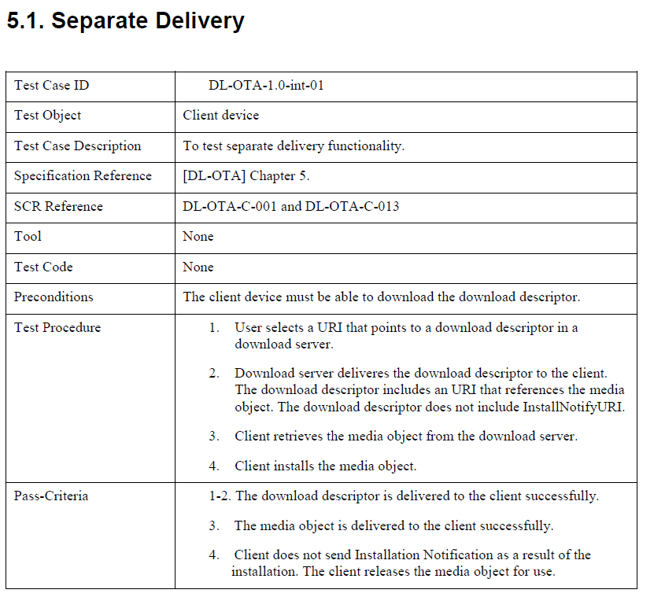
Example for Inspiration: OMA

Slide 11
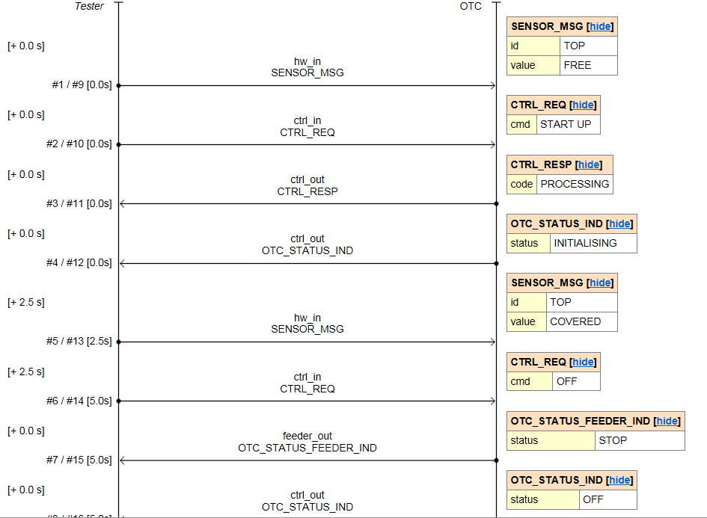
Example for Inspiration: MSC + Data

Slide 12
Example for Inspiration: Tabular

