Slide 1
Model-Based Black Box Testing in Automotive and its Standardization Layers (extract)
MaTeLo
THE SOLUTION TO BOOST
YOUR TEST EFFICIENCY

Slide 2
AUTOMOTIVE USE CASE

Slide 3
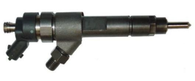
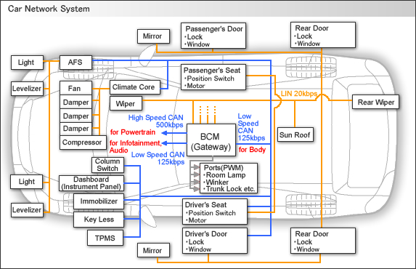
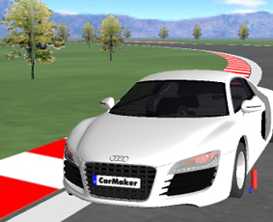
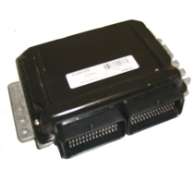
“Test Object” Presentation

Slide 4
“Test Framework” Presentation
EXAM
LabVIEW GUI
Automation API
Control API
Simulink Plant Model
Real -Time NovaSim Environment
Inputs
Outputs

Slide 5
MODEL BASED TEST PROCESS

Slide 6
MODEL-DRIVEN ENGINEERING
DESIGN
Functional
Requirements
TEST
Implement
Scenarize
Design
Model
Usage
Model
MaTeLo
Generate
Generate
Code
Model Based Testing
Test Cases
Compile
Derive
Test
Environment
EXE
Test Scripts

Slide 7
MODEL BASED TEST PROCESS BY PICTURES

Slide 8
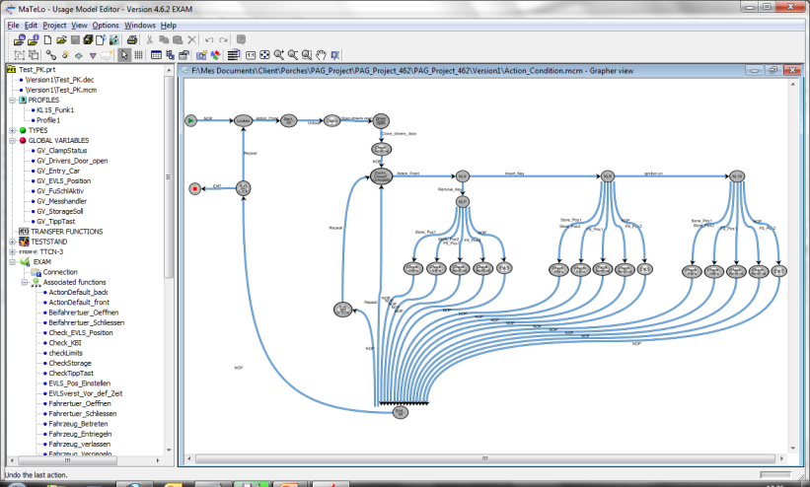
MaTeLo MODEL = TEST SPECIFICATION

Slide 9
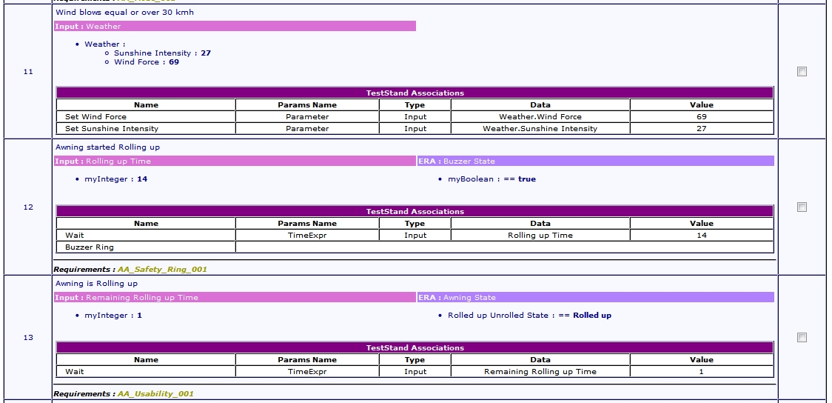
MaTeLo TEST CASE = TEST CASE SPEC
State
Requirement
Input
Expected Result
Test Function
Verdict

Slide 10
EXAM TEST SEQUENCE = TEST CASE IMPLEMENTATION (Abstract)
BEGINNING
END
INTERFACE

Slide 11
EXAM GENERATED CODE = TEST IMPLEMENTATION SCRIPT (Concret)
Python Code
CLASS

Slide 12
ALL4TEC MaTeLo and the “TEST MESS”

Slide 13
THEORETICAL MBT WORKFLOW
Atomic
Test
Action
Automation
Test Framework
Confidence
& Coverage
Reports
Test Scheduler
Test
Scripts
Usage
Model
Test
Cases
Test
Cases
Verdicts
Simulator
Test
Execution
Log
Functional
Requirements
System
Under
Test

Slide 14
A 1ST INDUSTRIAL TOOLS INTEGRATION
EXAM
Atomic
Test
Action
Automation
Test Framework
Confidence
& Coverage
Reports
Test Scheduler
UML
Test
Scripts
Python
Usage
Model
Test
Cases
Test
Cases
Verdicts
MaTeLo
dSpace
Simulator
MicroNova
Carts
Test
Execution
Log
Functional
Requirements
Doors
Vision
CAN
System
Under
Test
IOs

Slide 15
A 2nd INDUSTRIAL TOOLS INTEGRATION
EXAM
TestStand
Atomic
Test
Action
Automation
Test Framework
Confidence
& Coverage
Reports
Test Scheduler
UML
Test
Scripts
Python
Usage
Model
Test
Cases
Test
Cases
Verdicts
Proprietary
MaTeLo
dSpace
NI
Opal-RT
Simulator
MicroNova
Clemessy
Carts
Test
Execution
Log
Functional
Requirements
Doors
Reqtify
Vision
CAN
System
Under
Test
Diagnostic
Calibration
MS Excel
IOs
Radio

Slide 16
VARIOUS TOOLS INTEGRATION
EXAM
TestStand
Atomic
Test
Action
Automation
Test Framework
Confidence
& Coverage
Reports
CANoe
EXACT
PROVEtech
Proprietary
Test Scheduler
UML
TTCN-3
Test
Scripts
Python
VB
Usage
Model
Test
Cases
Test
Cases
Verdicts
CSV
C, C#
Proprietary
Java
MaTeLo
dSpace
NI
Opal-RT
Simulator
MicroNova
Clemessy
Carts
Test
Execution
Log
Simulink
CANoe
Functional
Requirements
Doors
Reqtify
Vision
CAN
HP QC
CSV
System
Under
Test
Diagnostic
Calibration
MS Excel
XML
Flexray
IOs
Radio
Temperature

Slide 17
VARIOUS TOOLS INTEGRATION
EXAM
TestStand
Atomic
Test
Action
Automation
Test Framework
Confidence
& Coverage
Reports
CANoe
EXACT
PROVEtech
Proprietary
Test Scheduler
UML
TTCN-3
Test
Scripts
Python
VB
Usage
Model
Test
Cases
Test
Cases
Verdicts
CSV
C, C#
Proprietary
Java
MaTeLo
dSpace
NI
Opal-RT
Simulator
MicroNova
Clemessy
Carts
Test
Execution
Log
Simulink
CANoe
Functional
Requirements
Doors
Reqtify
Vision
CAN
HP QC
CSV
System
Under
Test
Diagnostic
Calibration
MS Excel
XML
Flexray
IOs
Radio
Temperature

Slide 18
MBT AND ITS STANDARDS
EXAM
TestStand
Atomic
Test
Action
Automation
Test Framework
Confidence
& Coverage
Reports
CANoe
EXACT
PROVEtech
Proprietary
Test Scheduler
ATX
UML
TTCN-3
ATX
Test
Scripts
Python
VB
Usage
Model
Test
Cases
ATX
Test
Cases
Verdicts
ATX
CSV
C, C#
Proprietary
Java
OTX
HIL API
MaTeLo
dSpace
NI
Opal-RT
Simulator
MicroNova
RIF
ODS
Clemessy
Carts
Test
Execution
Log
Simulink
CANoe
Functional
Requirements
FIBEX
XCP
Doors
Reqtify
Vision
CAN
HP QC
CSV
System
Under
Test
ODX
GDI
Diagnostic
Calibration
MS Excel
XML
Flexray
IOs
Radio
Temperature

Slide 19
ALL4TEC VIEW WITH STANDARDS

Slide 20
ABSTRACTION LAYERS
Usage Scenario Description
Markov-Chain Usage Model
MaTeLo
<< derive >>
ATX
Test Case Specification
UML Sequence Diagram
<< generate >>
HIL API
Test Flow Control
Device Driver
Python
Precompiled Application
<< control >>
ODX, FIBEX, XCP…
System Under Test
Hardware In the Loop Test Bench
Third Party
Equipment

Slide 21
ABSTRACTION MANAGEMENT & STANDARDIZATION
Possible Usage Scenarios
Strategic Test Cases
ATX
Test Case 1
Test Case 2
Test Case n
Available Test Configurations
HIL Plateform
Network
Functions
Test Tools
Env. Model
HIL API
ODX, FIBEX, XCP…
HIL API
dSpace
CAN_1
Manual Gear
CANoe
Gasoline
NovaSim
CAN_2
Auto Gear
CANape
Diesel
Carts
LIN_X
Hand Free
INCA
Turbo
ASAM HIL API
FlexRay_1
ACC
MS Excel
Hybrid
Proprietary
FlexRay_2
StartStop
Diag Tool
Electric
…
…
…
…
…

Slide 22
OTHER STANDARD CONSIDERATION (ATX)

Slide 23
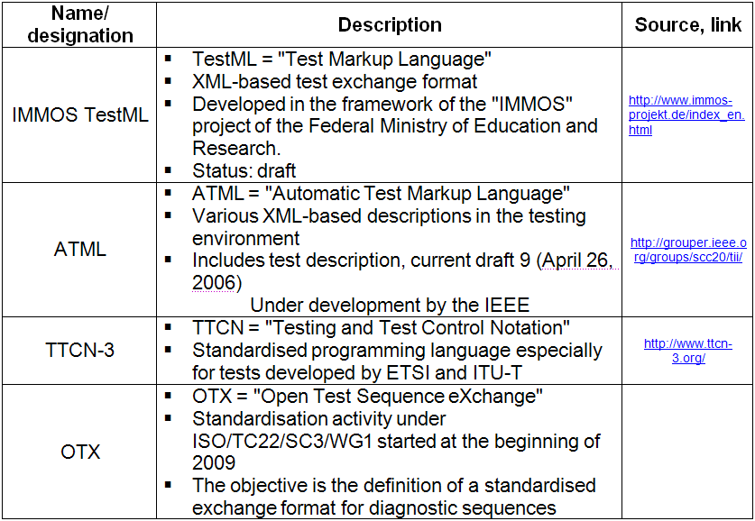
„Related Work“

Slide 24
CONNECTION ATX / (OTX, TTCN3, HIL API)

Slide 25
ATX – OTX cooperation model
ASAM ATX Part 1
(TDX+TAF Folder, Result, Suites - TAF Core)
OTX Core
ISO WD/13209-2
OTX Standard Libraries
(Lib-Com, Lib-Mmi, …)
ISO WD/13209-3
ASAM ATX Part 2
Standard Libraries for ASAM HIL API

