Slide 1
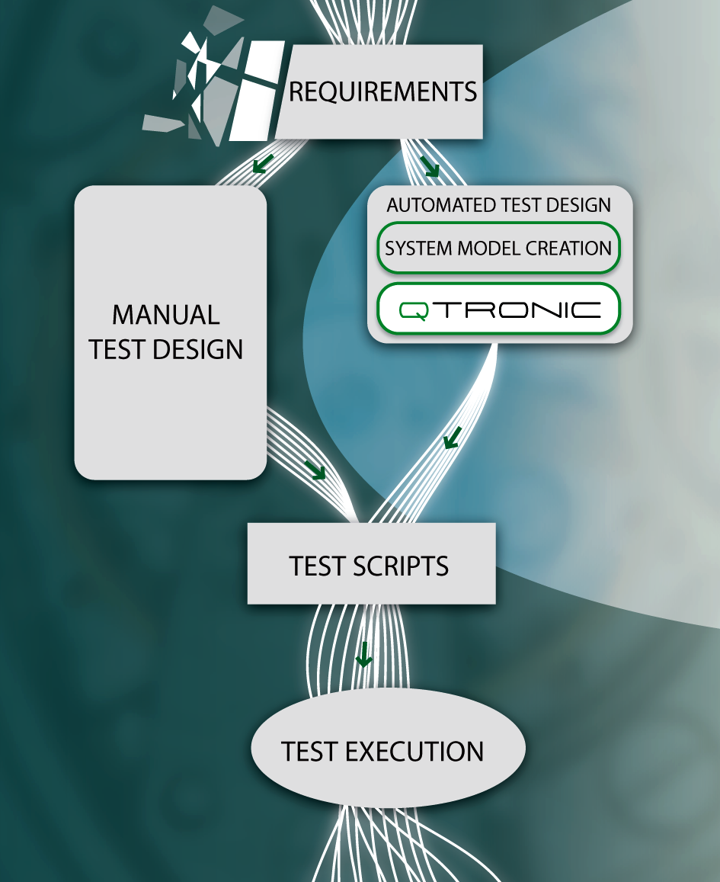
MBT@ETSI 2012 MTS #55 Meeting
CONFORMIQ DESIGNER

Slide 2
Overview
ETSI MBT STF preparatory meeting report
Planning MBT standards development work 2012
Review of outstanding issues
MBT related ETSI conference updates
MBT workshop at ETSI TTCN-3 User Conference in Bangalore India in June
Status of MBT user conference planning for Sep 2012
First Test Description Language standard outline (tomorrow)

Slide 3
STF WU/422 Preparatory Meeting
Preparatory meeting yesterday
Selected candidates from 8 applications:
Jens Grabowski (University of Goettingen) –> STF Leader
Antal Wu-Han-Chang (///)
Alain Vouffo (FOKUS)
Victor Kuliamin (ISPRAS)
PLUS Milan Zoric (ETSI CTI)
Tool introduction from 4 participating tools
Conformiq, Microsoft, Sepp.med, FOKUS

Slide 4
STF WU/422
Conduct case studies with all tools
IMS and ITS standards for which ETSI has developed TTCN-3 tests; deliverable is technical report
Goal is not complete coverage of standards but at least one “representative” feature or group of requirements
Analyze MBT based development
Measure modeling and validation effort
Quality of test suites
Validate MBT ES 202 951
Determine if any need for further standards

Slide 5
STF WU/422
Define ETSI Guide on methodology
Assume modeling purely for testing
How to develop models for conformance standards regardless of a specific tool (ideally mainly based on ES 202 951)
At least some first thoughts on how to involve ETSI TCs in MBT based test development process
MBT is a change in paradigm

Slide 6
Time Plan STF WU/422
Session plan until next MTS meeting defined
Coordination meeting with MTS work on MBT before/after plenary planned
First details
Another coordination session planned in parallel to Sep/Oct plenary
Final delivery by end of the year

Slide 7
Status ES 202 951
Work finished early 2011 – published by summer
Comments received after finalization
Formalization of concepts (in UML diagram)
Annex for flowchart/activity based modeling
“weak point is missing relation of modeling to testing”
Section on modeling from system vs test perspective
“Missing terms”
Missing modeling/coverage of specific test data
Anything else?

Slide 8
MBT 2012 Standardization Proposal
At least 2 working meetings adjacent to upcoming MTS plenary meetings (Mo before?)
May 14 Goettingen
Sep XX YYY
Topics for discussion
Active review, exchange of information with STF on methodology and shortcomings they find
Revise and discuss updates to ES 202 951 (work starts now)
Identify need for new standards

Slide 9
Conference Status – T3UC 2012 MBT WS
T3UC to happen June in Bangalore India
Currently planned half day workshop attached to TTCN-3 user conference
Not a replacement for MBT UC
Idea was to handle this “by invitation” via MTS MBT community
Currently a bit confusing on web site if T3UC like submission

Slide 10
Conference Status – MBT UC 2012
Event organization
Andrej Pietschker (Giesecke & Devrient) as PC chair
Elvior selected as host from 2 applications for hosting
Time & place: Tallinn, 25-27.9.2012
Rough time plan
Building of MBT UC PC now
CfP in March
Submissions by end of May
Notification by end of June

