Slide 1
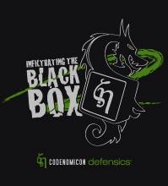
Fuzzing Basics
Ari Takanen
Codenomicon Ltd.

Slide 2
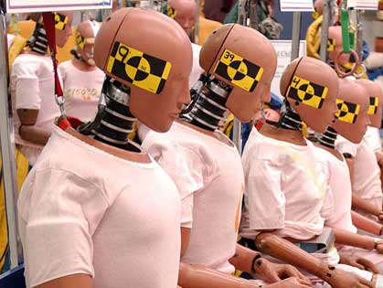
Product Security Terminology
Vulnerability – a weakness in software, a bug.
Threat/Attack – exploit against a specific vulnerability
Protocol Modeling – functional behavior, interface message sequences and message structures
Anomaly – abnormal or unexpected input
Failure – crash, busy-loop, memory corruption, or other indication of a bug in software

Slide 3
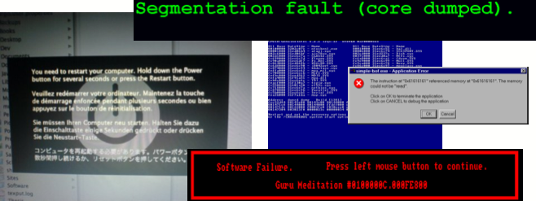
Security Vulnerability = Just A Bug

Slide 4
Approaches to testing, how does fuzzing fit in?
Feature/conformance testing
Performance/load testing
Robustness testing
Fuzzing
Static Code Analysis

Slide 5
Definition of Fuzzing
Fuzzing is a technique for
intelligently and
automatically
generating and passing into a target system
valid and
invalid
message sequences to see if the system breaks, and if it does, what it is that makes it break.

Slide 6
Types of Fuzzing
Random fuzzing
Apple’s The Monkey, in early 1980’s
Barton P. Miller, Fuzz, since late 1980’s
Template based fuzzing
Capture traffic OR use sample files OR... → create mutated test cases
Specification based fuzzing
Model the specification, inject anomalies, transmit to target system

Slide 7
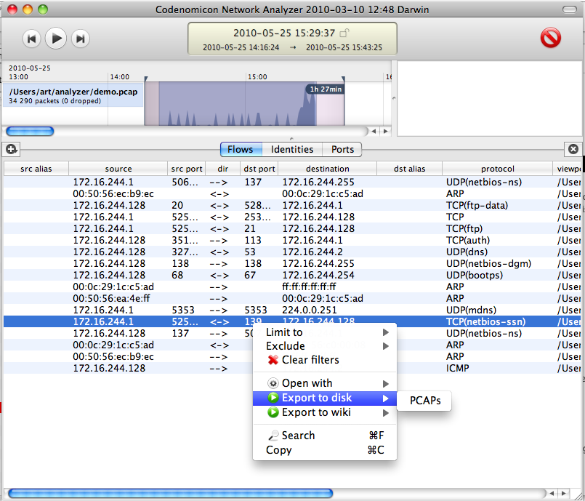
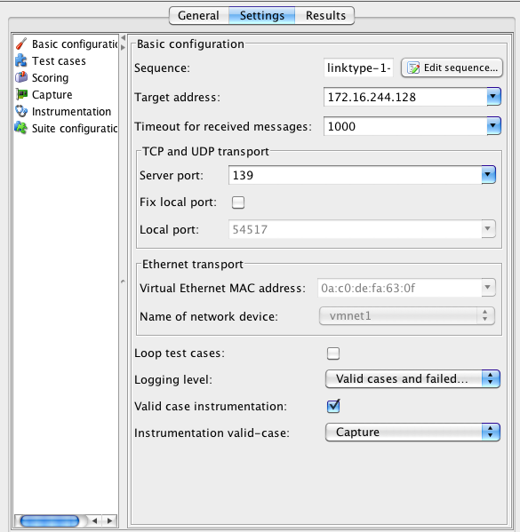
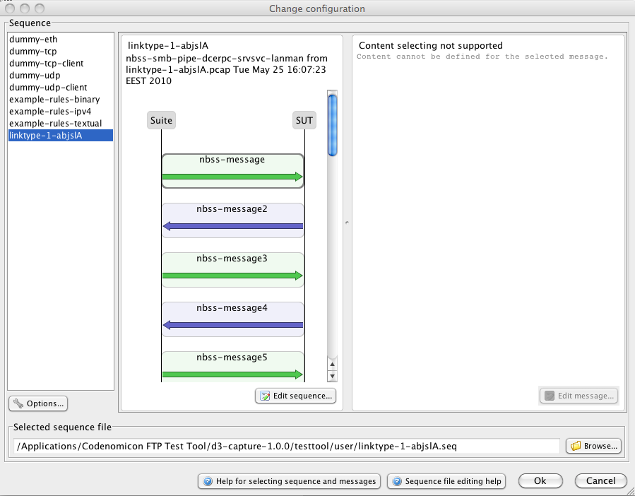
Example: Traffic Capture Fuzzing

Slide 8
Security Testing and Fuzz Testing Terminology
First draft
Proposed structure and content for ETSI TS

Slide 9
Proposed Structure
Terms are logically bundled
Each bundle of terms contains:
Introduction to topic
List of terms and definitions, with references
Discussion in regards to the document
Alphabetic index in the end

Slide 10
Security Testing
Security testing = Testing whether the system meets its specified security objectives.
Types of security testing
- Risk assessment, Risk analysis (ISO/IEC, TVRA)
- Functional testing (CC, ETSI TVRA)
- Penetration testing (CC, TVRA)
- Vulnerability testing/auditing (CC, TVRA)
- Performance testing (recent perftest TR)
- Fuzzing (new content)

Slide 11
Vulnerability
- Known vs. Unknown Vulnerability
- Zero-day vulnerability
- Weakness
- Design, Implementation and Configuration vulnerabilities

Slide 12
Attack
- Known vs. Unknown Attack
- Zero-day attack
- Threat and Threat agent
- Attack tree
- Attack potential
- Malicious code, malicious logic, malware

Slide 13
Exploitability
- Confidentiality, Integrity, Availability
- Denial of Service
- Distributed Denial of Service
- Buffer overflow and other memory handling bugs
- SQL injection and other execution bugs
- Directory traversal and other file handling bugs
- Busy loop
- Memory leak

Slide 14
Tool categories
- SAST, Static analysis
- DAST, Dynamic analysis
- Vulnerability Scanner
- Port scanner
- Fuzzing, Fuzz testing
- Monitoring

Slide 15
Basic testing terminology (fuzz testing)
- Software reliability, Robustness
- IUT, DUT, SUT
- Test, testrun, test suite, test group, test case, subtest
- Test strategy
- Test purpose
- Test plan
- Test design
- Test (case) specification
- Test (case) generator
- Test oracle, Test comparator
- Test driver
- Test execution
- Test process
- Test log
- Test report
- Tester

Slide 16
Fuzzing in SDLC
Unit test
Product test
System test
Penetration test

Slide 17
Test automation
- Automated test generation
- Automated test execution
- Automated reporting
- Online/Offline test generation/execution

Slide 18
Monitoring/Instrumentation
- inline instrumentation
- on-host instrumentation
- valid-case instrumentation
- asynchronous instrumentation

Slide 19
Other names for fuzzing
- Syntax testing
- Robustness testing
- Negative testing
- Grammar testing

Slide 20
Related testing techniques
- Black-box testing and Grey-box testing
- Risk-based testing
- Boundary value testing, Boundary value analysis, Stress testing
- Whitenoise testing
- Ad-hoc testing, Ad-lib test
- Error guessing
- Input Fault Injection
- Interface testing
- Regression testing
- Smart testing

Slide 21
Unrelated testing techniques
- Structural testing, white-box testing, glass-box testing, logic driven testing
- Mutation testing
- Symbolic execution

Slide 22
Fuzzing models
- Executable model, Mini-simulation
- Behavioral model
- Structural model
- Model inference

Slide 23
Software interface
- Communication interface
- Protocol, PDU, Interface
- Protocol specification
- Context-free grammar/language
- Attack surface analysis
- Attack vector analysis

Slide 24
Languages
- BNF, A-BNF, E-BNF
- ASN.1
- XML
- PDML
- UML
- TTCN, TTCN2, TTCN3

Slide 25
Test generation
- Anomalization
- Bitflips and other simple fuzzers: move, replace, delete
- Systematic test generation
- Random test generation
- Multi-field anomalization

Slide 26
System state (fuzz testing)
- dynamic tests
- dynamic operands, rules, function code, keyword-based functions
- system state, state transitions
- precondition

Slide 27
Fuzzing requirements
- number of passed tests
- mean time between failures
- coverage as a requirement
- fuzzer maturity

Slide 28
Fuzzer types
- Specification-based fuzzer
- Model-based fuzzer
- Block-based fuzzer
- Random fuzzer
- Mutation fuzzer
- Evolutionary/Learning fuzzer
- File fuzzer
- Protocol fuzzer

Slide 29
Metrics and Coverage (fuzz testing)
- Specification coverage
- Anomaly/Input coverage
- Leaf coverage
- Code coverage, Statement coverage
- Branch coverage
- Boundary-value coverage
- Error seeding, found vulnerabilities

Slide 30
Template optimization (for seeding a template-based fuzzer)
- corpus distillation
- fuzzer specific or tool-neutral
- SUT specific or SUT-neutral
- code coverage
- branch coverage
- leaf coverage
- execution trace/path

Slide 31
Test direction
- Client fuzzing
- Server fuzzing

Slide 32
Performance (fuzz testing)
- test cases per second
- messages per second
- protocol transactions per second
- Test generation time (pre test preparations)
- Test execution time
- Test analysis time (post test analysis)

Slide 33
Test setup
- interfaces
- debugger
- virtual setup
- debugger
- installation and configuration of SUT
- test date (usernames, passwords, URLs, other automatically populated data)

Slide 34
Test verdict (fuzz testing): Pass, Fail or Inconclusive
- Test result, expected result
- Response, other messages sent out
- "Diff" of data/system
- Failure - crash, hang of memory hog
- Fault
- Failsafe - When software or device fails
- Reproducing failures
- False positive
- False negative
- Exception, Exception handler

Slide 35
Observability (fuzz testing)
- Fault tolerance, Reliability engineering
- Instrument, Instrumentation
- Recovery
- Failure trace, Audit trace, Crash trace
- Logging, debug logs
- Data persistence - regarding failure logs
- Software/Firmware version

Slide 36
Misc
- 3rd party audit & testing (fuzz testing)
- Pre-emptive/Proctive
- Bug remediation
- Cloud fuzzing

Slide 37
PROACTIVE SECURITY AND ROBUSTNESS SOLUTIONS
”Thrill to the excitement of the chase! Stalk bugs with care, methodology, and reason. Build traps for them. .... Testers! Break that software (as you must) and drive it to the ultimate - but don’t enjoy the programmer’s pain.”
[from Boris Beizer]

