Slide 1
Rebooting www.ttcn-3.org
Contribution to MTS#56 15-16 May 2012 Göttingen

Slide 2
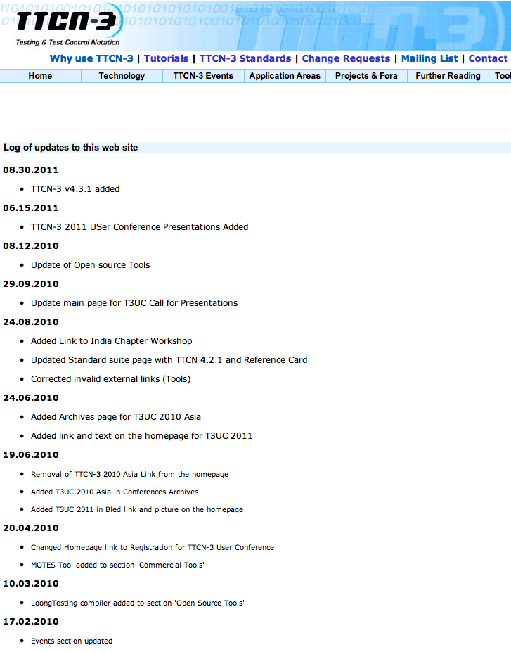
Analysis
Current website is not up-to-date in terms of
Design
Structure
Content
Social media integration
But, website is supposed as still important for technology promotion and as user forum

Slide 3
Proposal
New WI to found an editorial team
All interested MTS members are invited to contribute
Purpose of that editorial team would be to
Propose a new structure an design of the website
Propose policies of editing, i.e. what kind of content and how content will be published and what rules of objection will apply
Maintain the website in the future
Timeline proposals due to MTS#57 in September

Slide 4
TT Offer
Coordination of the editorial team
Hosting the website with write access for the editorial team
On a voluntary basis and with no costs

