Slide 1
Security SIG in MTS
Fraunhofer FOKUS
Tallinn, 4-5 October 2011
Berlin, 15 December 2011 update
Sphia Antipolis 13 March 2012
Göttingen, 15 May 2012

Slide 2
Recall of SIG history
Plan for Security-SIG in MTS (Tallin, 10/2011)
SIG#1 (Berlin, 12/2011)
Discussion on scope: specification, analysis, testing
3 NWIs „wording“: terminology, case study experiences (2nd half 2012), design guide
Appointment of rapporteurs: Ari T. and Scott C.
SIG#2 (Sophia, 03/2012)
Start of Wiki initiative about terminology
Draft on security design guide (with lifecycle diagram)
Need for more promotion

Slide 3
SIG#3 (today)
Participants: Ian B., Jan dM., Bogdan S., Axel R., Steve R., Ari T., Scott C. (missed due to E2NA)
Review of work progress
Terminology in progress
Design guide concentrates on the life cycle diagram
Timeplan, next steps, workplan
Potential NWI

Slide 4
Security Testing Terminology and Concepts - STATUS
not a pure listing of definitions but an introduction of terms using full text
Abstract → TBD
Introduction/Basic terminology (NN)
(focus/promote new testing areas) → listing available, text TBD
Use cases (Ari) → TBD
Security Testing in security design life cycle
Serucity testing in post-realease (incl. Penetration test)
Security Test Requirements (Jan) → first input, TBD
Map to chart, assurance framework level 2
Functional Testing (Axel) → general overview available, but specific parts TBD
Performance Testing (Ari) → TBD
Fuzzing (Ari) → available
Please JOIN & Contribute: https://collab.codenomicon.com/collab/codeetsi/

Slide 5
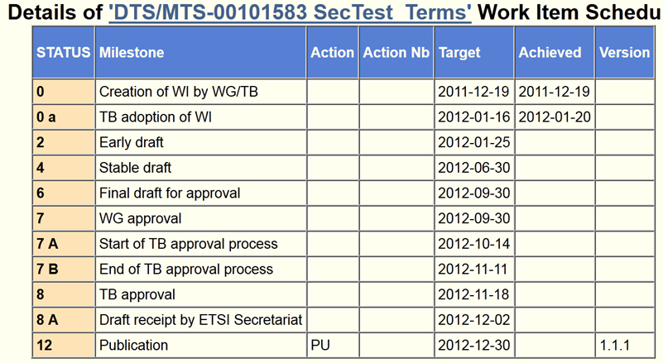
Time plan

Slide 6
„Workplan“
Workitems got several input, in time
Less contributions -> more promotion?
Cooperation with other groups: E2NA-security (re)starts, ITS, OCG-security, LI (lawful intercept)
Assigned responsibilities/deadlines (13th July)
Next meetings/calls
SIG#4: 16th July 2pm (GoToMeeting)
SIG#5: 18th September (day before MTS#57)

Slide 7
Possible New Work Item Architectural Security Specification
MTS Security SIG has defined an Architecture and Assurance Lifecycle
Original intention had been for Architecture element – which would form the platform for Security Specification – to rely on work of ISO/IEC JTC1 SC27 WG4 in this area
ISO/IEC JTC1 SC27 WG4 item now in abeyance
Option identified for MTS Security SIG to adopt the existing effort

Slide 8
Architectural Security Specification Proposed Work Item Structure
Introduction
Scope
Normative References
Terms And Definitions
Overview
Information Security Architecture Framework
Information Security Architecture Requirements
Information Security Architecture Implementation
Annex A (Informative) Functional Groups And Classes
Annex B (Normative) Generic Effect Class
Annex D (Informative) Example Design Class
Annex E (Informative) Example Design Pattern
Bibliography

