Slide 1
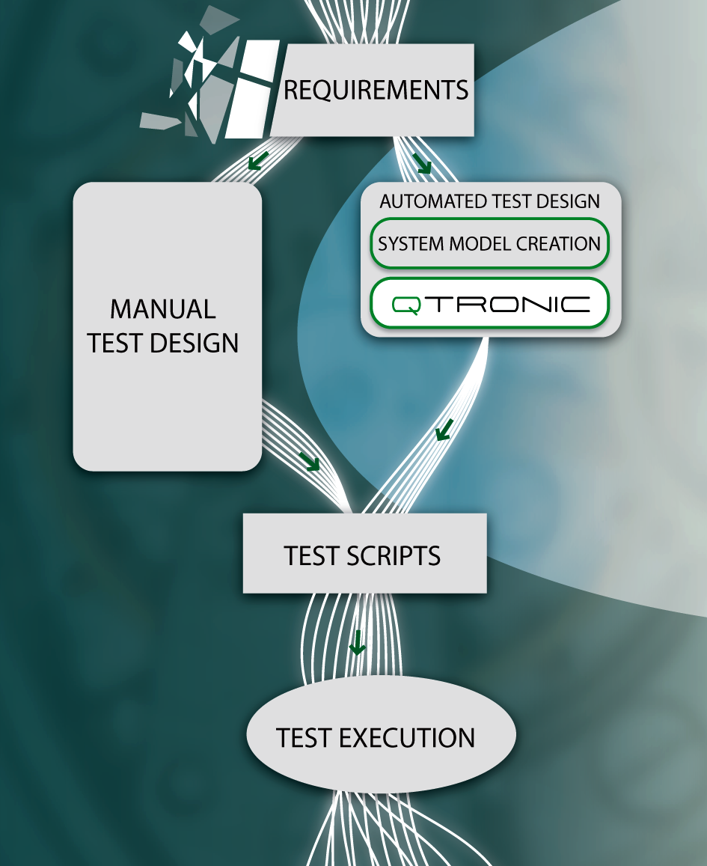
On ES 202 951 v1.2.1 Stephan Schulz MBT Working Meeting/MTS#56, Göttingen
CONFORMIQ DESIGNER

Slide 2
Outline
Status ES 202 951
DSLs in ETSI test language specification?
Test selection standardization

Slide 3
Status ES 202 951
Work finished early 2011 – published by summer
Comments received after finalization
Formalization of concepts (in UML diagram)
Annex for flowchart/activity based modeling
“weak point is missing relation of modeling to testing”
Section on modeling from system vs test perspective
“Missing terms”
Missing modeling/coverage of specific test data

Slide 4
Test language specification and DSLs
After years of ”unification” a clear & strong trend in industry to specialization in (modeling) languages, i.e., DSLs
So far deployments mainly in MDD
UML, TTCN-3, etc – one size fits all?
One size is how many pages of standard?
One language ?= one compiler
XMI ?
A(nother) domain specific modeling hype ?
”Everything is a domain specific language” -> what is a ”domain”
Presentation format vs actual language
Strong (Eclipse) open source initiative ”xtext”

Slide 5
What is a Domain Specific Modeling?
Modeling with a Domain Specific Modeling Language
What is a Domain Specific Modeling Language (DSML)?
A formal language defined on a custom, limited set of domain specific concepts, symbols, and rules in a so called meta model
Attempts to achieve a higher level of abstraction than a general purpose language like, e.g., UML
Conceptual foundation dating back to the 80s (ISO 10027)
Later on popularized in 90s by OMG as “Meta Object Facility” (MOF)

Slide 6
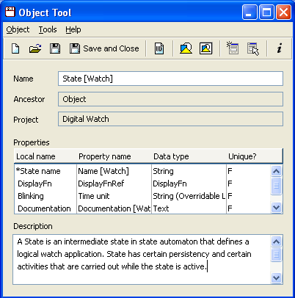
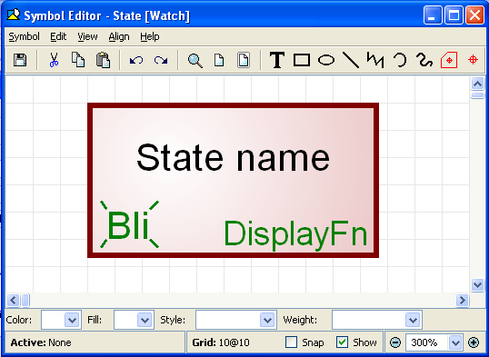
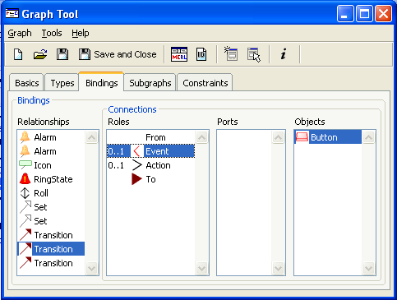
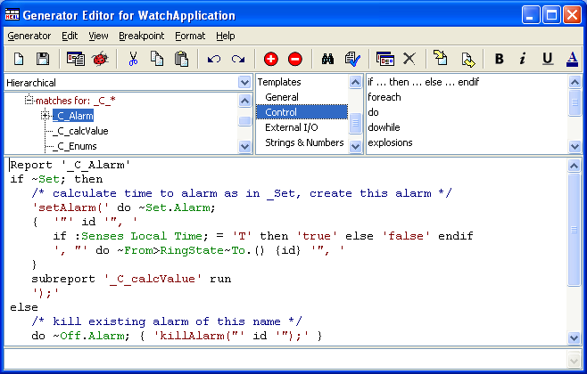
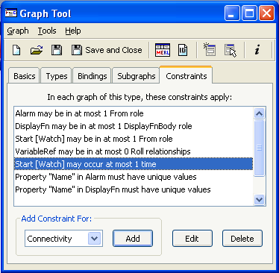
[Example] Anatomy of a DSML or Meta-Model
Rules
Generators
1
2
3
4
Concepts
[Symbol]s

Slide 7
A Layered Definition of ETSI Testing DSLs? [based on Oligschläger, LACTOSE 2012]
input, entity
A DSML definition in multiple levels
A new level can add new concepts, properties, relationships etc
A new level can refine or restrict already existing concepts, properties, relationships, etc
initial state
Generic System
test step
System Operation
Generic Testing
SIP UA
Application Domain
Specific System
Specific System Operation
SpecificTest Description

Slide 8
Why DSML(s) in Standardization?
Not a new idea in context of TTCN-3
A fast way to nice & free text editors available for anybody (via xtext)
One of the challenges of the ExTRA aka TPLan
A nice way to formalize dependencies and ensure consistency between different abstraction levels
ExTRA -> System operation or TDL -> TTCN-3 ?
Allow space for tool proprietary presentation formats and even refinements, and extensions
At same time enables enforcing ”tool independent single language” for use in standardization

Slide 9
Open Issues
xtext as common denominator?
In ES 202 951 or rather separate standard?

Slide 10
About Test Selection in ES 202 951
test generation: automatic derivation of abstract test cases in one or more different formats from a model based on user defined test selection criteria
test selection: process or the result of choosing a subset of tests during test generation from a larger or infinite set of tests which can be derived from a model
test selection criterion: property that is satisfied by a set of test cases generated from a model

Slide 11
About Test Selection in ES 202 951
Section 4: ”The model is then instrumented for the purpose of test generation by adding or selecting test selection criteria, i.e., coverage goals or test purposes specifying what is to be covered, and heuristics specifying how these goals are to be covered. Test selection is necessary since from every non-trivial model, an infinite or huge amount of tests can be derived. A model-based testing tool then automatically generates an abstract test suite that complies with these criteria.”
”NOTE: The specification of test selection criteria is beyond the scope of the present document.”

Slide 12
(Part of ) An Earlier Attempt
Instrumenting the model for test selection
A model of system interface and system behaviour provides the basis for model-based testing. In order to control the generation of a test suite from a model, an engineer will need to provide additional information steering the test selection process.
In this section, general concepts for test selection are defined. While these concepts are not necessarily part of a modelling notation itself, they are tightly connected to it, and in some instances are models themselves which relate to the behavioural model via model composition.
Coverage
In model-based testing, coverage is defined in terms of the elements of the model. Coverage goals can be used to either prune the generation of the model graph from the model, or to steer the test generation process from the model graph. There is a variety of coverage criteria available. In this standard, only very basic coverage criteria are mentioned; many tools will provide more than those.
Test selection instrumentation shall provide a way to define coverage goals in terms of model requirements capture.
Test selection instrumentation shall provide one or more ways to define coverage goals in terms of the structure of the model, i.e. rule coverage, branch coverage, arc coverage, parameter range coverage, etc.
We need more here!

Slide 13
Next steps
Section Test Selection and Test Suite Coverage?
Concepts & terminology/dictionary for use in context of MBT
Revise notion of a state?
What is a test in the context of a model
Effectively are the same quality – means to compare
Test selection
Paramerization
Test case properties like redundancy, priority/cost, differences in general
Test Suite Coverage
Something may be measurable
Type of coverage: Loop, definition coverage once vs n-times, ”full coverage”
Criteria/types incl data and combinations thereof
Reachability vs trace/pattern/test purpose (data at certain point)
Use model vs specification vs implementation vs usage coverage

