Slide 1
STF 442 ACTIVITY: MBT CONFORMANCE TEST DEVELOPEMTN CASE STUDIES
Victor Kuliamin STF 442

Slide 2
Outline
ATM Toy Example Case Study
General Description
SpecExplorer Model and Test Generation
Conformiq Model and Test Generation
GeoNetworking Location Service Case Study
General Description
Modeling Issues
SpecExplorer Model and Test Generation

Slide 3
ATM Toy Example
Simple ATM
User insert card / ATM checks its validity
User provide PIN / ATM checks its correctness
User requests money / ATM checks balance and provides money if balance is greater than requested sum

Slide 4
ATM Example: statechart
[!valid(card)] Insert card / “Invalid card”
[!match (pin, card)] Provide pin / “Incorrect PIN”, return card
Idle
Authentication
[valid(card)] Insert card
[match (pin, card)] Provide pin
[amount <= card.balance] Request amount / return card, provide money, card.balance = card.balance ‑ amount
ReadyForMoneyRequest
[amount > card.balance] Request amount / “Invalid amount”

Slide 5
ATM EXAMPLE: Specexplorer model
Card class {uint id, uint pin, uint balance} set of valid cards
ATMState enum {Idle, Authentication, ReadyForMoneyRequest}
ATMModelProgram class
Data
currentState : ATMState
currentCard : Card
currentMessage : string
void InsertCardRule(uint cardID)
void CheckPinRule(uint pin)
uint RequestAmountRule(uint amount)
string GetMessageRule()

Slide 6
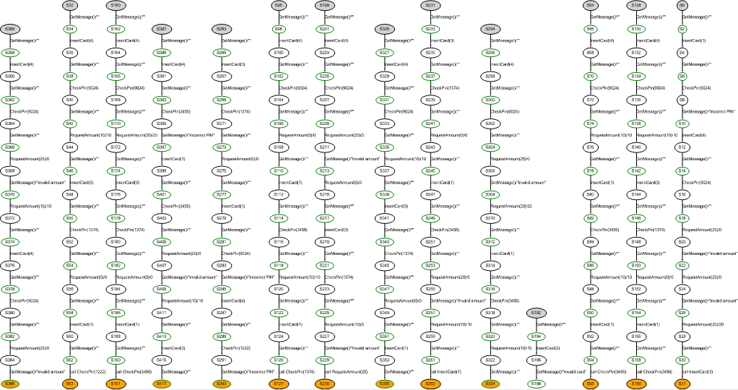
ATM Example: SpecExplorer tests

Slide 7
Issues
Tests can’t be always interpreted as test action sequences starting from initial state
“Short tests” strategy requires too much exploration

Slide 8
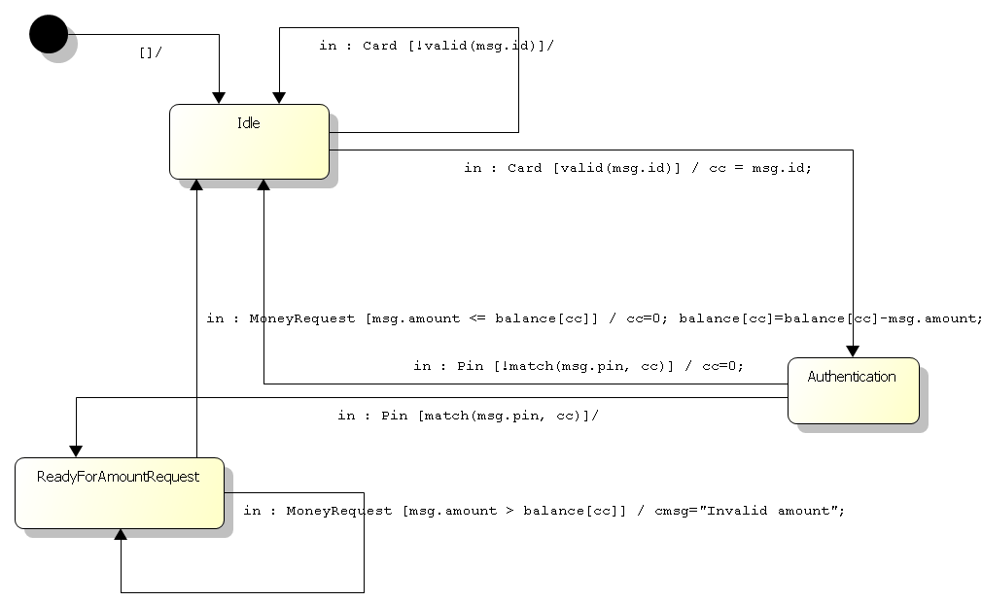
ATM example: conformiq model

Slide 9
ATM example: conformiq tests
For “All transitions” coverage
For “2-transitions” coverage

Slide 10
GeoNetworking protocol
Transport protocol for communications between vehicles/road facility
Main features
Adaptive header structure
Internal operations
Address and position maintenance
Beaconing – neighbor discovery
Location service – search for a unit with specific address
External services
GeoUnicast – sending a packet to specific address
GeoBroadcast/GeoAnyCast – to all units in a specific area
Single Hop Broadcast – to all neighbors
Topologically Scoped Broadcast – to all n-hop neighbors

Slide 11
GN Location service (SOURCE UNIT)
[!known(addr)] GeoUnicast(PDU, addr) / ls-buffer[addr].add(PDU), set ls-timer[addr], ls-rtcounter[addr] := 0, issue LSRequest for addr (as broadcast)
Idle
Waiting
[ls-rtcounter[addr] = MAX] ls-timer[addr] / remove ls-timer[addr], ls-buffer[addr].clear()
[ls-rtcounter[addr] < MAX] ls-timer[addr] / set ls-timer[addr], ls-rtcounter[addr] ++, issue LSRequest for addr (as broadcast)
LSReply(addr, loc-data)/ ls-buffer[addr].flush(),
loc-table[addr] := loc-data,
loc-table[sender] := …
[naddr = addr] GeoUnicast(PDU, naddr) / ls-buffer[addr].add(PDU),
buffered PDU lifetime expires / ls-buffer[addr].remove(PDU)

Slide 12
GN Location service (OTHER)
[addr != local-addr] LSRequest(addr) / transmit LSRequest (as TSB)
loc-table[sender] := …
LSReply(addr, loc-data) / transmit LSReply (as GeoUnicast)
loc-table[addr] := …
loc-table[sender] := …
Idle
[addr = local-addr] LSRequest(addr) / issue LSReply (as GeoUnicast)
loc-table[sender] := …

Slide 13
Modeling GN location service
Synchronous model
Interface
packet GeoUnicast(PDU, addr)
packet LSTimer(addr) (maybe problem for executable tests)
void LSBufferedPacketExpired(PDU) (maybe problem for executable tests)
[packets flushed] LSRequest(packet)
[packets flushed] LSReply(packet)
Data intensive location[addr], LS buffer[addr], UC buffer[addr], BC buffer
Involvement of other features
Address maintenance – not modeled
Duplicate packet detection
Location data maintenance for sources and forwarders of received packets
Common header processing
Issuing packet as TSB
Issuing packet as GeoUnicast (Forward address calculation - only GREEDY algorithm, CBF not modeled)

Slide 14
GN Location Service TESTS
The number of tests is too large
Hard to interpret yet

Slide 15
Results and FURTHER development
GN Location Service SpecExplorer model
Just now too complex for full exploration
Possible abstractions
Decrease size of buffers and counters
Create several specific configurations
Skip some data fields from headers and state
Skip some (internal) operations
Decomposition into small single-feature models
???
Byproducts
~12 issues in GeoNetworking specifications
Requirements catalogue (not refined yet)

