Slide 1
The DIAMONDS Security Information Model
A. Vouffo (Fraunhofer FOKUS)

Slide 2
Introduction
ETSI TVRA [TS 102 165- 1 V4.2.3 (2011 - 03)] provides an information model for security
SINTEF reuses elements of the ETSI TVRA information model in its CORAS metamodel and extends it with risk modelling concepts
Common Criteria combines elements of ETSI TVRA and introduces testing concepts.
However testing is not specifically addressed by any of those models
The DIAMONDS project is working on Model-based Security Testing
Model-based security design
Model-based testing
An information model combining model-based testing and model-based security design can be common ground for model-based security testing

Slide 3
Goals
To clarify terminology and define concepts
To put concepts from the different aspects of security (System design, security design, risk analysis and testing) in relationship to each other.
To provide a common concept space for tools targetting different aspects of the method.

Slide 4
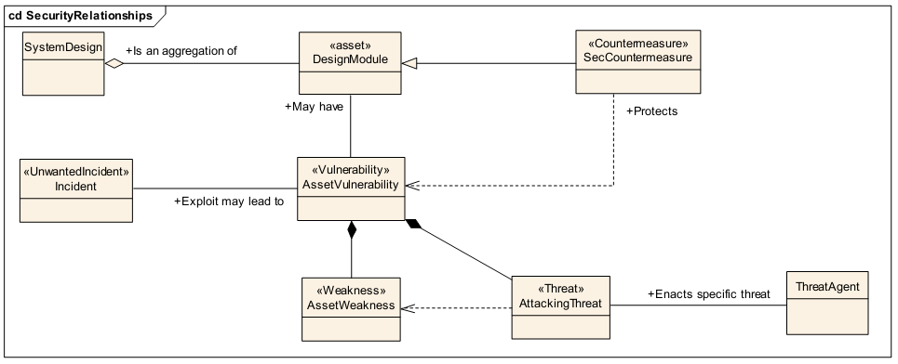
Generic Security TRVA Model

Slide 5
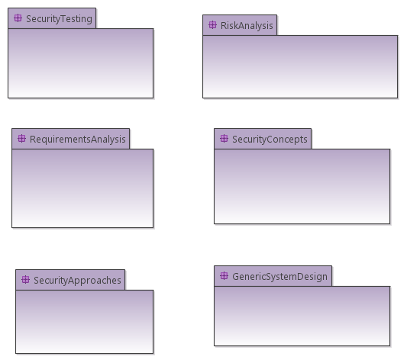
Overview of the DIAMONDS Information Model

Slide 6
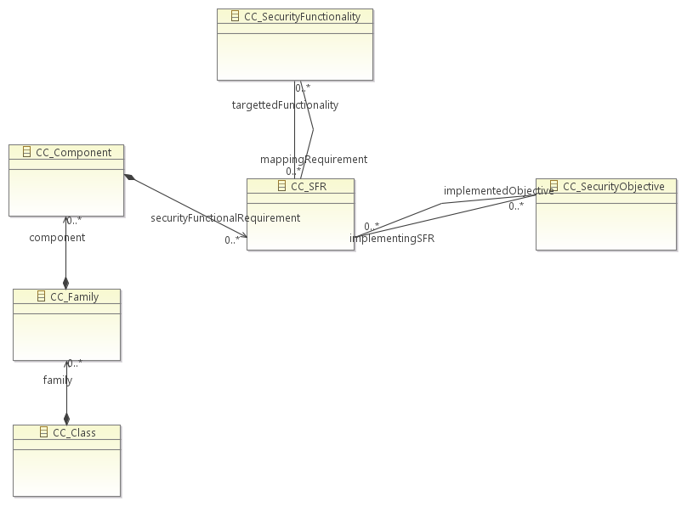
DIAMONDS Information Model: Common Criteria

Slide 7
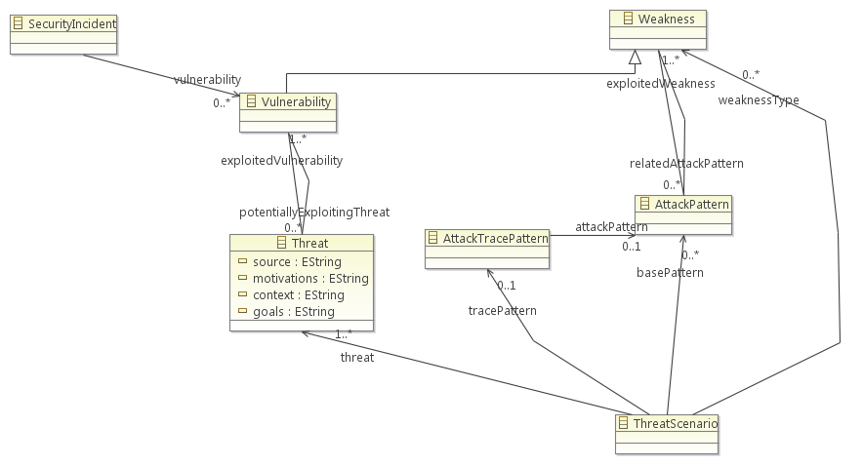
DIAMONDS Information Model:

Slide 8
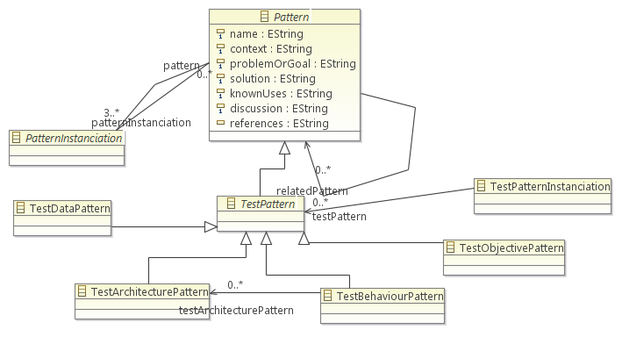
DIAMONDS Information Model: Test Patterns

Slide 9
Summary and Outlook
The DIAMONDS information model reuses concepts already defined by TVRA, SINTEF and Common Criteria
Focus is on testing concepts and relationship with other security concepts
The model will provide a common base for the DIAMONDS project‘s security testing integration platform
The model is not completely defined yet
Testing information model is ready
Security information model is ready
Generic system design information model is ready
Linking of concepts with each other has been started, but yet to be completed

