Slide 1
Security SIG#4 in MTS 10th August 2012
Fraunhofer FOKUS

Slide 2
Agenda SIG#4
Currently registered participants: I. Bryant, S. Cadzow, J. deMeer, S. Schulz, A. Takanen, B. Stanca-Kaposta, A. Rennoch, …
Work item overview & status
Discussion of work progress
Relation to other groups/events
Next steps, perspectives:
E2NA, Security workshop, SIG#5

Slide 3
Recall of SIG history
SIG#1 (Berlin, 12/2011)
Discussion on scope: specification, analysis, testing
NWIs : terminology, case study experiences, design guide
Appointment of rapporteurs: Ari T. and Scott C.
SIG#2 (Sophia, 03/2012)
Start of Wiki initiative about terminology
Draft on security design guide (with lifecycle diagram)
Need for more promotion
SIG#3 (Göttingen, 05/2012)
Review of Wiki contents
Proposal regarding Architectural Security Specification

Slide 4
Previous APs
Wiki text should not only be a list of words, but with text and tutorial character (in progress)
Invite CTI to check Contents (open)
Steve: the introduction part should focus/promote new testing areas (open)

Slide 5
Previous APs
Steve: opportunity for ETSI Security workshop
MTS to chair a security testing session (open)
Start to plan topics, areas of interests
Deadline 12.October, event 16/17.January http://www.etsi.org/SECURITYWORKSHOP
„Old“ WI „Security Testing Methodology“ is not active at the moment and may be closed (to be confirmed by Scott C.) (open)

Slide 6
Security Testing Terminology and Concepts - STATUS
not a pure listing of definitions but an introduction of terms using full text
Abstract → TBD
Introduction/Basic terminology (Steve?)
(focus/promote new testing areas) → listing available, text TBD
Use cases
Security Testing in security design life cycle (Ian) → listing available, text TBD
Serucity testing in post-realease (incl. Penetration test) (Ari) → TBD
Security Test Requirements (Jan) → first input, TBD
Map to chart, assurance framework level 2
Functional Testing (Axel) → available
Performance Testing (Ari) → TBD
Fuzzing (Ari) → available
Please JOIN & Contribute: https://collab.codenomicon.com/collab/codeetsi/

Slide 7
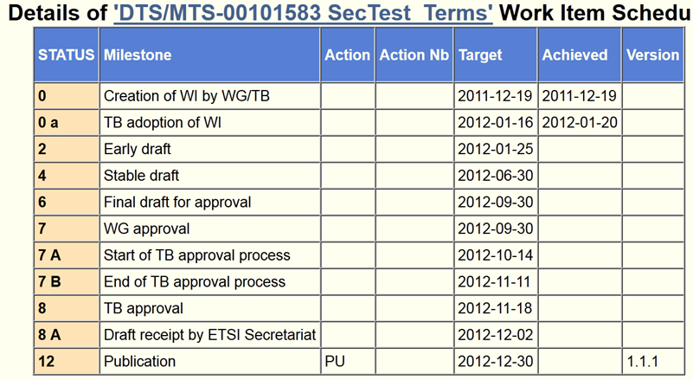
Time plan (delayed)

Slide 8
„Workplan“
Workitems got only some input
Less contributions -> more promotion?
Cooperation with other groups:
E2NA-security (re)starts,
ITS, OCG-security, LI (lawful intercept)
Assigned responsibilities/new deadlines?
Next meetings/calls
SIG#5: 19th September (morning before MTS#57)

Slide 9
Possible New Work Item (from SIG#3) Architectural Security Specification
MTS Security SIG has defined an Architecture and Assurance Lifecycle
Original intention had been for Architecture element – which would form the platform for Security Specification – to rely on work of ISO/IEC JTC1 SC27 WG4 in this area
ISO/IEC JTC1 SC27 WG4 item now in abeyance
Option identified for MTS Security SIG to adopt the existing effort

Slide 10
Architectural Security Specification Proposed Work Item Structure (from SIG#3)
Introduction
Scope
Normative References
Terms And Definitions
Overview
Information Security Architecture Framework
Information Security Architecture Requirements
Information Security Architecture Implementation
Annex A (Informative) Functional Groups And Classes
Annex B (Normative) Generic Effect Class
Annex D (Informative) Example Design Class
Annex E (Informative) Example Design Pattern
Bibliography

