Slide 1
Security SIG in MTS
05th November 2013
DEG/MTS-202793
RISK-BASED SECURITY TESTING
Fraunhofer FOKUS

Slide 2

Risk-based Security Testing
Methodologies I
  Document status (Resp: JGR)
  WI: Security Testing Methodologies (Section 6 with methodologies for risk based security testing based on standards like ISO 31000 and IEEE 829/29119),
  Draft work plan for WI
  Draft document with input from RASEN/DIAMONDS
  Resolution
  AP (JGR) establish work plan and initial contribution until next Security SIG meeting
  AP (JGR) provide list of terms from the case studies (until mid of October)

Slide 3
Risk-based Security Testing
Methodologies II

Slide 4
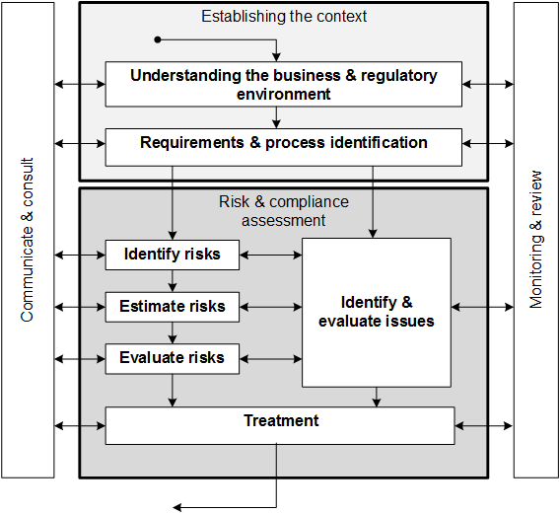
Risk & Compliance Process
Conforms to ISO31000
Integrates risk assessment and compliance evaluation
Applicable to different level of abstraction:
  Legal risk and compliance management
  Security risk assessment and security testing

Slide 5
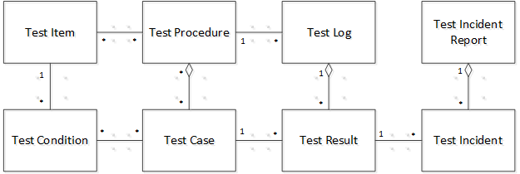
Conceptual Model (e.g. for Testing)
Provide basic terms and their relation
Test case – is a set preconditions, inputs (including actions, where applicable), and expected results, developed to determine whether or not the covered part of the test item has been implemented correctly [8].
Notes:
Explain the terms by means of English text
Provides relationship between the terms by means of associations in the model
Test item – is a work product (e.g. system, software item, requirements document, design specification, user guide) that is an object of testing [8].
Test condition – is testable aspect of the test item, such as a function, transaction, feature, quality attribute, or structural element identified as a basis for testing [8].
Test case – is a set preconditions, inputs (including actions, where applicable), and expected results, developed to determine whether or not the covered part of the test item has been implemented correctly [8].
…

Slide 6
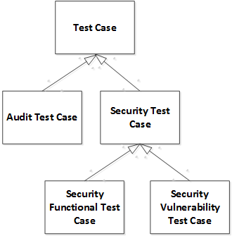
Conceptual Model (Security & Auditing)
Audit test case – is a set preconditions, inputs, and expected results to check whether the business execution adheres to the defined compliance requirements and checking the suitability and effectiveness of the control measures put in place.
Security test case – is a set preconditions, inputs (including actions, where applicable), and expected results, developed to determine whether the security features of a test item have been implemented correctly or to determine whether or not the covered part of the test item has vulnerabilities that may harm the availability, confidentiality and integrity of the test item.
Security functional test case – is a security test case that checks if the software security functions are implemented correctly and consistent with the security functional requirements.
Security vulnerability test case – is security test case that directly addresses the identification and discovery of actually undiscovered system vulnerabilities.
Notes:
Security test case – is a set preconditions, inputs (including actions, where applicable), and expected results, developed to determine whether the security features of a test item have been implemented correctly or to determine whether or not the covered part of the test item has vulnerabilities that may harm the availability, confidentiality and integrity of the test item.
Security functional test case – is a security test case that checks if the software security functions are implemented correctly and consistent with the security functional requirements. It is used to check the functionality, efficiency and availability of the specified security features of a test item
Security vulnerability test case – is security test case that directly addresses the identification and discovery of actually undiscovered system vulnerabilities. This kind of security testing targets the identification of design and implementation faults that lead to vulnerabilities that may harm the availability, confidentiality and integrity of the test item.

Slide 7
Risk-based Security Testing
Step 1: Test Planning
The test planning is the activity of developing the test plan. Depending on where in the project this process is implemented this may be a project test plan or a test plan for a specific phase, such as a system test plan, or a test plan for a specific type of testing, such as a performance test plan (adapted from [12]).
Step 2: Risk Assessment
In this context, risk assessment refers to the process of using risk assessment to identify and prioritize test procedures that will be used as a starting point for test design.
Step 3: Test Design and Implementation
The test design and implementation is the process of deriving the test cases and test procedures (adapted from [12]).
Step 4: Test Environment Set-up and Maintenance
The test environment set-up and maintenance process is the process of establishing and maintaining the environment in which tests are executed (adapted from [12]).
Step 5: Risk Assessment
In this context, risk assessment refers to the process of using risk assessment to prioritize the test cases which should be executed.
Step 6: Test Execution
The test execution is the process of running the test procedure resulting from the test design and implementation process on the test environment established by the test environment set-up and maintenance process. The test execution process may need to be performed a number of times as all the available test procedures may not be executed in a single iteration (adapted from [12]).

Slide 8
Test-based Risk Assessment
Step 1: Establish Objective and Context
Establishing the context refers to the process of defining the external and internal parameters to be taken into account when managing risk, and setting the scope and risk criteria for the remaining process (adapted from [13]).
Step 2: Testing Process
In this context, testing process refers to the process of using testing for identifying/discovering threat test scenarios or areas or vulnerabilities where the risk assessment should be focused. This may be performed by e.g. use of network discovering techniques or vulnerabilities scanners.
Step 3: Risk Identification
Risk identification is the process of finding, recognizing and describing risks. This involves identifying sources of risk, areas of impacts, events (including changes in circumstances), their causes and their potential consequences. Risk identification can involve historical data, theoretical analysis, informed and expert opinions, and stakeholder’s needs [13].
Step 4: Risk Estimation
Risk estimation is the process of comprehending the nature of risk and determining the level of risk. This involves developing an understanding of the risk. Risk estimation provides the basis for risk evaluation and decisions on whether risks need to be treated, and on the most appropriate risk treatment strategies and methods (adapted from [13]).
Step 5: Risk Evaluation
Risk evaluation is the process of comparing the results of risk estimation with risk criteria to determine whether the risk and/or its magnitude is acceptable or tolerable (adapted from [13]).
Step 6: Testing Process
In this context, testing process refers to the process of using testing to validate the correctness of the risk model.
Step 7: Risk Validation and Treatment
Risk validation refers to the process of validating or updating the risk model based on the risk assessment results. Risk treatment is the process of modifying risk which can involve risk mitigation, risk elimination or risk prevention (adapted from [13]).

Slide 9
Instantiation: Iterative Risk-based
Security Testing
T1: Test planning: From risk assessment (RA) to test patterns (TP)
  Risk-based security test condition identification and prioritization: Prioritize test items and test conditions on basis of the risk assessment (RA) and test patterns (TP(.
  Risk-based security test technique identification and prioritization: Maps security test patterns to threat scenarios or vulnerabilities (test coverage item identification, test technique identification & related test completion criteria)
T2: Test design and execution: From test patterns to test implementation and execution
  Security test generation: Generate test cases and test procedures(this process can be automated using Model-Based techniques)
  Security test execution and result determination: Execute test procedures and determine test results and report test incidents
T3: Test evaluation and incident reporting: From test results back to risk assessment
  Security test result aggregation: Aggregate test results (e.g. by means of test and coverage metrics)
  Identify new threat scenarios and vulnerabilities (propagate results to R2): Identify new threat scenarios and vulnerabilities by means of test incidents
  Adjust the risk assessment (propagate results to R3): Adjust probability values and frequency values for vulnerabilities, threat scenarios, and unwanted incidents.

Slide 10
Next Steps
Adding compositional approaches for Risk-based security Testing
Integration with VV

