Slide 1
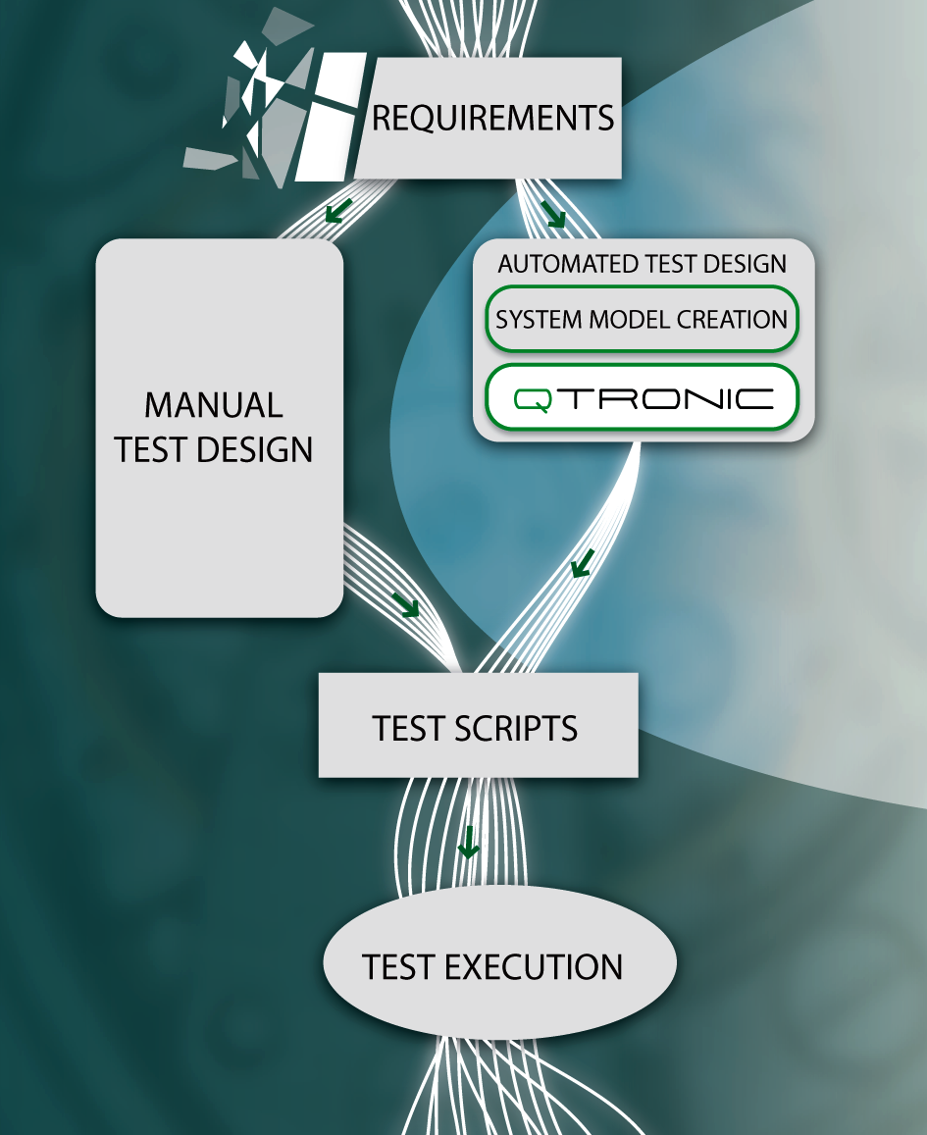
MBT @ ISTQB Stephan Schulz MTS#61, Sophia
CONFORMIQ DESIGNER

Slide 2
About ISTQB
Who is ISTQB?
How do they work?
About new advanced module on MBT

Slide 3
How do they work?
ISTQB
(3 meetings a year)
budget, approval, etc
Working Groups
(MBT, Foundation, Glossary, etc) produces (syllabus) documents
Leader
National Testing Boards responsible for managing certifications providing people, conducting own work
Editors (limited)
Reviewers
(limited)

Slide 4
Status MBT
GTB has working on a MBT module for some time
ISTQB has in 2013 create a new working group for creating an advanced module on MBT
GTB syllabus will be used as input
Current status of the working group remains unclear
Contact your national testing boards if you want to become involved on a personal level

