Slide 1
Open source aspects to select technology for the TDL prototype
György Réthy

Slide 2
Pre-conditions
ToR (clause 6.6, Task 1 – Reference implementation)
Graphical editor based on the Eclipse platform related technologies (e.g. Sirius or UML)
Covering essential (graphical) constructs
UML profile for TDL and integration with Eclipse Papyrus as open TDL UML profile reference implementation
Textual editor based on the Eclipse platform and related technologies
TDL exchange format
Open source
There is a consensus that the tool shall be free open source
Part of task 1 is to: Setting up necessary project infrastructure and open-source portal

Slide 3
What is what
Framework to create (or customize existing) concrete syntaxes for own graphical modeling workbench on top of EMF and GMF
Allows the users to create, edit and visualize EMF models; extensible in many ways, notably by providing new kinds of representations, new query languages and by being able to call Java code to interact with Eclipse or any other system (https://eclipse.org/sirius/overview.html)
Eclipse project, also available through modeling components discovery
EPL 1.0 license
------------------------------------------------------------------------------------------------------
Integrated environment for editing any kind of EMF model, in particular supporting UML, SysML and MARTE;
Advanced support for UML profiles enabling DSLs.
Every part of Papyrus may be customized: model explorer, diagram editors, property editors, etc.
Eclipse project, also available through modeling components discovery
EPL 1.0 license

Slide 4
What is needed for Open Source - 1
Tool (with examples)
Licensing
Which license terms? How business-friendly shall it be? (adding own, business-critical extensions?; use in commercial products [relicensing]?)
Business-unfriendly: GPL, LGPL, MPL ….
Business-friendly: EPL, Apache, BSD, MIT ….
Legal
IPR checking
Registered trademark name checking
Decide copyrigth/copyleft
Select place/community to host it
Which business model? (http://opensource.com/business/12/9/a-complete-guide-marketing-project-business) Community- vs. consortium-driven ecosystem? (vendor driven is out of scope)
Infrastructure
Services provided
How widely it is known/accepted?

Slide 5
What is needed for Open Source - 2
Marketing and Communication
Logo, datasheets/flyers
Introduction video(s)
Presentations at events etc.
Website, wikipedia page etc.
Drivers
Who?
Closely related to marketing and communication – drivers shall promote the tool and communicate actively
Interested parties
Contributors
“Passive” users

Slide 6
Services provided by Foundation
Creation of new projects
Trademark checking
Complete IPR checking of code and 3rd party SW
Creation of web pages for the projects (content to be provided by initiator)
Infrastructure
Source code (Git or GitHub) storage and version control
Build infrastructure
Bug tracker
Community
Considerable user base
Infrastructure (forums, project management etc.)
Conferences, events (EclipseCon, etc.)
Specialized user groups (e.g. Polarsys:

Slide 7
Comparision
Open Source
Complete MBT ecosystem, a TDL editor would become part of the MBT workflow automatically
Supports sequence diagrams already
Considerable user base
Influential drivers behind
Existing project with all infrastructure, community, management, users etc. available
Open Source
According to analysis of STF476 experts, efficient platform for prototyping
Supports sequence diagrams already
Pros
Maybe heavy-weight for simple (non-MBT) use-cases (requires Eclipse, EMF, Papyrus)
No analysis of missing features needed for TDL has been done yet
New platform, hidden weaknesses may show up (1.0 is released in June-2014, but has a few years history[details unknown])
Who will be the community driver?
TDL editor would be stand-alone, not integrated into a workflow
User base volume is unknown
No analysis of missing features needed for TDL has been done yet
Cons
https://projects.eclipse.org/projects/modeling.mdt.papyrus http://www.eclipse.org/papyrus/
https://projects.eclipse.org/projects/modeling.sirius http://www.eclipse.org/sirius/overview.html

Slide 8
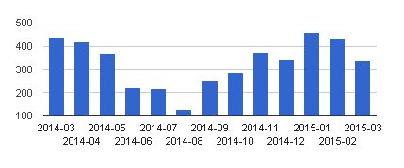
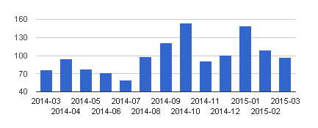
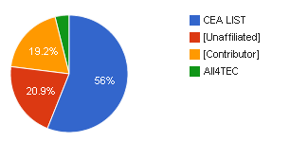
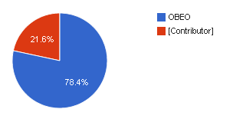
Comparision
Commits:
Who is involved
Active committers: 19
No. of users/downloads: unknown at the moment
Commits:
Who is involved
Active committers: 16
No. of users/downloads: unknown at the moment

