Slide 1
TDL:
The ETSI Test Description Language
Stephan Schulz, TC MTS

Slide 2
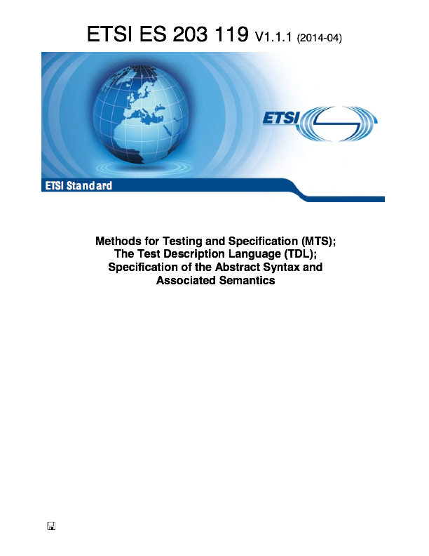
About TDL
Test Description Language
Language for design, documentation, and representation of test descriptions
Follows scenario-based approach
Developed and standardised at ETSI by TC MTS since 2011
Supported by 3 STFs to date
Current STF 492
Main players in standardization
Siemens, Ericsson, Fraunhofer, ETSI CTI, University of Göttingen, Elvior, Cinderella, CEA

Slide 3
TDL Goals
Standardized language for test description – complementary to TTCN-3
Separation of test specification from test implementation
Applicable in various use cases
Standard/product & test documentation, specification of test execution logic, test generation, test transformation & exchange, validation, log visualization
Suitable for use in standardization as well as industry
Agility - ease test development and review
Not ”one-size-fits” all notation – customizable representation
Enable creation and review of test descriptions for all stakeholders
Improve productivity and quality
Automatic generation of test scripts
Automatic checking of test descriptions and analysis
Automatic transfer between different tools in testing process

Slide 4
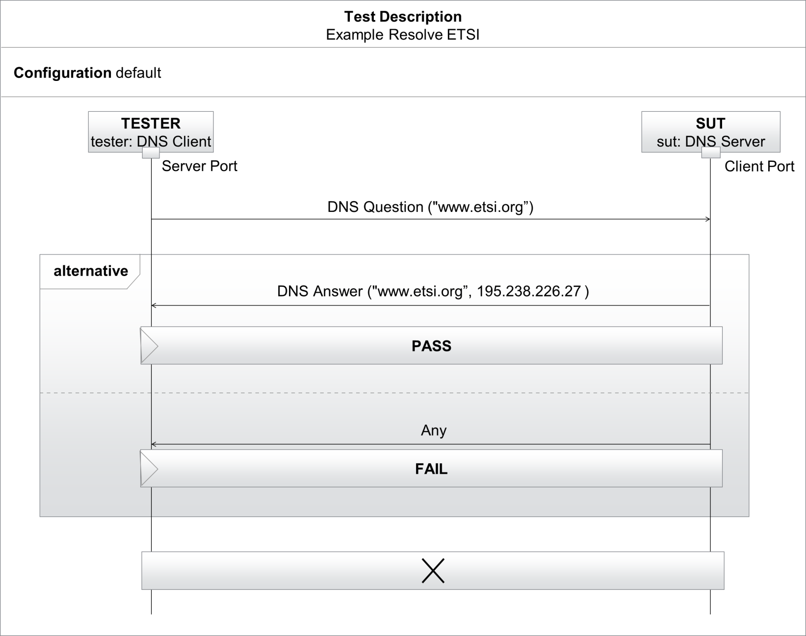
TDL Main Concepts
Test objective
Test configuration
Expected behavior
Abstract test data
Time
One possible representation: Graphical

Slide 5
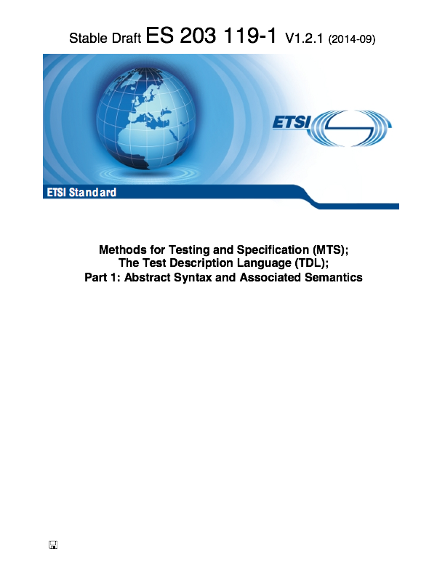
TDL Standards Today
Concrete Syntax
TDL P2: GR
TDL P3: XF
User-defined Syntax
TDL P4: TO
TDL P1: MM
Abstract Syntax

Slide 6
TDL and Tooling
Exchangeable and reusable tool components – adjustable to specific demands
Textual Editor
(incl. ES 203119-4)
UML-based Editor
Report
TDL Analyzer
TDL Test Generator
TDL Exchange Format (ES 203119-3)
Graphical Editor
(ES 203119-2)
(Graphical) Viewer & Doc. Gen.
Doc
Test Code Generator
TTCN-3,
C, Java
Front-end tool
Back-end tool
Artefact (output)

Slide 7
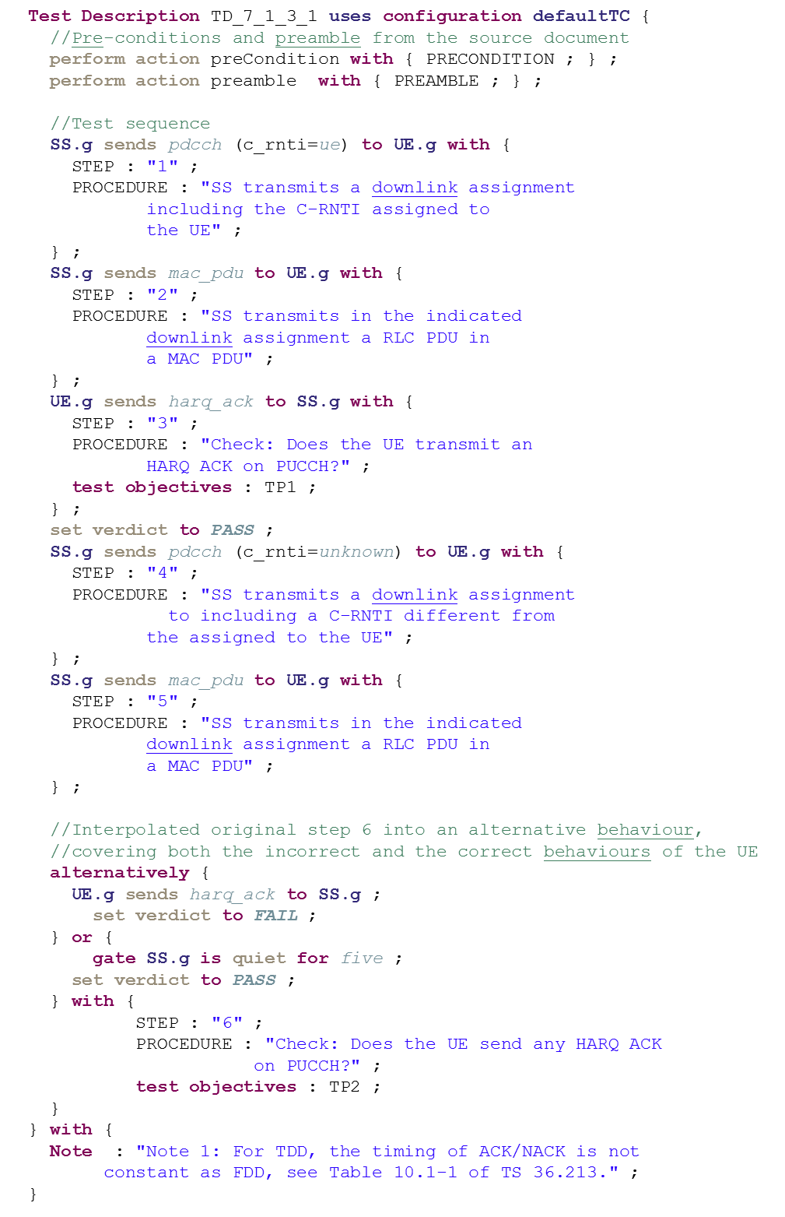
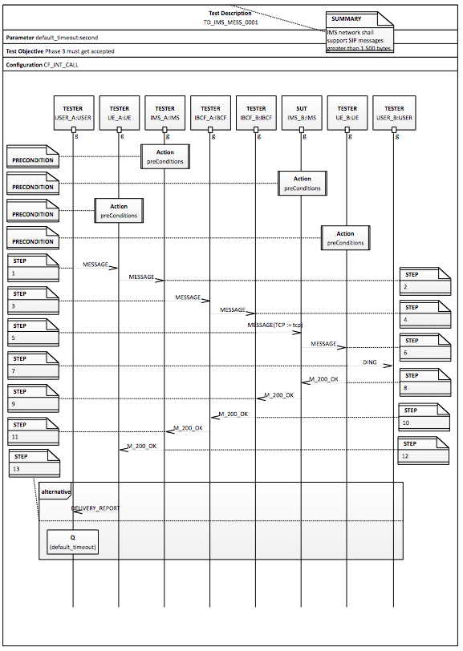
TDL in ETSI Standard Specification
Base Standard Specification
Identification of Requirements
TTCN-3
LOG
Creation of ICS/IFS
DOC
Definition of TSS
Specification of Test Purposes (TPLan, TDL)
Specification of Test Descriptions (TDL)
TDL for …
Representing tests in TR, TS, ES, etc
Generating TTCN-3 test logic
Visualizing test execution logs
Specification of Test Cases (TDL + TTCN-3)
Validation (TDL)
Notes:
But where does TDL fit in?

Slide 8
TDL in Standard Specification
Target
Technical Committees in ETSI, 3GPP, other standards organisations or fora
ETSI members such as operators, equipment vendors, tool makers, consultants
ETSI Plugtests™ and its participants, or other industrial testing events
ETSI STFs, [TTCN-3] test engineers, test managers, etc
TDL offers
Using agile practices in standard development
Development and review and approval of test specification by standardization experts (operators, equipment vendors, tool makers, consultants) instead of STFs
Reducing TTCN-3 development effort by generating TTCN-3 test logic
Validation of test execution traces by all stakeholders
Guaranteed consistency between standards and TTCN-3 test execution
Tool independence
So far trials with 3GPP & ITS conformance and INT interoperability testing standards

Slide 9
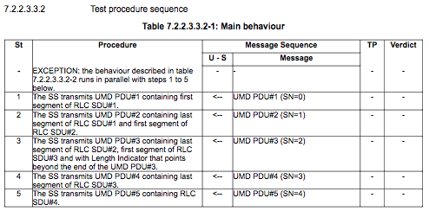
Example: 3GPP TS 36.523-1 (Today)

Slide 10
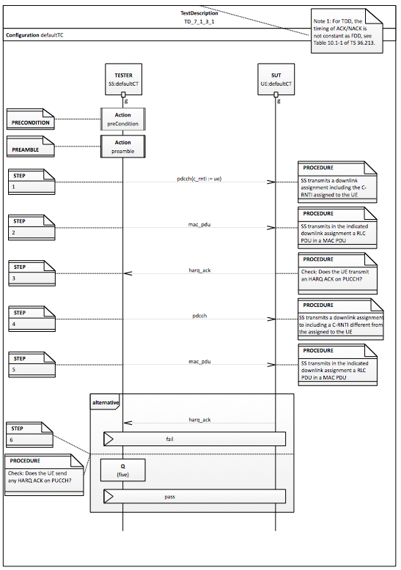
Example: 3GPP TS 36.523-1 (TDL)
< Textual
Graphical >

Slide 11
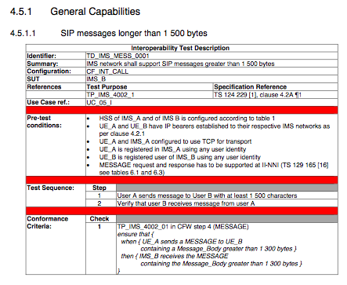
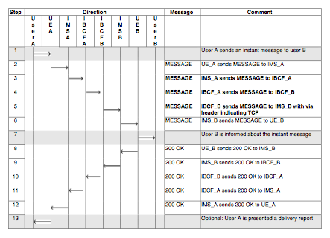
Example: INT TS 186 011-2 (Today)

Slide 12
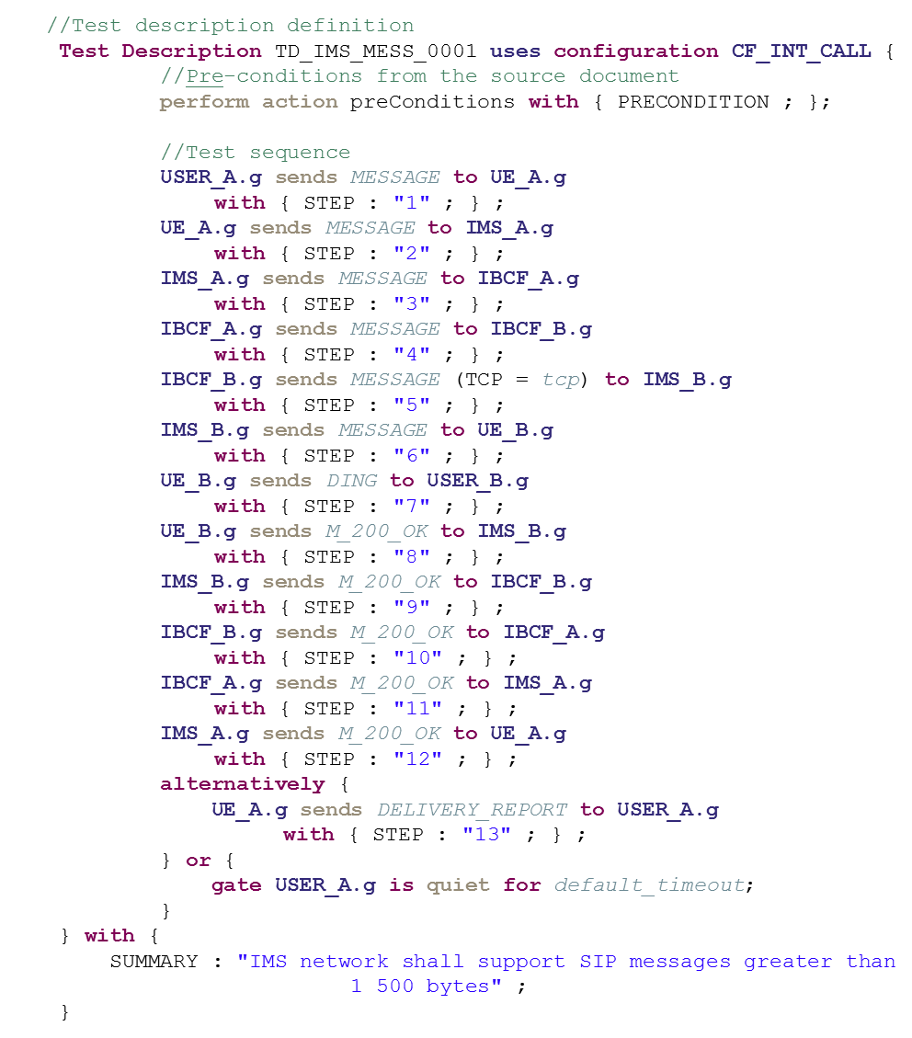
Example: INT TS 186 011-2 (TDL)
< Textual
Graphical >

Slide 13
Benefits for ETSI Technical Bodies
Higher productivity and quality of specifications due to automation
Improved consistency and readability of [test] specifications
Customizable and adaptable representation for different domains and stakeholders
Automatic TTCN-3 code generation for test logic
Exchange and reuse of test descriptions between different working groups and technical committees
Enabler for transitioning to new working methods such as agile and behavioral driven development

Slide 14
Summary
ETSI’s Test Description Language (TDL) is a new standardized test specification language being developed at ETSI TC MTS
Captures interaction of system with its environment (not just the test)
TDL targets to enable engaging (literally) all stakeholders into the test development process and evolving requirements to tests in product or standard development using the same language
Novel compared to previous approaches is the ability for users to define own presentation formats on top of standardized TDL
TDL complements TTCN-3 in the way that test logic specified in TDL can be exported to TTCN-3
MTS STFs have applied TDL to represent current standardized tests in context of 3GPP RAN, TC ITS and TC INT test documentation

Slide 15
Next Steps
Definition of a mapping of TDL to UML in order to allow ETSI and its members to also use existing UMLs tool seamlessly within TDL context
Contribution and initiation of open source TDL tool implementation initiative
Promote TDL at ETSI and in industry
TDL launch at UCAAT 2015 (Oct 20-22 on ETSI premises) with tool demos and tutorial
TDL Website similar to TTCN-3
Standardize a TDL notation specifically for ETSI standard development

Slide 16
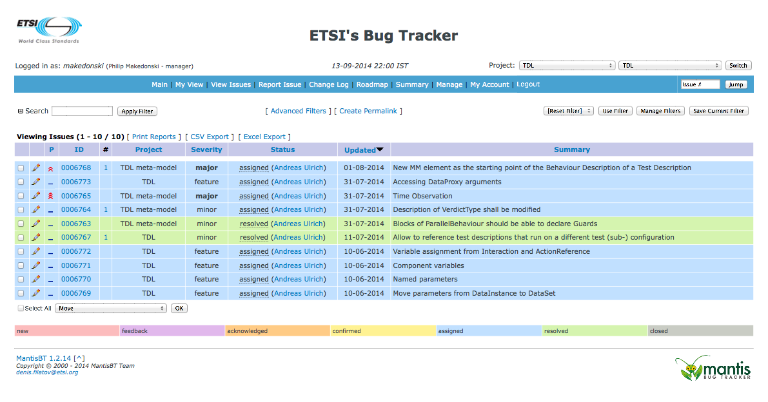
Further Information and Feedback
Feel free to contact TC MTS for more information
Provide feedback and requests via http://forge.etsi.org/mantis/main_page.php

