Slide 1
Security SIG in MTS 30th September 2015 Progress Report
Fraunhofer FOKUS

Slide 2
MTS SECURITY SIG Work Items
Case Studies: To assemble case study experiences related to security testing in order to have a common understanding in MTS and related committees. Industrial experiences may cover but are not restricted to the following domains: Smart Cards, Industrial Automation, Radio Protocols, Transport/Automotive, Telecommunication
Terminology: To collect the basic terminology and ontology (relationship between stake holder and application) to be used for security testing in order to have a common understanding in MTS and related committees.
TR 101 583
Terminology
EG 203 250
Security Assurance Lifecycle
TR 101 582
Case Studies
EG 203 251
Risk-based Security Testing
Published
Security Assurance Life Cycle: Guidance to the application system designers in such a way to maximise both security assurance and the verification and validation of the capabilities offered by the system's security measures.
Risk-based Security Testing: Describes a set of methodologies that combine risk assessment and testing. The methodologies are based on standards like ISO 31000 and IEEE 829/29119
Published
Draft
Stable Draft

Slide 3
EG 203 250: Security Assurance Lifecycle
Document Reference
DEG 203 250
Document Title
Methods for Testing and Specification (MTS);
Security Assurance Lifecycle
Document Purpose
Guide to the application of security capabilities in systems in such a way to maximise both security assurance and the verification and validation of the capabilities offered by the system's security measures.
Document Status
Draft v0.0.12 (2015-09)

Slide 4
EG 203 250: Security Assurance Lifecycle -- Progress
Document Progress
Work Plan produced and updated
Initial draft structure agreed,
Design section of Life Cycle drafted
TVRA parts reduced
Aligned with TR 101583
Restructuring of document after review
Introduced “Demonstration of Fulfillment” for each Sections 6-9
Alignment of diagrams
Received comments from Jürgen/Milan
Next steps/open issues
Guidance character need to be improved.
Guide is hard to read. Language must be be simplified.
TB approval planned for January 2015

Slide 5
EG 203 251: Risk-based security assessment and testing methodologies
Document Reference
DEG 203 251
Document Title
Methods for Testing and Specification (MTS);
Risk-based security testing methodologies
Test-based risk assessment methodologies
Document Purpose
Describes a set of methodologies that combine risk assessment and testing. The methodologies are based on standards like ISO 31000 and IEEE 829/29119.
Document Status
Stable Draft v0.0.15 (2015-09)

Slide 6
EG 203 251: Risk-based security assessment and testing methodologies -- Progress
Document Progress
Aligned with TR 101583
Content accepted and presented at RISK 2015 (workshop hosted by OMG)
Restructuring to remove redundant parts
New revision of Section “Managing complexity within system development” based on comments from Milan Zoric
Next steps/open issues
TB approval planned for October 2015

Slide 7
Liaison to ISO/IEC JTC 1/SC 27
ISO/IEC JTC 1/SC 27 N 15364 “Liaison statement to ETSI TC MTS” dated 2015-05-07
Covering WG3 ISO/IEC 18367, ISO/IEC 19791, ISO/IEC 30104, ISO/IEC 30111, ISO/IEC 18045
Covering WG4 ISO/IEC 27034-2,3,5,6,7
MTS Security SIG provides
ETSI DTR 101 182, ETSI DTS 101 583, ETSI DEG 203 250, ETSI DEG 203 251
Outgoing liaison statement from Security SIG has been sent in July
Additional standards ISO/IEC 27036 1,2,3 (WG4)

Slide 9
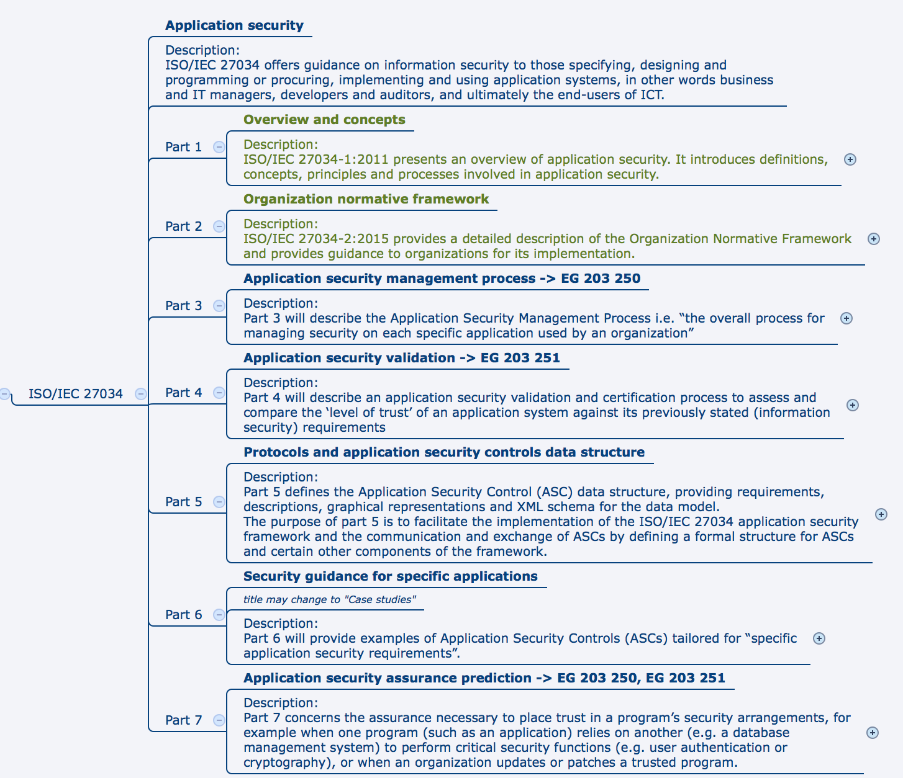

Slide 10
Outlook
Future topics/issues/cooperation:
Requirements metrics and acceptance criteria for Fuzzing (WI proposal postponed, discuss with Ari)
Look for possible input for Security SIG on MBT (i.e. from Bruno Legeard)
Document timeline:
TR 101 582 (Case Studies) has been approved in May 2014
TR 101 583 Terminology has been approved in January 2015
DEG 203 250 (Security Assurance Lifecycle) to be approved in January 2016
DEG 203 251 (Risk-based Security Testing) to be approved in October 2015

