Slide 1
DEPLOYMENT OF MODEL-BASED AUTOMATED TESTING INFRASTRUCTURE IN A CLOUD
ETSI MTS TR
Stable draft
Roman Kužnar, SINTESIO
Boštjan Pintar, SINTESIO
Andreas Hoffmann, Fraunhofer FOCUS
Martin Schneider, Fraunhofer FOCUS
Marc-Florian Wendland, Fraunhofer FOCUS
Nicola Tonellotto, CNR
Alberto De Francesco, CNR
Guiseppe Ottaviano, CNR

Slide 2
Motivation & Scope
Producing technical report (ETSI TR) which delivers case study based on practical experience:
for the deployment of MBT automated testing infrastructure as TPaaS (Test Platform as a Service);
for the deployment of (3rd-party) test methods for automated test suite generation, scheduling, execution, and test arbitration within TPaaS;
for the definition and use of Domain Specific Language (DSL) for developing SUT models and Test models that are compliant with the test methods used within TPaaS.

Slide 3
Content of the TR
Introductory sections (IPR, Foreword, …)
Scope, References, Definitions and Abbreviations
Integrated framework for testing automation on a cloud infrastructure
Overview of end user use cases
  Use Case #1: Test Execution
  Use Case #2: Manual Test Design
  Use Case #3: Automated Test Design
System models in TPaaS
  MDSL conceptual model
  Realisation as UML Profiles
  Mapping of the DSL to TTCN-3
  Constraints on the MIDAS DSL
  TTCN-3 Generator
  SCA4SAUT approach to system modelling

Slide 4
Content of the TR – Con´t
Deployment on the TPaaS on the public cloud infrastructure
  Integration of test methods on the TPaaS platform
  Implemented facilities
Appendix A:
  Direct Execution Use Case Example: IMS Conformance testing
  Manual test design example: Supply Chain Management Pilot
  Automated test design example: e-Health Pilot
  Above cases described from the following aspects:
    SUT description
    Test configuration (arhitecture, message flow)
    Experiances

Slide 5
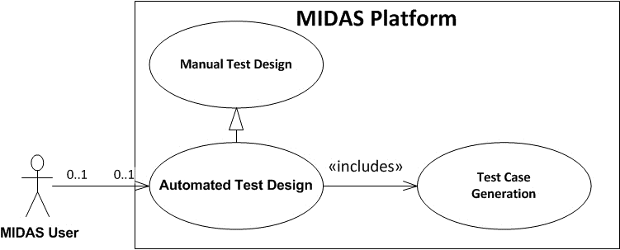
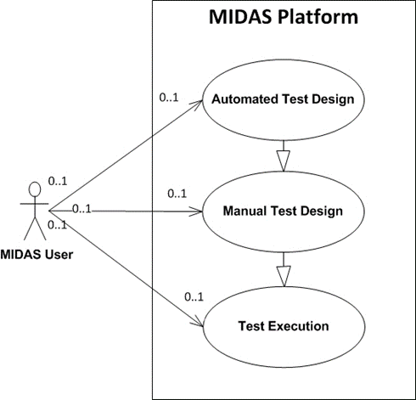
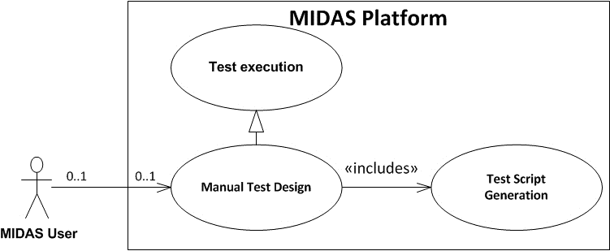
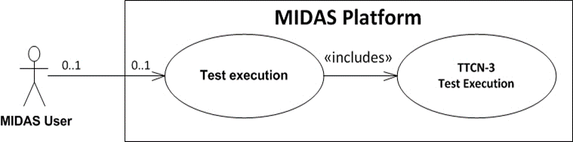
Use Cases Considered within MIDAS project

Slide 6
Process for model-based testing with system models
*MBT process as described in [ETSI TR 102 840 V1.2.1].

Slide 7
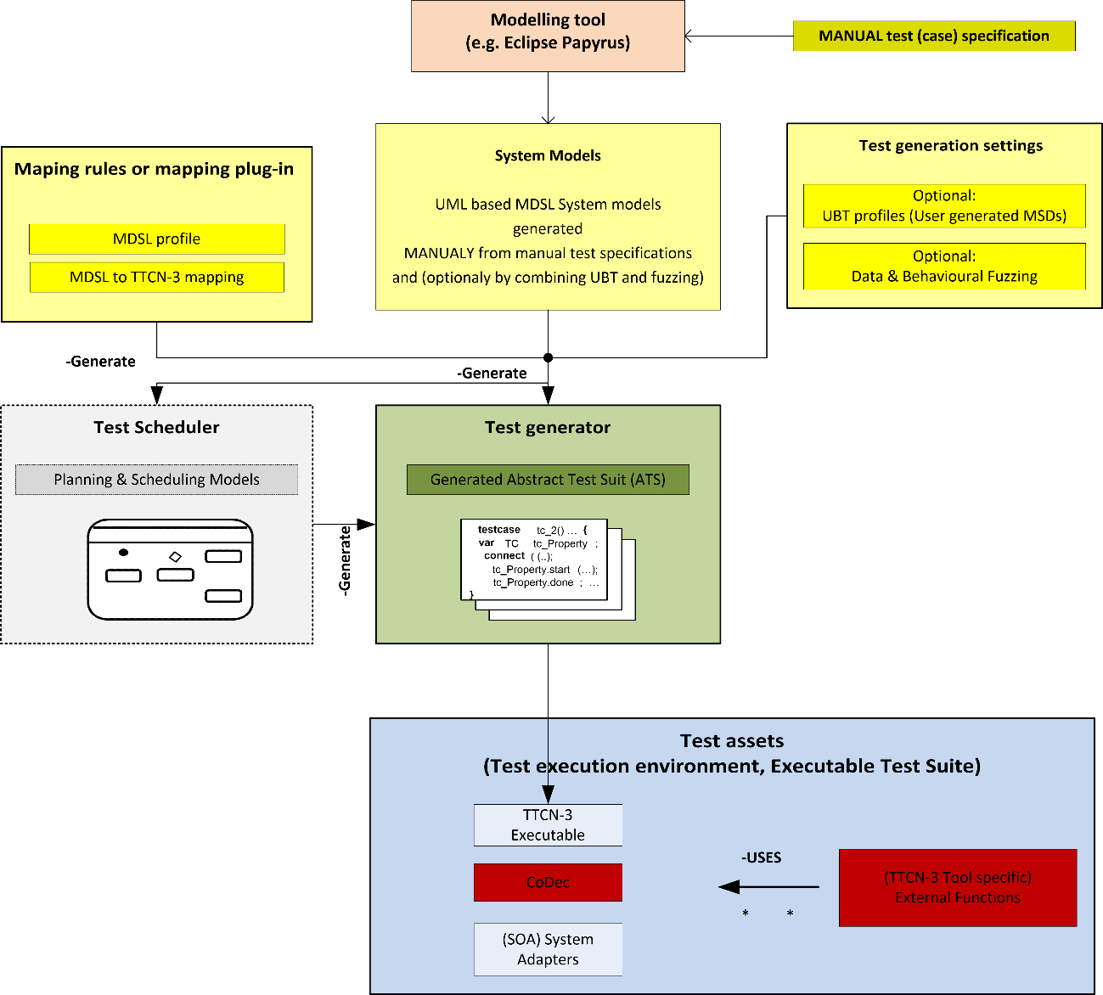
Overview of the Manual test design use case workflow.

Slide 8
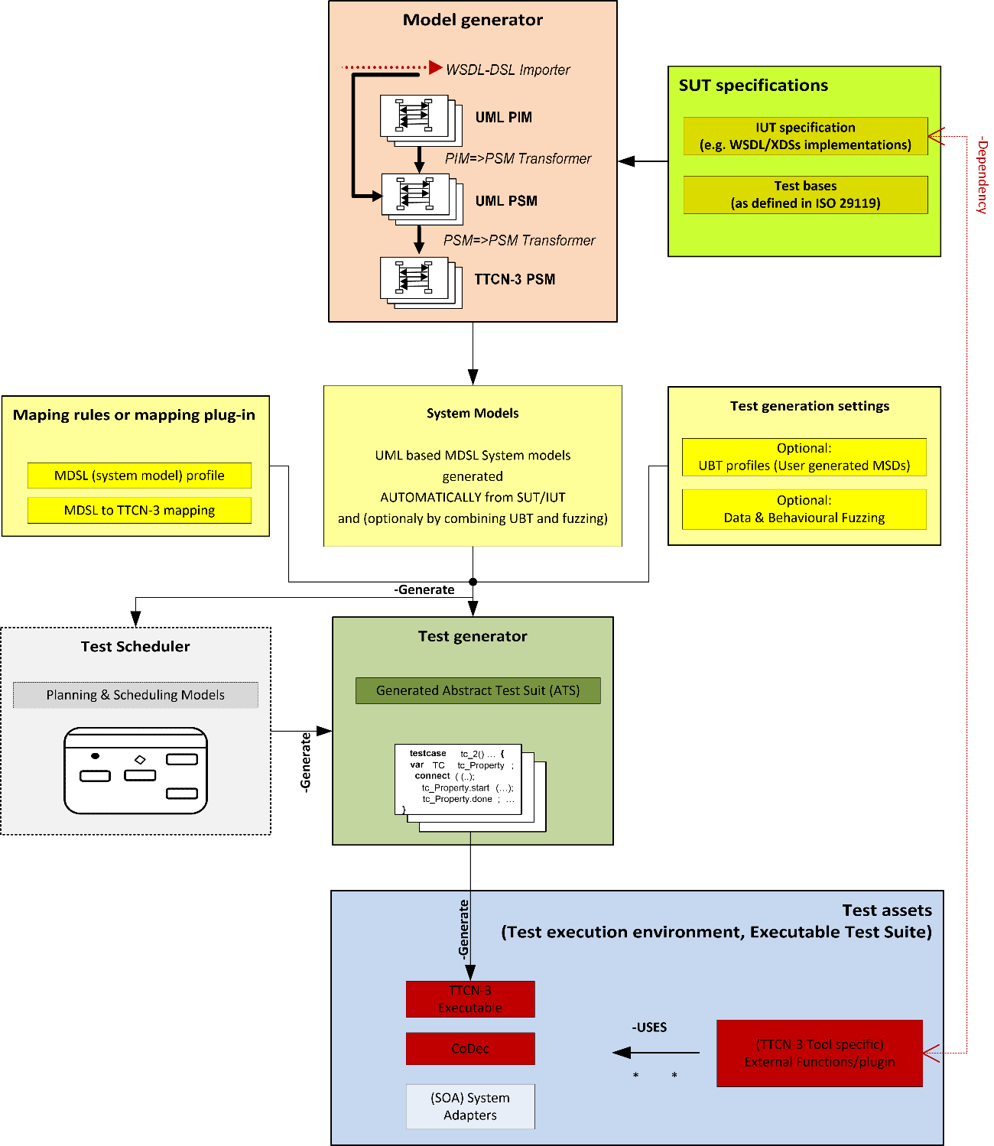
Automated test design use case workflow.

Slide 9
TTCN-3 Specifications
ES 201 873-1 TTCN-3: Core Language
ES 201 873-2 TTCN-3: Tabular Presentation format
ES 201 873-3 TTCN-3: Graphical Presentation Format
ES 201 873-4 TTCN-3: Operational Semantics
ES 201 873-5 TTCN-3: TTCN-3 Runtime Interface
ES 201 873-6 TTCN-3: TTCN-3 Control Interface
ES 201 873-7 TTCN-3: Using ASN.1 with TTCN-3
ES 201 873-8 TTCN-3: The IDL to TTCN-3 Mapping
ES 201 873-9 TTCN-3: Using XML schema with TTCN-3
ES 201 873-10 TTCN-3: TTCN-3 Documentation Comment Specification
ES 201 873-12 TTCN-3: Using WSDL with TTCN-3 (NEW WI)

Slide 10
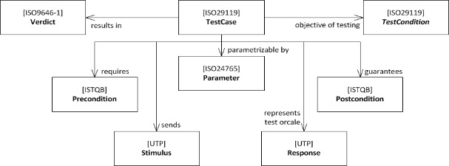
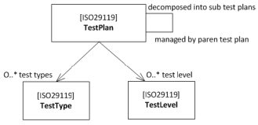
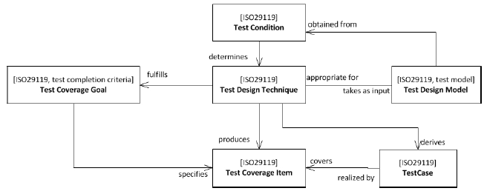
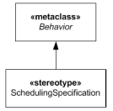
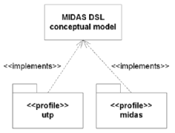
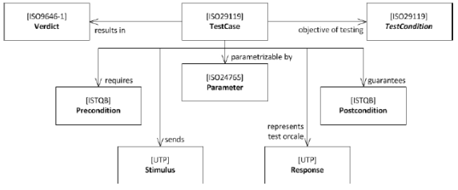
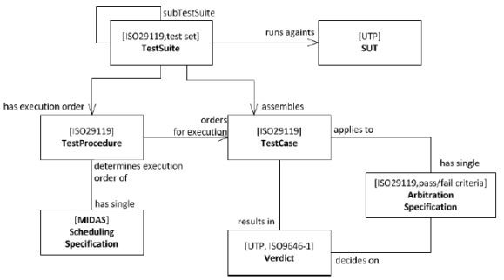
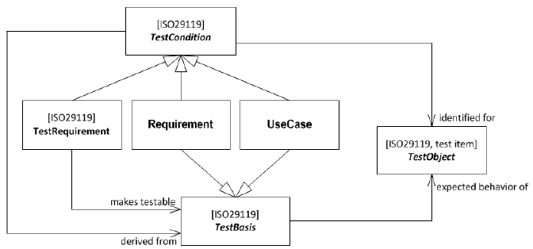
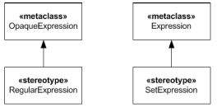
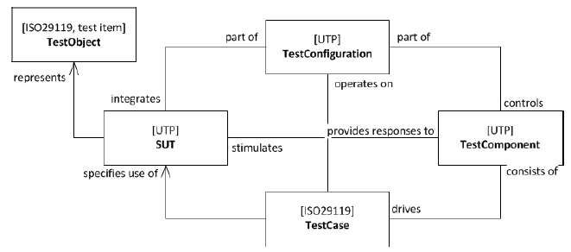
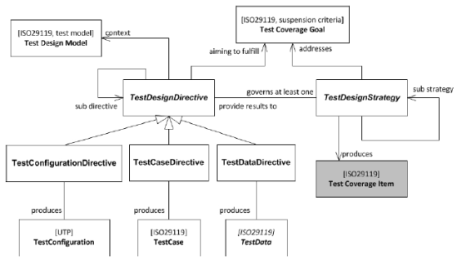
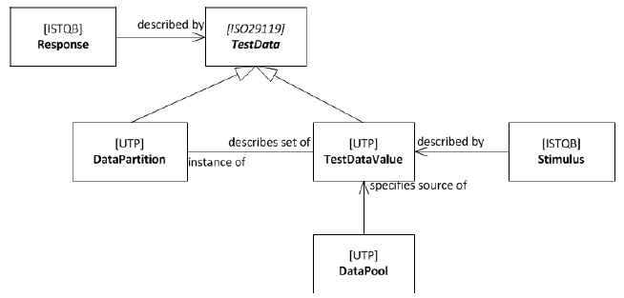
Description of the MIDAS DSL

Slide 11
Mapping of the MIDAS DSL to TTCN-3
MIDAS DSL Concept | TTCN-3 Concept
TestContext | Module
TestContext’s Propety | Module Parameters, Constants
TestComponent | Component (assuming the role of a tester in a test configuration)
SUT | Component (assuming the role of the System Interface component in TTCN-3)
TestCase Operation | Test Case
TestConfiguration | Test Configuration
TestCase Operation Parameter | Test Case Parameter
Test Case Method | Functions that runs on Components assuming the role of a Test Component
Primitive Type | Basic Type and facets thereof
Data Type | record
Enumeration | Enumerated
Signal | record
InstanceSpecification | Template
MIDAS DSL Concept | TTCN-3 Concept
LiteralSpecification | Primitive Type Literal
DataPartition | -
Interface Component | Port Type
Port | Component Port
Connector | Map/Connect
Interval | Range/Length
SetExpression | List of templates
Property | Field (of a record)
Test Configuration Part | Instance of a Component in a Test Configuration
Message Asynchronous Signal | Non-blocking send-/receive-Message
Message SynchCall | call/getcall Call
Message Reply | Reply-/getreply Call
Message AsyncCall | Non-Blocking call
DetermAlt | Altstep
Loop | do … while, for, while … do
Optional CombinedFragment | If () then
Alternative CombinedFragment | If .. else if … else
DurationConstraint | timer start (duration), timer stop, timer timeout
InteractionUse | Function call

Slide 12
Specification of Platform Components
MIDAS Model Validator
Implements the constraints for
MIDAS models to conform to the MIDAS DSL
Input models shall be validated by the MIDAS
Model Validator before test generation is started
TTCN-3 Generator
Implemented as a service of the MIDAS platform
Supports functional, UBT and security test
generation & scheduling (see later)
Provides log file with error messages in case
of errors
MIDAS DSL
Input
Validation
MIDAS DSL
Generation
testcase tc_2() … {
var TC tc_Property;
connect( (..);
tc_Property.start(…);
tc_Property.done; …
}
TTCN-3

Slide 13
Integration of Test Methods - UBT & Fuzzing
Combination of test methods
  Idea: security testing could benefit from usage-based testing (UBT)
UBT aims at testing functionality that is mostly used
  rarely used functionality is less tested
  Attacker‘s can exploit this fact
  an inverted usage-profile could be used for security testing
Adaption of UBT
  simply inverse probabilities in usage-profile
  functional test cases generated from inverted usage profile serve as input for security testing
Notes:
Usage-based testing aims at testing functionality that is mostly used
Therefore, rarely used functionality is less tested and might contain more bugs, including security-relevant weaknesses.
Attacker‘s can make use of this and focus attacks on functionality that is rarely used.
Security testing can use an inverted usage-profile to fuzz functional test cases for rarely used functionality

Slide 14
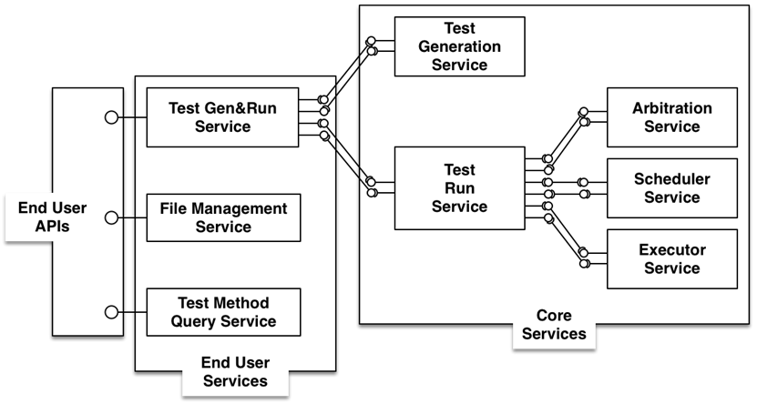
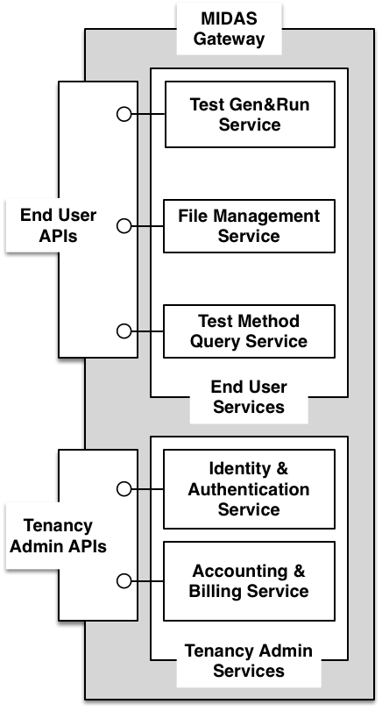
End User and Core Services deployed on Cloud Infrastructure

Slide 15
Appendix A
Experiances acquired
  Direct Execution Use Case Example: IMS Conformance testing
    Existing test suite was used to check direct execution
      Benefit with Regresion testing
      Test adapter and codec/decodec manual implementation
      PICS and PIXITS parameters should be set before testing
  Manual test design example: Supply Chain Management Pilot
  Automated test design example: e-Health Pilot
    MIDAS project is at the final phase and testing activities are intensive against both pilots

Slide 16




Thank you
www.midas-project.eu
info@midas-project.eu
@EUMIDASProject

