Slide 1
DEPLOYMENT OF MODEL-BASED AUTOMATED TESTING INFRASTRUCTURE IN A CLOUD
ETSI MTS WI
Proposal
Roman Kužnar, SINTESIO
Andreas Hoffmann, Fraunhofer FOCUS
Martin Schneider, Fraunhofer FOCUS
Marc-Florian Wendland, Fraunhofer FOCUS
Nicola Tonellotto, CNR
Alberto De Francesco, CNR
Guiseppe Ottaviano, CNR

Slide 2
Motivation & Scope
Producing technical report (ETSI TR) which will deliver case study based on practical experience:
for the deployment of MBT automated testing infrastructure as TPaaS (Test Platform as a Service);
for the deployment of (3rd-party) test methods for automated test suite generation, scheduling, execution, and test arbitration within TPaaS;
for the definition and use of Domain Specific Language (DSL) for developing SUT models and Test models that are compliant with the test methods used within TPaaS.

Slide 3
Outline of the TR
Introductory sections (IPR, Foreword, …)
Scope, References, Definitions and Abbreviations
Overview of use cases
  Use case #1: Test Execution
  Use Case #2: Manual Test Design
  Use Case #3: Automated Test Design
Modelling and Test Suite generation process
  Overview of Modelling and Generation process
  Description of DSL (Domain Specific Language)
  Mapping of the DSL to TTCN-3
  Specification of TPaaS Platform Components
Test Scheduling, Test Execution and Arbitration
  Integration of 3rd party test methods and tools

Slide 4
Outline of the TR – Con´t
Model-based automated testing cloud infrastructure
  Overview of the Testing as a Service Platform (TPaaS)
  Admin and End-user Platform Services
  Platform Use Case Sequence Diagrams
  TPaaS deployment on a Public Cloud Infrastructure
  Implementation of the Use cases as TaaS
Appendix A:
  Experiences & Results from the e-health pilot
  Experiences & Results from the Supply Chain Management pilot

Slide 5
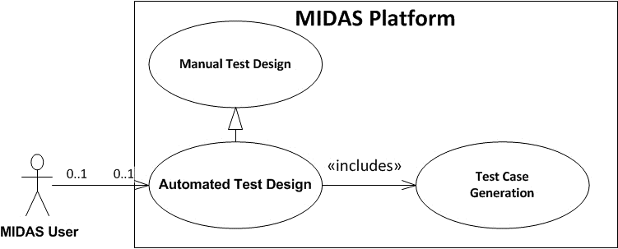
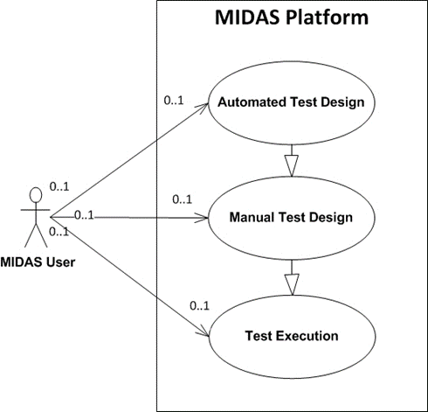
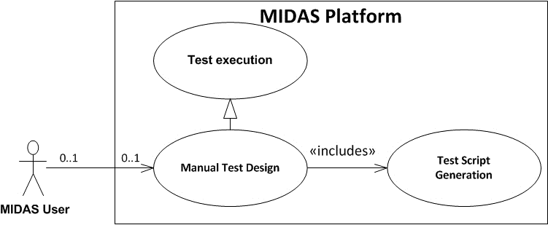
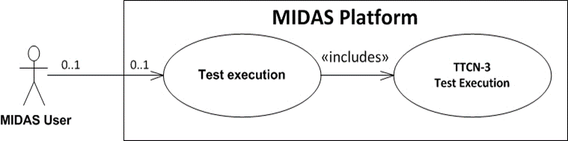
Use Cases Considered within MIDAS project

Slide 6

Test Execution Use Case
Inputs from Pilots
MIDAS Models
MIDAS DSL
Input validation
Design & Behaviour Infos
Combination of UBT & Fuzzing
Import
WSDL
Import
Generation
Data & Behavioural
Fuzzing
Usage Profiles
Generation
Generation
Generation
Planning & Scheduling
Models
Generated
Test Scripts
TTCN-3
testcase tc_2() … {
var TC tc_Property;
connect( (..);
tc_Property.start(…);
tc_Property.done; …
}
: TMScheduler
Generation
MIDAS DSL
Generation
Execution Environment
Java
TTCN-3 Executable
Usage
CoDec
Running
External
Functions
SOA System
Adapter

Slide 7
Manual Test Design Use Case
Manual
Test (Case)
Specification
MIDAS Models
MIDAS DSL
Input validation
Combination of UBT & Fuzzing
Data & Behavioural
Fuzzing
Generation
Generation
Planning & Scheduling
Models
Generated
Test Scripts
TTCN-3
testcase tc_2() … {
var TC tc_Property;
connect( (..);
tc_Property.start(…);
tc_Property.done; …
}
: TMScheduler
Generation
MIDAS DSL
Generation
Execution Environment
Java
TTCN-3 Executable
Usage
CoDec
Running
External
Functions
SOA System
Adapter

Slide 8
Automated Test Design Use Case
Inputs from SUT
MIDAS Models
MIDAS DSL
Input validation
Design & Behaviour Infos
Combination of UBT & Fuzzing
Import
WSDL
Import
Generation
Data & Behavioural
Fuzzing
Usage Profiles
Generation
Generation
Generation
Planning & Scheduling
Models
Generated
Test Scripts
TTCN-3
testcase tc_2() … {
var TC tc_Property;
connect( (..);
tc_Property.start(…);
tc_Property.done; …
}
: TMScheduler
Generation
MIDAS DSL
Generation
Execution Environment
Java
TTCN-3 Executable
Usage
CoDec
Running
External
Functions
SOA System
Adapter

Slide 9
Overview on the overall Modelling & Generation Process
Inputs from Pilots
MIDAS Models
MIDAS DSL
Input validation
Design & Behaviour Infos
Combination of UBT & Fuzzing
Import
WSDL
Generation
Data & Behavioural
Fuzzing
Usage Profiles
Generation
Generation
Planning & Scheduling
Models
Generated
Test Scripts
TTCN-3
testcase tc_2() … {
var TC tc_Property;
connect( (..);
tc_Property.start(…);
tc_Property.done; …
}
: TMScheduler
Generation
MIDAS DSL
Generation
Execution Environment
Java
TTCN-3 Executable
Usage
CoDec
Running
External
Functions
SOA System
Adapter

Slide 10
Overview on the Generation Process
Manual
Test (Case)
Specification
Behaviour Models
Automated
Test (Case)
Generation
(Complex)
Behaviour
Description
MIDAS DSL
Test Model
Generation
Complex
Test
Scenarios
MIDAS DSL
Test Case Generation
Test Case Generation
Generated
Test Cases
Simple
Test
Scenarios
MIDAS DSL
Generated
Test Scripts
Test Script Generation
testcase tc_2() … {
var TC tc_Property;
connect( (..);
tc_Property.start(…);
tc_Property.done; …
}
Test
Scripts
TTCN-3
Automated
Test Script
Generation

Slide 11
Description of the MIDAS DSL
MIDAS DSL
  Describes the UML-based MIDAS DSL (to be standardised as UTP2)
  Specifies constraints for MIDAS DSL compliant models
UML Testing Profile v2 (UTP2)
  Still in OMG‘s standardization process (now also planned for ISO)
  Initial submission of UML testing profile V2 (UTP2)
    Standardising the core and the conceptual model of the MIDAS DSL
    Presented at OMG‘s Boston technical meeting in June
  Feedback from OMG’s ADTF (Analysis & Design Task Force):
    Very good technical work
    UTP2 is considered to be the currently most important and visible activity of ADTF!
  Presentation of the pre-final UTP2 version in December 2014
    Final presentation planned for March 2015 OMG meeting

Slide 12
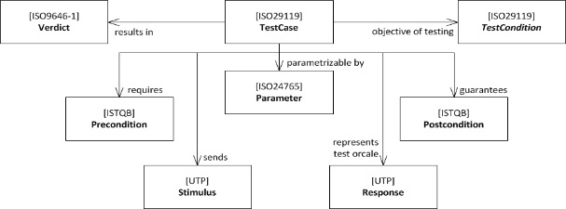
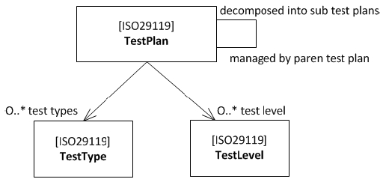
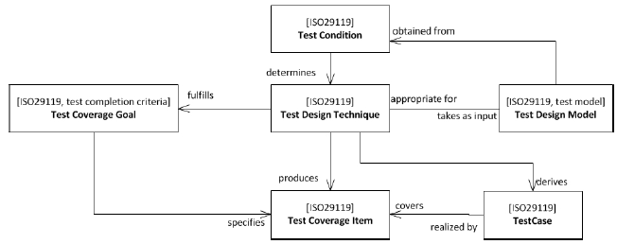
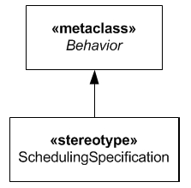
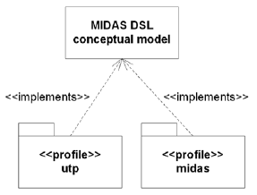
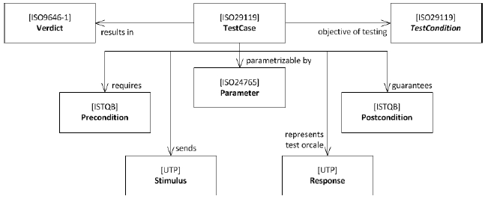
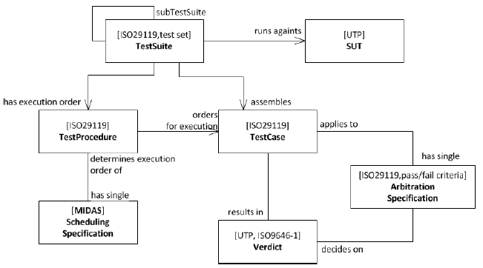
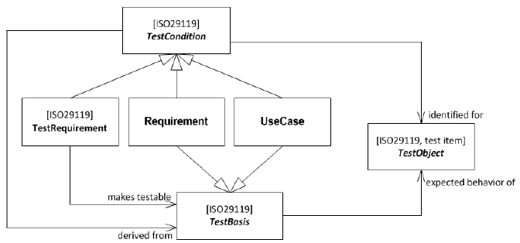
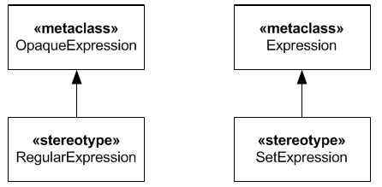
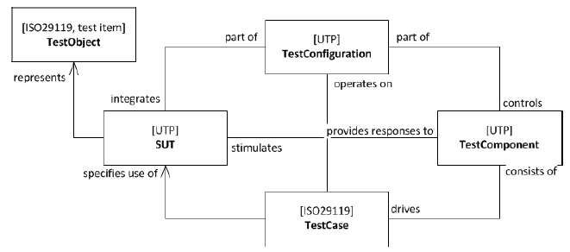
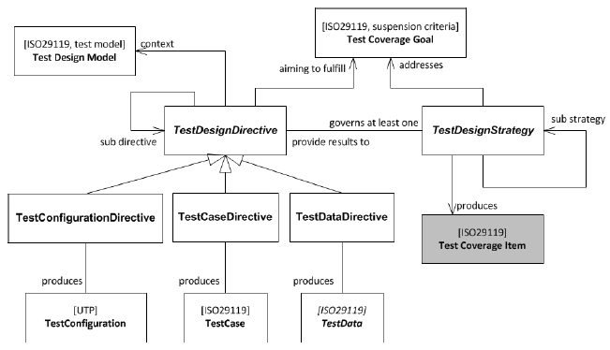
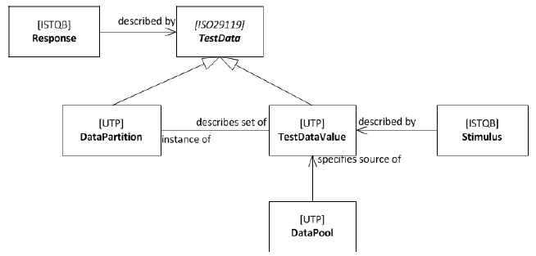
Description of the MIDAS DSL

Slide 13
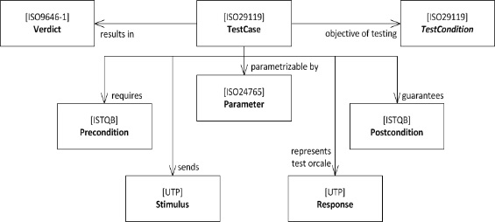
Description of the MIDAS DSL

Slide 14
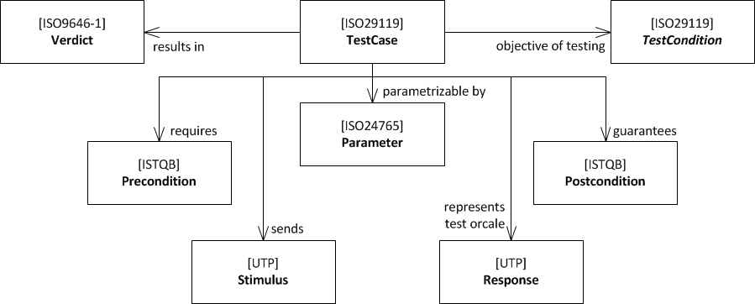
Description of the MIDAS DSL (Example 1)
Example 1: Definition of the concept TestCase

Slide 15
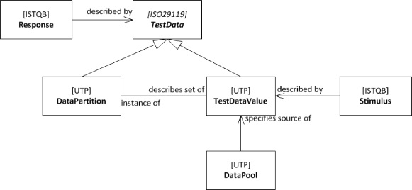
Description of the MIDAS DSL

Slide 16
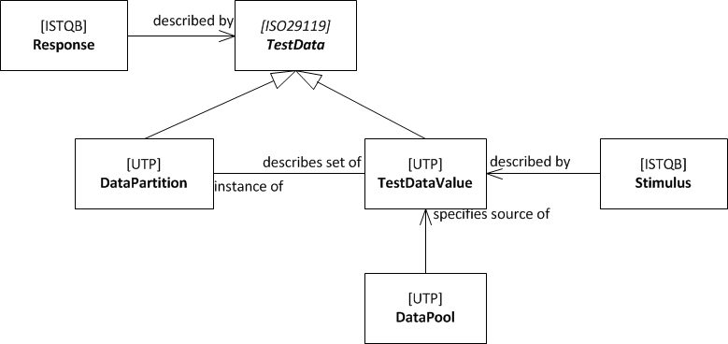
Description of the MIDAS DSL (Example 2)
Example 2: Test Data Concept

Slide 17
Mapping of the MIDAS DSL to TTCN-3
MIDAS DSL Concept | TTCN-3 Concept
TestContext | Module
TestContext’s Propety | Module Parameters, Constants
TestComponent | Component (assuming the role of a tester in a test configuration)
SUT | Component (assuming the role of the System Interface component in TTCN-3)
TestCase Operation | Test Case
TestConfiguration | Test Configuration
TestCase Operation Parameter | Test Case Parameter
Test Case Method | Functions that runs on Components assuming the role of a Test Component
Primitive Type | Basic Type and facets thereof
Data Type | record
Enumeration | Enumerated
Signal | record
InstanceSpecification | Template
MIDAS DSL Concept | TTCN-3 Concept
LiteralSpecification | Primitive Type Literal
DataPartition | -
Interface Component | Port Type
Port | Component Port
Connector | Map/Connect
Interval | Range/Length
SetExpression | List of templates
Property | Field (of a record)
Test Configuration Part | Instance of a Component in a Test Configuration
Message Asynchronous Signal | Non-blocking send-/receive-Message
Message SynchCall | call/getcall Call
Message Reply | Reply-/getreply Call
Message AsyncCall | Non-Blocking call
DetermAlt | Altstep
Loop | do … while, for, while … do
Optional CombinedFragment | If () then
Alternative CombinedFragment | If .. else if … else
DurationConstraint | timer start (duration), timer stop, timer timeout
InteractionUse | Function call

Slide 18
Specification of Platform Components
MIDAS Model Validator
Implements the constraints for
MIDAS models to conform to the MIDAS DSL
Input models shall be validated by the MIDAS
Model Validator before test generation is started
TTCN-3 Generator
Implemented as a service of the MIDAS platform
Supports functional, UBT and security test
generation & scheduling (see later)
Provides log file with error messages in case
of errors
MIDAS DSL
Input
Validation
MIDAS DSL
Generation
testcase tc_2() … {
var TC tc_Property;
connect( (..);
tc_Property.start(…);
tc_Property.done; …
}
TTCN-3

Slide 19
Integration of Test Methods - UBT & Fuzzing
Combination of test methods
  Idea: security testing could benefit from usage-based testing (UBT)
UBT aims at testing functionality that is mostly used
  rarely used functionality is less tested
  Attacker‘s can exploit this fact
  an inverted usage-profile could be used for security testing
Adaption of UBT
  simply inverse probabilities in usage-profile
  functional test cases generated from inverted usage profile serve as input for security testing
Notes:
Usage-based testing aims at testing functionality that is mostly used
Therefore, rarely used functionality is less tested and might contain more bugs, including security-relevant weaknesses.
Attacker‘s can make use of this and focus attacks on functionality that is rarely used.
Security testing can use an inverted usage-profile to fuzz functional test cases for rarely used functionality

Slide 20
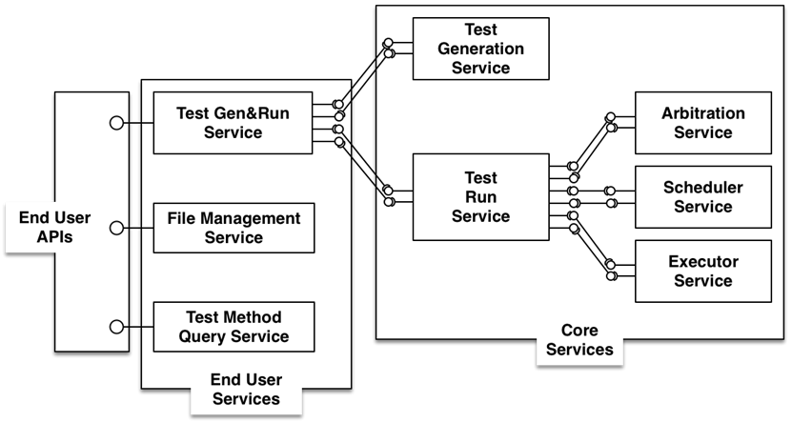
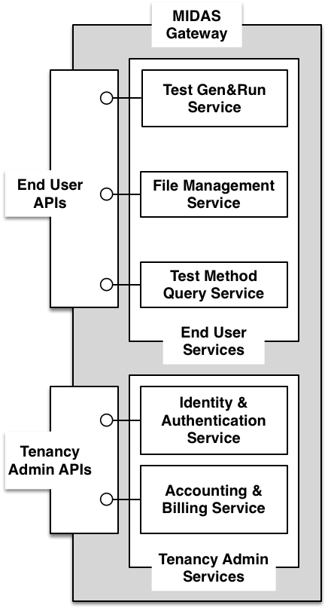
End User and Core Services deployed on Cloud Infrastructure

Slide 21
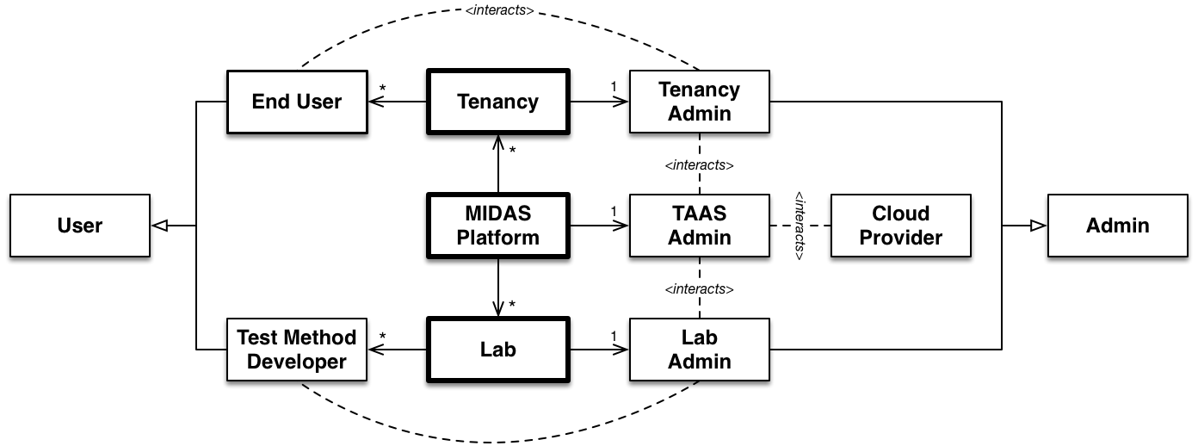
Usage Model for MBT automated testing cloud infrastructure

Slide 22
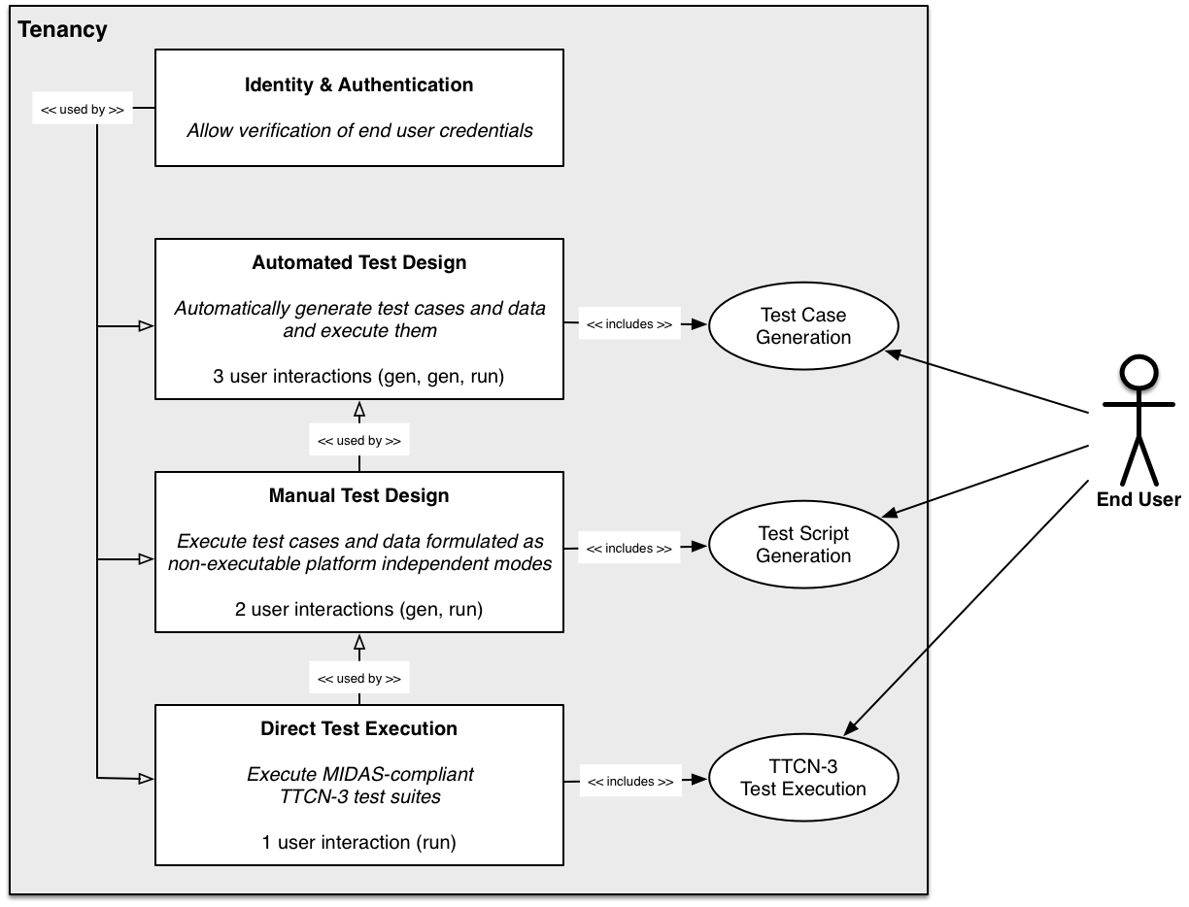
End user main use cases

Slide 23
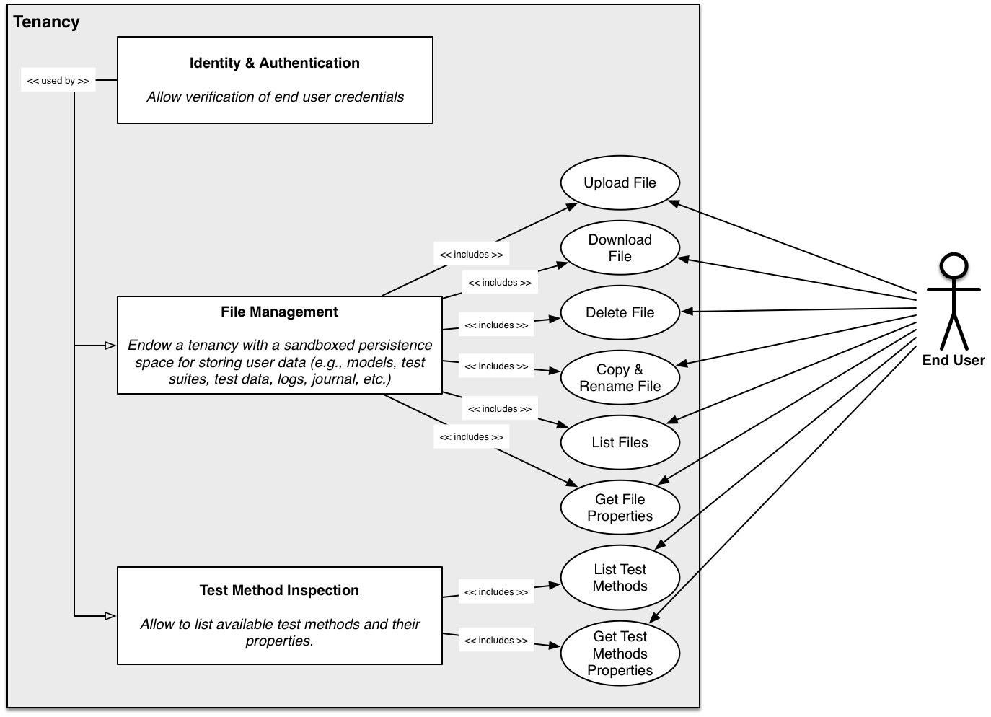
End user ancillary use cases

Slide 24
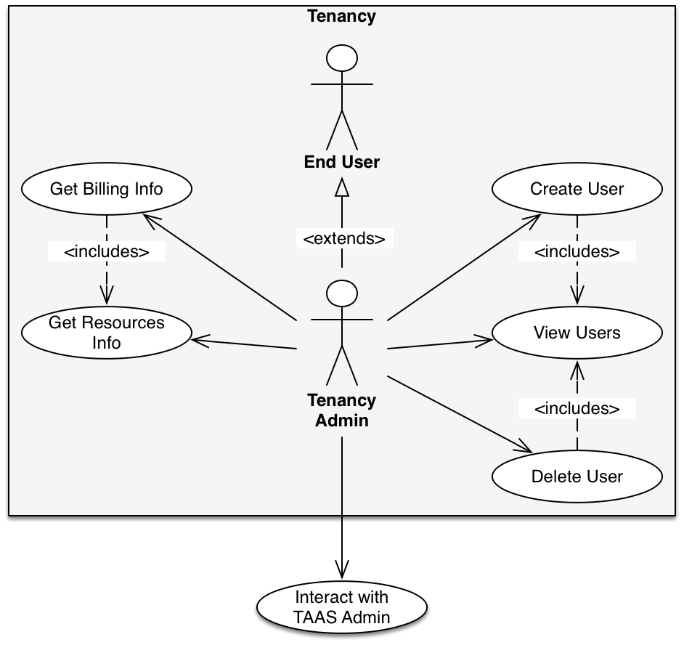
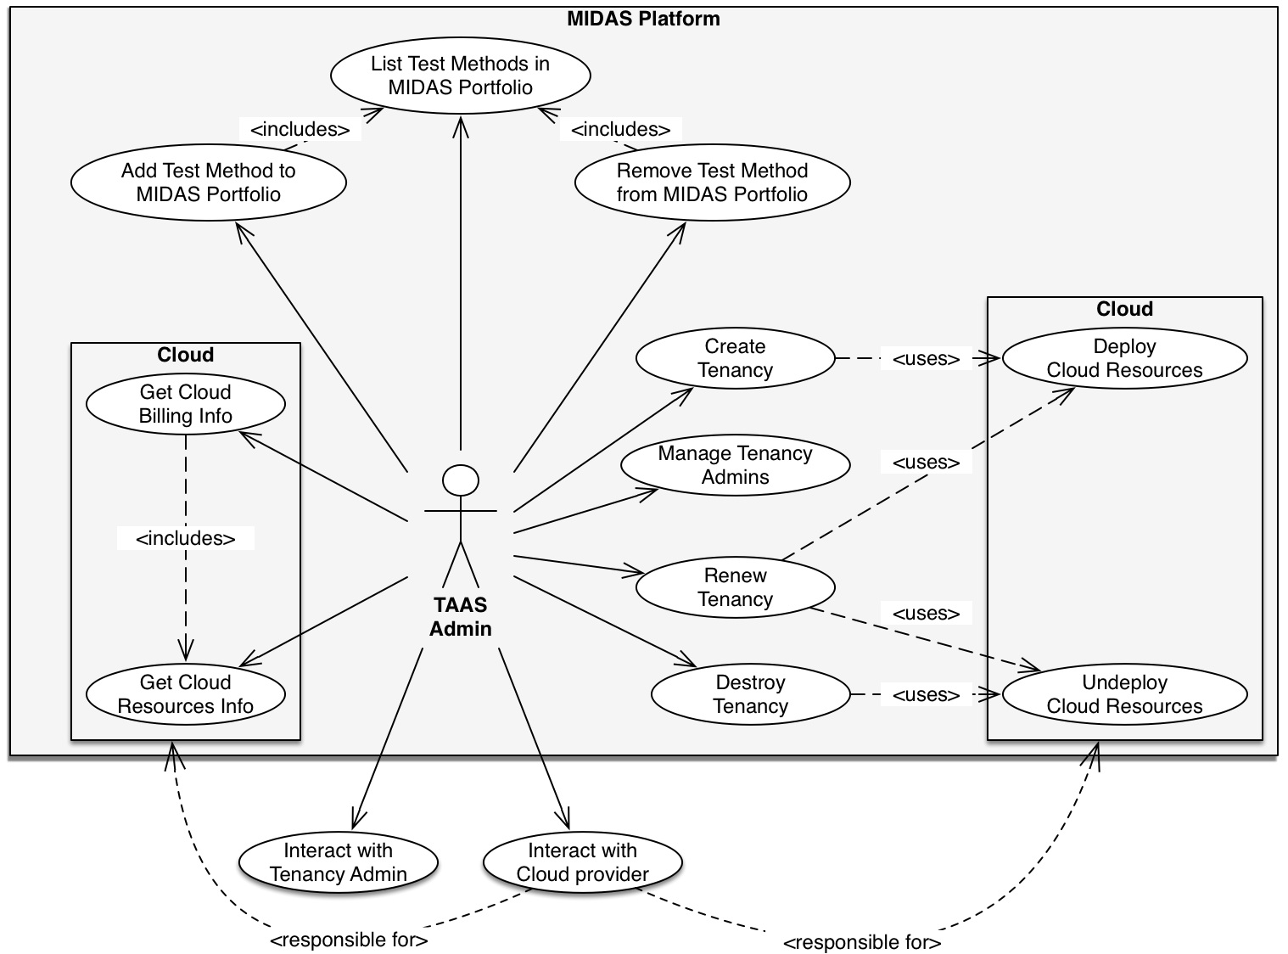
Tenancy Admin and TaaS Admin use cases

Slide 25
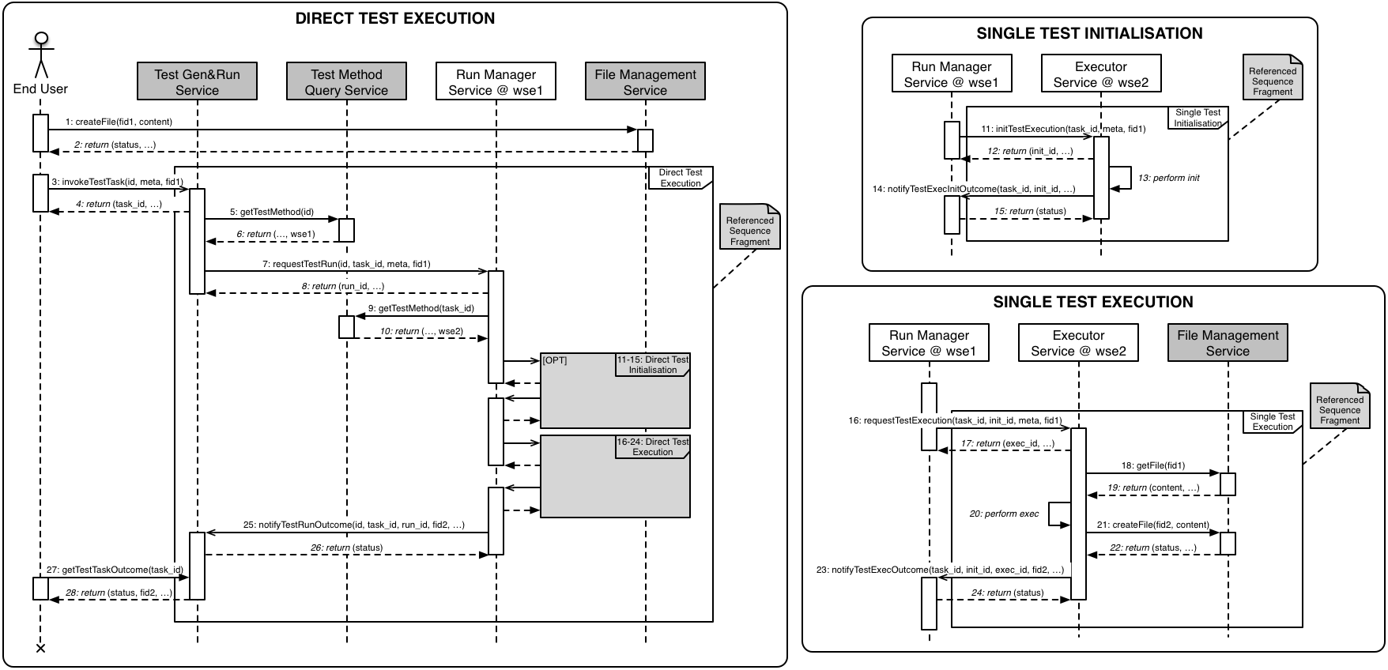
Implementation of Test Execution Use Case as TaaS

Slide 26
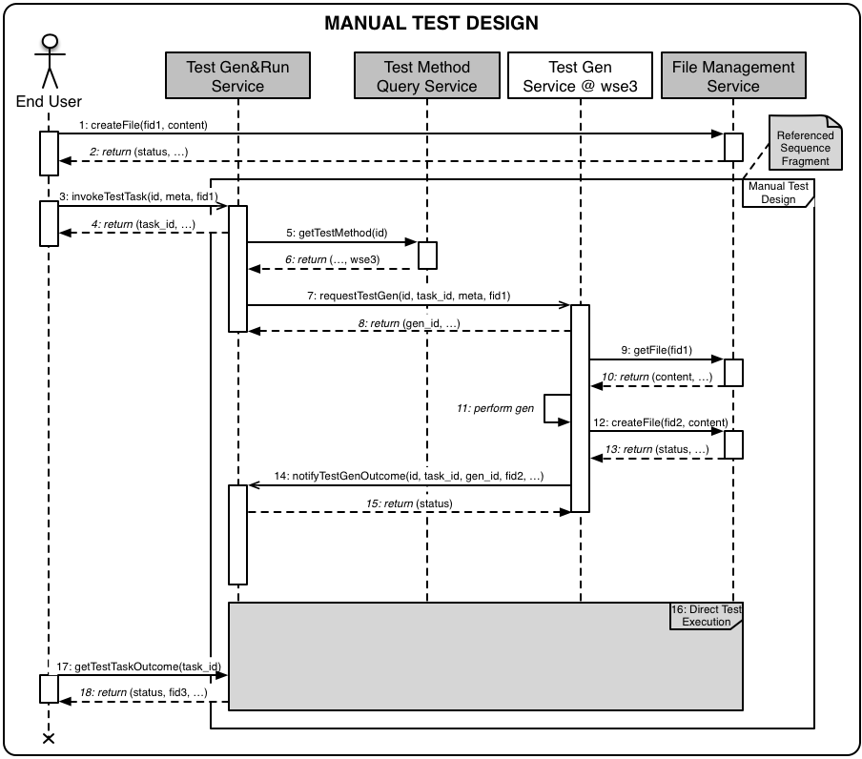
Implementation of Manual Test Design use case as TaaS

Slide 27
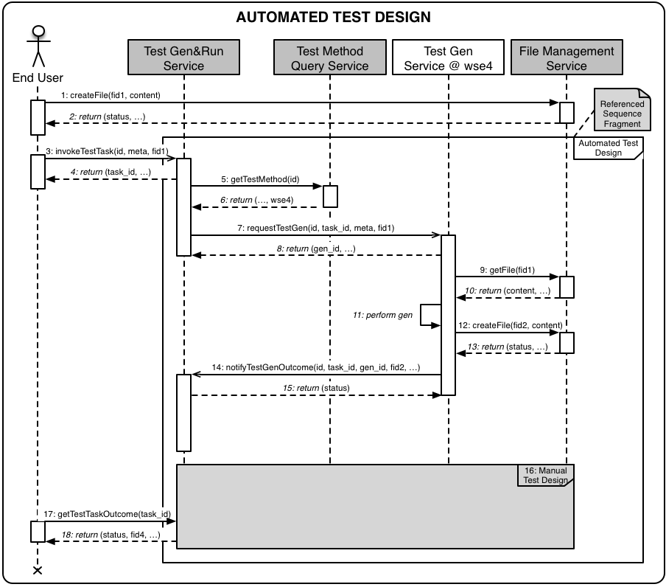
Implementation of Automated test design use case as TaaS

Slide 28
MIDAS TaaS deployment strategy: the DevEnv (in local) and the ProdEnv (on the Cloud)

Slide 29
MIDAS TaaS Deployment on a Public Cloud Infrastructure (M24)

Slide 30
Towards the end of the project
Forthcoming Activities
  Supporting Tools for Pilots: WSDL Importer
  Further Integration with Pilots & evaluation and evolution of the MIDAS DSL and of the MIDAS Constraints along the two pilots
  Integration of Test Methods – Usage-based Testing & Fuzzing
  Adding some missing features
Based on the experiences with the pilots in the 3rd year, the following changes are expected
  Fixing of bugs in the implementations
  Updating/adding constraints of the input validation
  If concepts are missing, they need to be integrated into the MIDAS DSL and implemented accordingly
  Adaptations to the test generation strategies

Slide 31
Timeline and Milestones
Milestone name | Target date
TB adoption of WI | 2015/01/28
Early Draft | 2015/04/30
Stable Draft | 2015/07/30
Draft for approval | 2015/08/31
WG approval (delete if no WG)
TB approval | 2015/xx/xx
To be published as version: | V x.x.x

Slide 32
Supporting Organizations
Regular ETSI members
  SINTESIO, FOUNDATION
  Fraunhofer Institute for Open Communication Systems FOKUS
  Institut für Informatik, Universität Göttingen
  Iskratel
  Testing Technologies

Slide 33




Thank you
www.midas-project.eu
info@midas-project.eu
@EUMIDASProject

