Slide 1
Lifelines in TDL
György Réthy
L.M.Ericsson

Slide 2
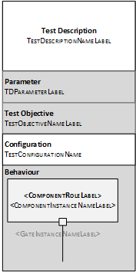
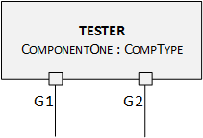
Currently defined
Lifelines: gate instances
One component instance symbol contains ALL gates of that component

Slide 3
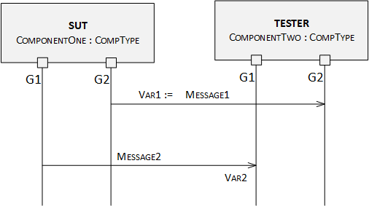
Interactions in current version

Slide 4
Problems
Current tool prototype implementations faced some difficulties with this
Difficult to map to UML
More difficult to implement in other graphical frameworks
The STF has looked at possible alternative solutions that will be shown on the next slides

Slide 5
Proposed solution 1
Lifelines: gate instances
A component instance has as many symbols as many gates it has
Introduced by the Reference Implementation
Due lack of time

Slide 6
Problem in Solution 1
Is Action related also to OtherComp? No, only to ComponentOne, but may be misunderstood
Similarly for Function call, Verdict assignment, Assertion, …
If a lifeline of a component is “far” from other lifelines of the same component, may be forgotten when an Action, etc. drawn
G3 on picture
To be able to handle component-related actions, etc., the “lifelines” of the same component instance shall be placed next to each other
Added value: ????

Slide 7
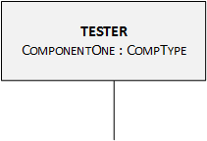
Proposed solution 2
Lifelines: component instances
One lifeline represents ALL gate instances of that component
UML-like
This notation often used in interoperability test standards
Consequence: gate names – if required – shall be given in interactions

Slide 8
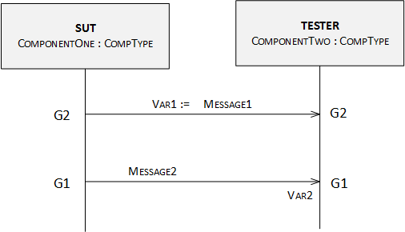
Interaction in proposed version 2

Slide 9
MTS-TDL decisions requested- 1/3
Which solutions to be supported?
Solution 1, solution 2, both or none?
Ericsson’s proposal: In addition to the current notation, add solution 2 to the standard - APPROVED (double check other notations)
Reasons
Solution 1: Could lead to readability problems; could lead to unambiguity in handling component data, timers etc.
Solution 2: Solves the problem and in addition provides better support for interoperability test descriptions and typical system specification practices. It provides better support to incremental TD design

Slide 10
MTS-TDL decisions requested -2/3
Shall tools support all or just one way to be compliant with TDL?
Ericsson’s proposal: Taking into account the different use cases (UML mapping and incremental design), tools may be compliant by supporting only one of the notations - APPROVED (also applies to other cases with alternative notations - e.g. packages - double check and add constraints if applicable, refine conformance statement with different conditions and applicability)

Slide 11
MTS-TDL decisions requested -3/3
On a diagram only one version shall be used or allow mixed notation?
Ericsson’s proposal: Allow mixing current notation and solution 2

Slide 12
MTS-TDL decisions requested -3/3
On a diagram only one version shall be used or allow mixed notation?
Ericsson’s proposal: Allow mixing current notation and solution 2
Reason
No harm, but provides better support to incremental TD design
Only one notation per component (no mixing within a component instance)
APPROVED

