Slide 1
Ucaat ORGANIZATIONAL CHANGES
For information
Presented by Nathalie Guinet for ETSI SERVICES, events@etsi.org
21/01/2016 - MTS(16)067018

Slide 2
Rationale
Strong ETSI Management will to include UCAAT in ETSI events management infrastructure to ensure durability & consistency despite various Hosts
Reinforce UCAAT Brand
A single and permanent URL ucaat.etsi.org on ETSI website
Less financial risk and workload for the Host

Slide 3
New Split of Responsabilities
 | Host coordinating with ETSI | ETSI coordinating with the Programme Committee (PC) and the Host
VENUE | Providing and covering the costs of a suitable venue and AV equipment
EVENT RESOURCE | Providing event coordinator’s contact for ETSI to work with, prior and during the event. | Providing a dedicated event professional throughout the event process
COM | Provide contacts to implement local communication in coordination with ETSI Communications Initiate contacts for local sponsors | Website set up and maintenance Promoting the event at a world wide level (ETSI press and social media networks) Harmonize and synchronize communication with the Host (local and ww) Sponsors follow up (financially and logistically) with local contacts provided by the Hosts Payment of all promotional costs
LOGISTICS | Provision of local contacts and liaison with local suppliers (eg. caterer, printers etc) Provision of bilingual (English + local language) local resource during the event to assist with registration, liaison with local suppliers & participants | Organize the events logistics with the help of the event contact provided by the Host in line with the Programme built by the PC Cover catering costs and social event costs
SECURING PROGRAMME |  | In coordination with the PC: Securing speakers in the programme, gathering and handling speakers presentations for the PC Chair, briefing speakers/moderators On-site support during the event with the speakers and presentations handling
FINANCIAL | Payment of the venue and AV equipment | Fees and sponsors collection and all related administrative follow up Payment of all non venue /av related expenses

Slide 4
Making Hosting UCAAT more attractive
The Host name is clearly associated to the conference name from the very first message
The Host does not bear profits and losses anymore
The Hosts covers only the costs of a suitable venue and provides local contacts (suppliers, press and sponsors)
The Host provides an event manager working with ETSI Events
The Host works in full cooperation with ETSI, who is handling the financial and logistical parts in line with the Programme Committee’s decisions
The Host benefits from a Hosting package

Slide 5
UCAAT Partner
The Partner provides a real added value for UCAAT:
e.g. relaying communication, providing staff and/or expertise, executing a clear and important action for the benefit of the conference
The partner’s name is associated with the conference from the beginning
The Partner benefits from a full promotional package

Slide 6
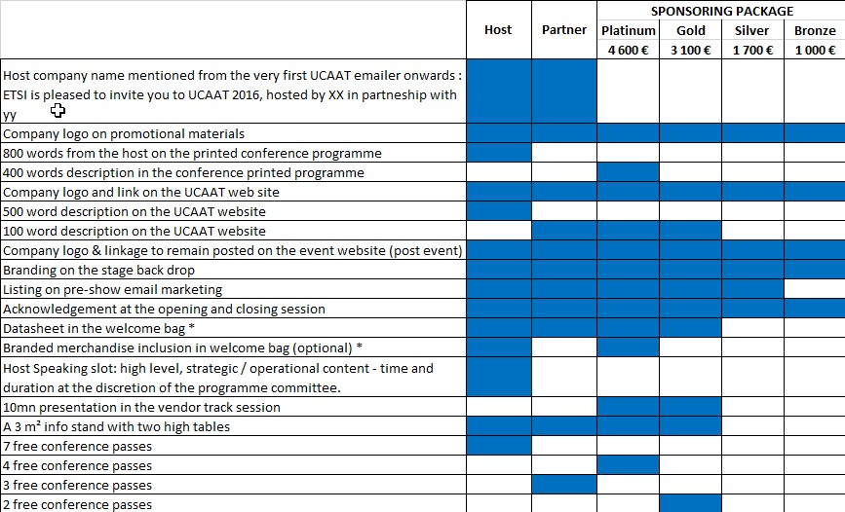
Host and Partner’s Package - NEW

Slide 7
QUESTIONS ?
COMMENTS?
Thank you!

