Slide 1
TDL Open Source Project (TOP) Input to MTS#70, 2017-01-26

Slide 2
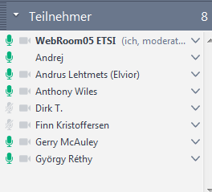
Summary of previous TOP meeting from 2016-12-12
TOP is part of the normal work of TC MTS (not a special project) which means identifying roles and responsibilities
Suggestion: follow largely the Eclipse.org process to be able to easily rebase TOP as an Eclipse project at any time if needed and to learn from best practices
https://eclipse.org/projects/handbook/#starting
Project roles
Management
Project lead
Contributors and committer
IPR: base it on Eclipse EPL v1.0
http://www.eclipse.org/legal/epl-v10.html
Resources anticipated from the Secretariat need to be discussed
Gerry McAuley from CTI is supporting MTS on TOP
Board presentation by Dirk on anticipated resources estimation, governance model

Slide 3
Roles in TOP (output from last meeting)
MTS takes role of leadership and advisory board
TDL SG has the role of the technical advisory board
Defines the roadmap
Responsible that any code submission is in-line with this roadmap
TOP Project lead: ensures neutrality of development according of project goal
Gerry on CTI side + few (1-3) persons from MTS
Committer: write access to code, IP due diligence
From MTS membership, basically STF TDL members will be eligible to be committers
Performs the technical checking of code
Reviews code to be committed by MTS members or the public → code approval process needed
Contributor: contribute code that needs to be approved by a committer
From MTS members and other ETSI membership organizations
From public
There might be 2 different processes for both groups of contributors, e.g. limited access to resources

Slide 4
Needed TOP infrastructure (output from last meeting)
Project infrastructure → use tools already supported by ETSI to keep cost down
Source code management, git
Third-party libraries
Issue tracker
User forum, wiki
Project website – tdl.etsi.org
ETSI platform used for MANO
Gitlab + extensions
IPR search tool
Wikis (public + private)
→ Gerry provides more details; TDL SG decides about tools to be used
→ STF TDL shall provide a list of third-party libraries used in current TDL code
→ Gerry provides an Excel sheet for all anticipated activities on TOP

Slide 5
TDL promotion team (output from last meeting)
TPT tasks
TPT shall support TOP
Manage TDL website, user forum
TPT members
Currently, Miguel performs the uploading, MTS provides contents
→ should be transferred to a responsible person within MTS
→ combine with the roles needed to run TOP
Goal: Setup of initial platform available on next MTS meeting by Gerry
Based on the checklist for needed platform tools
Legal might be still a problem when going public
Therefore 2 steps
First: go live within MTS/ETSI
Second: go live for public

Slide 6
Proposed topics for next meeting and derived action items
Deciding on the infrastructure to be used for TOP
Estimating the required support from ETSI Secretariat for TOP
Detailing the roles and process needed to run TOP
Preparing the TOP presentation for the Board meeting in February
AI: Gerry provides input on the Gitlab platform and extensions available at ETSI
AI: Philip provides a list of third-party libraries used in current TDL code
AI: Gerry provides an Excel sheet for all anticipated activities on TOP to be performed by the ETSI Secretariat
AI: Anthony checks whether there are constraints imposed by ETSI Legal when deploying the Eclipse process, incl. EPL, for TOP
AI: Andreas details further roles and responsibilities for TOP, incl. TDL promotion
AI: Dirk prepares an initial structure and contents of his presentation

Slide 7
Follow-up discussion

Slide 8
Detailing on TOP project structure and tasks
AG
Advisory Group – MTS, decisions at MTS meetings
SG
Technical Steering Group – TDL Steering Group
PL
TOP Project Lead -- small group from MTS + CTI (3 persons)
To set the policies of the project
To make administrative decisions
To coordinate marketing efforts
To coordinate TOP's technical activities
To provide guidelines for future development
To resolve conflicts at technical level
To guarantee neutrality from contributors
To provide project timeline and roadmap
To ensure IP compliance of code base
To decide on TOP committers (see next slide)

Slide 9
Roles in TOP
Guest – anybody (inside/outside ETSI)
Contributor – any registered person (inside/outside ETSI)
Committer – a contributor from an ETSI organization
Browse and download code base
Join the mailing list or forum, access to wiki
Same as guest +
Create a new issue / bug report
Provide bug fixes as code patches
Create new feature requests
Provide code and tests for new features
Contribute to the TOP wiki
Same as contributor +
Consolidate code changes
Manage new versions and branches
Ensure software quality and validate bug fixes

Slide 10
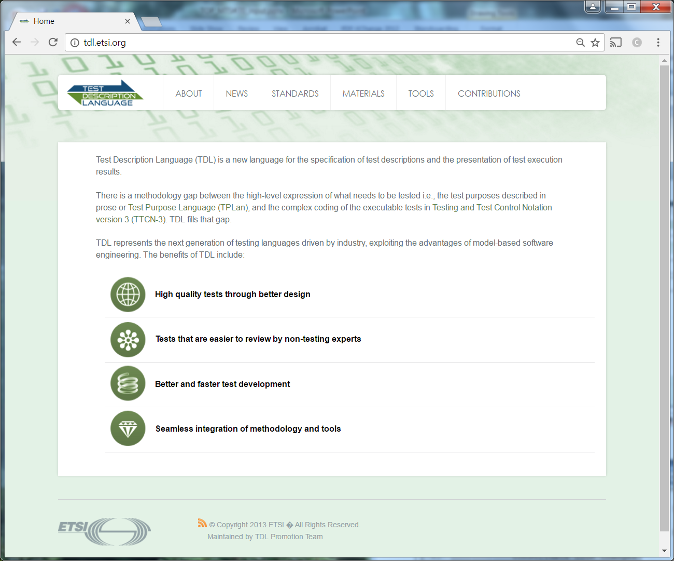
TOP infrastructure
TOP is based on Gitlab platform
Code repository
Build system / continuous integration
Issue tracking system
Wiki
TDL website (http://tdl.etsi.org/) as entry point
Introduction and motivation of TDL
Presentations, tutorials about TDL
TDL standards
Reference to TOP project site
Code repository, issue tracking, wiki
Current state of TDL website is from 2013!

