Slide 1
TOP project – STATUS UPDATE & Workflow demo
ETSI platform for contributing TDL Open source software
Presented by ETSI CTI to TC MTS

Slide 2
Overview
Project Scope
High level workflow
Development and collaboration platform tools
  Website, issue tracking, contributing & reviewing, navigation, wiki
User and permissions management
Legal framework
Tentative project agenda
Next steps

Slide 3
Project scope
TOP: TDL Open source Project
ETSI to provide platform and support to foster the development, testing and the spread of TDL tools, compilers, code generators, syntax checker, etc.
Project leaders:
  Philip Makedonski, Institut für Informatik, Universität Göttingen
  Martti Käärik, OÜ Elvior
Project coordinator:
  Michele Carignani, CTI, ETSI

Slide 4

Project scope 2
Leverage the know-how from successful open source initiatives (e.g. OSM http://osm.etsi.org/)
Provide feedback to the standardization activity
ETSI TOP
Reference implementation
Data Model aligned with MTS
ETSI MTS
Architectural Framework
Language Model
Specs
Testing

Slide 5







Contribution workflow
Aut. Build/Testing
(Jenkins)
Developer
Verify
(+1/- 1)
code,
new features, feedback
Module Leads
review (+2/- 2),
feedback
(Gerrit)
Code review
Local code (git)
feedback
merge
Public repo
(Git)
Bugs,
comments
Issue Tracker
(Bugzilla)
User

Slide 6

Platform tools in place at tdl.etsi.org
Well known tools that developers and users are familiar with
Hosted and managed at ETSI
Free and Open Source Software
Tool | Scope
Website | Communication
Bugzilla | Report issues about the contributed code or the platform itself
Gerrit | Review, discuss, merge submissions
Gitweb | Navigate code repositories, submissions
Wiki Public | Public information and community feedback
Wiki Private | (if needed) WG reserved information
Jenkins | Automated testing and integration
Build & Deploy | Dedicate vhost to setup builds and Eclipse repository
… | …possibly others

Slide 7
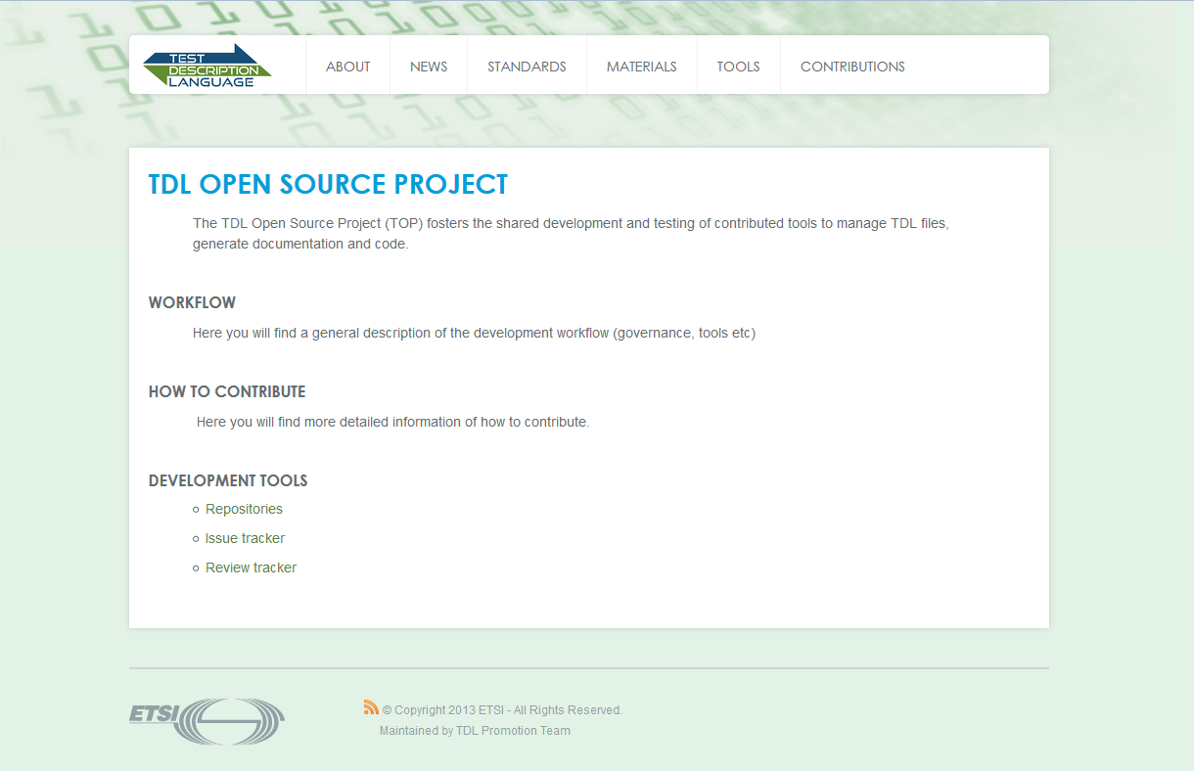
TDL Website
One or more pages dedicated to TOP
TDB: part of the communication plan
Looking for contributors

Slide 8
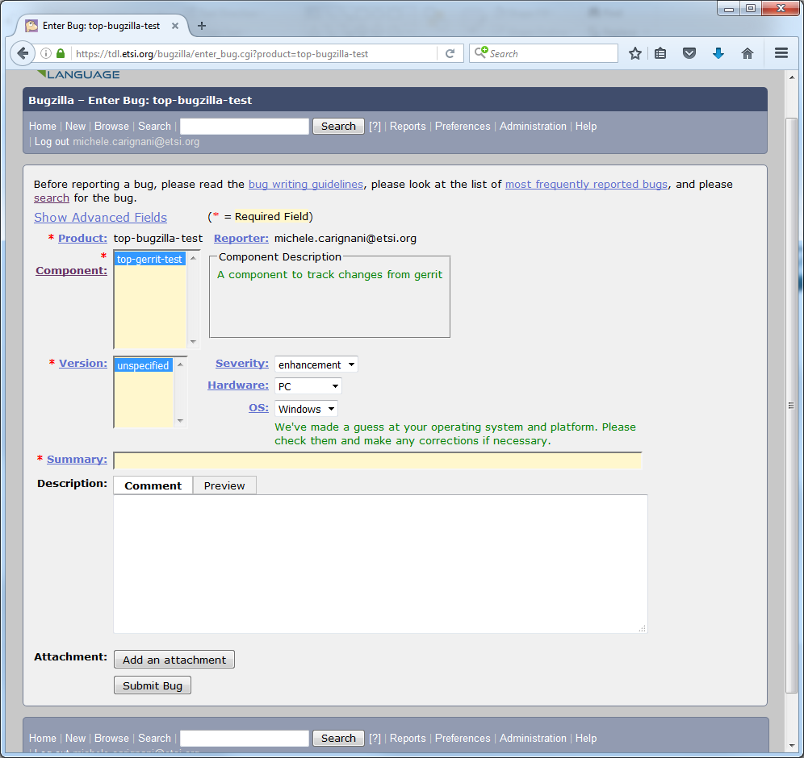
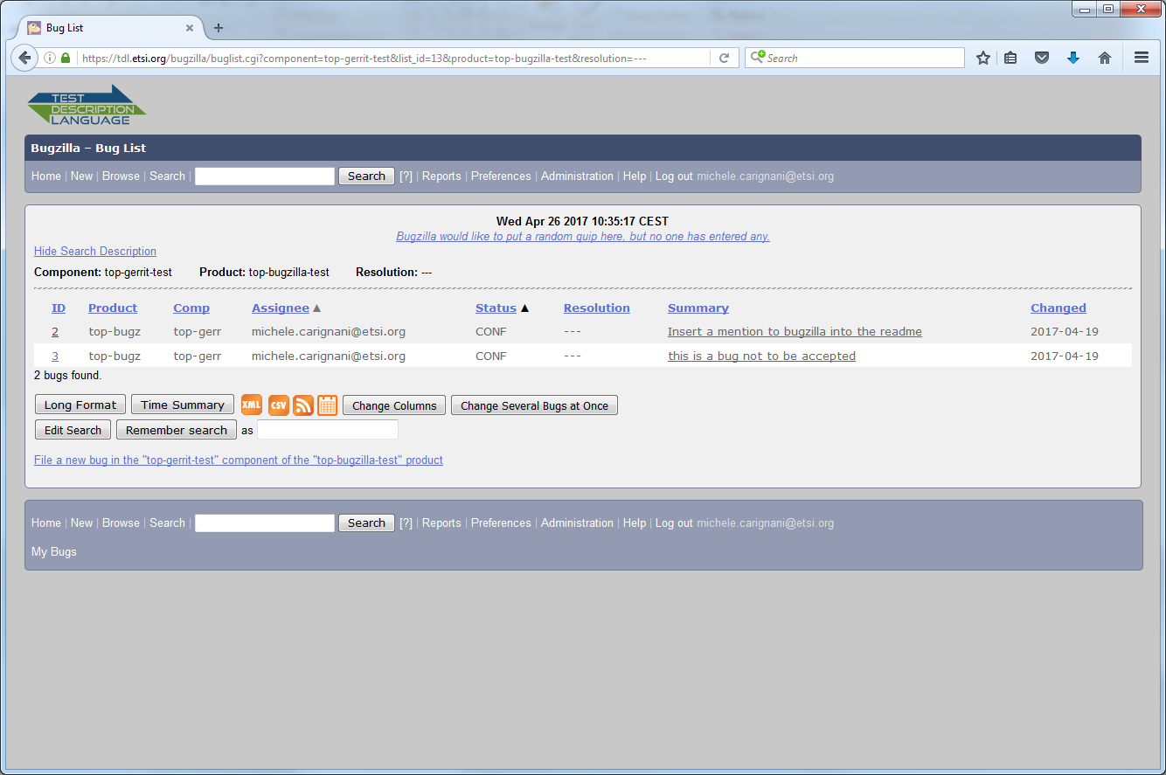
Issue management with Bugzilla
Reporting an issue
List of reported issues

Slide 9
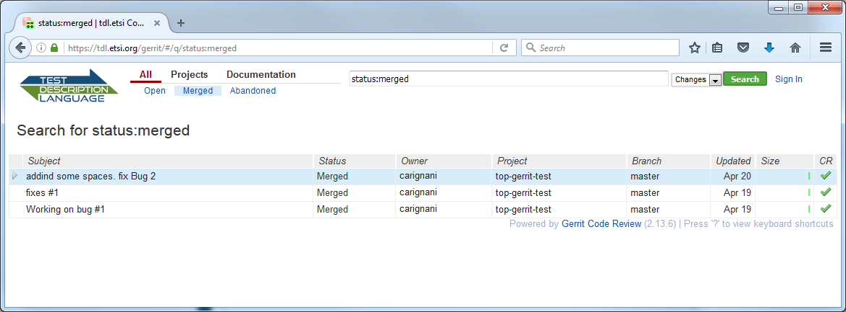
Review, discuss, accept, reject with Gerrit
List of accepted revisions

Slide 10
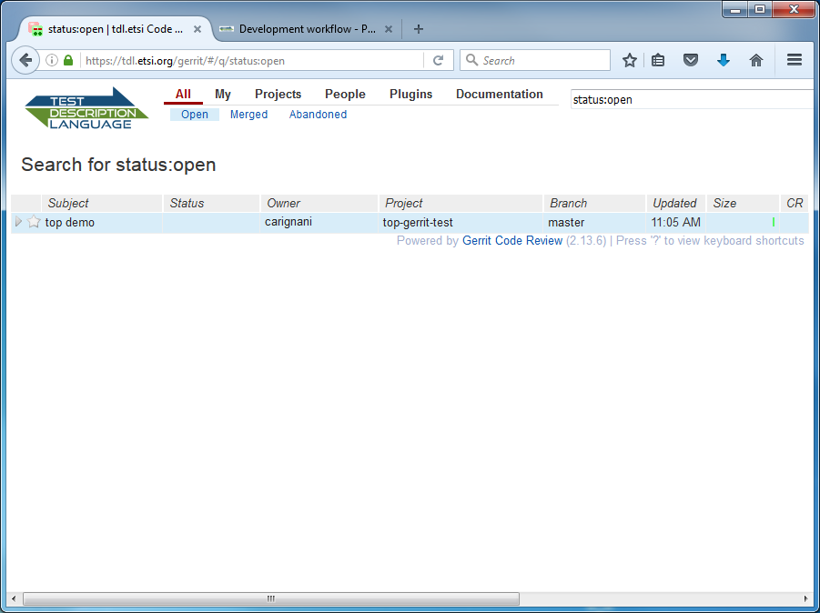
Review, discuss, accept, reject with Gerrit (2)
List of submissions to be reviewed

Slide 11
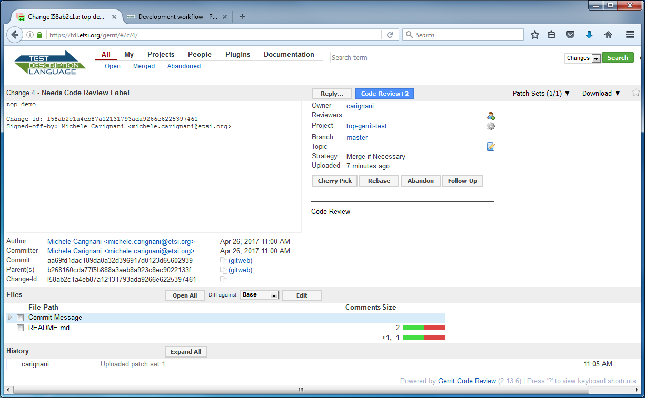
Review, discuss, accept, reject with Gerrit (3)
Actions
panel
General info
Navigate files
Modified files
Submission amendments

Slide 12
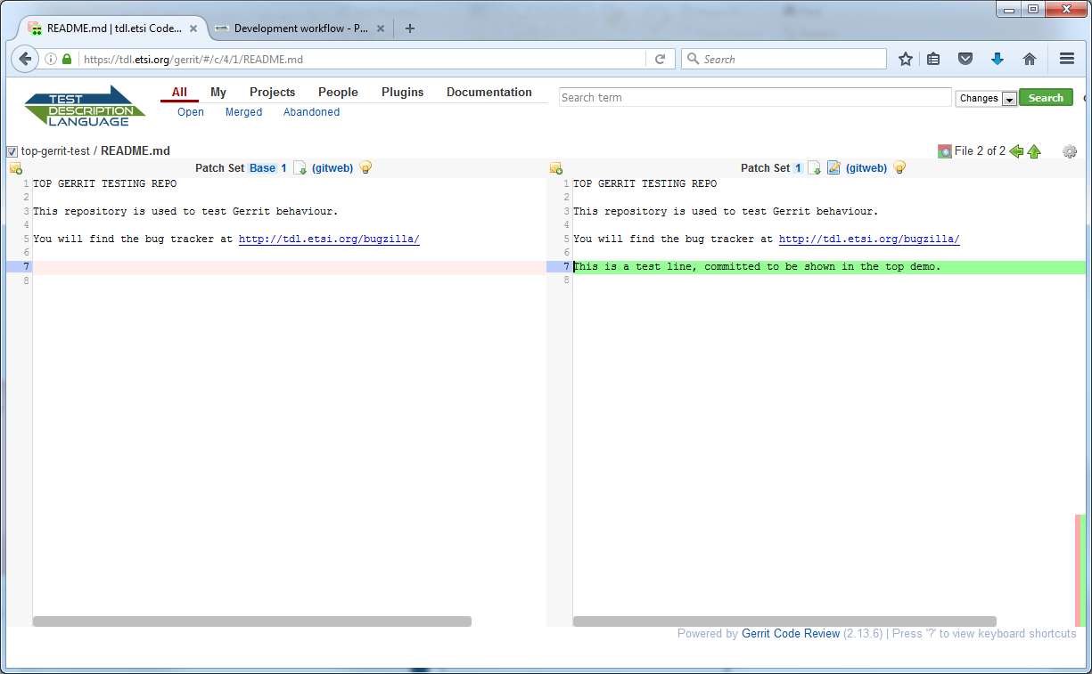
Review, discuss, accept, reject with Gerrit (4)
Per line diff
Edit online as a submission amendment

Slide 13
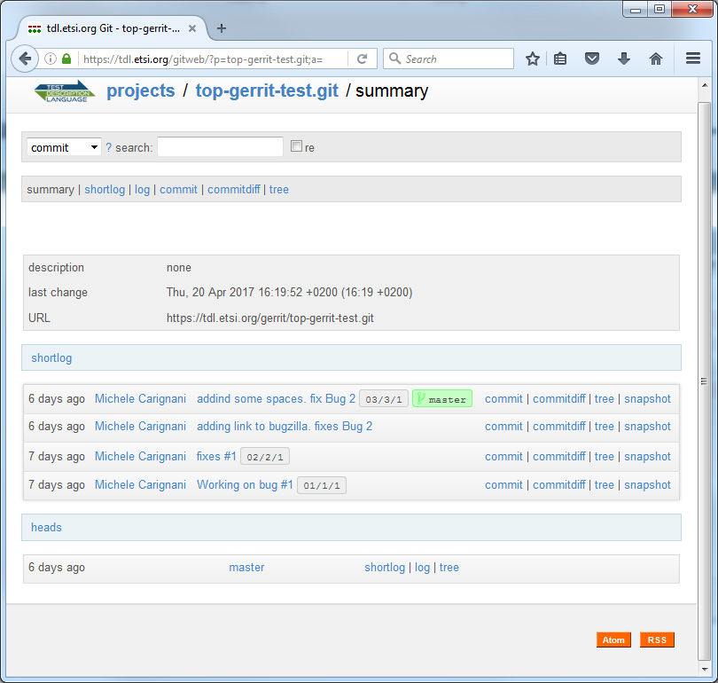
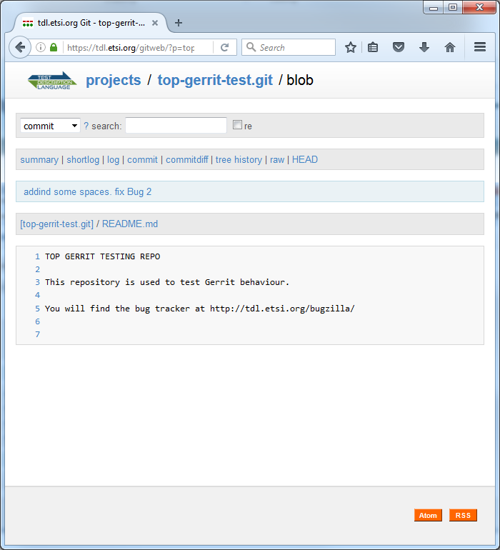
Navigating the repositories with Gitweb
Navigate files content
List of contributions

Slide 14
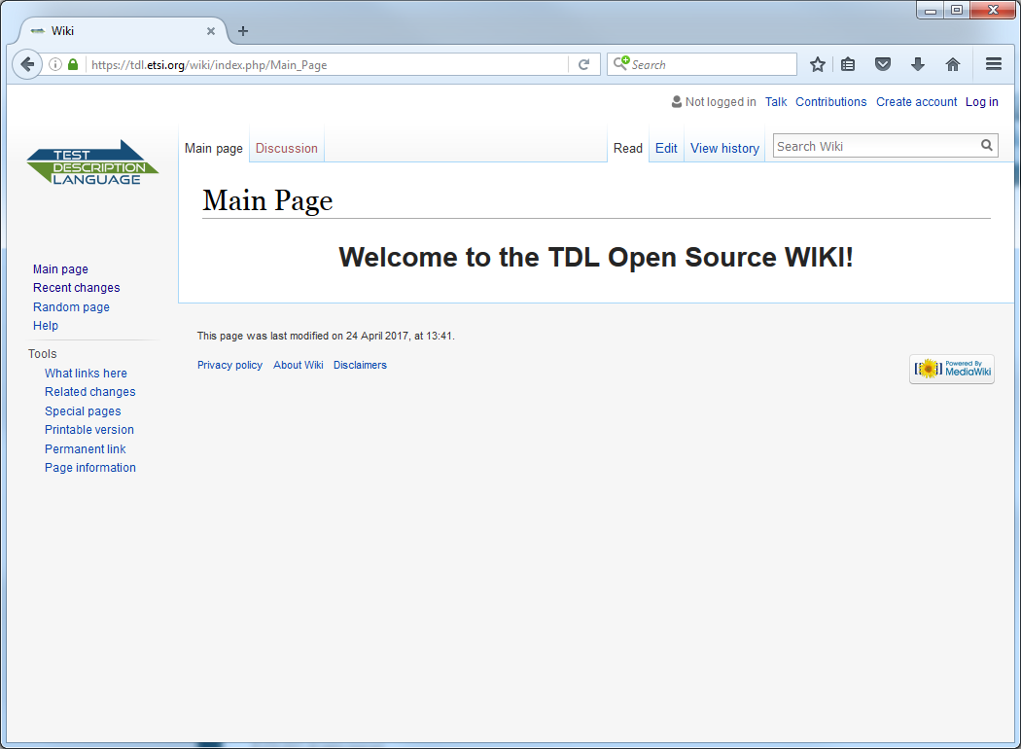
Documentation center with Mediawiki

Slide 15


User management with ETSI On Line
ETSI On Line accounts directly access to the platform
External users able to register at tdl.etsi.org
Group based Access Control Levels
  Groups are valid among all the tools (to be set up only once)
  May map to governing groups of the project
    To be decided within TOP Steering Committee
The granularity of permissions is the repository.
Group A
read,write
Repository 1
read,write
Repository 2
read,write
Group B
Repository 3
read
read,write
Group Z
read,write
Repository n

Slide 16
Legal: Licensing & Contribution agreements
IPR covered by the Eclipse Public License v1
Contributor License Agreements (CLA)
  Terms and conditions for any contribution to the project
Corporate CLA
  Contributions in name of a company
  Signed once by the company, covers any employee
Individual CLA
  Covers people contributing in their own name
  Employee are still allowed to register both under corporate and as individuals

Slide 17

Tentative agenda proposal
Platform ready May week 2
Initial commits May week 3
Presentation to MTS May week 4
  Governance?
  Communication?
Beta test access to TC May week 4
Communication, …
Public launch October week 2

Slide 18
Next steps
To decide governing bodies
  Assign admin and management tasks
  Mailing list, support
To plan testing activities
Communication plan
Other activities?
Q&A

Slide 19
Contact Details:
Michele Carignani
(Technical Expert, ETSI CTI)
michele.carignani@etsi.org
Thank you!

