Slide 1
TDL Open Source Project (TOP) Input to MTS#71, 31 May / 01 Jun 2017

Slide 2
Recap

Slide 3
From MTS#70: Detailing on TOP project structure and tasks
AG
Advisory Group – MTS, decisions at MTS meetings
SG
Technical Steering Group – TDL Steering Group
PL
TOP Project Lead -- small group from MTS + CTI (3 persons)
To set the policies of the project
To make administrative decisions
To coordinate marketing efforts
To coordinate TOP's technical activities
To provide guidelines for future development
To resolve conflicts at technical level
To guarantee neutrality from contributors
To provide project timeline and roadmap
To ensure IP compliance of code base
To decide on TOP committers (see next slide)

Slide 4
From MTS#70: Roles in TOP
Guest – anybody (inside/outside ETSI)
Contributor – any registered person (inside/outside ETSI)
Committer – a contributor from an ETSI organization
Browse and download code base
Join the mailing list or forum, access to wiki
Same as guest +
Create a new issue / bug report
Provide bug fixes as code patches
Create new feature requests
Provide code and tests for new features
Contribute to the TOP wiki
Same as contributor +
Consolidate code changes
Manage new versions and branches
Ensure software quality and validate bug fixes

Slide 5
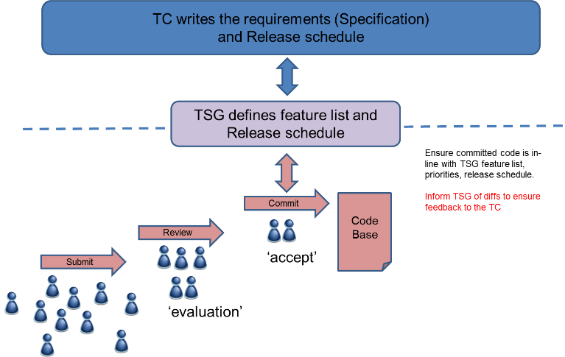
From TDL SG Meeting (Anthony), 2017-03-23
SC – MTS-TDL-SC or MTS-TOP-SC?
Who?
SC chair
Technical Project leader (PM/MK/MC (GR/AW))
CTI Project co-ordinator (MC)
Review WI?
Project structure (BOSS checklist)
Website (TOP tab in TDL website)
Seed code
Timeline (Kickoff week 20)

Slide 6
From TDL SG Meeting, 2017-05-12 (ETSI CTI): Contribution workflow
Aut. Build/Testing
(Jenkins)
Developer
Verify
(+1/- 1)
code,
new features, feedback
Module Leads
review (+2/- 2),
feedback
(Gerrit)
Code review
Local code (git)
feedback
merge
Public repo
(Git)
Bugs,
comments
Issue Tracker
(Bugzilla)
User

Slide 7
Additional input
ETSI Open Source MANO Working Procedures V1.0
https://portal.etsi.org/Portals/0/TBpages/OSM/Docs/OSM%20WP%20v1.0.pdf

Slide 8
TOP Organization

Slide 9
TOP Governance Bodies
TC MTS (acting as Advisory Group)
Community building;
Receiving feedback;
Adjusting TOP plan
Supports SG work; Confirms TOP activity plan
Reports achievements;
Proposes TOP activities, e.g. STF, NWI, release plan
ETSI / Non-ETSI TOP Users
TDL Steering Group (acting as TOP Technical Steering Group)
Creates a TOP module; Appoints Module Lead;
Guides technical development
Commits new releases; Raises technical issues for clarification
TOP Module
TOP Module
TOP Module

Slide 10
TOP Module
TOP Module goal
Implementation of parts of the TDL standard series
Accommodating additional user needs, e.g. on the selection of the chosen base technology
TOP Module tasks
Release planning of TOP Module
Coding of TDL standard (R/W access to source code)
Maintain existing code base, including bug fixing and (release/development) branch management
Review of submitted code from the community, so-called “merge requests”
Perform IP compliance check (fossology)
Maintains the TOP Module website/wiki under the TDL website
Answer questions from users
TOP Module organization
Module Lead – from an active MTS member organization; appointed by SG
Virtual team – about 3 team members from ETSI organizations, on a voluntary basis or from an STF

Slide 11
TDL SG – TOP Technical Steering Group
TOP TSG goal
Driving the TOP Modules to ensure their successful operation
Driving TDL standardization activities to reflect user needs
TOP TSG tasks
Create/withdraw TOP Modules; appoint Module Leads
Organizing periodic calls to drive technical development in TOP Modules
Define feature lists and coordinate release plans of TOP Modules according to a common roadmap
Bring forward New Work Items and STF proposals to Advisory Group
Solve technical issues and conflicts that cannot be solved within a Module (escalation)
Report regularly at MTS meetings
TOP TSG organization
SG Lead – appointed annually(?) by MTS
SG members – 5 to 10 persons from MTS members with interest in TDL and TOP SG membership shall be confirmed annually after an open call for participation

Slide 12
TC MTS – TOP Advisory Group
TOP AG goal
Providing support for the TOP development activities
Reaching out to promote TDL and TOP within other ETSI TBs and elsewhere
TOP AG tasks
Coordinate TOP and TDL development with TTCN-3 and other upcoming WIs
Confirm TOP activity plan as proposed by TOP TSG
Promote actively TOP and TDL for use in other ETSI TBs, e.g. organize workshops, tutorials
Manage liaisons with external organizations on TOP and TDL
Manage the finances to support TOP and TDL development
Maintain the TOP working procedures
TOP AG organization
The Advisory Group is effectively the TC MTS, represented by its active members

Slide 13
Roles in TOP Module (revised)
Users (from ETSI and non-ETSI organizations)
Contributors (from a TOP Module team or eligible users)
TOP Module Lead
Browse and download code base from git repo
Do interact within the community
Ask questions; issue bug reports
Suggest changes on documentation, code, test (merge requests)
Following the TOP strategy and has a vision for module development
Have the authority and the skills to decide on the direction
Handle merge requests
Improve the non-functional requirements, code re-factoring
Use the software
Answer user questions
No registration required
Registered user only
Registered user only
Check with Michele’s access levels

Slide 14
Responsibilities of the ETSI Secretariat
Input from Anthony; reference needed.
Project co-ordination = contact point to relevant ETSI departments and TC MTS
Tracking the overall progress of the project and ensuring that correct process is adhered to (w.r.t. ETSI rules)
Drafting legal documentation (CCL, ICLA, EULA, DCO etc.)
Handling the signature process for any agreements that may be needed
IT support (set up and maintenance of the platform)
Access control (for participation and code download)
Co-operative application of fossology
Assistance to create and publish project website and ensuring legal documentation etc. is visible/available
Setting up conference calls, LISTSERV, etc.
Issue news releases, social networking

Slide 15
TOP Module Structure

Slide 16
TOP Module Structure – Input for Discussion
Current features (code deliverables) from the previous TDL-3 STF; see ETSI TR 203 119 V1.1.2 (2016-04), submitted to MTS#68
TDL-MM implementation + MM validation + Import and export TDL models (parts 1 + 3)
Textual editor (part 1)
Textual editor for structured test objectives (part 4)
Graphical viewer (part 2)
UML profile for TDL (part 1, Annex C) integrated within Eclipse Papyrus
Each feature is represented in one git repo; represented as an individual TOP Module
Distribution = Packaging of features according to end-user cases needed → need to be defined

Slide 17
Action Items on TOP from MTS#71
Detailed TOP working procedure; deadline: end of June
→ Andreas prepares a text document for circulation within TDL SG
First installation of TOP code base; deadline: end of June
→ Philip + Martti with support by Michele
Creation of initial wiki pages + TDL website update; deadline: UCAAT, 11 Oct 2017
Wiki content: short description of
TOP and its features → Philip + Martti
how to join + how to contribute (incl. CCLA, ICLA, DCO), licensing information → Michele
TDL/TOP steering group
Progress report + discussion
Next meeting: in week 26-Jun to 30-Jun; doodle poll needed → Emmanuelle

Slide 18
Review of TDL Use Cases

Slide 19
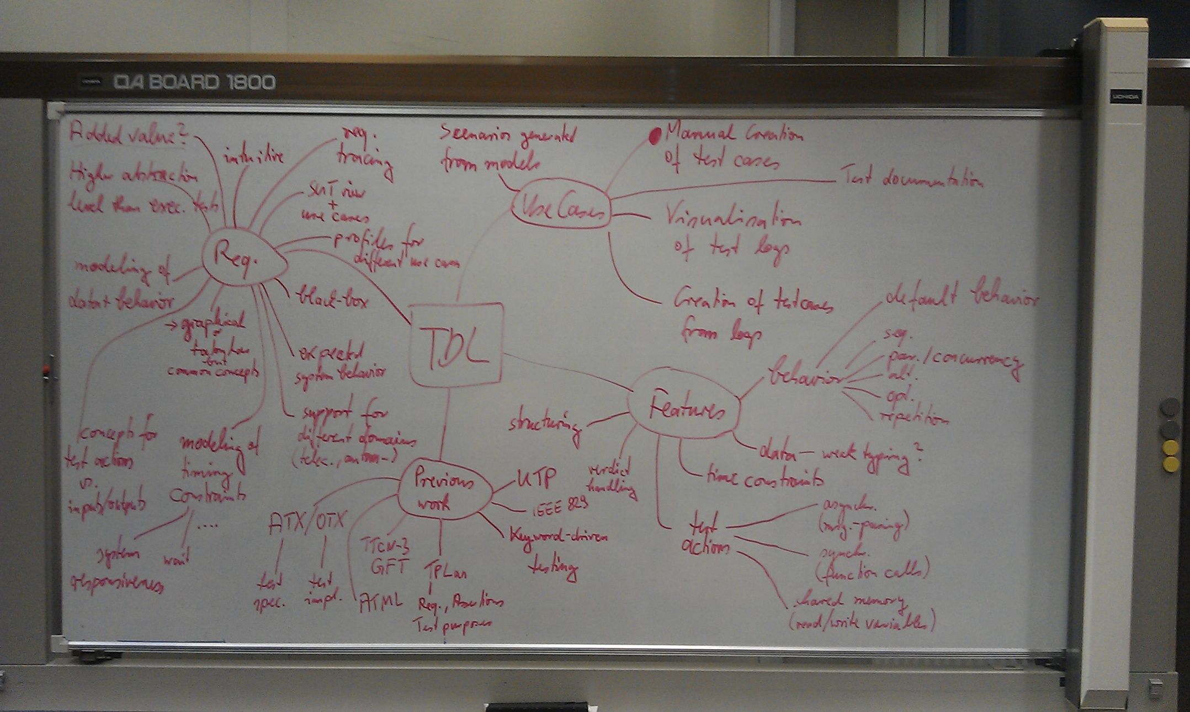
Does anyone remember? Result from the TDL Kick-Off Meeting, Munich, 14-Dec-2011
Are we there yet?
What is missing?
What else have we achieved?
TDL Use Cases

Slide 20
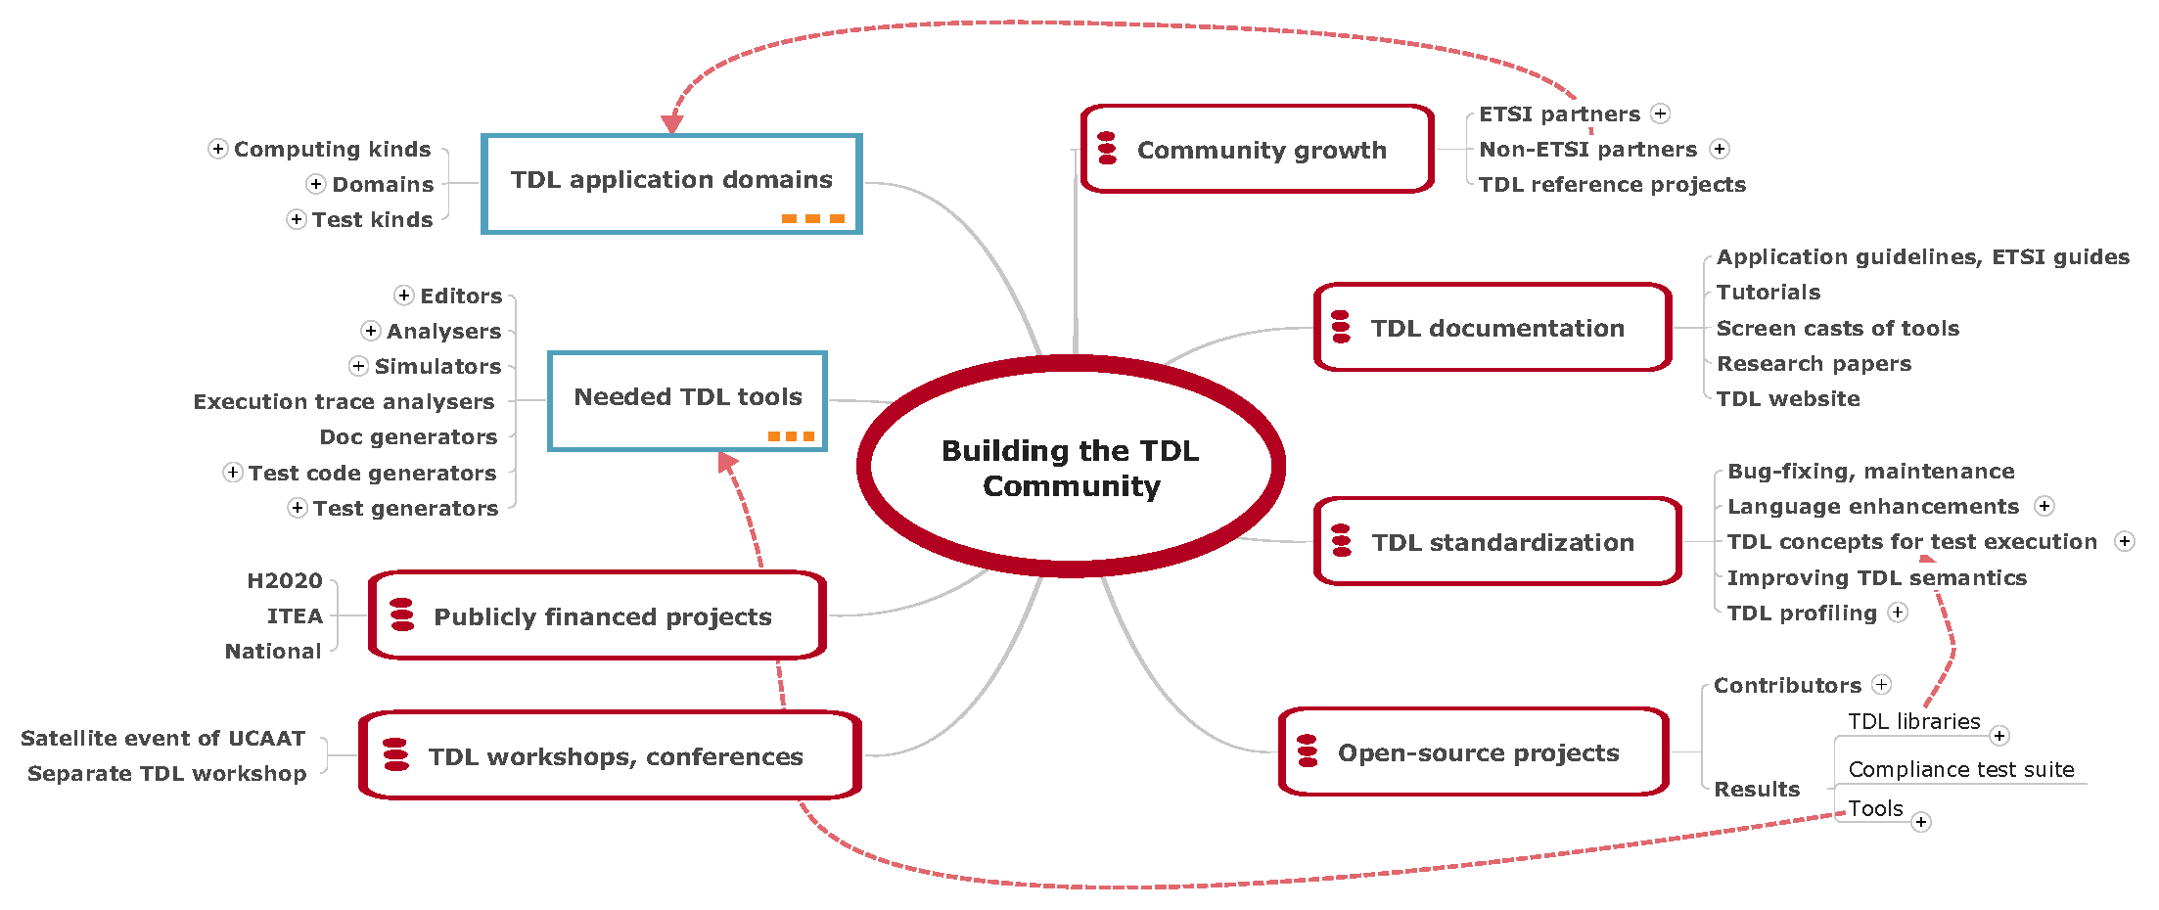
Does anyone remember? Building the TDL Community, MTS#66, 16-Nov-2015

Slide 21
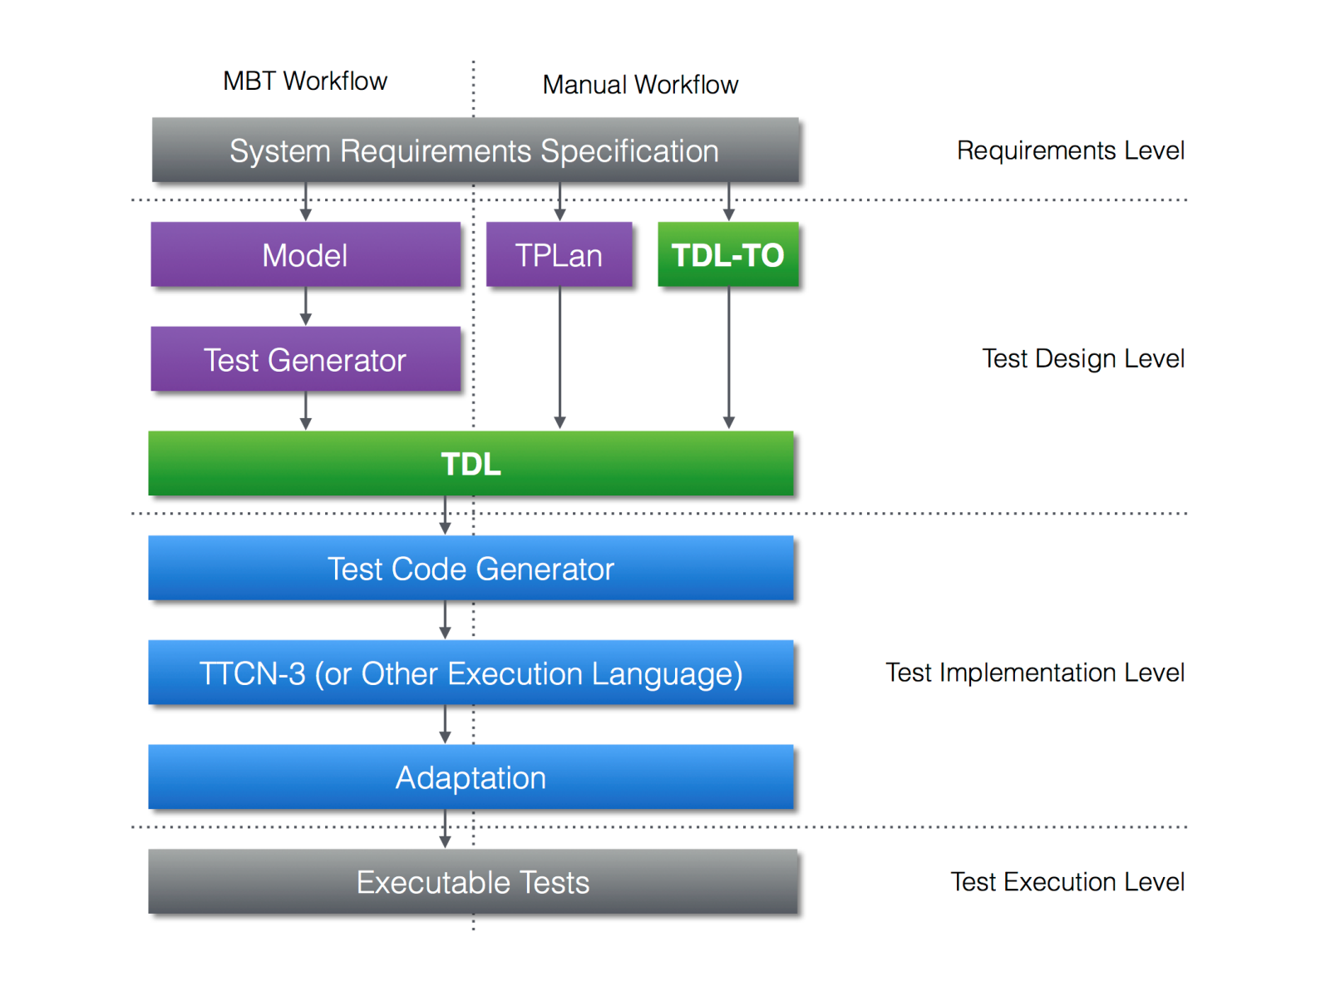
The TDL Story as We Sell It (from the TDL website)
Is it still our view on the role of TDL?
What else needs to be done to implement this workflow?

