Slide 1
TOP project – status update for mts#72
Current status, communication plan, UCAAT2017
Presented for MTS#72

Slide 2
Current status
Initial software uploaded in June
16 commits, 2 contributors
3 Agreements received
Platform in place, tested
TDL SC meeting on Sept 7th
Planning for communication activities around TOP

Slide 3
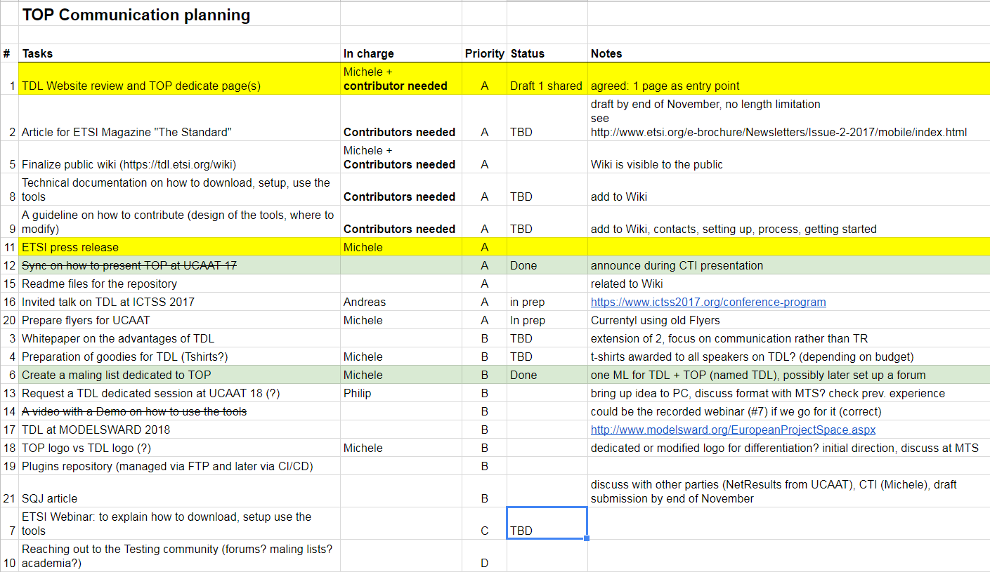
Communication plan
Live document here

Slide 4
LAUNCH AT UCAAT 2017
CTI presentation will introduce the TOP project
Project announcement and scope
Governance, licensing, roles of MTS as AG, CTI as coordination
Platform and tool
Current status and next steps
ETSI booth
TOP material to be finalized

Slide 5
Next steps
Finalizing launch for UCAAT 2017
Finding contributors for the tasks in the communication plan
Setting up TOP calls?
Bi-weekly?
Monthly?

Slide 6
Contact Details:
Michele Carignani
TOP coordinator
ETSI Centre for Testing and Interoperability (CTI)
michele.carignani@etsi.org
Thank you!

Slide 7
Communication plan
Live document here

