Slide 1
Report on TDL activities since Mts#73
Michele Carignani (ETSI)

Slide 2
Highlights
TDL SG meetings
Future of TDL meeting held on Feb 23rd
Meetings in preparation of TOP F2F meeting
May
New version of the plugins released!
Version 1.4.1
Eclipse repository updated
Under testing
Announcement will be made as soon as the plugins are tested

Slide 3
TDL Open Source F2F Meeting
Held in ETSI premises on May 23rd
20 Registered participants (11, 9)
Link
Agenda, notes and materials available at:
https://tdl.etsi.org/wiki/index.php/1st_TDL_Open_Source_Meeting
Well attended (usual suspects and few newcomers)
Active users for TDL-TO
No active projects for TDL
Several requests made for improvements or bug fixes
Need for more documentation
(in particular Samples and development information)

Slide 4
TDL Survey
Live at
https://www.surveymonkey.com/r/L7ZTMZW
Results
Collected 5 responses
Far from reaching the expected target (17 people in the TDL mailing list)
All participants showed interest in TDL

Slide 5
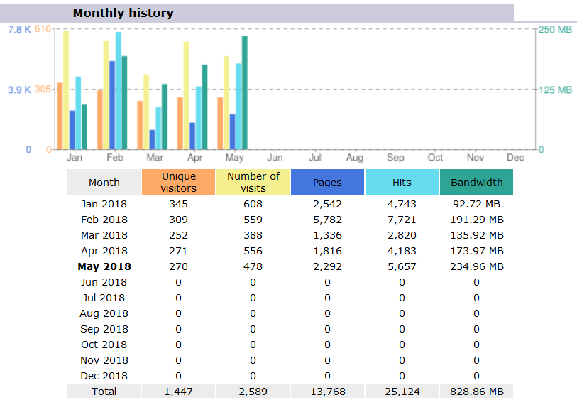
TDL website stats

Slide 6
TDL website stats (Aggregated 2018)

Slide 7
Mailing lists
MTS_TDL_SC: 14 subscribers
TDL: 17 subscribers (+8 since MTS#73)

Slide 8
Conclusions and personal considerations
Small but active user base
Interest shown from the outside world
Developers community did not grow
Short term goals (until MTS#75)
Focus on the needs and requests coming from real users
Release a feature release plan
Provide documentation requested
Given the limited resources, focus on targeted and effective initiatives
Medium term goals (until MTS#76)
Kickoff a project using TDL
Low the entry barriers for developers
Organise other open meetings ?

Slide 9
Contact Details:
Michele Carignani
Michele.carignani@etsi.org
TOP coordinator
Thank you!

