Slide 1
MTS WG TST STATUS
Axel Rennoch
MTS#74, Sophia-Antipolis, May 24, 2018

Slide 2
History
26.09.17: Creation at MTS#72 with initial working scope
23.10.17: MTSTST#1 (Sophia Antipolis, 10 participants) collection of interests
30.11.17: MTSTST#2 (Berlin, 11 participants) about collection of NWI ideas
23.01.18: MTSTST#3 (Munich, 15 participants) agreement on eight NWIs
Work started on functional TPs (CoAP, MQTT, LoRaWAN) and security
23.05.18: MTSTST#4 (Sophia Antipolis, 13 participants)
DEKRA, AUDI, Spirent, EGM, UoGöttingen, Elvior, Fraunhofer FOKUS, ETSI, Ericsson, Sintesio
Guests: relayr GmbH, Fraunhofer IPK about WI progress, one NWI draft, proposed liaisons

Slide 3
Functional Tests
Multiple TPs: CoAP (39), MQTT (56), OPC-UA (23)
CoAP and MQTT are available via ETSI https://portal.etsi.org/Contribution.aspx?MeetingId=34031
Using TDL-TO:
Event sequence
Domain: pics, entities, events, event templates
Data: type definition

Slide 4
Started WI

Slide 5
Foundational Security Tests
Multiple foundational TPs (8):
authenticator feedback,
password lifetime,
session lock,
account changeability
Using TDL-TO:
Event sequence
Domain: pics, entities, events
Time label and time constraint

Slide 6
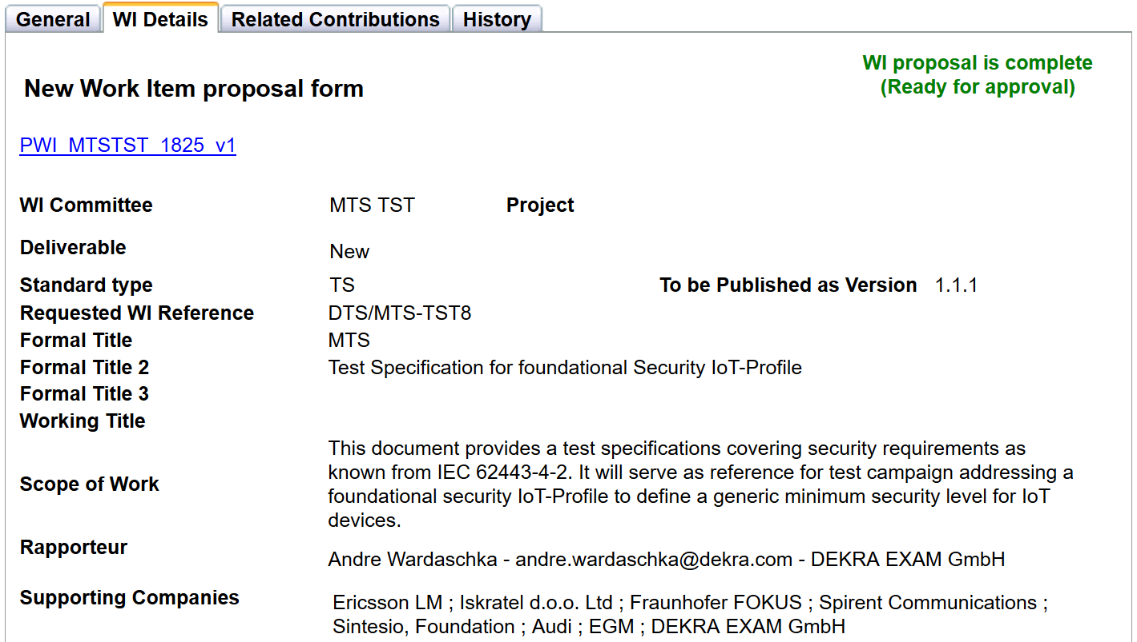
Proposed WI

Slide 7
Review WI Rapporteur/time schedule
Change of Rapporteur for DTS/MTS-TSTLoRaWAN:
Martin Jordan (EGM) -> Abbas Ahmed (EGM)
Change of schedules for COAP/MQTT (part 1) all others:
Stable Draft 2018-09-25
Draft for approval 2018-12-15
WG Approval 2019-01-30
TB Approval 2019-01-31

Slide 8
Proposed liaisons
To be confirmed by TC MTS:
ETSI TC Cyber
ETSI TC SmartM2M
oneM2M TST
oneM2M SEC
To be contacted before liaison request:
OPC-UA Foundation (contact via AUDI/FOKUS)
Input: based on information from TST draft flyer (MTSTST(18)000009)

Slide 9
TDL Source working repository
Currently TDL sources are available via Eclipse Foundation project IoT-Testware (together with TTCN-3 and installation scripts): https://github.com/eclipse/iottestware/tree/master/docs
Subject to move to ETSI location.
„Read/Write“-access / contributions from non-member experts/supporter.
Creation of ETSI TP documents by ETSI members only

Slide 10
Next meetings/calls
September 26th (morning), 2018, before MTS#75 in Budapest

Slide 11
Contacts
Fraunhofer FOKUS
Business Unit Quality Engineering (SQC) Kaiserin-Augusta-Allee 31 10589 Berlin, Germany
https://www.fokus.fraunhofer.de/sqc
Axel Rennoch
axel.rennoch@fokus.fraunhofer.de
phone +49 30 3463-7344

