Slide 1
Discussion on TDL future
AP(74)006: How and what to do to continue to progress with TDL
Andreas Ulrich, Siemens

Slide 2
Recap: Report on TDL activities since MTS#73 by Michele Carignani, MTS(18)074010

Slide 3
Recent (known) usage of TDL/TOP
ETSI standardization
Test purpose specifications in STF 551 on MEC (Edge computing), NG112 testing (emergency communication), MTS TST (IoT protocols)
Discussion ongoing at NFV TST; their need: generation of executable tests in Python
Industry (as reported at UCAAT)
NetResults: testing of collaboration IT services

Slide 4
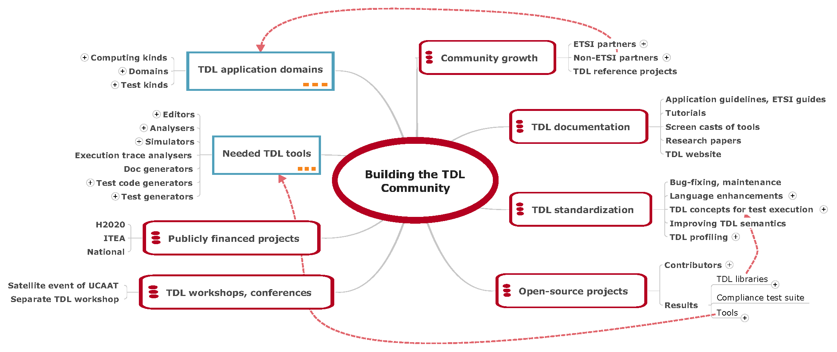
Recap: Building the TDL Community MTS#66 with update from 23 Feb 2018
Areas to be improved in 2018:
TDL reference projects, pilots, e.g. on IoT
TDL guidelines
ETSI workshop on TDL
TOP extensions on generation (e.g. TTCN-3); identify partner OSS projects on testing
Analysis of business cases for TDL in industry
So far some progress reached in important areas!

Slide 5
Recap: Detailing on TOP project structure and tasks (MTS#70)
AG
Advisory Group – MTS, decisions at MTS meetings
SG
Technical Steering Group – TDL Steering Group
PL
TOP Project Lead – small group from MTS + CTI (3 persons)
To set the policies of the project
To make administrative decisions
To coordinate marketing efforts
To coordinate TOP's technical activities
To provide guidelines for future development
To resolve conflicts at technical level
To guarantee neutrality from contributors
To provide project timeline and roadmap
To ensure IP compliance of code base
To decide on TOP committers
https://tdl.etsi.org/wiki/index.php/Governance

Slide 6
Discussion: TOP governance
Enter operation mode for TOP governance
TOP Roadmap needed, if possible with timeline, to provide a clear vision to users
We set up a TOP project structure, but have not put it into practice yet → Steering Group meetings to discuss TOP progress, e.g.
Advancing with TDL/TOP features
Decisions on development technologies
Ensure consistency and interoperability of TOP tools
Regular monthly SG meetings with open call for contributions for all members interested in TDL

Slide 7
Discussion: TOP reference projects
Declare one application area as primary target for TDL/TOP → Web API spec/testing (Michele) is a good candidate!
Guidelines on the application of TDL/TOP (ETSI Guide)
Improving TDL standards further
Improving TOP tools
Work on executable TDL
TDL-TO suffices for most cases in standardization
The generation of executable tests would thrive TDL/TOP acceptance → major stakeholder needed who is willing to put efforts in it
NFV TST needs tests in Python (→Michele)
TDL to TTCN-3 mapping defined, but not implemented yet?
Mapping to other languages
Validation of TDL dynamic semantics through execution

Slide 8
Discussion: TOP community growth
Goals
Increase awareness on TDL/TOP
Attract developers for TOP
TDL tutorial and presentations are regularly present at UCAAT
Webcast exists, too
Introductory slides, papers, poster, survey – all available
→ Are we doing fine? How can we do better?

Slide 9
Discussion: TOP funding
TOP maintenance
TOP is an ETSI project; potentially an Eclipse incubator project later
Funding for Project Lead required to keep TOP up-to-date
Which party covers the costs?
TOP project on testing microservices
Candidate for a NWI and potentially a STF
Publicly funded projects? → Further SG discussion, circulate information if available
H2020, ITEA3
Use them to drive development in TOP

