Slide 1
TDL and TOP Development at MTS
Doc: BOARDOSS(18)049003
Source: MTS
Agenda item: 5.4
For: Information
Achievements and Further Improvements
Dr. Andreas Ulrich
BoardOSS#49, 27-28 September 2018

Slide 2
Outline
Brief overview of TDL
The TDL OSS project TOP
Growing and nurturing the TDL/TOP community
Open issues

Slide 3
Why there is TDL – The need for abstraction in testing
Trends in testing
Behaviour-Driven Development (BDD) and Continuous Integration (CI)
Model-Based Testing (MBT) and other forms of (abstract) test generation
Test automation (of concrete tests) in the norm
ETSI MTS legacy: TTCN-3
The test specification language for executable, concrete tests
Detailed TTCN-3 code that makes understanding its larger intent hard
TDL – Test Description Language (developed between 2012 and 2017)
Supports the specification of (abstract) tests for conformance and interoperability
Influenced by TPLan, an earlier ETSI language for test purposes
Series of standards ES 203 119 parts 1 – 7

Slide 4
ETSI standard series on the Test Description Language (TDL)
The ETSI standard series ES 203 119
(1) TDL-MM: Abstract Syntax and Associated Semantics
(2) TDL-GR: Graphical Syntax
(3) TDL-XF: Exchange Format
(4) TDL-TO: Structured Test Objective Language
(5) TDL-UML: UML profile for TDL
(6) TDL-T3: Mapping of TDL to TTCN-3
(7) TDL-EX: Language Extensions
Published documents
http://www.etsi.org/standards-search?search=203119&ed=1&sortby=2
Concrete Syntax
TDL-GR
TDL-XF
Other syntax
TDL-TO
TDL-MM
Abstract Syntax

Slide 5
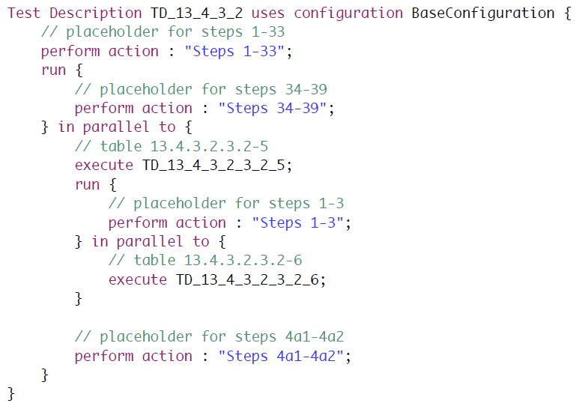
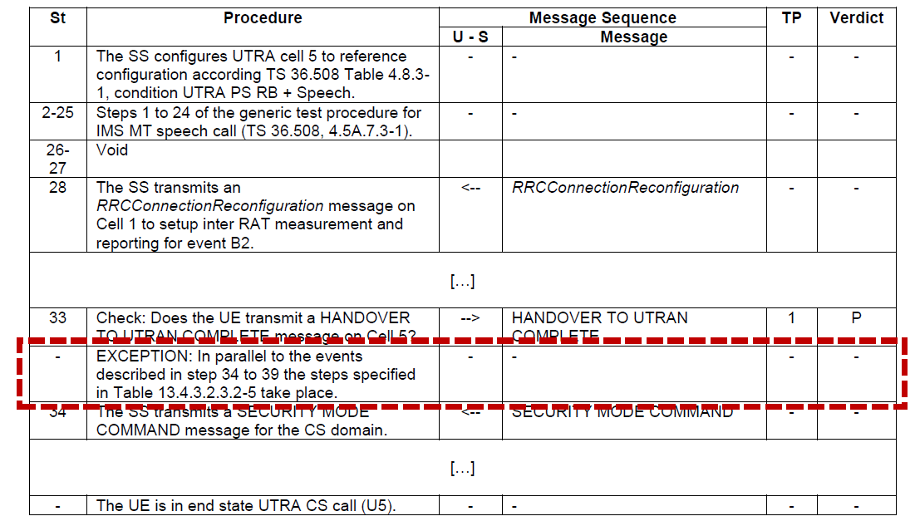
From documents to specifications – MS Word vs TDL
Example: 3GPP TS 36.523-1

Slide 6
Why there is TOP – Kick-starting TDL
Announced at UCAAT 2017
TOP – TDL Open Source Project
Proof-of-concept of TDL standards and their validation
Provides stimulus for future TDL standardization
Lowers the barrier of entry for both users and tool vendors
Independence from proprietary technology and tool vendors
Joint effort of industrial users, tool providers, academia
Creates an open platform and ecosystem for the development of versatile tools
Stays abreast of new technological trends
Community building

Slide 7
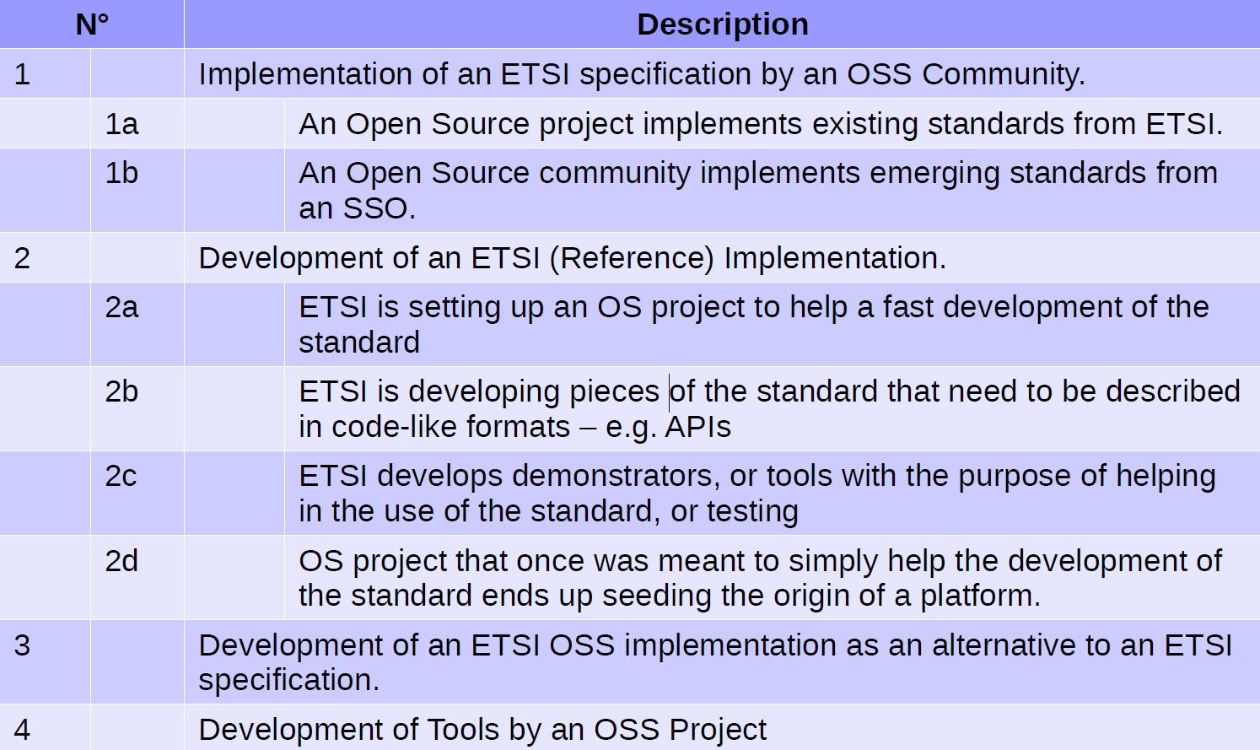
TOP goals and ETSI BOARD OSS scenarios
Covered TOP goals

Slide 8
An open and scalable tool architecture for TDL
Based on development standards (Java, Eclipse) and supporting the integration of open-source and third-party components
UML-based Graph. Editor
Report
TDL Model Analyzer
Textual Editor (incl. ES 203119-4)
TDL Test Generator
TDL Exchange Format (ES 203119-3)
Graphical Editor (ES 203119-2)
Graph. Viewer & Doc. Gen.
Test Plan
Test Code Generator
C-code,
TTCN-3
Front-end tool
Back-end tool
Artefact (output)
Currently covered in TOP

Slide 9
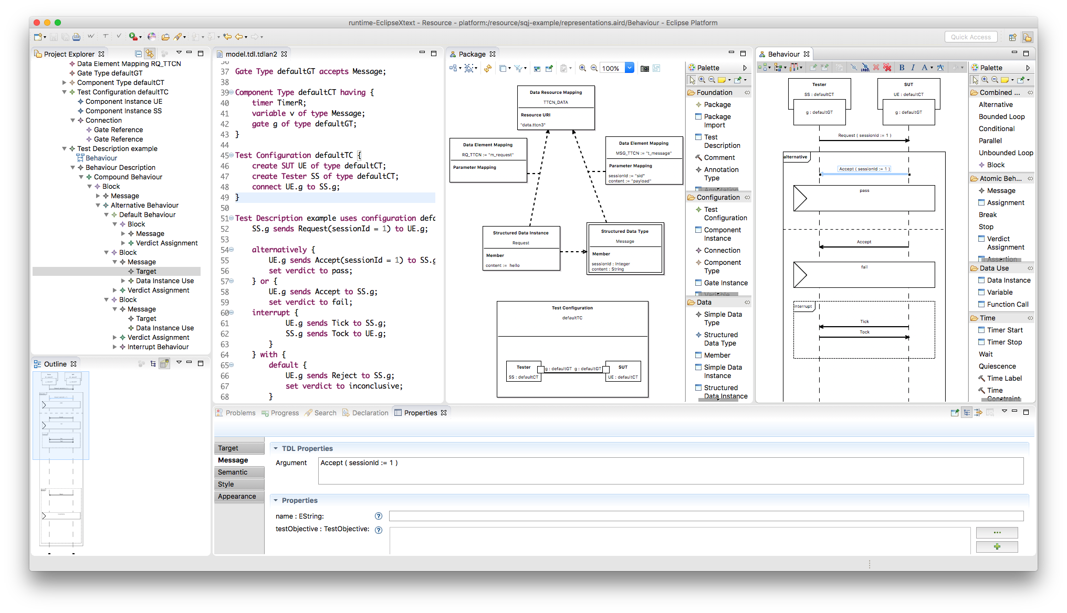
TDL Open Source Project (TOP)
Eclipse Public License (EPLv1)
TOP governance
Project Lead – ETSI member and CTI
Steering Group – MTS TDL SG
Advisory Group – ETSI TC MTS
Active contribution to code requires ETSI membership

Slide 10
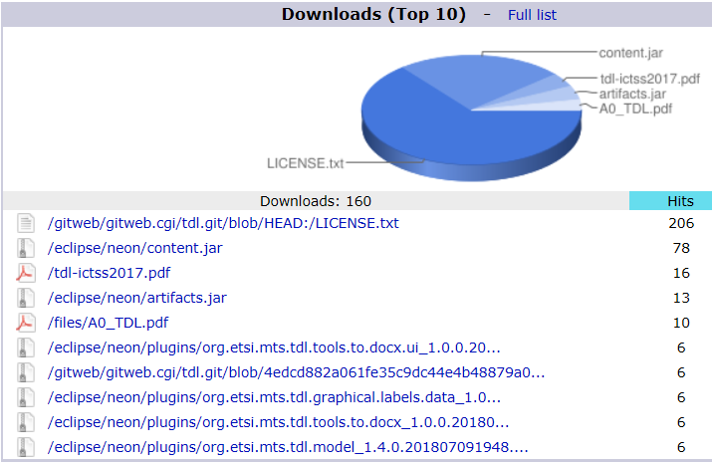
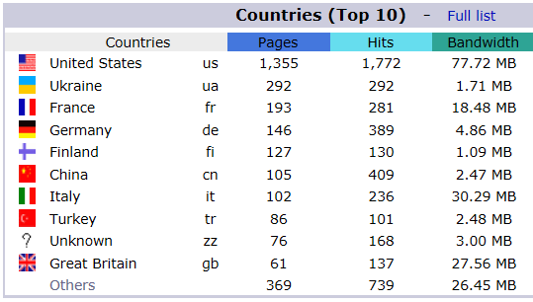
Some statistics on tdl.etsi.org website, including TOP

Slide 11
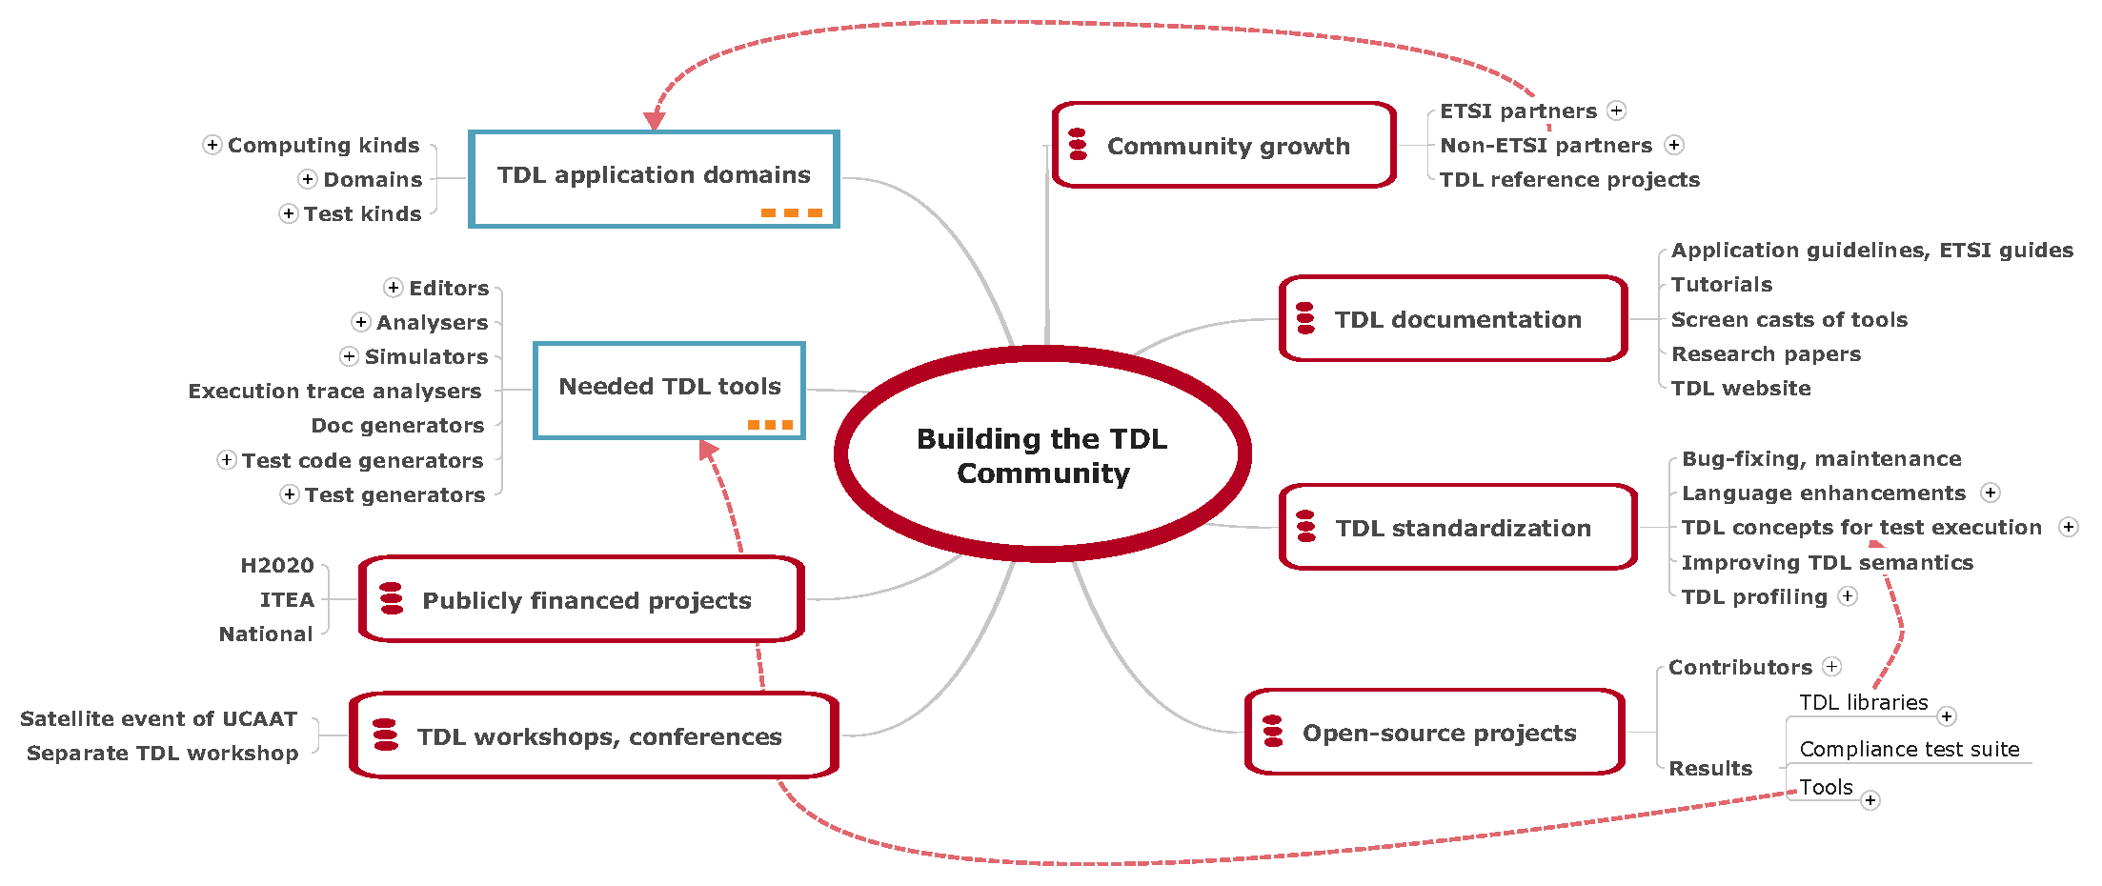
TDL/TOP community building and nurturing
Current activities
Webcast, survey on TDL/TOP
Trainings on TDL and TOP
TDL guidelines, e.g. ETSI Guide
TDL reference projects, pilots, e.g. on µ-services, Web API testing
TOP extensions on test generation (e.g. TTCN-3); identify partner OSS test automation projects

Slide 12
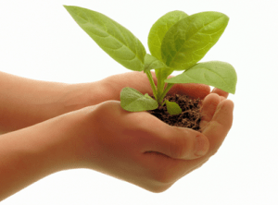
Nurturing new technology is hard
Recent (known) usage of TDL/TOP
ETSI standardization
Test purpose specifications in STF 551 on MEC (Edge computing), NG112 testing (emergency communication), MTS TST (IoT protocols)
Discussion ongoing at NFV TST; their need: generation of executable tests in Python
Industry (as reported at UCAAT)
NetResults: testing of collaboration IT services
Elvior: TDL support in test tools considered
Strong demand: Make TDL specs executable to use them in test automation!

Slide 13
Open issues related to TDL and TOP
How to balance efforts in TDL standardization vs TOP contributions
Attractiveness of TDL depends on available tools
ETSI outputs standards but not code → How much commitment should ETSI take on TOP project?
Resources and funding of TOP needed to implement its roadmap
Minimum: Maintenance of TOP projects by Project Leads is required
Possibly TOP will be mirrored as an Eclipse project in future
Acquire further resources, e.g. publicly funded projects (e.g. H2020, ITEA)

Slide 14
Contact
Dr. Andreas Ulrich
Siemens AG, Corporate Technology
Munich, Germany
andreas.ulrich@siemens.com

