Slide 1
Test Domain and Description Language Recommendations
Frank Massoudian
Edward Pershwitz
(Huawei Technologies Co. Ltd)
ETSI MTS#77,
Sophia Antipolis
22.05.2019

Slide 2
Table Of Contents
Challenges of Multi-actor Delivery
JAD Ecosystem
Standardization Progress
Test Domain & Description Language

Slide 3
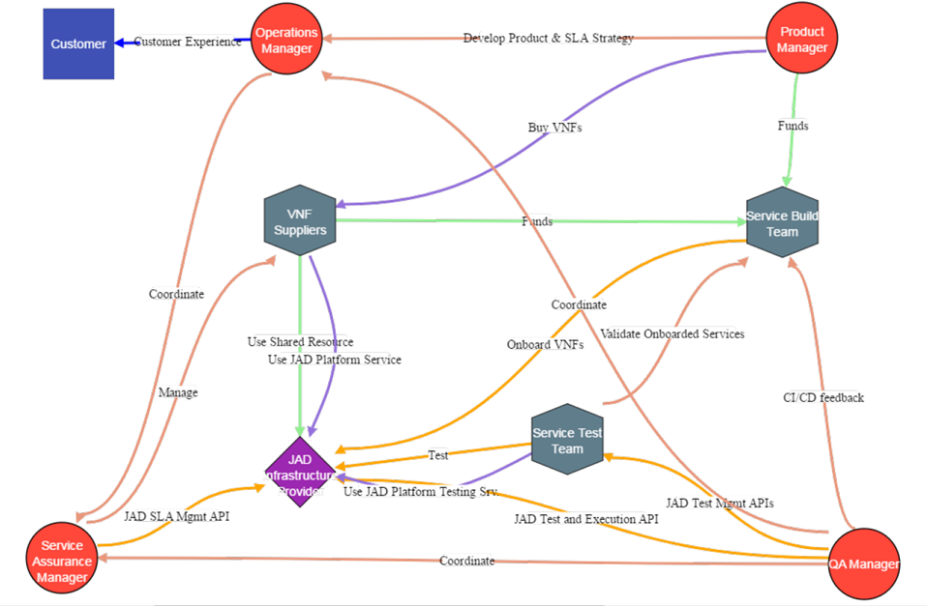
Challenges of Multi-actor Delivery
NFV/5G standards still maturing…
Solutions coming from multiple parties (including the Operator)…
Sequential supplier/Operator development & deployment leads to duplication of effort, lengthy TTM for end user, and high cost for operator
Separation of software from hardware poses additional requirements and certification challenges…
No single party can test and certify their contribution in isolation
Open Collaboration with CSP Acting as Gatekeeper
Collaboration is a solution that is only possible if processes are standardized and the parties utilize a platform to enable joint activities

Slide 4
Joint Agile Delivery (JAD)
Completed 3 phases of an award-winning TM Forum Catalyst program as proof of concept
Documented the end-to-end collaboration process (from Requirements to Service Assurance)
Concluded that the biggest issue is in testing
Highest cost and Largest consumption of time
Concluded that every supplier cannot be asked to use the same test technology or the same test language
Have to agree on a common test domain and description language which would enable contributions from multiple actors
Test Domain and Description Language was documented in ETSI NFV TST011
Multiple test technologies and repositories have to be accessible through open APIs
Currently working on an API component suite for testing with the TM Forum API team

Slide 5
JAD Testing Principles
Pooling of resources
Identify the interface points and the key interactions – Open TM Forum Test APIs
Strategic reuse – Test Plans, Test Cases, Test Execution Platforms
One single source of truth - Common Test Repository
Standardized Test Metamodel and language
Accessibility and visibility for all the stakeholders involved
Collaboration Platform
Traceability across the entire lifecycle

Slide 6
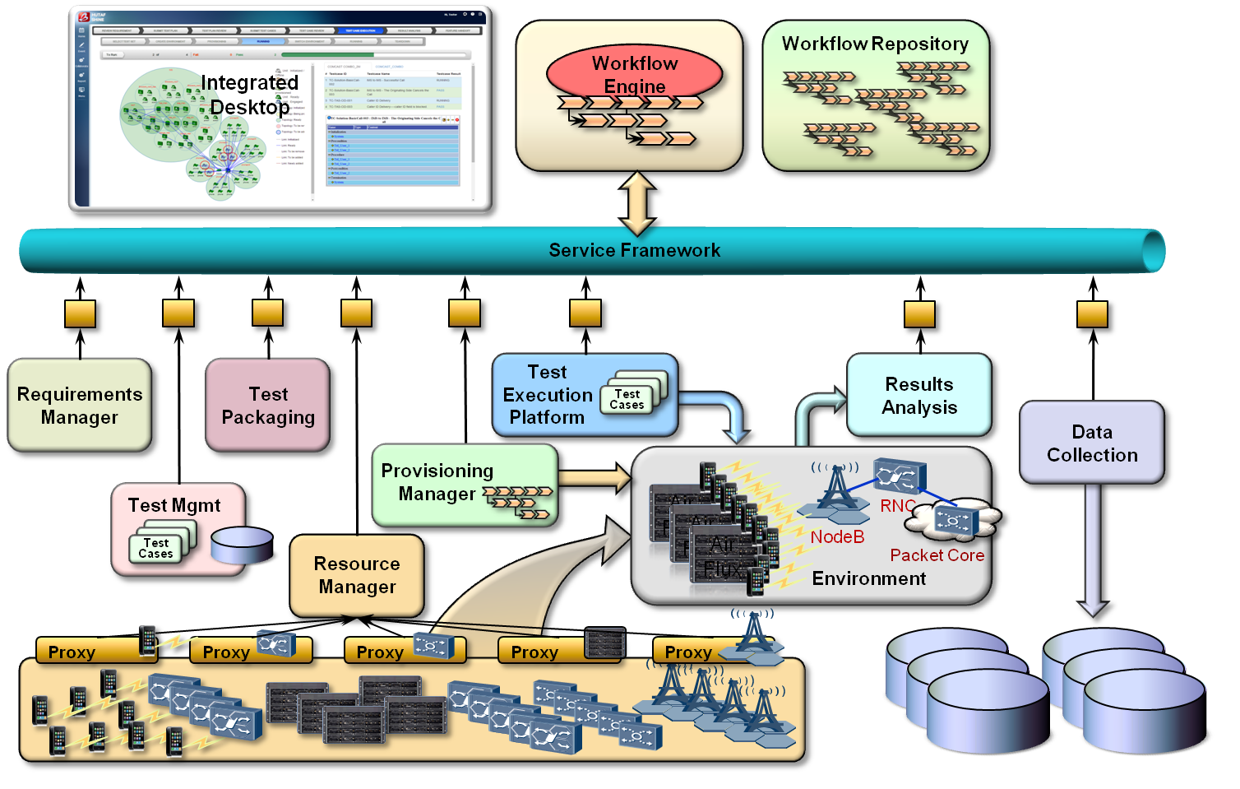
Joint Agile Delivery Ecosystem
Multiple test technologies and repositories accessible through open APIs and orchestrated through workflow-driven processes
with continuous project tracking on a collaboration platform
Service-oriented testing - decoupling test cases from underlying technologies
Standardized test case format and test Domain-Specific Language (DSL) based on a common domain definition
Cloudification of the test environment and test tools
Elastic contribution and consumption of test resources
Strategic reuse - reusability of test plans, test cases, test data and test environments
Correlated test results analysis
Service Provider
Suppliers
Integrator
End Users
Open APIs

Slide 7
Progress in SDOs
JAD Process & Test Model
TM forum IG1137A
Recommendations for a Standardized Test Domain Definition & Language
ETSI NFV TST011 (approved by ETSI NFV governing body on February 22, 2019)
Would like to work with ETSI MTS on applicability of the recommendations and concrete syntax beyond NFV
JAD Test Component Suite APIs – TMF913 (standardization in progress at TM Forum)
Officially announced at the TM Forum Nice event on May 15, 2019
ONAP is showing significant interest in adopting the component suite in their integration portfolio

Slide 8
Process Flow & APIs
Each supplier writes a set of test cases using abstract resources
Suppliers contribute resource APIs
Environment meta-models are created to describe contributed resources
Abstract environments are created and are managed
A run-time test environment is created at exection time by mapping abstract environments to a set of concrete resources using environment meta-models
The test cases are parameterized with the appropriate data
Test cases are executed
The test results are posted
The test results are retrieved by suppliers

Slide 9
JAD Test Model & Language (JADL)
JADL encompasses a standardized Test Model,
a Domain-Specific Test Language, and an integrated Test Automation Platform:
Test are written in an intuitive, easy to use and maintain Test Case DSL
Tests follow a standardized test case model that include reusable artifacts: script, data, abstract resources, environment, etc. – standardization enables JAD; reuse leverages assets; systematic approach improves quality
Test execution environment is created dynamically using Dynamic Resource Management to allow multiple providers contribute resources, improve resource utilization and reduce test execution time
Test are executed on a Test Execution Platform that ties Test Case elements together and provides intended interactions with the Test Infrastructure – unified solution across providers reduces overhead

Slide 10
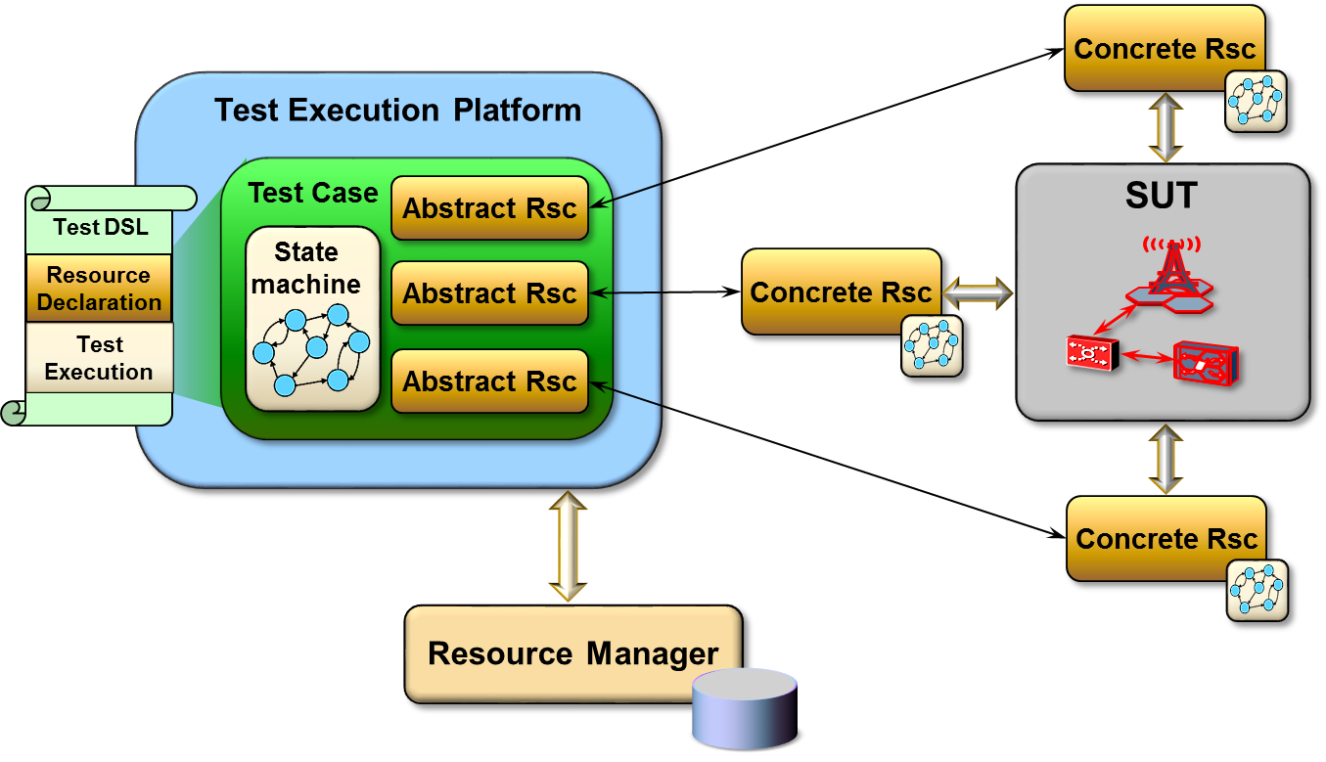
General Test Domain Concepts
System Under Test (SUT): a piece of software, a device, a network, etc.
Test Case Resources: abstract and concrete
Test Execution Flow: controlled and uncontrolled state transitions
High-Level Functions: a repeatable sequence of controlled state transitions
Test case data: resource-specific and non-resource-specific
Test Case Segments: executable blocks of the test case
Higher-Level Functions
Test Case Data (Symbol Lookup)

Slide 11
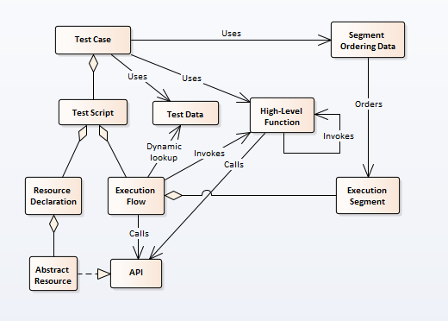
Test Case Elements
The test case has a test script and uses test data, high-level function libraries and segment ordering data
The test script has resource declaration and execution flow definition parts
The resource declaration section aggregates a set of abstract resources that realize their respective APIs
The execution flow can call the abstract resource APIs; it can also invoke higher-level functions which can invoke other higher-level functions and call abstract resource APIs

Slide 12
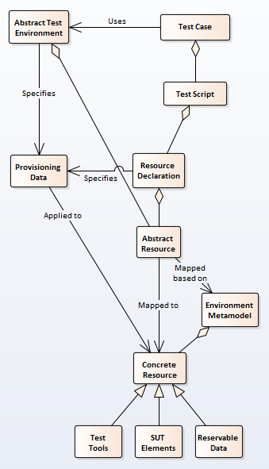
Test Environment
Abstract test environments aggregate abstract resources which are mapped to concrete resources
Three major types of concrete resources: SUT elements, test tools (used to interact with the SUT) and reservable data
The “glue” between the abstract and the concrete environments is provided by the Concrete Environment Resource Model
The Concrete Environment Resource Metamodel describes the concrete resource space as a set of reservable entities and provides a number of abstractions (e.g. pools) that can be referenced from the abstract environment definition
The Concrete Environment Resource Metamodel captures domain knowledge about the concrete resource space and considerably simplifies abstract environment definition

Slide 13
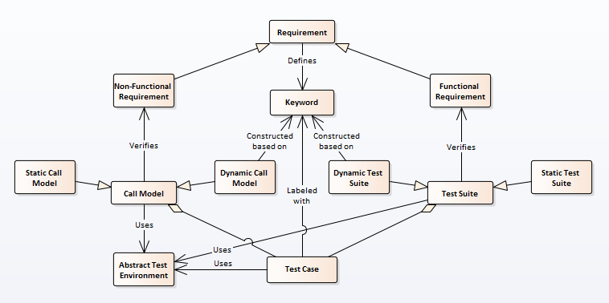
Test Scenarios
Test suites aggregate test cases that verify functional requirements.
Test cases in a test suite are executed once
Success and failure are considered on individual test case basis.
Call models aggregate test cases that verify non-functional requirements (performance, robustness, etc.)
Test cases execute repeatedly, each at its own rate.
Together, they emulate real network conditions where multiple activities happen at the same time.
Success and failure are considered on the entire call model basis and a certain number of individual test case failures is typically expected

Slide 14
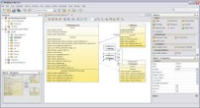
JADL Components
GPL 1 Representation
Execution Engine 1
Pool gsm_mobile:
orig01, ..., orig05, term01, ..., term05
10 aliases:
orig01 -> gsmTH:mobile101
...
orig05 -> gsmTH:mobile105
term01 -> gsmTH:mobile106
Projectional Modeler
GPL 2 Representation
Conceptual Model
Execution Engine 2
Pool gsm_mobile:
orig01, ..., orig05, term01, ..., term05
10 aliases:
orig01 -> gsmTH:mobile101
...
orig05 -> gsmTH:mobile105
term01 -> gsmTH:mobile106
IDE
Test Execution Platform
Concrete
Syntax
Test Execution Platform
Constraints
Optimizations
Grammar
Parser
Resource
Manager
Provisioning
Manager
Concrete Environment

Slide 15
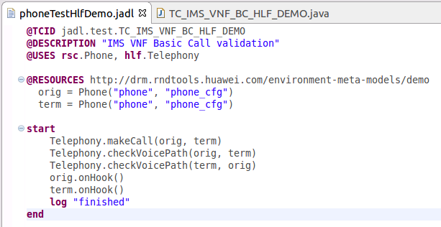
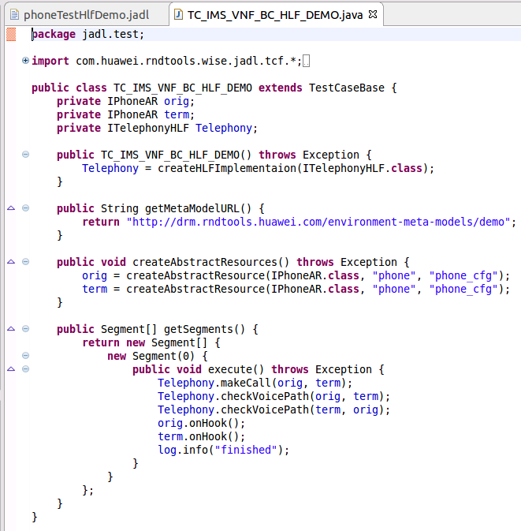
Text-based Test Case Example

Slide 16
Test Case Creation and Execution
Test Script
in DSL
Test Flow
Template
Test Execution Platform
10 aliases:
Pool orig:
orig01, orig02, ..., orig05
..., term05
10 aliases:
orig01 -> gsmTH:mobile101
...
orig05 -> gsmTH:mobile105
term01 -> gsmTH:mobile106
...
term05 -> gsmTH:mobile110
Pool orig:
orig01, orig02, ..., orig05
Pool term:
term01, term02, ..., term05
Pool gsm_mobile:
orig01, ..., orig05, term01, ...,
Pool orig:
orig01, orig02, ..., orig05
Custom code
Abstract Resources
10 aliases:
Pool orig:
orig01, orig02, ..., orig05
Generated code
Pool gsm_mobile:
orig01, ..., orig05, term01, ..., term05
10 aliases:
orig01 -> gsmTH:mobile101
...
orig05 -> gsmTH:mobile105
term01 -> gsmTH:mobile106
10 aliases:
orig01 -> gsmTH:mobile101
...
orig05 -> gsmTH:mobile105
term01 -> gsmTH:mobile106
...
term05 -> gsmTH:mobile110
Pool orig:
orig01, orig02, ..., orig05
Pool term:
term01, term02, ..., term05
Test Execution Platform (TEP) is an additional software layer between the test written in a DSL and its target platform.
Provides required interactions with the rest of the tools infrastructure
Controls all aspects of the test case execution on the target platform
10 aliases:
orig01 -> gsmTH:mobile101
...
orig05 -> gsmTH:mobile105
term01 -> gsmTH:mobile106
...
term05 -> gsmTH:mobile110
Pool orig:
orig01, orig02, ..., orig05
Pool term:
term01, term02, ..., term05
Pool gsm_mobile:
Template generated by the framework
Segment Ordering Data
Test Case
Framework
Framework code
Resource
Manager
Provisioning
Manager
Higher-Level Functions
Test Case Data (Symbol Lookup)
Concrete Environment

Slide 17
Thank you

