Slide 1
TOP Applying for Google Summer of Code
Michele Carignani (ETSI)
MTS#75
23.01.2019

Slide 2
Google Summer of Code 2019
https://summerofcode.withgoogle.com/about/
Google Summer of Code is a global program focused on introducing students to open source software development. Students work on a 3 month programming project with an open source organization during their break from university.
Since its inception in 2005, the program has brought together 14,000+ student participants and 24,000+ mentors from over 118 countries worldwide. Google Summer of Code has produced 35,000,000+ lines of code for 651 open source organizations.

Slide 3
How it works
https://summerofcode.withgoogle.com/how-it-works/
“Organizations
Open source projects apply to be mentor organizations. Once accepted, organizations discuss possible ideas with students and then decide on the proposals they wish to mentor for the summer. They provide mentors to help guide each student through the program.”

Slide 4
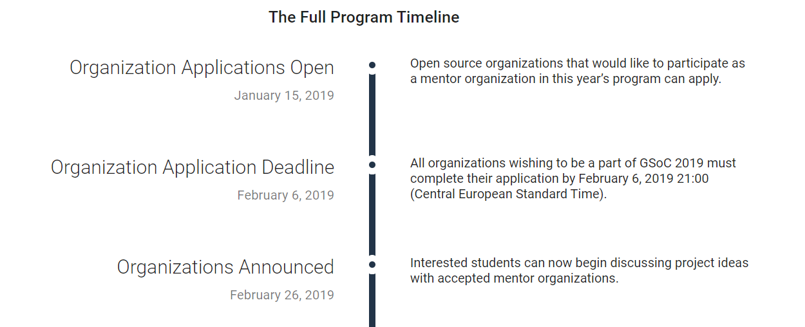
Timeline

Slide 5
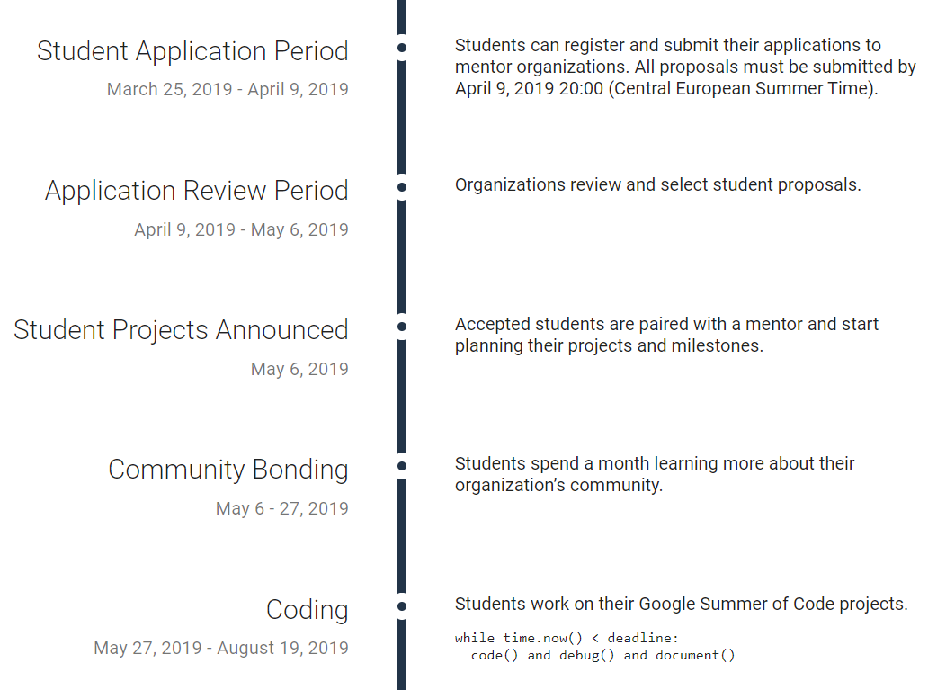
Timeline (cont’d)

Slide 6
Please approve the following proposal
MTS to pursue application for GSOC
Mandate ETSI Secretariat to prepare application
Shared with TDL SC on Monday
Review period till Friday 1st of Feb
Application done before Feb 6th
Set up a TDL SC confcall to review applications (if any)

