Slide 1
TDL
ETSI MTS#76 Meeting
23-Jan-2019

Slide 2
Agenda (14:00 – 17:30)
14:00 – 14:15: Opening
14:15 – 15:00: Presentation from NetResults and discussion on their open points
15:00 – 15:30: Open bugs, next features planned for TOP and roadmap
BREAK
16:15 – 16:30: PyTDL contribution to TOP
16:00 – 16:30: New application: TDL for RESTful service testing
16:30 – 17:00: TDL website and promotion
17:30: End of Meeting

Slide 3
2 Presentation from NetResults and discussion on their open points
Telco software, e.g. audio calls, conferences; ADA project (from UCAAT)
ThEIA – testing environment for internet applications
Test descriptions manually, manual/automated test execution
Goal: use TDL in this process
Nice TDL features to have (w.r.t. language or tools?)
Explicit “receive” statement, i.e. only a description of the tester
Template mechanism over test configurations, e.g. generic number of testers
Template mechanism for test description behaviour
Missing fuzz testing functions to generate random activities/events at random time
Even current TDL tool was a life saver for us due to the creation of formal specs

Slide 4
2 Presentation from NetResults and discussion on their open points
Discussion
A special “receive” could be just in concrete syntax, but TDL specifies interactions, i.e. send/receive pairs
Language can be extended to support beh./config. lists → bug report required
Further understanding and discussion required to use TDL for security/fuzz testing, e.g. extension by “random functions”
Ongoing work on mapping TDL to executable tests

Slide 5
3 Open bugs, next features planned for TOP and roadmap
TDL defect reporting, http://oldforge.etsi.org/mantis/view_all_bug_page.php
7803: TDL inheritance
7802: Separating language concepts for globally vs locally ordered behaviour
7078: Compliance of TDL-MM with presentation guidelines
7383: Refinement in exceptional behaviour
7192: TDL-TO: Formal TO parameters
7190: TDL-TO: predefined data types in inline data use
7163: Test input event definition
7810: TDL-TO: TP grouping
7705: Inter-tester default behaviour
7381: Mapping changes in UML Profile for TDL

Slide 6
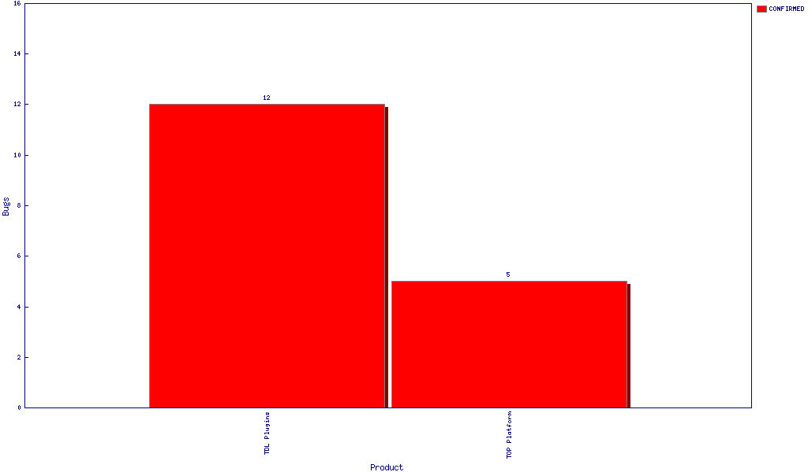
3 Open bugs, next features planned for TOP and roadmap
TOP defect reporting, https://tdl.etsi.org/bugzilla

Slide 7
3 Open bugs, next features planned for TOP and roadmap
New TOP features and roadmap
New features
Language
TTCN-3 mapping
Keeping pace with new Eclipse versions, e.g. platform, Sirius, Xtext
Decision: ToR on a new STF to work on TDL language and TOP tool enhancements and maintenance to support growing user community
Statements from supporting companies requested!
Timeline: ASAP, i.e. by end of Feb., decide on Wis to be updated

Slide 8
4 PyTDL contribution to TOP
Mapping TDL to Python; see own MTS#76 contribution
See: https://portal.etsi.org/Contribution.aspx?MeetingId=35310
Relation to current TOP – how does it enhance current features?
Have TDL closer to Python to enable executable tests
Proposal: create a new, 3rd repository in TOP

Slide 9
5 New application: TDL for RESTful service testing
Related WI: DEG/MTS-1029511 (2018-09-27) → EG 203 647 “Methodology for RESTful APIs specifications and testing”
Guidance and methodology for RESTful API specification and testing based on analysis of methods, languages and best practices used in the industry and in ETSI groups (ETSI TBs and Partnership Projects)
Timeline: 2019-03-22 start … 2019-11-22 final draft for approval
Possible approach – ToR planned → Michele, see WI cover page for details
Selection of a technical specification provided by a TB
Invite users from identified TBs to a joint meeting to report and discuss their current approach and understand their problems with Web API testing within MTS
Exemplified specification of test purposes and test descriptions
Reporting on findings and obtained results, to be published as ETSI guide

Slide 10
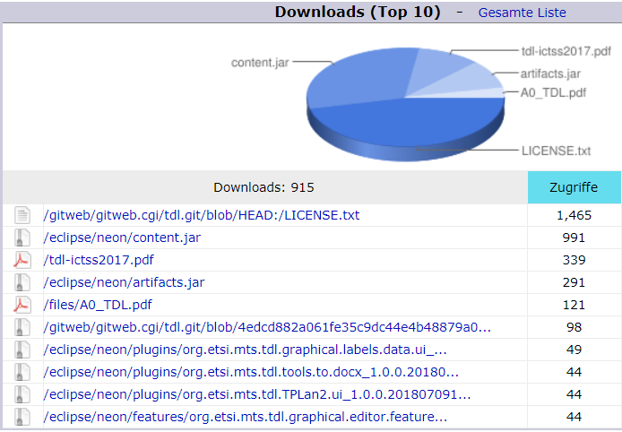
6 TDL website and promotion
Access to tdl.etsi.org in 2018

Slide 11
6 TDL website and promotion
TDL/TOP presentation to the BOARDOSS#49 meeting
https://portal.etsi.org//Contribution.aspx?MeetingId=35086
Kick off meeting on TDL/TOP on regular basis
TOP governance → Decision to be taken to create a TDL/TOP working group, similar to MTS TST
Project Lead → ETSI member and CTI – Who?
Steering Group → SG meeting before or combined with MTS meeting
Advisory Group (MTS) → reporting to each MTS meeting Jan/May/Sep

Slide 12
6 TDL website and promotion
TDL user guide
Application of TDL-TO and refinement to TDL test descriptions
Refined test descriptions to enable mapping to TTCN-3
Coordinate with WI “TDL for RESTful service testing”
TDL @ UCAAT and beyond
CCUF is the Common Criteria User Forum (Axel’s e-mail 22-Oct-2018)
Planned activities at UCAAT?
TDL/TOP website updates

