Slide 1
TC MTS WG TST Status
Axel Rennoch, MTS TST
TC MTS
24.1.2019

Slide 2
Reminder: History of WG TST
Start of Working program in January 2018
Current focus is
- CoAP, MQTT
- LoRa
- Security TPs
Participation is always 10 – 15 persons (four rapporteurs)

Slide 3
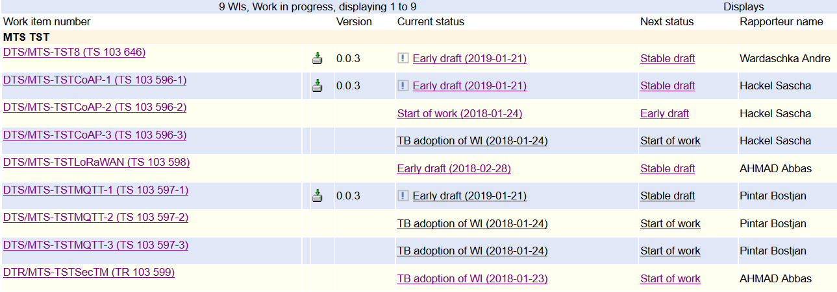
Overview of current work program

Slide 4
Review WI time schedule
Change of schedules for COAP/MQTT (part 1)
Stable Draft 2019-05
Final Draft 2019-09
Change of schedules for Sec TPs
Stable Draft 2019-09
Final Draft 2020-01
Change of schedules for all other WIs
Early Draft (ToC) 2019-05
Stable Draft 2020-01
Final Draft 2020-05

Slide 5
Liaisons/contacts with other groups
Pending liaisons
ETSI TC Cyber and SmartM2M
oneM2M TDE and SDS
Planned liaisons/contacts
OPC Foundation (ongoing):
next step: call with OPCF Compliance group ./. ETSI TDL experts
German DIN working group IoT (presentation of TST at meeting 8th March)

Slide 6
AOB
Promotional TST Flyer on the portal:
https://portal.etsi.org/Portals/0/TBpages/MTS/Docs/MTS%20TST_Q32018.pdf
Presentation of Security TPs at ETSI IoT week in October 2018 (DEKRA/FOKUS)
https://docbox.etsi.org/Workshop/2018/201810_IoTWEEK/02_IoTWORKSHOP/S03_IoTOPP_OPENSOURCE_CERTIF/IoTTESTS_QA_DEKRA_FRAUNHOFER_WARDASCHKA_RENNOCH.pdf
Draft TST#6 report: MTSTST(19)006006
Next meeting (TST#7) May 22nd (morning), 2019, before MTS#77 in Sophia Antipolis

