Slide 1
Introduction to TDL and TOP
MTS TDL
Joint MTS/NFV Session
22-May-2019

Slide 2
Introduction to TDL

Slide 3
Why there is TDL – The need for abstraction in testing
Trends in testing
Behaviour-Driven Development (BDD) and Continuous Integration (CI)
Model-Based Testing (MBT) and other forms of (abstract) test generation
Test automation (of concrete tests) in the norm
ETSI MTS legacy: TTCN-3
The test specification language for executable, concrete tests
Detailed TTCN-3 code makes understanding its larger intent hard

Slide 4
TDL – Test Description Language
Supports the specification of (abstract) tests for conformance and interoperability
Language design – customizable by language engineers
Language concepts (abstract syntax) can be pruned / extended
Concrete syntax for users can be adapted to fit the application domain
Developed between 2012 and 2018
Ongoing evolution and maintenance
Current focus on usability and mapping TDL to TTCN-3
Series of standards ES 203 119 parts 1 – 7
http://www.etsi.org/standards-search?search=203119&ed=1&sortby=2

Slide 5
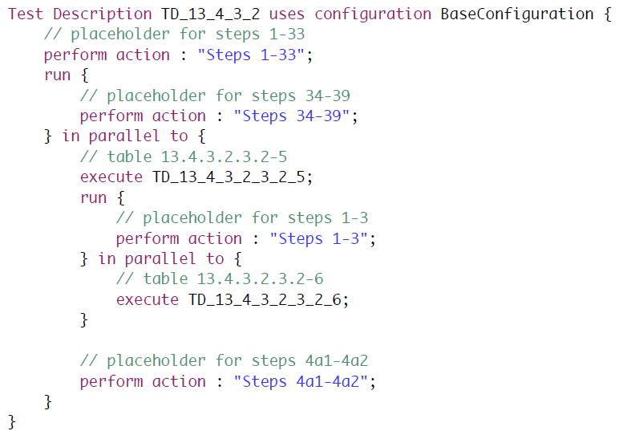
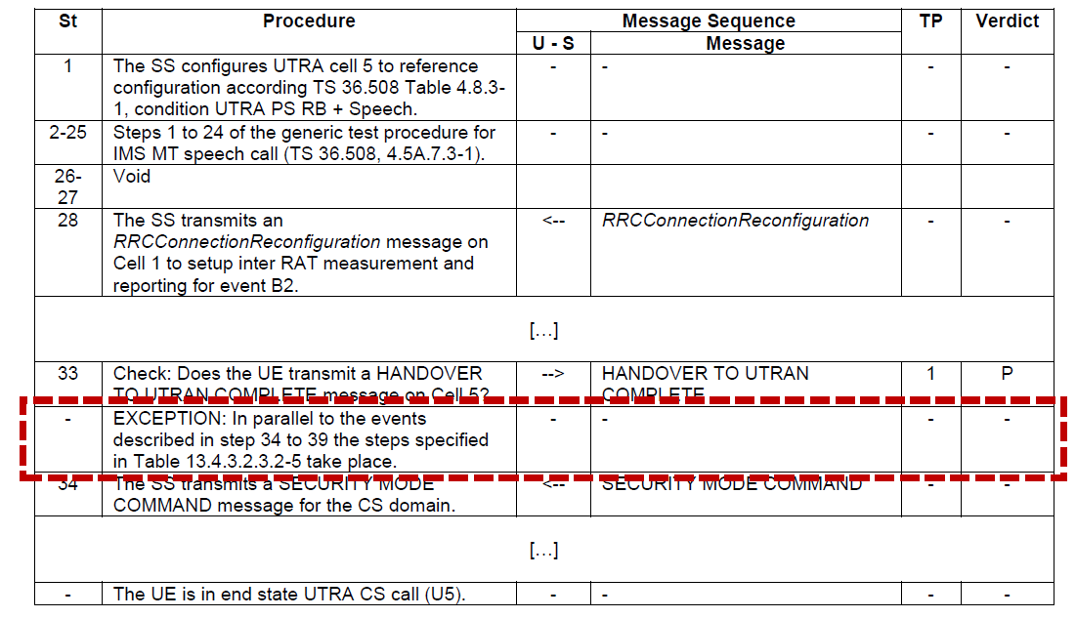
From documents to specifications – MS Word vs TDL
Example: 3GPP TS 36.523-1

Slide 6
The ETSI standard series ES 203 119
2
(1) TDL-MM: Abstract Syntax and Associated Semantics
(2) TDL-GR: Graphical Syntax
(3) TDL-XF: Exchange Format
(4) TDL-TO: Structured Test Objective Language
(5) TDL-UML: UML profile for TDL
(6) TDL-T3: Mapping of TDL to TTCN-3
(7) TDL-EX: Language Extensions
3
1
Concrete Syntax
TDL-GR
TDL-XF
Other syntax
TDL-TO
TDL-MM
Abstract Syntax

Slide 7
Working with TDL

Slide 8
Key concepts of a Test Objective Specification
References to requirements to be tested
Support of Behaviour-Driven Development
Prose syntax (similar to earlier TPLan)
GIVEN
WHEN
THEN

Slide 9
Key Concepts of a TDL Specification
Test configuration
Set of interacting components in the roles Tester or SUT
Test description
Represents the expected (passing) behaviour, i.e. any deviation is a fail
Expresses a test in terms of interactions of data exchanged between tester and SUT components
Interactions are totally ordered, i.e. they are implicitly synchronized among components
Test data
Represented as abstract name tuples

Slide 10
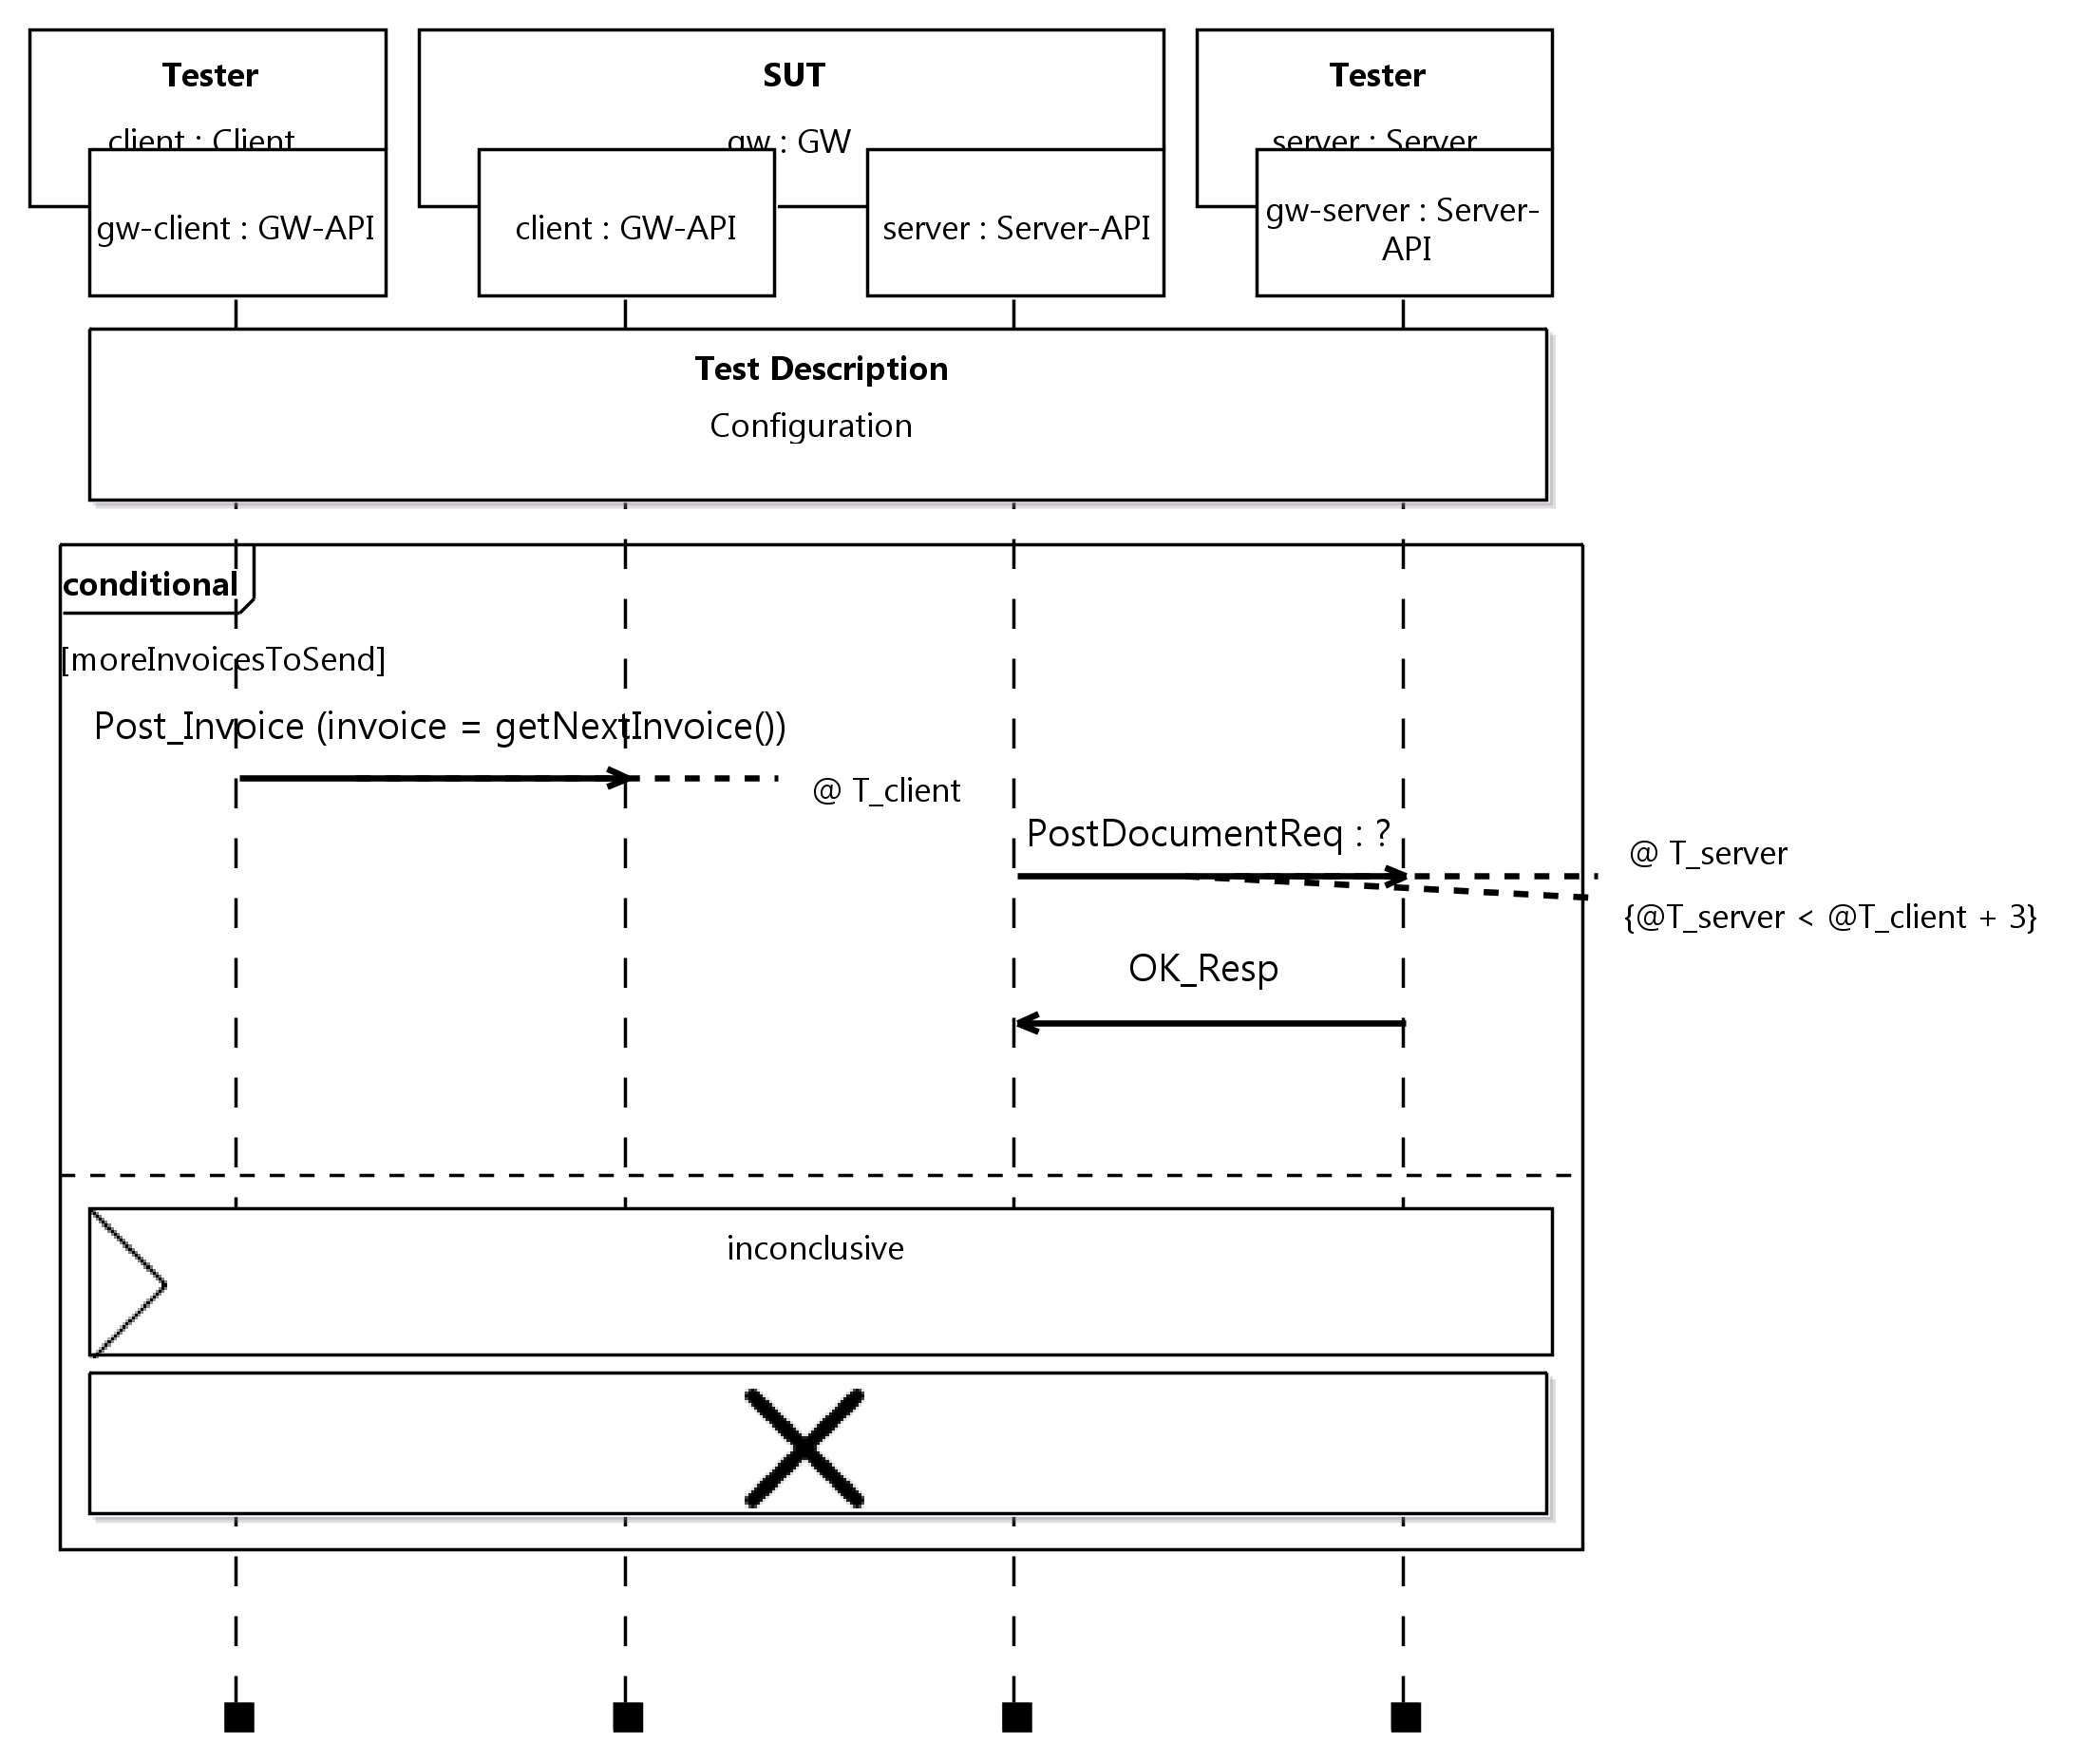
Graphical Syntax
test configuration being used
time
combined behaviour
① interaction
condition
② interaction
③ interaction
time constraint

Slide 11
Introduction to TOP

Slide 12
Why there is TOP – Kick-starting TDL
Announced at UCAAT 2017
TOP – TDL Open Source Project
Proof-of-concept of TDL standards and their validation
Provides stimulus for future TDL standardization
Lowers the barrier of entry for both users and tool vendors
Creates an open platform and ecosystem for the development of versatile tools
Community building

Slide 13
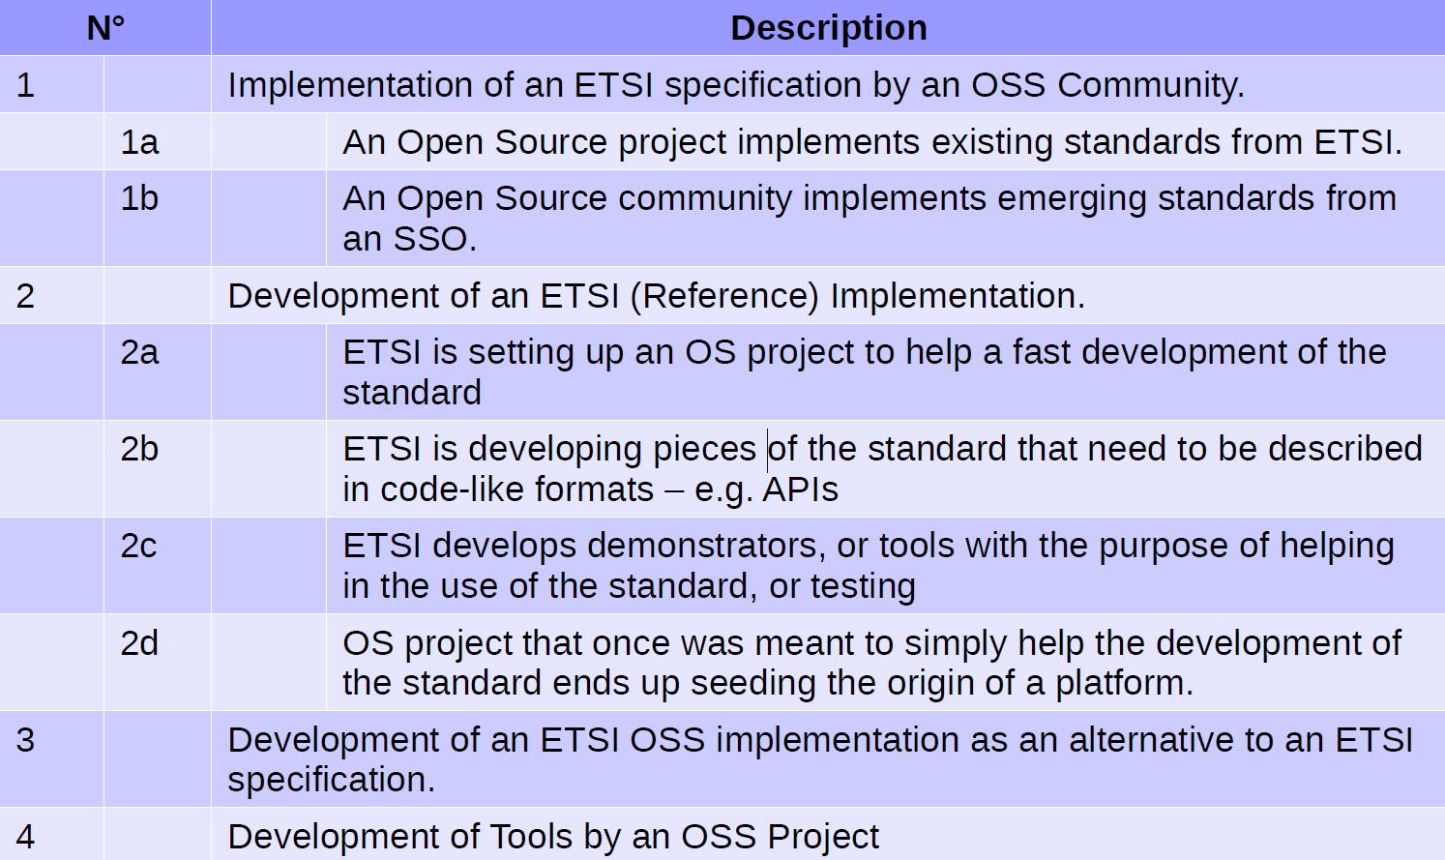
TOP goals and ETSI BOARD OSS scenarios
Covered TOP goals

Slide 14
An open and scalable tool architecture for TDL
Based on development standards (Java, Eclipse) and supporting the integration of open-source and third-party components
UML-based Graph. Editor
Report
TDL Model Analyzer
Textual Editor (incl. ES 203119-4)
TDL Test Generator
TDL Exchange Format (ES 203119-3)
Graphical Editor (ES 203119-2)
Graph. Viewer & Doc. Gen.
Test Plan
Test Code Generator
C-code,
TTCN-3
Front-end tool
Back-end tool
Artefact (output)
Currently covered in TOP

Slide 15
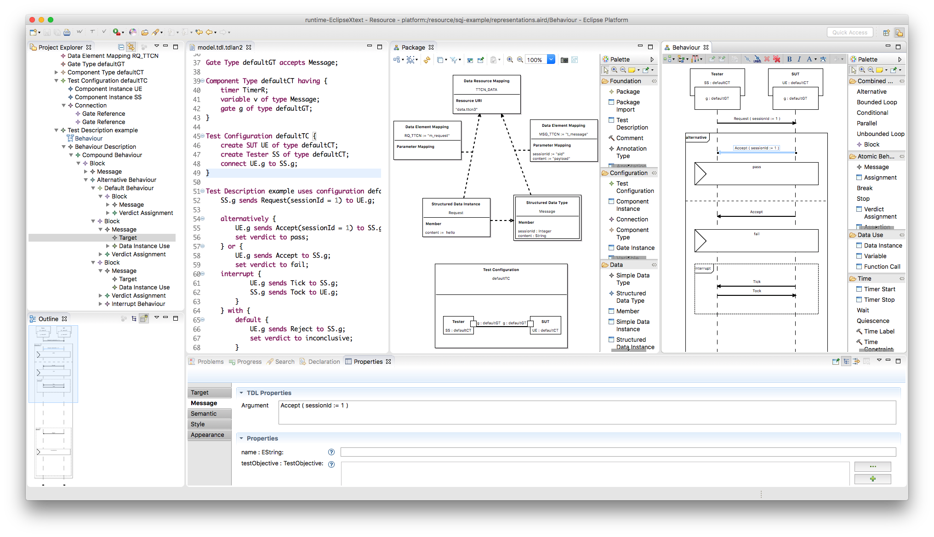
TDL Open Source Project (TOP)
Eclipse Public License (EPLv1)
TOP governance
Project Lead – ETSI member and CTI
Steering Group – WG MTS TDL
Advisory Group – ETSI TC MTS
Active contribution to code requires ETSI membership

Slide 16
TDL and TOP usage
Recent known usages
ETSI standardization
Test purpose specifications in STF 551 on MEC (Edge computing), NG112 testing (emergency communication), MTS TST (IoT protocols)
Industry (as reported at UCAAT)
NetResults: testing of collaboration IT services
Elvior: TDL support in test tools considered
Strong demand: Make TDL specs executable to use them in test automation!

Slide 17
Contact
Web site
https://tdl.etsi.org/ – TDL home page
https://top.etsi.org/ – TOP repository
TDL mailing list
MTS TDL Working Group Chairs
Andreas Ulrich, Siemens AG, andreas.ulrich@siemens.com
Philip Makedonski, University of Göttingen, makedonski@informatik.uni-goettingen.de

