Slide 1
“Methodology for RESTful APIs specifications and testing”
MTS(19)077005
Michele Carignani (ETSI)
MTS#77
22.05.2019

Slide 2
Why? Because REST is important!

Slide 3
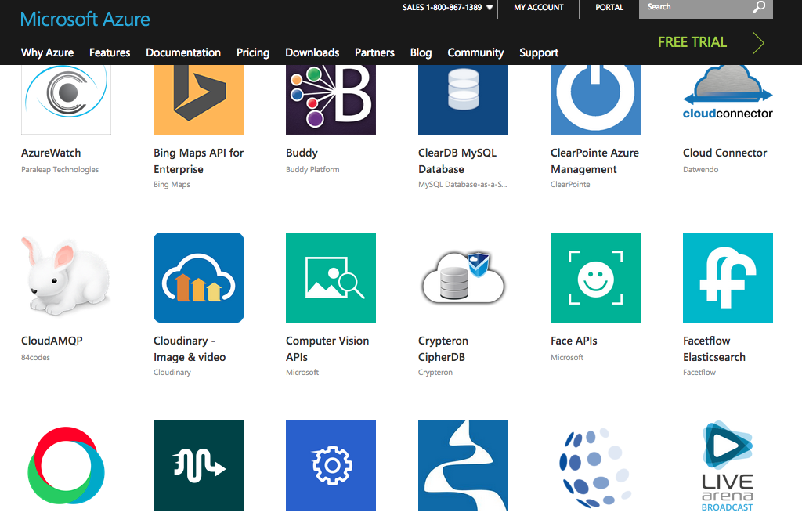
The real why: REST activities in ETSI (and outside)
ETSI Groups are standardizing REST APIs, e.g.
ISG NFV,
ISG MEC,
ISG QKD,
ISG CIM,
ISG ZSM,
And others
ETSI Partners are standardizing REST APIs
3GPP for the Core Network of 5G
OneM2M
And largely also outside of standardization

Slide 4
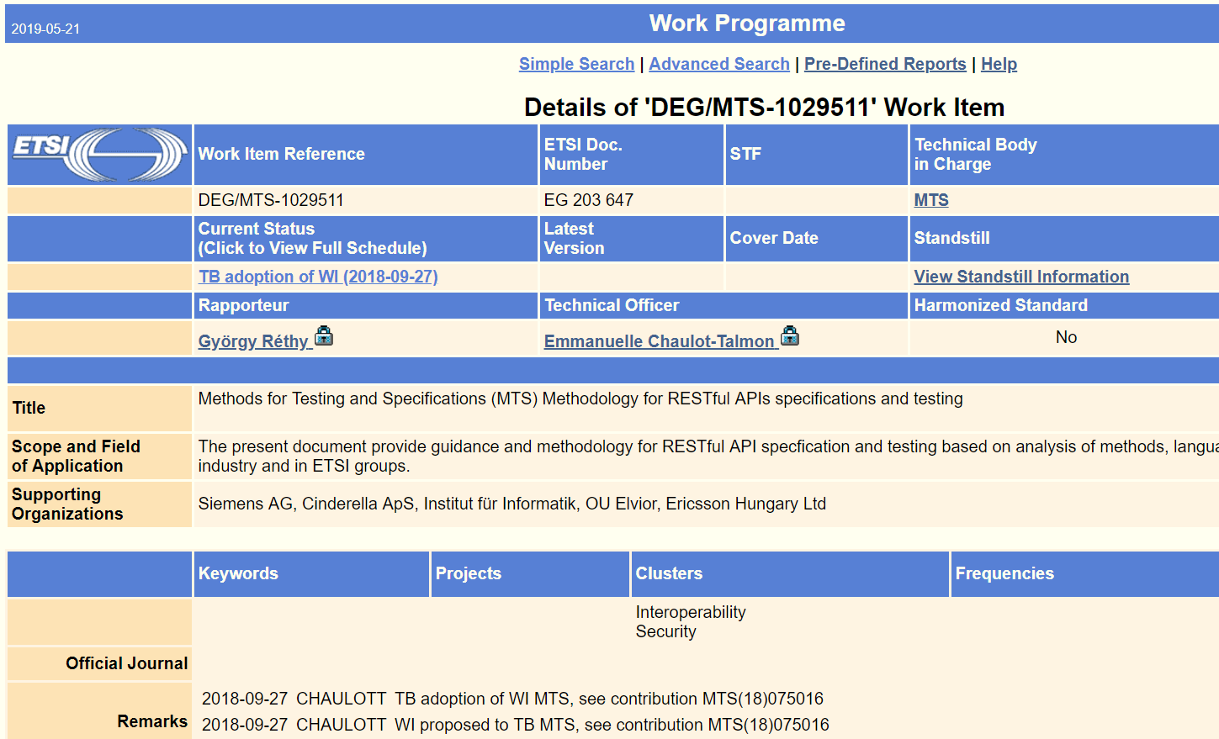
The WI: EG 203 647 - Methodology for RESTful APIs specifications and testing
Scope
The present document provides guidance and methodology for RESTful API specification and testing based on analysis of methods, languages and best practices used in the industry and in ETSI groups.
Rapporteur: György Réthy (Ericsson)
See on ETSI Portal

Slide 5
The STF: DK - Survey of current work and definition of a methodology for specification and testing of RESTful APIs
Text
Time scale: Sept 2019 to Mar 2020
Terms of reference available on Portal
Current status:
Approved by TC MTS,
OCG screening clearance,
waiting for BOARD approval

Slide 6
Rationale 1/2
It is becoming more clear that “REST API” specification needs to be:
Fast: the interfaces are simpler than other approaches and tend to have a shorter lifespan;
Automatable: given the high number of conventions in the design of an API, parts of the specification, implementation and testing process are well suited to be automated;
Developer friendly: developers need support in the discovery and implementation of the interfaces by using tools and methodologies more closely aligned with software development.

Slide 7
Rationale 2/2
The development of official ETSI guides for REST API specification and testing will support:
- Consolidation of efforts: TBs and PPs would be able to leverage from others’ experience
- Delivery time of specifications
- Standards quality (specification, testability, interoperability)

Slide 8
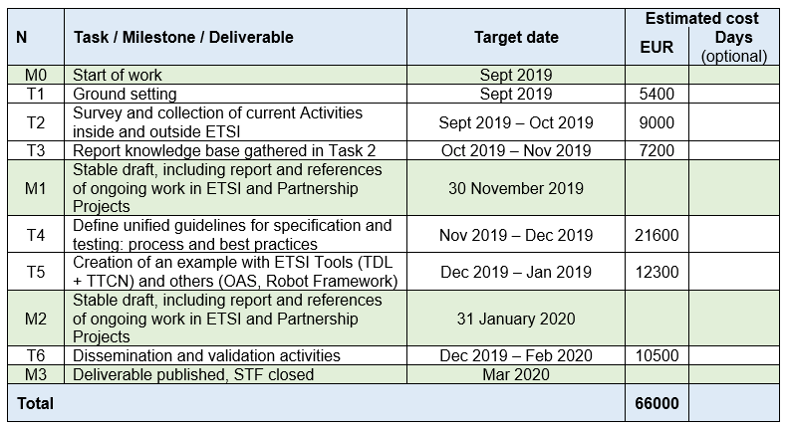
Task summary

Slide 9
Spotlight on Task 4: Objectives 1/2
Specification best practices
Specification of provisions (requirements, recommendations, options)
Data modelling practices
Specification formats (e.g. OpenAPIs, RAML, etc.)
Specification maintenance (e.g. versioning) and storage (e.g. with Git platforms such as ETSI Forge)
Generation of documentation from machine readable specification formats
Testing best practices
Instantiation of ETSI testing methodology with highlights on specifics for REST APIs, such as
Generic test architecture
Recommendations on Test Purposes
Recommendations on Abstract Test Suites
Recommendations on Conformance checks in Interoperability test activities,
Test Generation and Automation opportunities

Slide 10
Spotlight on Task 4: Objectives 2/2
REST API specification and test development process
Steps for an ETSI or PP working group to develop and maintain a REST API in an efficient way, meeting the high quality of ETSI standards
Overall goal of this task will be to consider a flexible approach that allows existing specifications of REST APIs and their underlying design principles in ETSI to be covered by the guidelines or to show an evolution path.

Slide 11
Final remarks
Focus on the end-to-end process
Specify with an eye on the testing
Take into account the experience out there
Other groups already drafted guidelines
Don’t overdo: no need to fix every detail, different options may be shown
Focus on timely delivery to allow dissemination and enable feedback from the groups

Slide 12
Thank you Questions are welcome

