Slide 1
ETSI TC MTS
WG TST introduction
MTS TST
Joint MTS/NFV Session
22.5.2019

Slide 2
ETSI TC MTS: WG TST
    Terms of reference:
  studies, guidelines, test catalogues and test specifications for specific ICT technologies
  (not covered elsewhere)
  conformance, interoperability, security and performance testing
  initial technical focus of TST will be:
      IoT network layer (communication protocols, node connectivity, edge computing etc.).
      IoT layer (data accumulation and aggregation)
      Application layer (interfaces, business processes etc.)

Slide 3
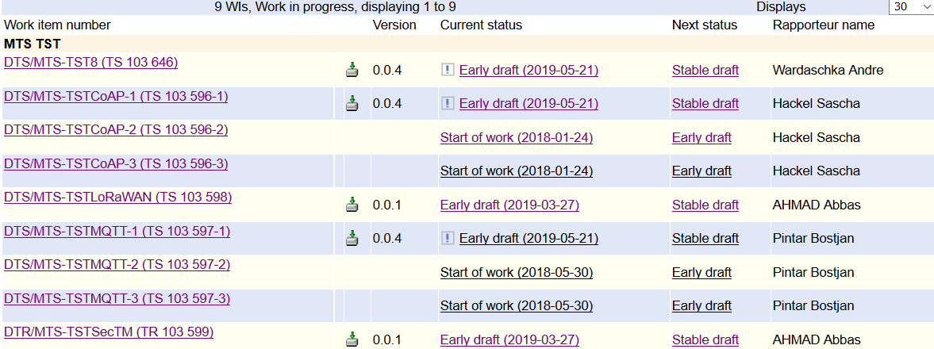
MTS TST Work Programme
IEC 62443-4-2
CoAP
LoRaWAN
MQTT
Vul. database
https://portal.etsi.org/tb.aspx?tbid=860&SubTB=860

Slide 4
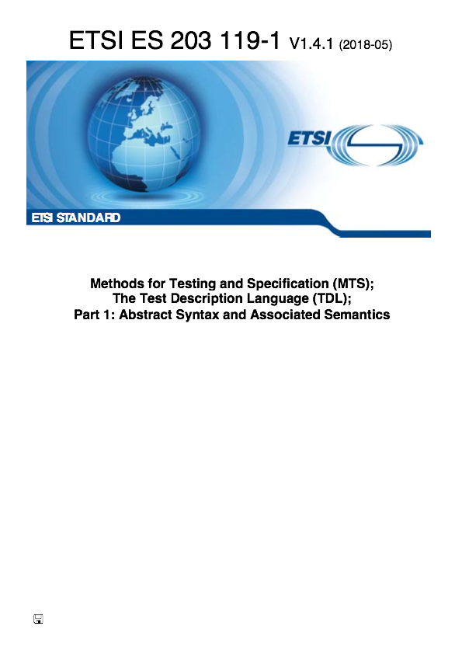

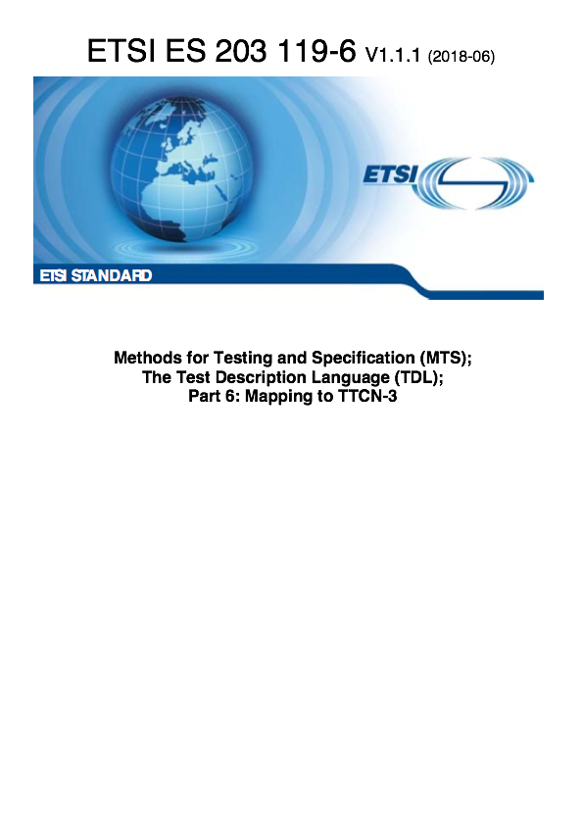
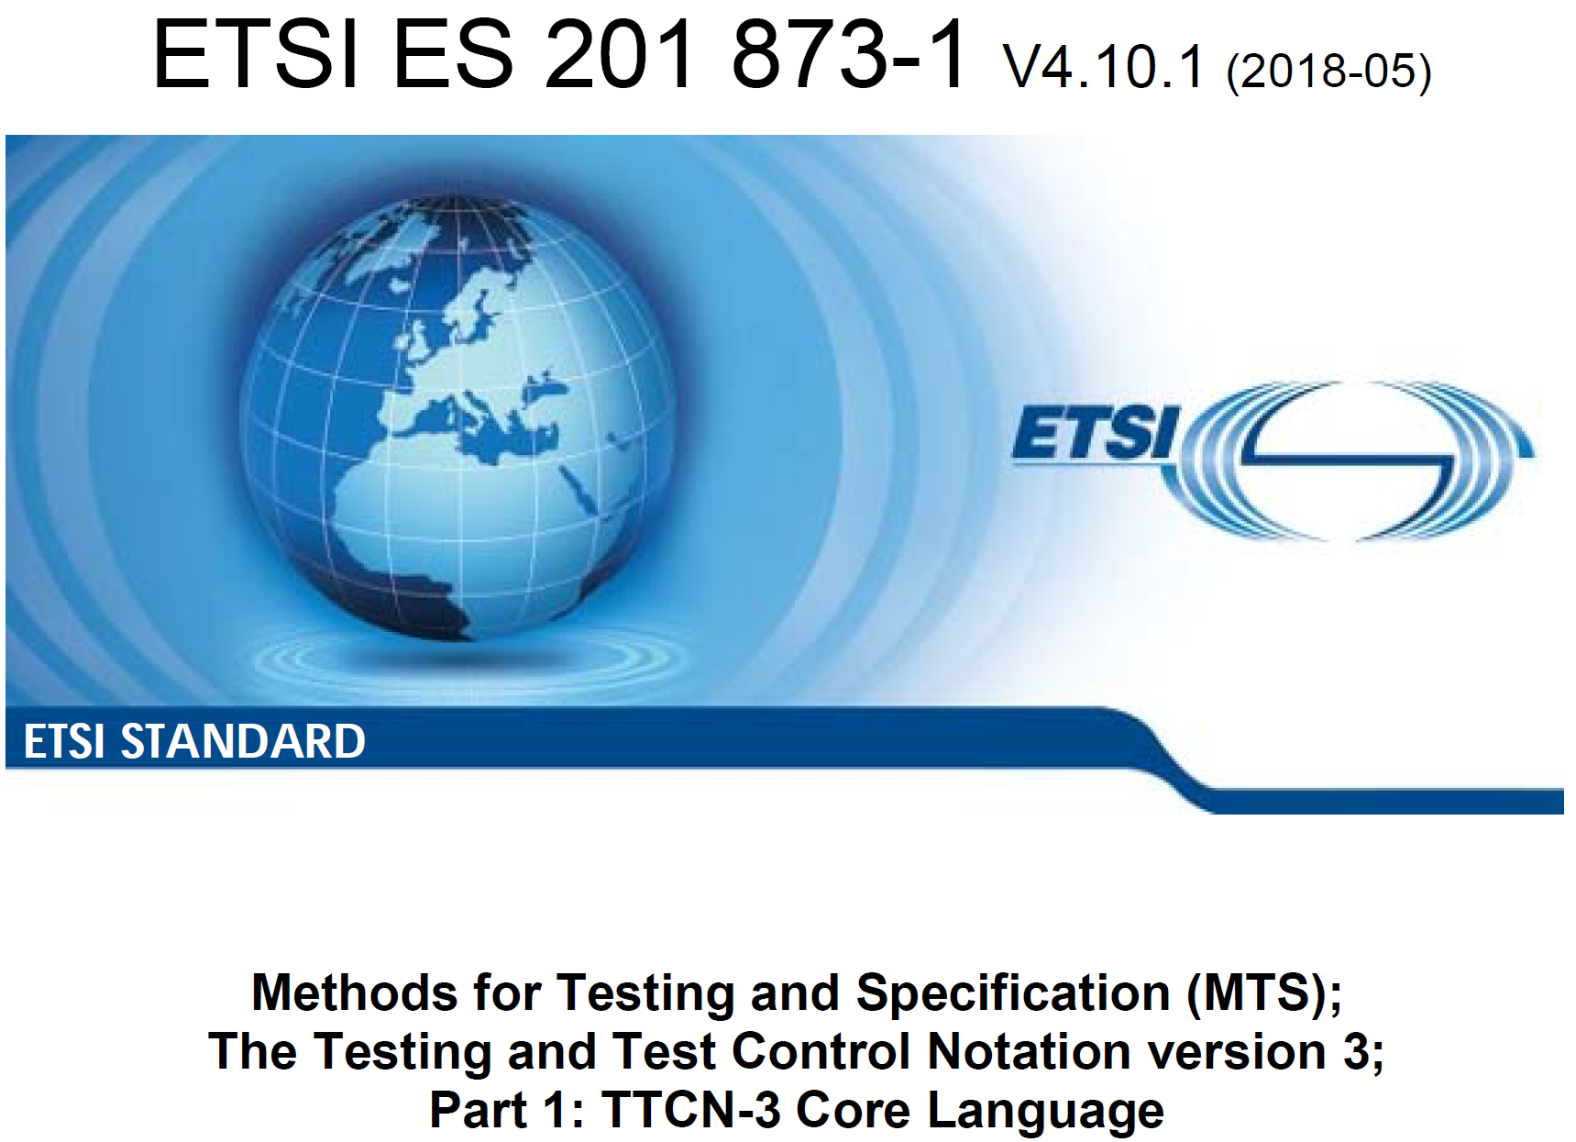

Background
Test Description Language
  Design, documentation, representation of formalised test descriptions
  Scenario-based approach
Testing and Test Control Notation
  Specification and implementation of all kinds of black-box tests
  Component-based approach

Slide 5
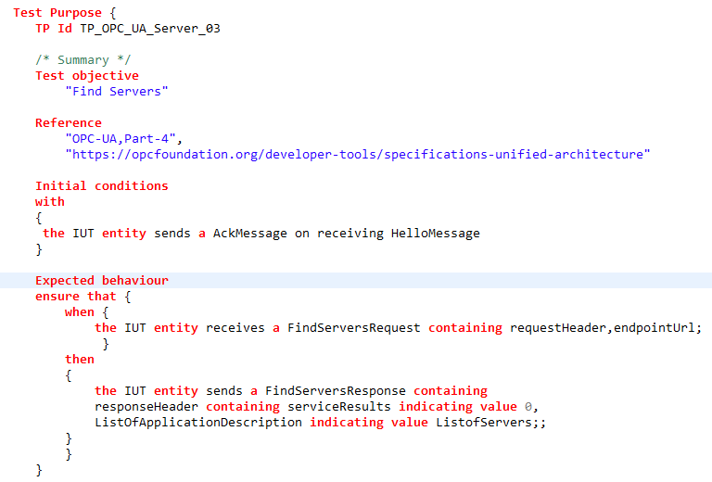
Sample OPCUA Services Test Purpose using TDL
OPCUA part 6, e.g.:
    FindServer
  Using TDL-TO, e.g.:
    Condition
    Domain: entities, events, pics
    Event sequence
TRIGGER
Expectation

Slide 6


The foundation for security certification
IEC 62443 as basis
Industrial
Generic
security requirements
IoT
Medical
Functional AND process
security requirements
Rail
Being established as „horizontal standard“
IEC 62443
Supports domain-specific profiles

Slide 7
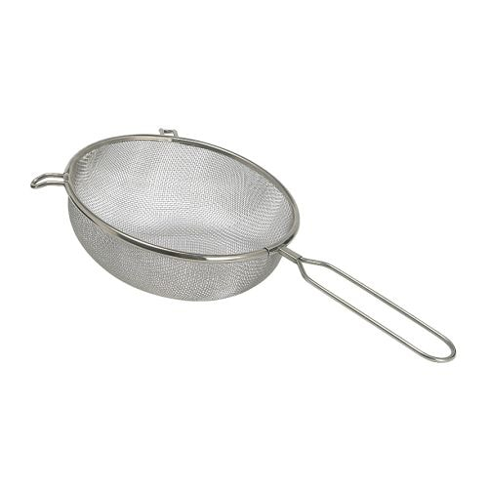
IoT profile
IEC 62443 subset to define minimum IoT security
IEC 62443-4-2 (component requirements)
Basic IoT security profile
Focus on SL1
Excluded aspects:
  Auditing
  Central Security Management
  Secure boot
  DoS- /malicious code protection
Basic IoT security requirements
Test development

Slide 8
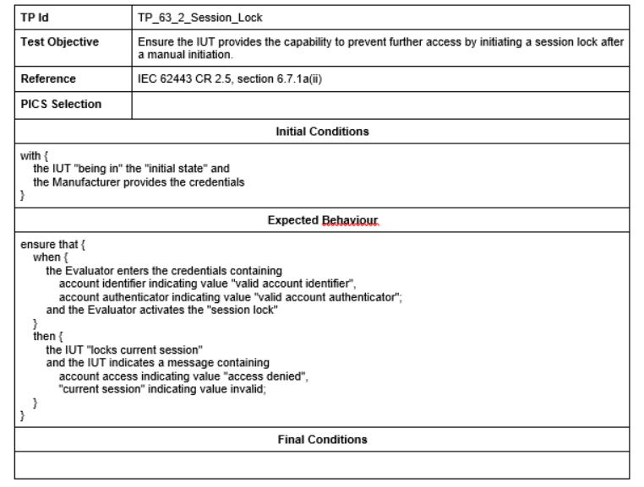
Sample Security Test Purpose using TDL
Foundational TPs, e.g.:
    Authenticator feedback
    Password lifetime
    Session lock
    Account changeability
  Using TDL-TO, e.g.:
    Domain: entities, events, pics
    Event sequence
    Time label and time constraint
TRIGGER
Expectation

Slide 9







IoT-Testware
Big Picture
…
TSS
TP
ATS
Reporting
ETS
TP: Test Purpose
TSS: Test Suite Structure
ATS: Abstract Test Suite
ETS: Executable TS
SUT: System Under Test
Logging

Slide 10
OPC-UA co-operation and vision
Technical co-operation
  Presentation of testing methodologies
    TDL and TTCN-3 workshop
      Samples: MQTT and CoAP
      Main supporters: AUDI, Ericsson, Spirent, DEKRA Exam, Sintesio/Iskratel, EGM, Fraunhofer, …
    Eclipse IoT-Testware (Open source)
        Liaison approach
          ETSI partnership type 2 (MoU) including observers and exchange of working documents (tbd)
          Initial working meeting, e.g. together with OPCF compliance group (29 May in Berlin)
          Technical introduction on OPC-UA tests using TTCN-3 (IoT-Testware)
          Common work on NWI: ETSI test specification for OPC-UA testing

