Slide 1
NWM
New Working Methods
Secretariat NWM Team
MTS#77
23.05.2019

Slide 2
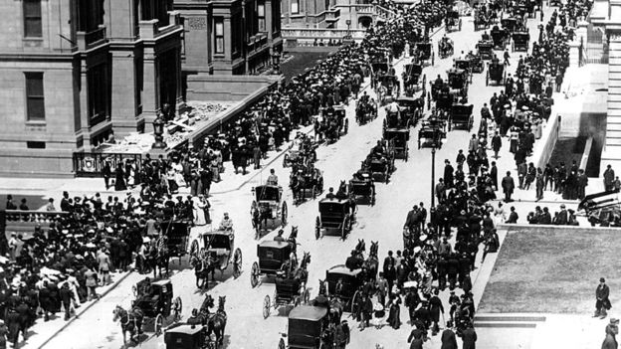
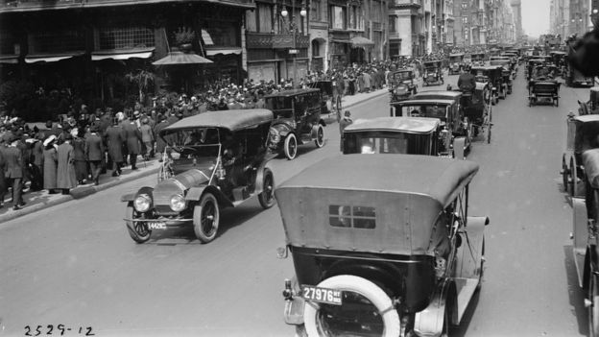
Change can be unexpected and fast
Where are the horses?
… 5th Avenue in1913.
5th Avenue, New York 1900 …

Slide 3
ETSI – What do we mean by change?
  ETSI is not the horse …
  ETSI is 5th Avenue!
One of ETSI’s strategic objectives, Being an Enabler of Standards, talks about providing the very best processes, methodologies and tools to enable the Members to draft and publish the very best technical standards.
The ‘horses’ are our processes, methodologies and tools …

Slide 4
But let’s not put the cart before the horse
  ETSI has a very successful record in the production and publication of its deliverables. In 2017 alone:
    384 face-to-face technical meetings were held at ETSI premises involving over 7000 delegates
    Over 20 000 contributions were uploaded to the Portal
    And 409 deliverables were published.
  In the same year:
    Around 16 000 3GPP delegates participated in 139 meetings,
    Over 100 000 T-Docs were uploaded
    Over 9 000 Change Requests handled
    And 2 351 deliverables were published.
  And the trend is upwards
  Many industries are re-evaluating their collaborative drafting processes, methodologies and tools
  Should we be doing the same?

Slide 5

We all have something in common !
Inconsistent
normative
references
Uploading
to the
portal
Conflicting
Change
Requests
Struggling
with styles
and layout
Info spread
over ftp,
email,
portal
Managing
multiple
local copies
Fixing
Quality
at the end
Preparing
a
Change
Request
At a meeting
2000+
documents,
hundreds
of emails
Finding the
latest version
of a draft
No
automated
process
control
Inconsistent
cover
pages
Notes:
1) Wrong styles
2) When starting a revision of a document you need to find the right version of the document. Where is it? Has the chair a newer version with comments included etc.
3) Incomplete list of references that you use ; incorrect referencing; no deep links possible
4) When drafting in a team; use email+attachment+append with initials
5) Ask somebody new to upload a document ☺
6) Document contains something else as what the cover page describes
7) Too cumbersome and hence hardly used at ETSI
8) How to keep the oversight? How to compare?
9) Big meeting and lots of documents (redundancy in CRs)
10) Information spread wide. How to keep the oversight?
11) No process control

Slide 6
The motivation to change?
  By taking advantage of modern collaboration and drafting approaches NWM hopes to achieve the following:
    To help ETSI technical groups to work as efficiently as possible;
    To enable increased throughput by the ETSI Secretariat;
    To ensure the highest editorial and technical quality of our Deliverables;
    To facilitate closer integration with Member working practices;
    To give ETSI Deliverables an added value for end-users;
    To be attractive to the next generation of standardizers and external organizations.
    To be the best in the pack (in other words, to use cars and not horses)

Slide 7
Scope of NWM in the context of the ETSI SMP
And non-ETSI documents too!!
Focus of NWM
Added Value
for Members
WI Creation
Drafting
Approval
Pre-processing
Adoption
Publication
Added Value for Users
WI Form
Draft Deliverables
Agendas
Minutes (Meeting Reports)
Change Requests
Liaison Statements (In and out)
STF Proposals
New Work Items
Discussion Papers
Other …
Draft Deliverables
Draft Deliverables
Comments
Deliverables
Plus Added Value

Slide 8

Fundamentals of a generic drafting process
  Drafting = taking a document from content state D1 -> content state D2
  Fundamental drafting process characteristics
    Well-defined roles (responsibilities, permissions etc.)
    Submission of proposed modifications (by some means)
    Review of the proposed modifications (by some means)
    Decisions based on those proposed modifications
    Actions taken as a result of those decisions
    Integration of the (accepted) modifications into the baseline
    Time (sync points , durations, deadlines, overlaps … )
    Quality control (editorial & technical, progress and oversight … )
    Ability to split work off into sub-processes
    Traceability of decisions, actions, modifications etc.
A Variant is a linked modified copy (child) of a base (parent) document
By looking at how we do this ...
… and tweaking these parameters
… we can accommodate various modes of working (= processes)

Slide 9

Can be summarized in this conceptual model
Can be a
Meeting cycle
Document
Variant cycle
Issue cycle
:
COLLECT
SHARE
Roles
Decisions
Actions
Timing
Quality
INTEGRATE
DISCUSS
This is a conceptual model. It is neither a process description nor a state diagram. It is simply an aid to understanding and a hook for a neutral terminology

Slide 10

NWM - in a nutshell
STF Leader
Share
Chair
Delegates
EditHelp
Technical Officers
Rapporteur

Slide 11
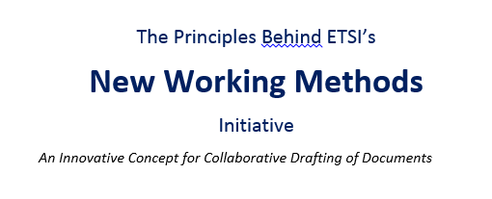

NWM – Concept Paper
Concept paper available at https://docbox.etsi.org/Board/2019_Board/BOARD(19)122_005_New_Working_Methods_Principles_and_concepts.docx

