Slide 1
NFVTST(19)000134r1
Joint MTS-TST Meeting
NFV#26

Slide 2
ETSI NFV TST Landscape and Collaboration
Reports
Conformance
NFV Testing
3rd Party

Slide 3
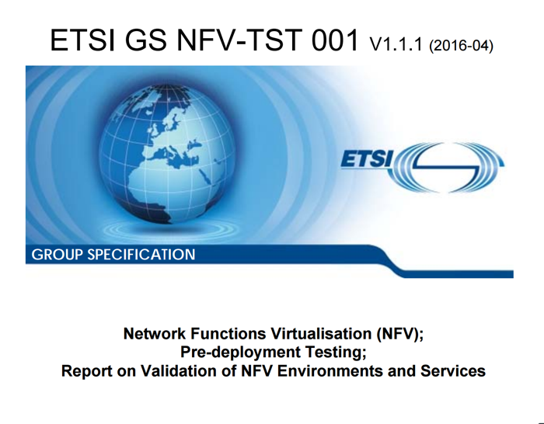
TST001 – Report on Validation of NFV Environments and Services
Target audience:
All companies wanting to validate new SW, SW updates
CI/CD pipeline
Content summary
Definition of SUTs
Test methods for pre-deployment validation of SUTs
Pre-deployment validation of NFV Infrastructure
Pre-deployment validation of VNFs
Pre-deployment validation of Network Services

Slide 4
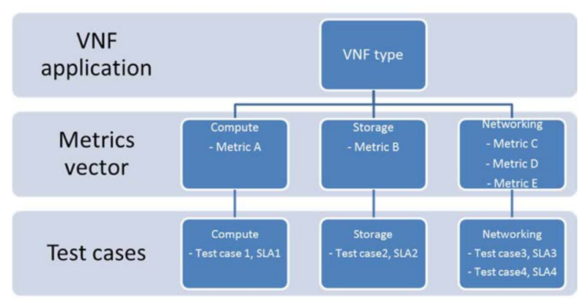
TST001 Highlights
Impact of virtualization on test methods
How to isolate the System Under Test (SUT)
HW vs SW test units
Workload type impacts: control vs data plane testing
VNF and NS validation
Lifecycle, control & data plane, autoscaling
NFVI validation
Examples!

Slide 5
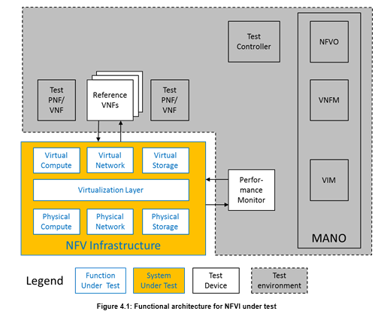
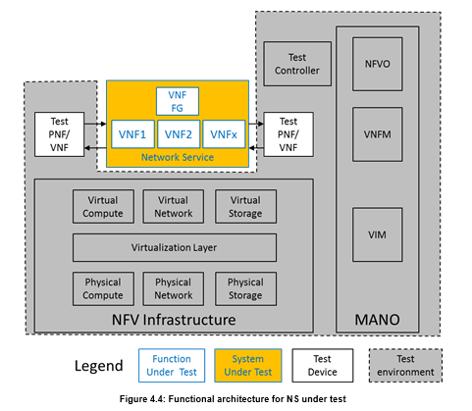
SUT Examples

Slide 6
TST002 – Interop Test Methodology
Target audience
Anyone concerned about interop of different NFV architecture components
Content summary
Basic concepts
Definitions
Test specifications
Specifics about how the test specs should look like
SUT architecture
Diagrams with SUT/FUT, test inputs, environment, etc
Interop features
Series of features covered in the report

Slide 7
TST007 - Guidelines on Interoperability Testing for VIM/VNFM
Focus on features applicable directly for interoperability with and within MANO
Focus:
VNF Performance Management
VNF Fault Management;
VNF Lifecycle management and Software Image Management.
Based on IFA013 and IFA008 for stimulus and monitoring
This WI is a follow-on to NFV TST WG (TST002).
The WI is applicable for all implementations aligned with ETSI NFV architecture; references to open source implementations are included.

Slide 8
TST009 – NFVI Network Benchmarks and Measurement Methods
Expands the Requirements and Methods of RFC2544
New reality of NFVI platforms are different than dedicated “boxes” of the past
Benchmark definition
Test setups
Test tool requirements
Methods of Measurement
Rapporteur: Al Morton (AT&T Labs)

Slide 9
Benchmarks
For each Benchmark:
}
Throughput
Offered Load Frame Size
Offered Load Step Size
Min Trial Repetition Interval
Trial Duration
Max X% Loss Ratio
Max # of Trials
Latency
Delay Variation
Loss
Background
Name
Parameters
Scope
Units of Measure
Definition
Units of Measure
Sources of Error
Discussion
Reporting Format

Slide 10
Methods of Measurement: Core Procedures
Method (iterate over multiple frame sizes)
64 oct
128 oct
.256 oct
512 oct
1024oct
1280 oct
1518 oct
Method
Rep #1
Rep #2
Set (multiple repetitions of the same settings from Method)
Set
Meas Goal
Meas Goal
Test (multiple Trials searching for a Measurement Goal)
Test
30 Mfps
45 Mfps
37 Mfps
41 Mfps
43 Mfps
44 Mfps
Trials at different Offered Load levels
Trial

Slide 11
Mitigating Background Processes that Cause Errors (Loss)
0 Mfps
12 Mfps
1 Mfps
2 Mfps
....
11 Mfps
12 Mfps
Resource Exhaust, or Loss
False
False
....
True
True
Questioner
Responder / DUT
Traffic
Generator
~
Error-Free
Resource Limit Exceeded
Messages:
TRUE or FALSE
Traffic
Receiver
RCVR
Background Process Errors
Events per
Unit Time
Error converts FALSE -> TRUE
Error retains TRUE -> TRUE (half-lies)
Because of the nature of NFVI platform
Andrzej Pelc, "Searching games with errors— fifty years of coping with liars ", Theoretical Computer Science 270 (2002) 71–109. Available from https://www.gwern.net/docs/statistics/comparison/2002-pelc.pdf

Slide 12
Binary Search with Loss Verification
Goal
Separate resource exhaustion and loss due to transient processes
They are dealt with in separate ways
Solution
If a trial fails because of loss (< z), run the trial again with the same stimulus (Max (r) = 2)
Keep trials short to avoid transients
Isolate loss due to transients
Run long duration tests to characterize effects and frequency
Prototyped with OPNFV
Showed marked success in repeatability

Slide 13
TST010 – MANO API Conformance Test Suite
For 3 Reference Points:
Os-Ma-Nfvo - ETSI GS NFV-SOL 005
Or-Vnfm - ETSI GS NFV-SOL 003
Ve-Vnfm - ETSI GS NFV-SOL 002
Document + Automatable Test Descriptions
OpenAPIs developed by the SOL WG
Using the open source Robot Framework
Rapporteur: Pierre Lynch (Keysight)

Slide 14
Sample Test Description

Slide 15
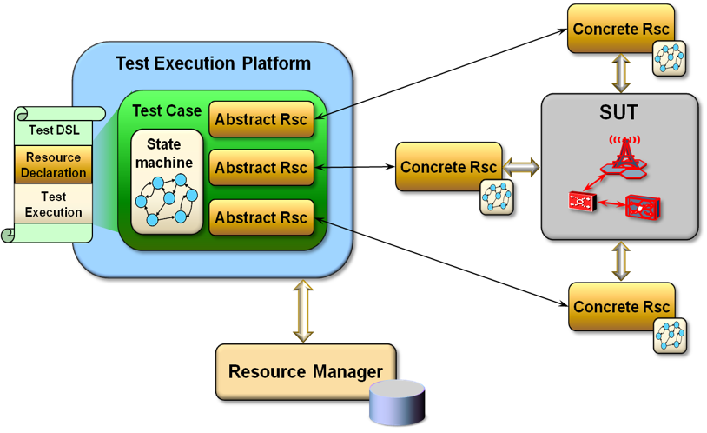
TST011 – Test Domain and Description Language Recommendations
NFV Test Domain with automation ecosystem
Recommendations for a DSL (Domain Specific Language)
Rapporteur: Frank Massoudian (Huawei)

Slide 16
TST012 - VIM & NFVI Control and Management Performance Evaluation
Focus on the control plane performance of VIM + NFVI
Based on functional requirements in ETSI GS NFV-IFA010
Potential Metrics:
Virtualization container instantiation
Scaling
Migration
Delicate!
VNFs can impact these metrics
Care will be taken to define the metrics and methods to be independent of VNF (maybe use standard samples)
Rapporteur: Huang Cheng (Huawei)

