Slide 1
Standards related to AI Quality/Testing
Martin Schneider
Joint MTS/INT call
06-Mar-2020

Slide 2
Agenda
ISO/IEC TR24029 Assessment of the robustness of neural networks
DIN SPEC 92001 AI Quality Metamodel and Robustness
ISO/IEC TR 29119-11 Software and systems engineering

Slide 3
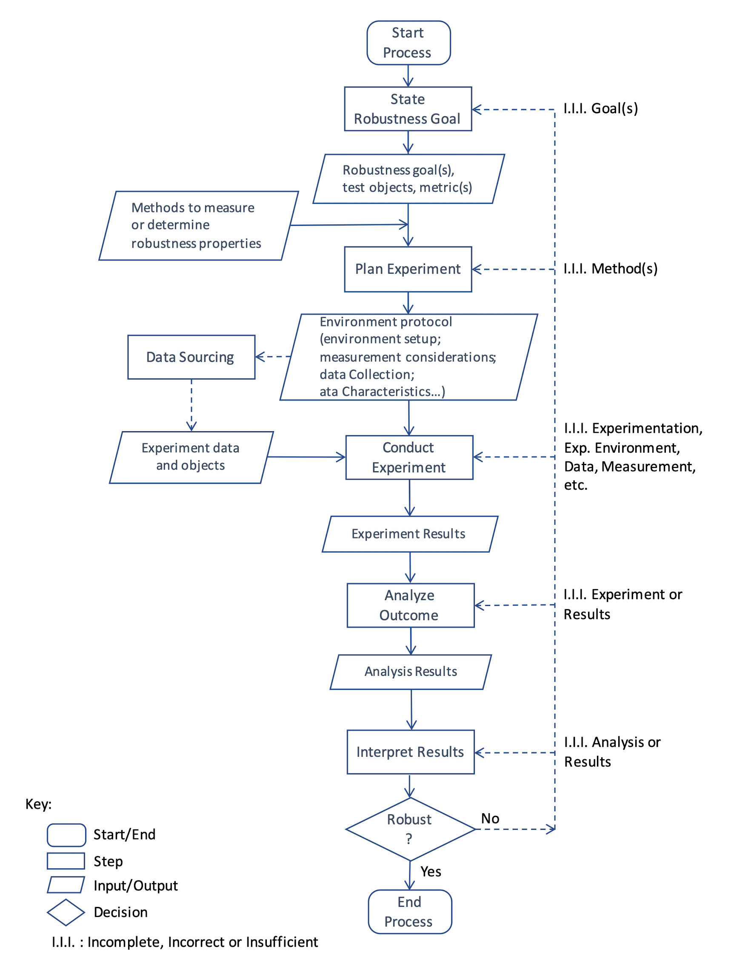
ISO 24029-1 Assessment of the Robustness of Neural Networks: High-Level Process
high-level process similar to a traditional testing process
state robustness goal
plan experiment
data sourcing: process of selecting, producing and/or generating the data needed (not covered in ISO 24029-1)
conduct experiment
analyze outcome
interpret results

Slide 4
ISO 24029-1 Assessment of the Robustness of Neural Networks: Classification of Methods
considers three classes of method for robustness assessment
statistical methods: mathematical testing process on some datasets
formal methods: formal proof to demonstrate a mathematical property over a domain
require approximations
empirical methods, i.e., testing
variation of possible inputs is unlikely to be large enough to provide any guarantees on system performance

Slide 5
ISO 24029-1 Assessment of the Robustness of Neural Networks: Statistical Methods
provide statistical measures for
interpolation systems: e.g., root mean square error/deviation, max error
classification systems: binary cases, multiclass cases, multilabel case, e.g. confusion matrix and related metrics
neural networks: different variations of cross validation

Slide 6
ISO 24029-1 Assessment of the Robustness of Neural Networks: Formal Methods
interpolation stability: to detect insufficient interpolation performance which may have an impact on robustness
uncertainty analysis
maximum stable space (data perturbation/adversarial samples): size of the domain with stable classification performance
describing it as a Boolean problem to be tackled by a solver
describing it as a numerical problem resolved by an optimization algorithm seeking a maximum
describing it as a mathematical property to be approximated using abstract interpretation

Slide 7
ISO 24029-1 Assessment of the Robustness of Neural Networks: Empirical Methods
the shortest section: about 2 pages
field tests
very general section on AI testing
ends with synthetic input data derived from real input data collect in the field trial as a “method”
a posterior testing
adversarial examples
test scenarios with normal operating conditions and corner cases
a posterior evaluation and post-deployment evaluation

Slide 8
ISO 24029-1 Assessment of the Robustness of Neural Networks: Annex “Data Perturbation”
data perturbation methods
examples
image perturbations: homogeneous noising, brightening, vibration and rotation, atmospheric turbulence, blurring, blooming, smear
sound perturbations: human-audible and ultrasound-based perturbations

Slide 9
ISO 24029-2 Assessment of the Robustness of Neural Networks: Formal Methods Methodology
Introduction, 2. Scope, 3, Normative references, 4. Terms and definitions
Methodology to put in place robustness assessment of neural networks using formal methods
Image processing context
Mathematical function interpolation context
Other contexts [tbd]

Slide 10
DIN SPEC 92001: Artificial Intelligence – Life Cycle Processes and Quality Requirements
Part 1: Quality Meta Model
Part 2: Robustness

Slide 11
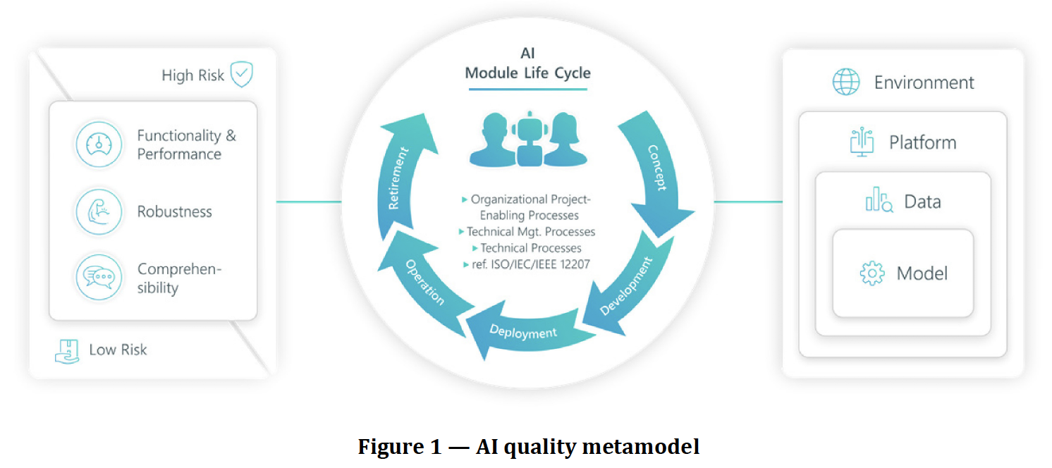
DIN SPEC 92001-1: AI Quality Metamodel

Slide 12
DIN SPEC 92001-1: AI Quality Metamodel
distinguishes between AI modules that have safety, security, privacy, or ethical relevance and the ones that do not
three AI quality pillars: functionality & performance, robustness, comprehensibility
AI module as part of a software system is the focus of DIN SPEC 92001
risk evaluation: high-risk and low-risk modules and possible deviations from requirements
environment (w.r.t. its embedding in a software system), platform (hardware and OS), data (used for training, validation, testing), model (model space and inference model)

Slide 13
DIN SPEC 92001-2: Robustness
draft stage, requirements documents
distinguishes adversarial robustness (adversarial perturbations) and corruption robustness (natural causes such as hardware deterioration or distributional shifts)
for both: threat model analysis, likelihood & impact analysis, robustness evaluation, mitigations
example: analyze the given AI module with respect to the test plan after every training procedure, adversarial metric list update, or other fundamental code changes.

Slide 14
ISO 29119-11: Guidelines on the Testing of AI-based Systems
introduction to AI and testing: very general, refers to the DIN SPEC 92001 parts 1 and 2 (AI quality metamodel)
focuses on machine learning
quality characteristics in addition to ISO 25010 to be considered when testing: flexibility, adaptability, autonomy, evolution, bias, transparency/interpretability/explainability, complexity and non-determinism
explains machine learning workflow and quality problems: overfitting and underfitting in ML, data quality, ML algorithm and model selection

Slide 15
ISO 29119-11: Guidelines on the Testing of AI-based Systems: Machine Learning Testing and Quality Assurance
review of ML workflow
acceptance criteria including performance metrics and AI-specific characteristics
framework, algorithm/model and hyperparameter selection
training data quality: selection of training data in terms of the size of the data set and characteristics such as bias, transparency and completeness
test data quality: level of independence from training data
model updates: re-testing, e.g. A/B testing or black-box testing
adversarial examples and testing: first distinction between black-box and white-box testing

Slide 16
ISO 29119-11: Guidelines on the Testing of AI-based Systems: Machine Learning Performance Metrics and Benchmarks
machine learning performance metrics and benchmarks
refers to and provides the same information as ISO 24029
additionally: benchmarks for ML

Slide 17
ISO 29119-11: Guidelines on the Testing of AI-based Systems: Introduction to the Testing of AI Systems
challenges in testing AI-based Systems
system specifications (how to specify the expected system behavior), related to the test oracle problem, a priori/a posteriori testing and complexity
test input data
self-learning systems
flexibility, adaptability, autonomy, evolution, bias, transparency/interpretability/explainability, complexity and non-determinism

Slide 18
ISO 29119-11: Guidelines on the Testing of AI-based Systems: Introduction to the Testing of AI Systems (2)
testing AI-based Systems across the life cycle
unit/component testing: corresponds to the evaluation and testing stages of the ML workflow, coverage of ML components can be measured by the representativeness of the datasets (training, validation and test) – or, for neural networks, through coverage of the networks themselves
integration testing, system testing, system integration testing, acceptance testing: very similar to traditional systems
maintenance testing: probabilistic and non-deterministic nature of many AI-Based systems can cause apparent test fails

Slide 19
ISO 29119-11: Guidelines on the Testing of AI-based Systems: Black Box Testing of AI-Based Systems
combinatorial testing: refers to ISO/IEC/IEEE 29119-4, considered very useful
back-to-back testing: using an an alternative version of the system (pseudo-oracle)
A/B testing: testing two different systems against each other
metamorphic testing: based on metamorphic relations that describe the relationship of outputs depending on the relationship of inputs
exploratory testing

Slide 20
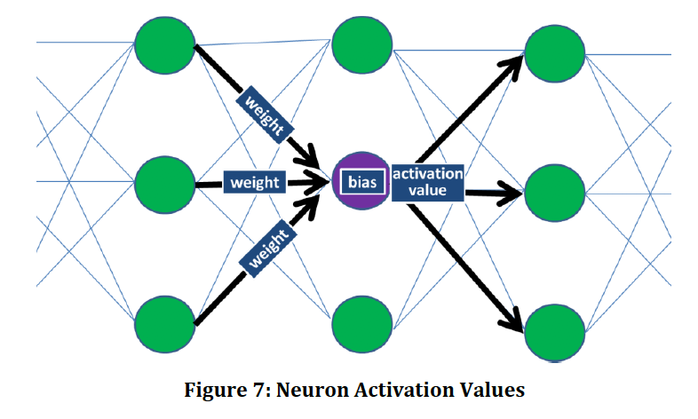
ISO 29119-11: Guidelines on the Testing of AI-based Systems: White Box Testing of Neural Networks

Slide 21
ISO 29119-11: Guidelines on the Testing of AI-based Systems: White Box Testing of Neural Networks
neuron coverage: proportion of activated neurons
threshold coverage: proportion of neurons exceeding a threshold activation value
sign change coverage: proportion of neurons activated with both positive and negative activation values
value change coverage: proportion of neurons activated where their activation values differ by more than a change amount
sign-sign coverage: achieved if each neuron by changing sign can be shown to individually cause one neuron in the next layer to change sign while all other neurons in the next layer stay the same
layer coverage: defined based on whole layers of the neural network and how the activation values for the set of neurons in a whole layer change

Slide 22
ISO 29119-11: Guidelines on the Testing of AI-based Systems: White Box Testing Tools for Neural Networks
DeepXplore: specifically for testing deep neural nets, proposes a white-box differential testing (back-to-back) algorithm to systematically generate adversarial examples that cover all neurons in the network (threshold coverage).
DeepTest: systematic testing tool for automatically detecting erroneous behaviours of cars driven by deep neural nets. Supports the sign-sign coverage for DNNs.
DeepCover: provides all the levels of coverage defined in this section.

Slide 23
ISO 29119-11: Guidelines on the Testing of AI-based Systems: Annex A Using AI for Testing
forms of AI used for testing: probabilistic software engineering, classification, learning and prediction, search-based software engineering
example use cases: bug prediction, static analysis, optimization of regression testing, test input generation, automated exploratory testing,

